Slide 1

NSF’s Innovation Call:
A suite of relatively untapped opportunities for GEO Pis
R. Montelli, Ph.D.
Program Director, Geophysics
Directorate for the Geosciences Topic Specific Program Director, I-Corps
Directorate for the Geosciences Innovation/Industry contact
IRIS Seismic Instrumentation Technology Symposium
Albuquerque, June 10, 2013

Slide 2
“Innovation – the process by which individuals and organizations generate new ideas and put them into practice – is the foundation of American economic growth and national competitiveness.”
The White House, February 2011
National Economic Council, Council of Economic Advisers, and Office of Science and Technology Policy
www.whitehouse.gov/sites/default/files/.../InnovationStrategy.pdf
R.Montelli Ph.D., June 10, 2013

Slide 3
NSF’s Innovation Call
Build an academic-industry platform to perform fundamental research of common interest
I/UCRC – Industry University Cooperative Research Centers Program
Up to 16 years of NSF funding (1 yr planning + 5 yrs Phase I + 5 yrs Phase II + 5 yrs Phase III) to manage the center. Multi-institutional centers are preferred. Industry partners pay a membership fee to participate in the center. International partners are welcome, though restrictions on funding apply.
Educate and train
IGERT – Integrative Graduate Education and Research Traineeship Program (new solicitation coming soon)
Establish new models for graduate education and training that include integrated interdisciplinary research and innovation activities supported by an additional up to $200,000 Competitive Innovation Incentive Fund.
GOALI – Grant Opportunities for Academic Liaison with Industry
Project funds or fellowships/traineeships available to support an eclectic mix of industry-university linkages (supplement or full proposal for Industry-University Collaborative Projects; supplement for Faculty and Students in Industry, supplement for Industry Engineers and Scientists in Academe).
ATE – Advanced Technological Education Program
With an emphasis on two-year colleges, program focuses on the education of technicians for the high-technology fields.
Accelerate the Translation of Research Discoveries in Commercial Products
Get your prototype: AIR – Accelerating Innovation Research (new solicitation coming soon)
Discover your customers: I-Corps Teams – Innovation Corps Teams Program
$50,000 to help you find your market and define your best business plan.
Translate your research product in a commercial reality:
BIC – Building Innovation Capacity (new solicitation coming soon)
STTR – Small Business Technology Transfer
SBIR – Small Business Innovation Research
University
Industry
Discovery
Development
Commercialization

Slide 4
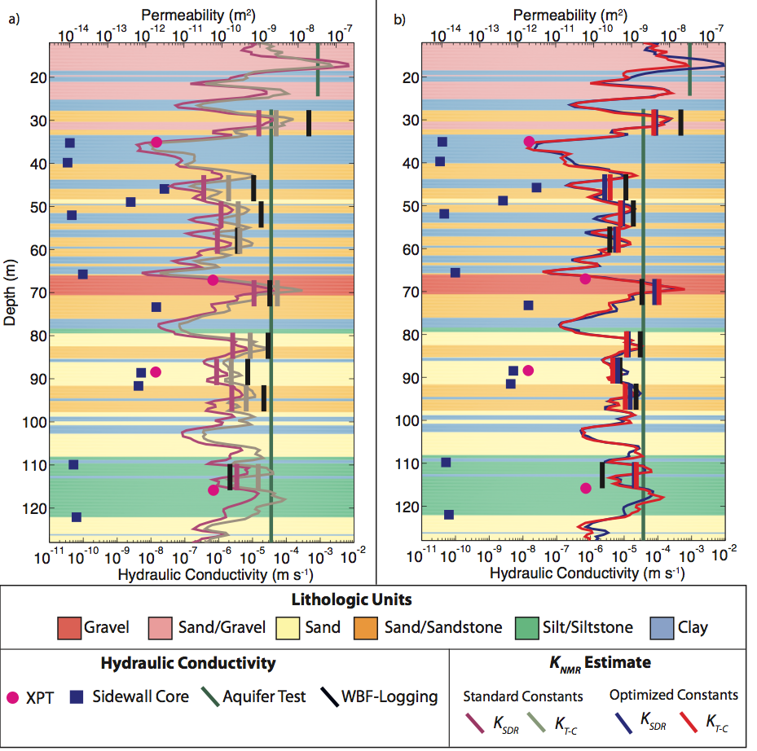
GOALI - Grant Opportunities for Academic Liaison with Industry
Promotes interaction and staff exchange between universities and industry including joint graduate student advising, and supports transformative research that lies beyond what industry would normally fund.
GOALI: The use of logging and surface Nuclear Magnetic Resonance (NMR) measurements to estimate hydraulic conductivity in unconsolidated aquifers
Rosemary Knight (PI), Stanford University teamed with Yi-Qiao Song (Co-PI), Schlumberger-Doll Research, Schlumberger Water Services and members of Vista Clara Inc, and the USGS to develop a new framework to nuclear magnetic resonance-based aquifer characterization.
“The student and post-doctoral fellow in particular will benefit tremendously by seeing the connections between their research and the “real world” applications and needs.”
A comparison of hydraulic conductivity derived through traditional hydrologic methods and NMR-derived hydraulic conductivity. (a) NMR-derived hydraulic conductivity determined using the standard constants developed for petroleum applications. (b) NMR-derived hydraulic conductivity determined using the site-specific constants developed for in this study (figure courtesy of Prof. R. Knight and PhD student K. I. Dlubac).
R.Montelli Ph.D., June 10, 2013

Slide 5
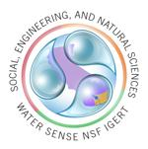
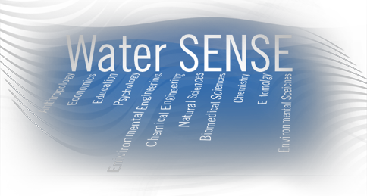
IGERT – Integrative Graduate Education and Research Traineeship Program
To establish new models for graduate education and training in a fertile environment for collaborative research that transcends traditional disciplines boundaries. Since March 2011, the program requires that training explicitly includes innovation activities supported by a Competitive Innovation Incentive Fund up to $200,000.
IGERT: Water SENSE - Water Social, Engineering, and Natural Sciences Engagement
It is happening at University of California Riverside!
“The training Water SENSE IGERT Fellows will receive will prepare them in all aspects of water and waterborne disease management, including designing, executing and evaluating water-based interventions in close consultation – and with the active participation – of the intended beneficiaries. We will be teaching and using new and established approaches to water utilization and management, waterborne pathogen control and vector biology, and simultaneously training students in the social and cultural challenges required for the sustainable use of clean water.”
http://watersense.ucr.edu/index.html
R.Montelli Ph.D., June 10, 2013

Slide 6
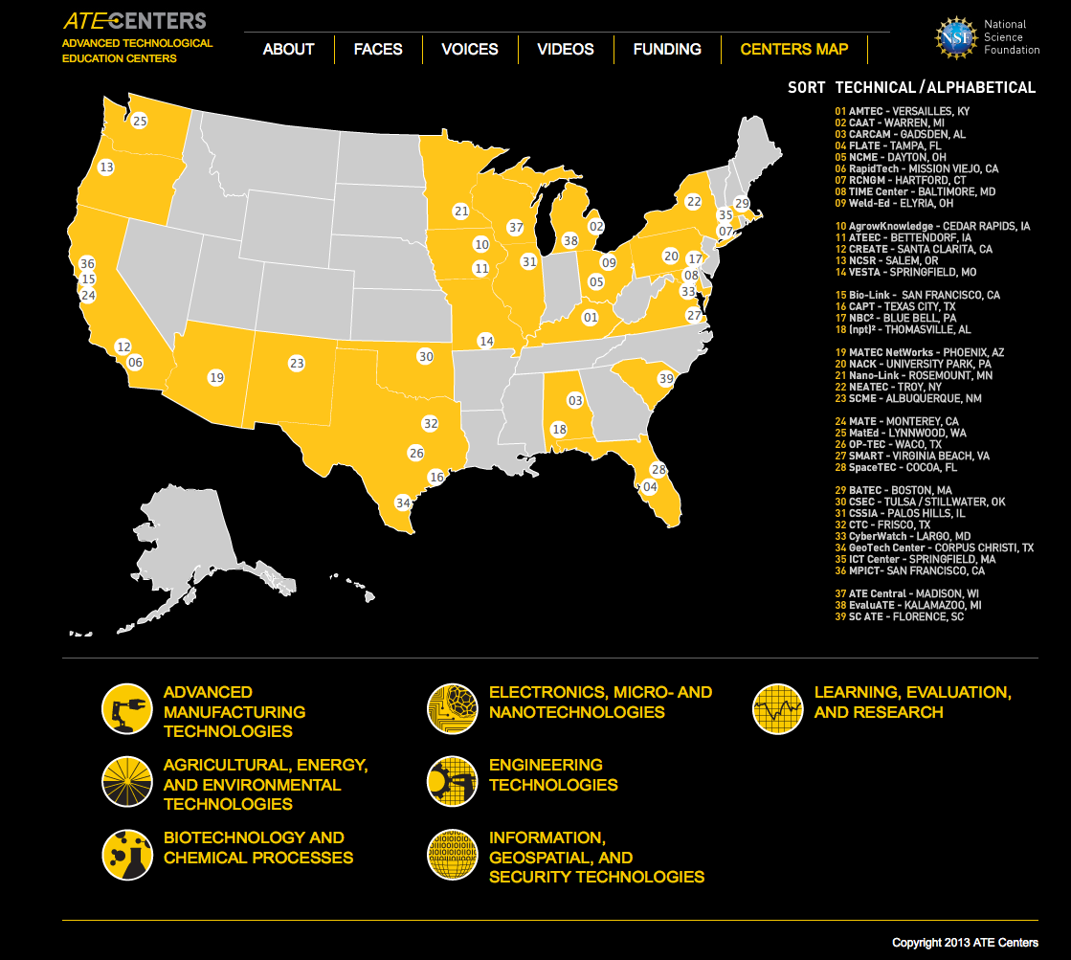
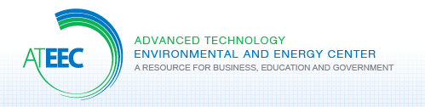
ATE – Advanced Technological Education Program
To form academic-industry partnership to promote improvement in the education of science and engineering technicians at undergraduate and secondary school levels.
An ATE example:
“Foster a network of educational communities, supported through public and private partnerships, that ensures human health, safety and global sustainability.”
Partners:
Eastern Iowa Community College
Nahant Marsh Education Center
Hazardous Material Training and Research Institute
Partnership for Environmental Technology Education
University of Northern Iowa
National Renewable Energy Laboratory
Mission: “The advancement of environmental and energy technology education through curriculum, professional, and program development..”
http://atecenters.org/#t-slide-one
R.Montelli Ph.D., June 10, 2013

Slide 7
I-Corps - Innovation Corps Program
To prepare scientists and engineers to extend their focus beyond the laboratory, and to test the immediate potential of their findings for broader applicability and impact in the commercial world.
I-Corps has more recently expanded to support the creation of a network of entrepreneurial hubs - the I–Corps Nodes and Sites – functioning as catalyst in the commercialization process of NSF supported research discoveries across the United States.
I-Corps Nodes:
DC, Maryland, Virginia Region
NSF Bay Area Regional I-Node Program
New York City Regional Innovation Node (NYCRIN)
Michigan
Georgia Tech
I-Corps Sites: Upcoming (full proposal deadline July 1st, 2013)
I-Corps Teams: 9 cohorts since October 2011; about 236 teams
R.Montelli Ph.D., June 10, 2013

Slide 8
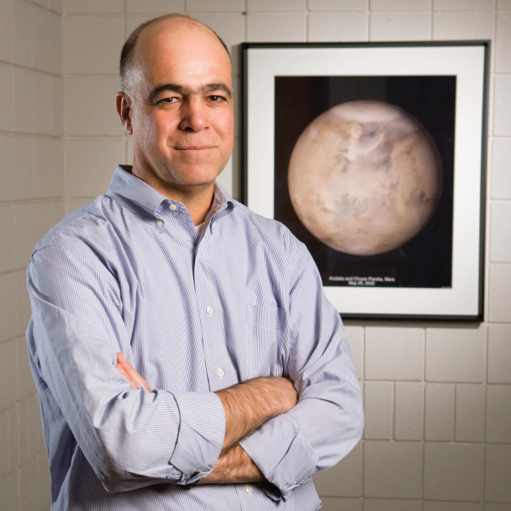
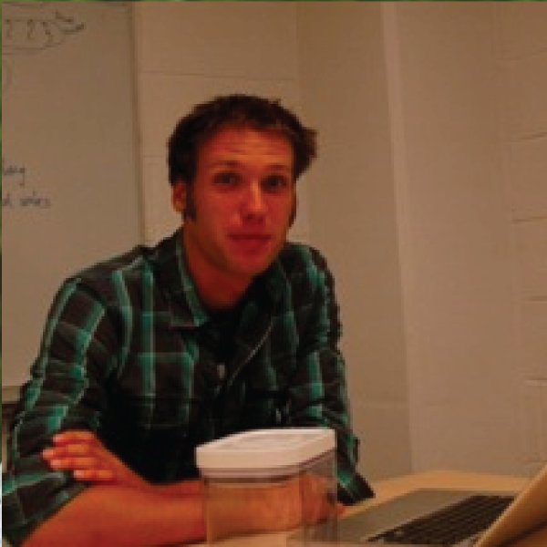
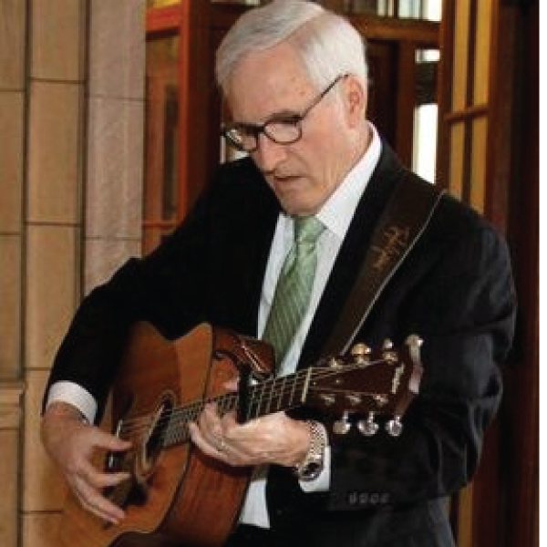
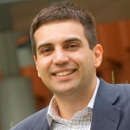
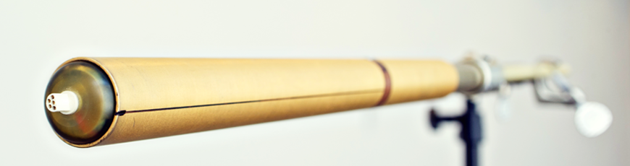

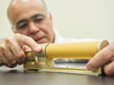
I-Corps: The Charge Tracker (University of Michigan Ann Arbor)
They started I-Corps with….
a team…
a technology…
The Charge TrackerTM
Nilton
Harvey
and a lot of ideas…
Dave
Gus
$1.6 Million funding from NASA and NSF since June 2007
They ended I-Corps with….. a business
Story Video: http://www.youtube.com/watch?v=AoliIFtcSuY
Technical Video: http://www.youtube.com/watch?v=yH4nHBVqEcg
Website: www.electricfieldsolutions.com
(Slide courtesy of Harvey Elliott ).
R.Montelli Ph.D., June 10, 2013

Slide 9
Geo teams put their entrepreneurial skills in action and they shine!
“I-Corps: Open-Path, compact nitrous oxide sensor using quantum cascade laser spectroscopy” (Princeton University)
PI Mark Zondlo - an Assistant Professor of Civil and Environmental Engineering, and Dr Tao - a postdoctoral fellow at Princeton University - developed an accurate, portable and inexpensive sensor to measure atmospheric nitrous oxide (N₂O), an important rapidly increasing greenhouse gas. In the Fall 2012, they paired with Dr Derek B Lidow, the I-Corps Mentor and a visiting Professor in Entrepreneurship, and throughout the intense I-Corps training, they received confirmation that they can break into the growing market for environmental sensors.
The sensor mounted on an eddy covariance tower in the middle of a cornfield in Michigan. (Photo courtesy of Prof Zondlo).
Winner of the first prize at the 8th Annual Innovation Forum sponsored by the Keller Center, in conjunction with the Keller Center’s Venture Sponsorship Program and Princeton’s Office of Technology Licensing
R.Montelli Ph.D., June 10, 2013

Slide 10
Creating a platform of opportunities:
Industry-University Cooperative Research Centers Program
Interagency Funds
Educate
Fundamental Research Program for I/UCRC
Innovate
GOALI
I/UCRC
Stimulate long-term partnerships among academe, industry and government with mutual research interest.
STTR
IGERT
AIR
SBIR
workforce
BIC
ATE
Centers leverage heavily on industry contributions with a small investment from NSF who plays a supporting role in the development and evolution of the center.
I-Corps
startup
REU
licensing
RET
Collaborative Research Opportunities for I/UCRCs
International collaborations
Develop and foster a healthy and productive national innovation ecosystem that builds upon fundamental research, and prepares a highly skilled and diverse workforce
R.Montelli Ph.D., June 10, 2013

Slide 11
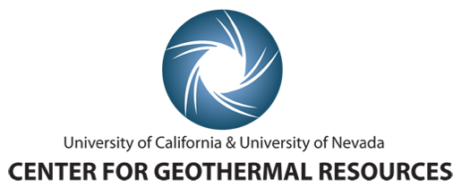
The first GEO supported Industry & University Cooperative Research Program (I/UCRC) (in planning stage)
The “Center for Geothermal Energy Resources (CGR)” comprises two academic institutions (I/UCRC sites): U.C. Davis and U. Nevada at Reno
https://www.geology.ucdavis.edu/geothermal/
The primary areas of research focus include research in exploration, reservoir management and the frontiers of geothermal research.
The center will host the planning meeting with several potential industry members on June 25 and 26, 2013, check the webpage for more information.
R.Montelli Ph.D., June 10, 2013

Slide 12

Why?
The benefits
To the Government
Offset industry investment in research and education;
Preserve fundamental research;
Increase diversity by strengthening the industry commitment to invest in fundamental research and education at Institutions less familiar with industry partnerships.
To Academia
Vehicle to attract and to retain students to geosciences;
Form a talented and broadly skilled geosciences workforce ready for a career in academia and/or industry;
Stimulate creativity and reinvigorate the research labs;
Bring a stable source of funding;
Provide access to otherwise inaccessible data and to additional funds with applied research projects byproduct of this common fundamental goals
To Industry
Opportunities to investigate fundamental research topics that will not otherwise be addressed;
Bring a more strategic and multidisciplinary environment to academia;
Invest in preparing the future workforce.
Educate and Collaborate to Innovate!
R.Montelli Ph.D., June 10, 2013

Slide 13

We Want GEO, We want YOU!
Thank You

