Slide 1
IRIS’s Large N Initiative
John Hole, Virginia Tech
Chair of IRIS Large N Working Group
SPATIAL
ALIASING
Hole, Seismic Instrumentation Technology Workshop, June2012

Slide 2
IRIS’s Large N Initiative
IRIS’s current instrumentation and field procedures are ~20 years old
this limits the number of instruments per project
most earthquake seismology is badly spatially aliased
currently limited in the science that we can do
new array analysis methods have been developed
directly invert or image using the full wavefield
huge improvement in resolution is possible
but requires data to be not spatially aliased
past decades have seen rapid improvements in technology
improved instruments are possible
improving technology enables new science
Hole, Seismic Instrumentation Technology Workshop, June2012

Slide 3
IRIS’s Large N Initiative
“Large N” = 1-2 orders of magnitude more instruments per deployment
= unaliased arrays
- much less expensive
- much simpler deploy & retrieve instrument
- much simpler to retrieve data; dirt to desktop solutions
- high quality
- broadest possible range of applications, from 10 m to 10,000 km
transform how we acquire data
resolution
resolution
resolution
SPATIAL
ALIASING
Hole, Seismic Instrumentation Technology Workshop, June2012

Slide 4
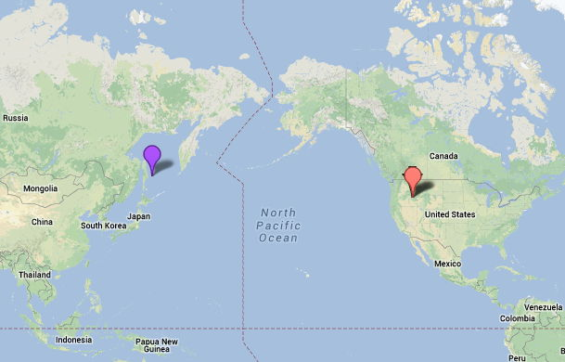
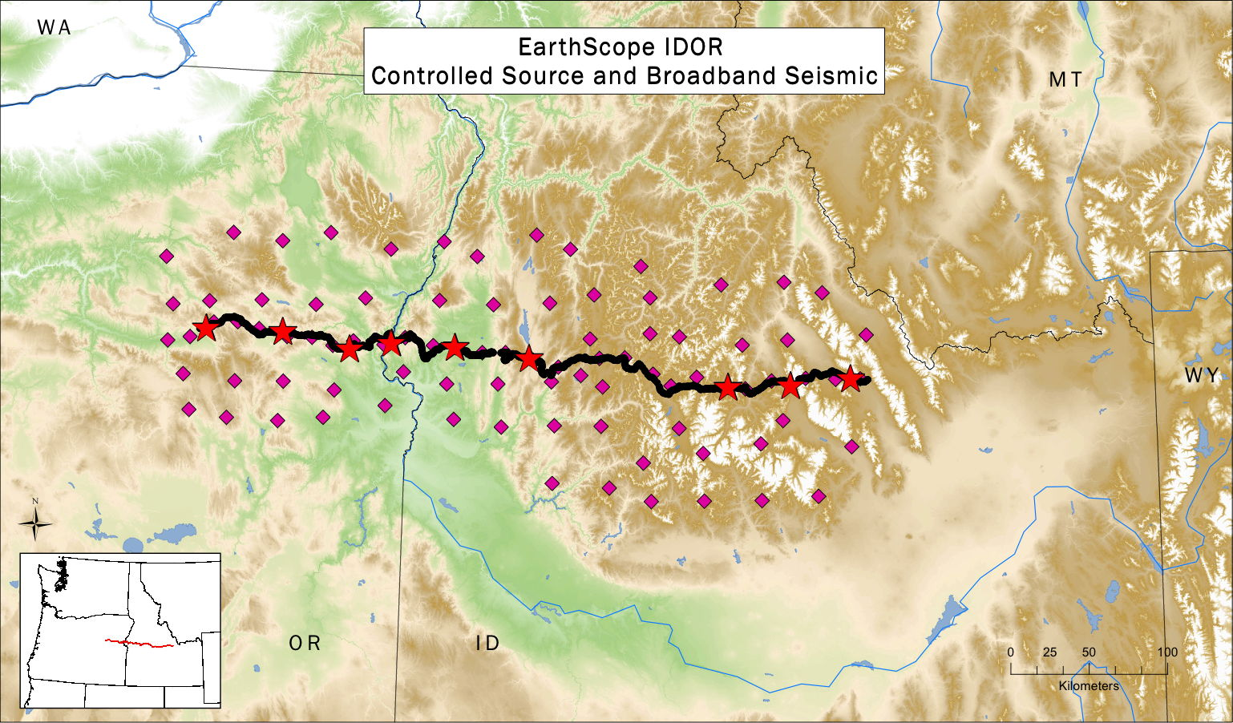
Large N Example 1: Russia - USA
M7.7 earthquake
2012-08-13
Sea of Okhotsk, Russia
580 km depth
recorded on
- broadband array
- controlled-source array
Hole, Seismic Instrumentation Technology Workshop, June2012

Slide 5
EarthScope IDOR (Idaho-Oregon)
450 km long arrays 8 hour drive time 4WD, some hiking
broadband: 85 stations 6 skilled crew 3 months deploy
(29 inline)
controlled-source: 2555 stations 44 beginners + 6 skilled 3 day deploy
Hole, Seismic Instrumentation Technology Workshop, June2012

Slide 6
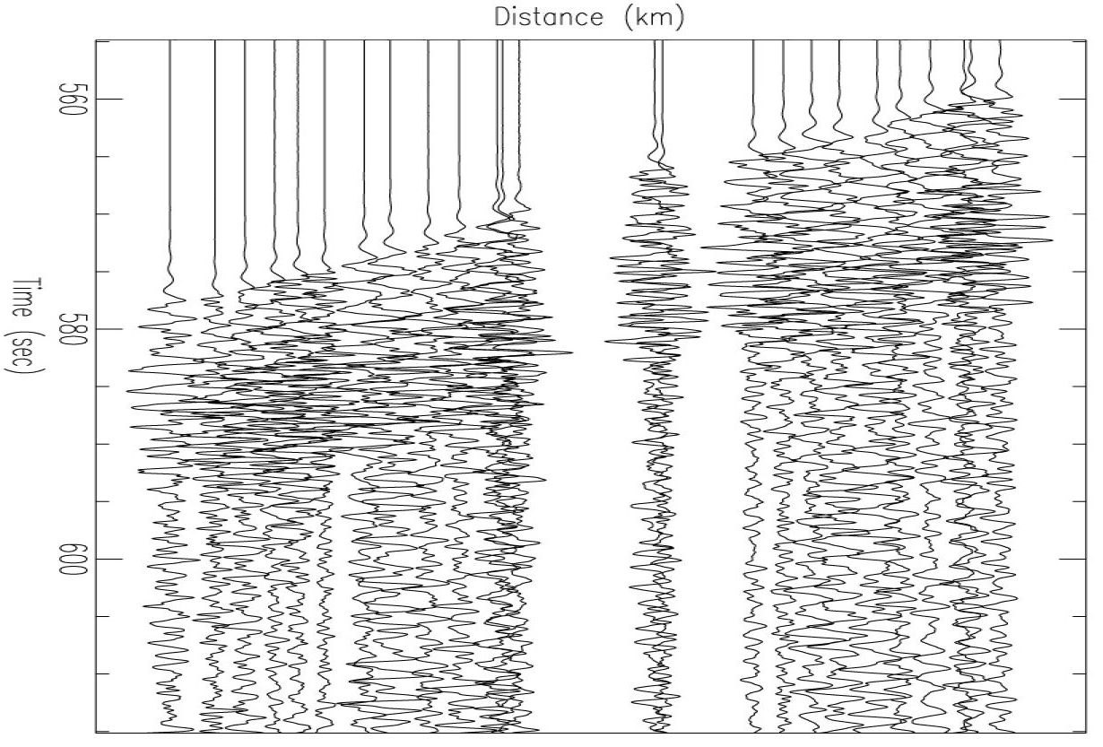
EarthScope IDOR (Idaho-Oregon)
0.5-5.0 Hz
P
PmS
60 s
PcP
Hole, Seismic Instrumentation Technology Workshop, June2012

Slide 7
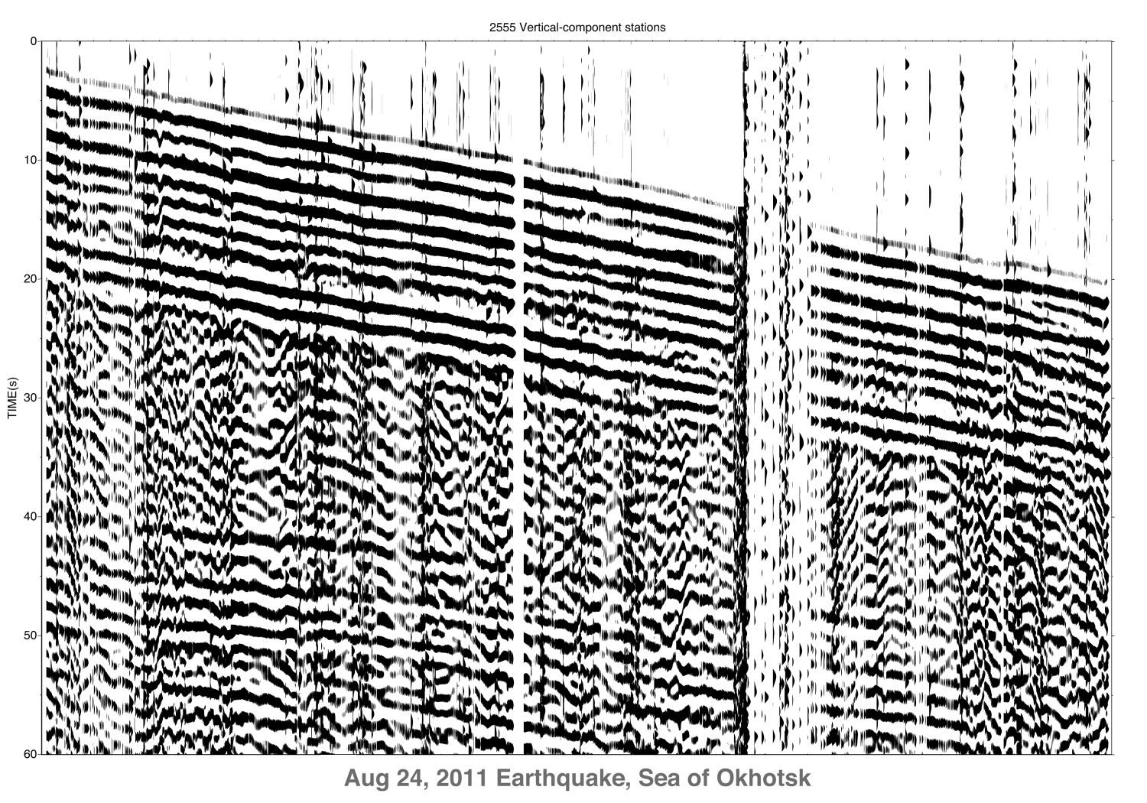
EarthScope IDOR (Idaho-Oregon)
0.1-1.0 Hz
on 4.5 Hz geophones!
P
PmS
more traces than pixels!
60 s
PcP
Hole, Seismic Instrumentation Technology Workshop, June2012

Slide 8
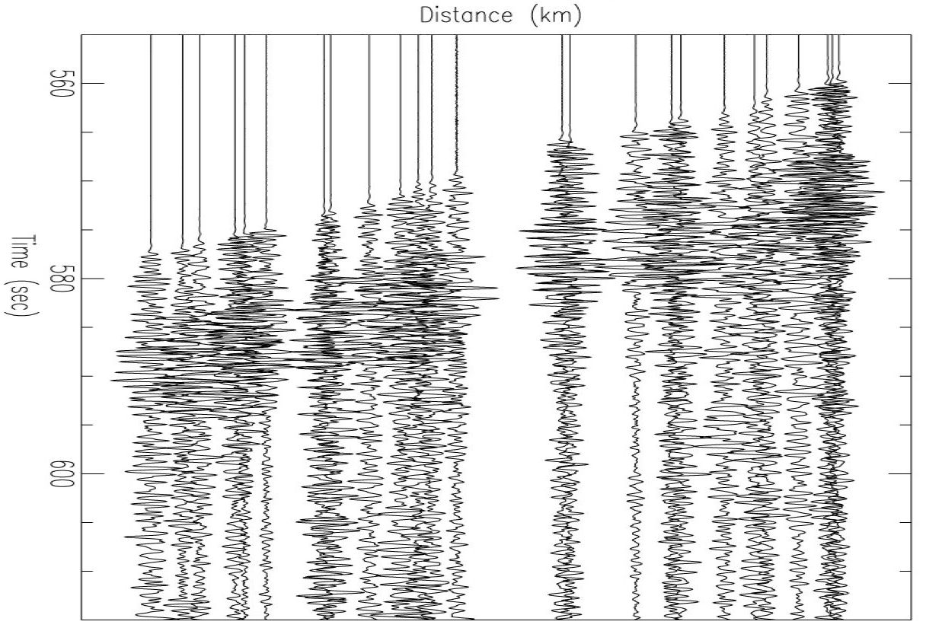
EarthScope IDOR (Idaho-Oregon)
1-10 Hz
P
PmS
60 s
PcP
Hole, Seismic Instrumentation Technology Workshop, June2012

Slide 9
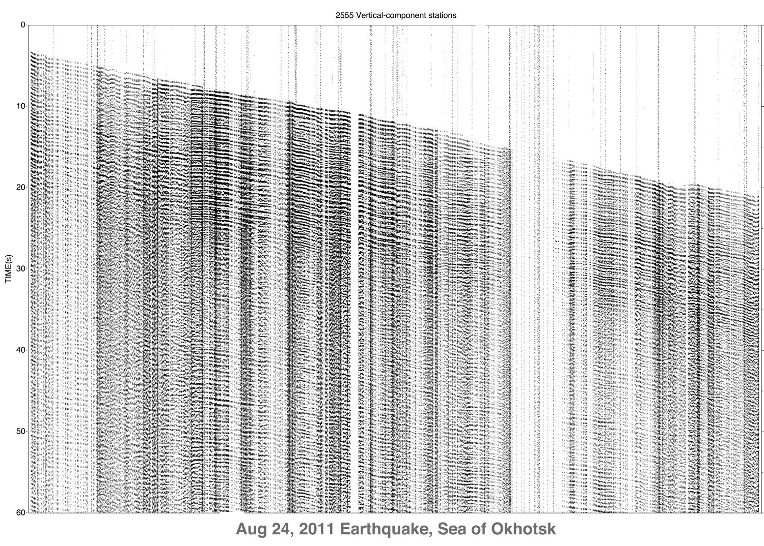
EarthScope IDOR (Idaho-Oregon)
1-10 Hz
P
PmS
60 s
PcP
Hole, Seismic Instrumentation Technology Workshop, June2012

Slide 10
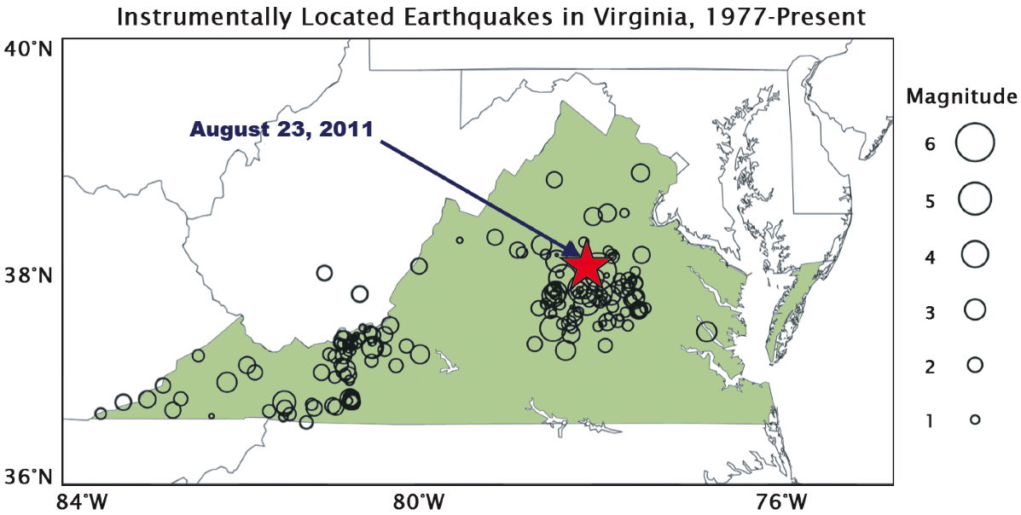
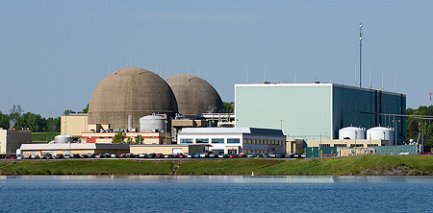
Large N Example 2: Virginia
M5.8 earthquake
2011-08-23
central Virginia
8 km depth
National Cathedral
Washington Monument
North Anna
nuclear power plant
Hole, Seismic Instrumentation Technology Workshop, June2012

Slide 11
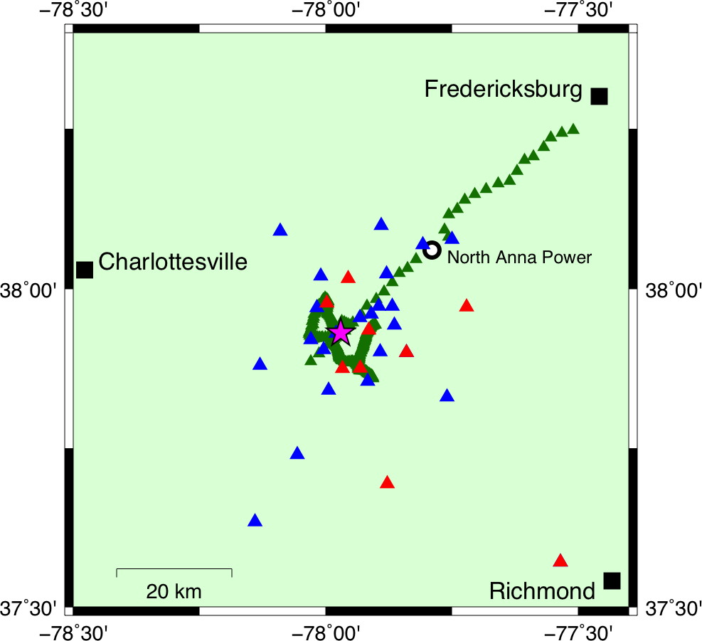
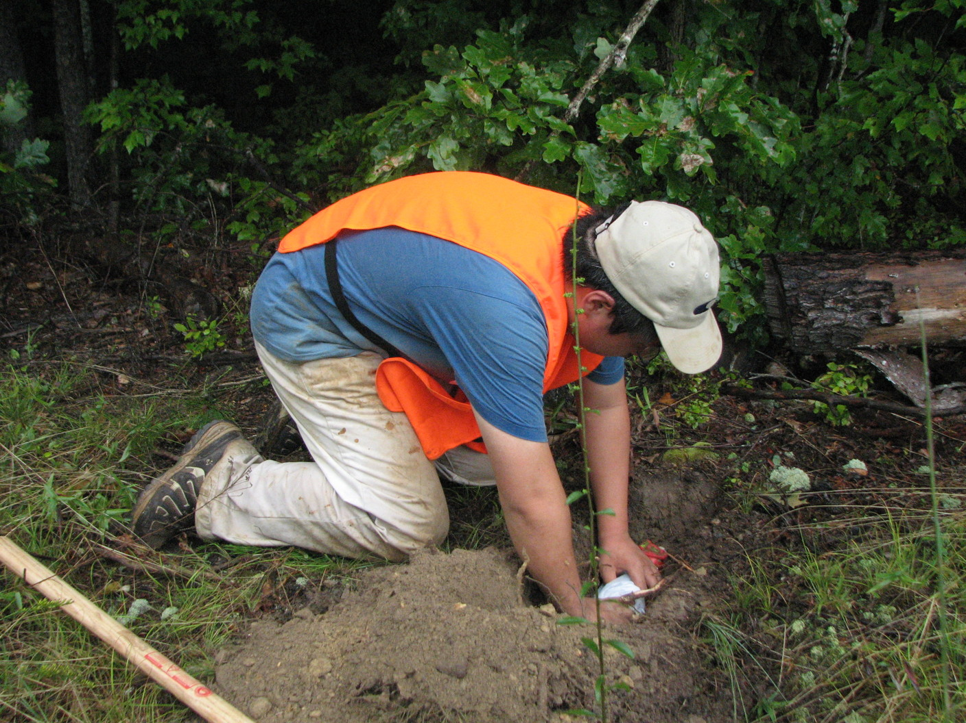
Aftershock Imaging with Dense Arrays (AIDA) Virginia
blue & red:
traditional aftershock array
42 3-component
some telemetered
~20 people, 3 days
green:
controlled-source sensors
148 1-component
30 3-component
7 people, 1 day
Hole, Seismic Instrumentation Technology Workshop, June2012

Slide 12
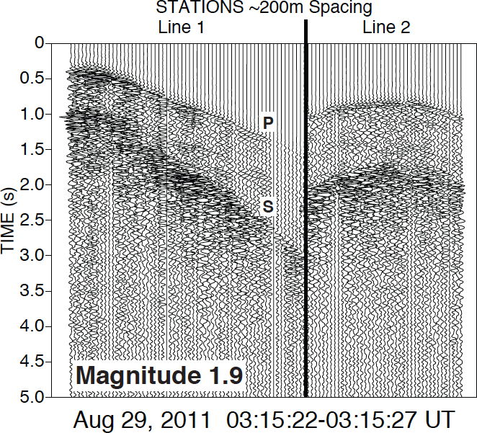
Aftershock Imaging with Dense Arrays (AIDA) Virginia
200 m spacing
Hole, Seismic Instrumentation Technology Workshop, June2012

Slide 13
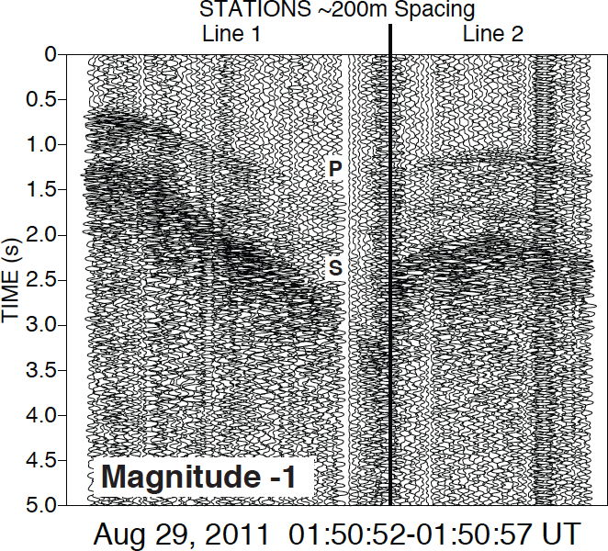
Aftershock Imaging with Dense Arrays (AIDA) Virginia
200 m spacing
Hole, Seismic Instrumentation Technology Workshop, June2012

Slide 14
Aftershock Imaging with Dense Arrays (AIDA) Virginia
Sumatra-Andaman 2004 M9.0 earthquake
Japan HiNET stations @20 km spacing
source back-projection by reverse-time migration
30 s
420 s
300 km
Ishii et al., 2005
resolution ~100 km and ~20 s
Hole, Seismic Instrumentation Technology Workshop, June2012

Slide 15
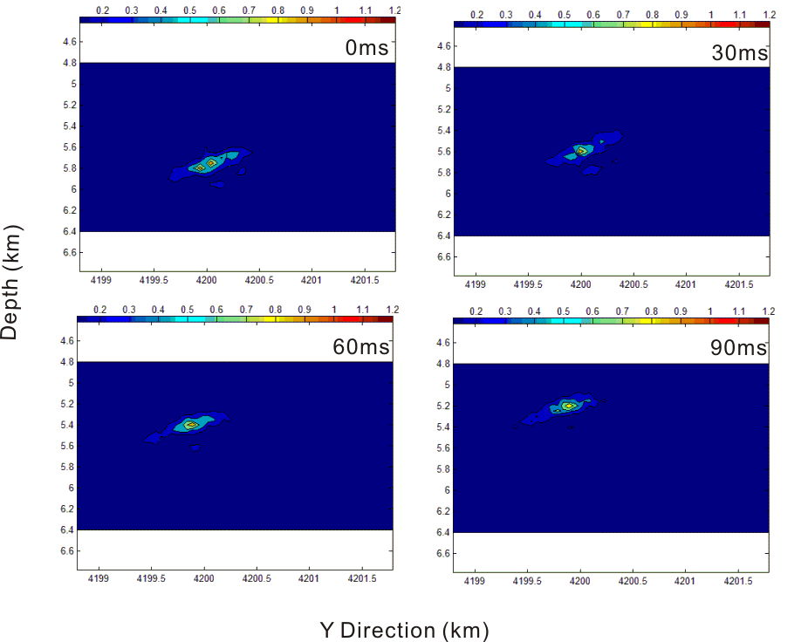
Aftershock Imaging with Dense Arrays (AIDA) Virginia
Virginia 2011
M2.9 aftershock
AIDA stations
@200 m spacing
source back-projection
by reverse-time
migration
resolution ~0.5 km
and ~0.05 s
0 s
0.03 s
0.06 s
0.09 s
1 km
Wang, Hole et al., in prep.
Hole, Seismic Instrumentation Technology Workshop, June2012

Slide 16
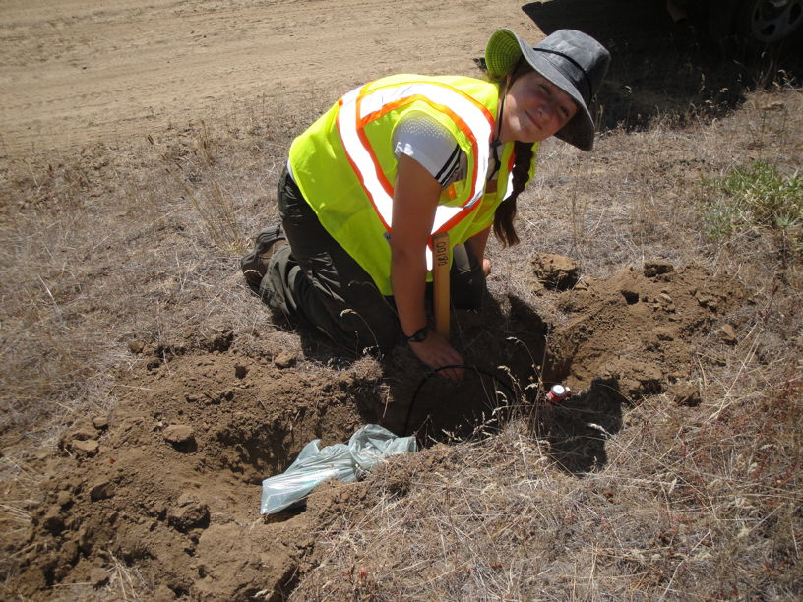
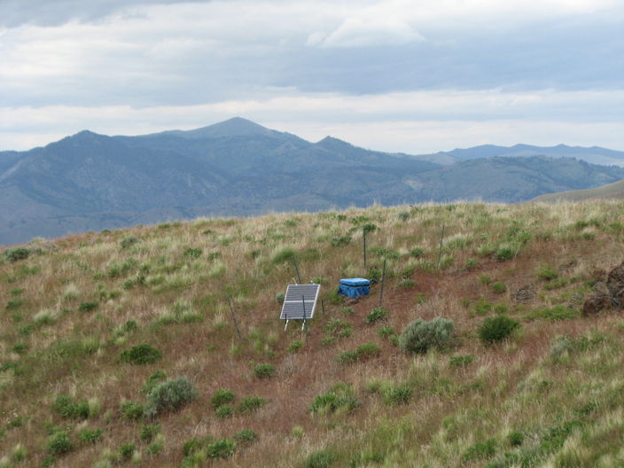
Today: 1990’s technology
for Large N:
combine the best of both
probably some compromises
quantity
quality
Texan
~$4k
<2 kg
3-minute deployment
broadband
~$35k
>100 kg
3-6-hour deployment
long period
high sensitivity
3-component
large memory
GPS
Hole, Seismic Instrumentation Technology Workshop, June2012

Slide 17
Today: 1990’s technology
high-quality waveforms high-quality wavefields
for Large N: combine the best of both
probably some compromises
Hole, Seismic Instrumentation Technology Workshop, June2012

Slide 18
IRIS’s Large N Initiative
IRIS 5-year proposal for FY14-18 (starts Oct. 2013)
sustain the core facilities
complete the goals of the EarthScope USArray
facilitate evolving science
create sustainability beyond 2018
proposal approved by NSF, cooperative agreement being negotiated
reduced funding expected
Hole, Seismic Instrumentation Technology Workshop, June2012

Slide 19
IRIS’s Large N Initiative
IRIS 5-year proposal for FY14-18 (starts Oct. 2013)
sustain the core facilities
complete the goals of the EarthScope USArray
facilitate evolving science
create sustainability beyond 2018
proposal approved by NSF, cooperative agreement being negotiated
reduced funding expected
in the proposal:
IRIS is strongly committed to continue providing existing instrument services
global (to 300 s) through to near-surface (to 1000 Hz)
and
development of Large N
develop, purchase, pilot a Large N deployment
Hole, Seismic Instrumentation Technology Workshop, June2012

Slide 20
IRIS’s Large N Initiative
plan for implementation
(schedule tentative)
by early 2014:
- develop science objectives, engage stakeholders
(workshop May 2012) (Large N Working Group) (webinars, workshop?)
- compile needs to enable the objectives (no decisions)
- explore technology options and developments (e.g., this meeting)
by summer 2014:
- make technical decisions, compromises (IRIS governance)
- place orders for prototype instruments (~10?)
- design integrated systems for technical support, data support
Hole, Seismic Instrumentation Technology Workshop, June2012

Slide 21
IRIS’s Large N Initiative
plan for implementation
(schedule tentative)
by summer 2015:
- test prototype instruments
- place place order for prototype array (N = 500-1000?)
- develop integrated systems for technical support, data support
during 2016:
- deploy prototype array in pilot project(s)
by early 2017:
- validate value of Large N system
- fund-raising
by end of 2018:
- place order for multiple large-N systems (MxN = 25,000???)
Hole, Seismic Instrumentation Technology Workshop, June2012

Slide 22
IRIS’s Large N Initiative
Goal:
enable unaliased seismic array deployments
completely new science should be enabled
by early 2017:
- acquire Large N datasets
- prove viability of Large N systems
- validate value of Large N datasets
by 2018:
- purchase several Large N systems
SPATIAL
ALIASING
Hole, Seismic Instrumentation Technology Workshop, June2012

