Slide 1
Measurements using Atom Free Fall
Mark Kasevich
Stanford Physics (Prof. Physics and Applied Physics)
AOSense, Inc. (Consulting Chief Scientist)

Slide 2
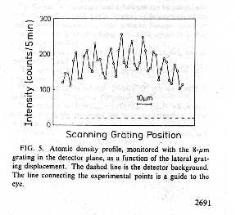
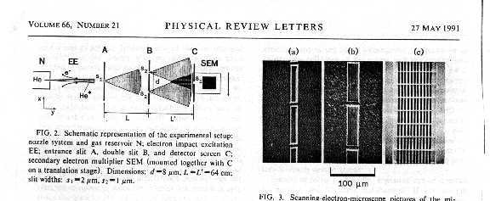
Young’s double slit with atoms
Young’s 2 slit with Helium atoms
Interference fringes
One of the first experiments to demonstrate de Broglie wave interference with atoms, 1991 (Mlynek, PRL, 1991)
Slits

Slide 3
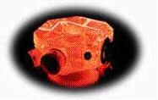

Interferometric sensors
Optical Interferometry
Atom Interferometry
Litton Ring Laser Gyroscope
Future atom optics-based sensors may outperform existing inertial sensors by a factor of 10⁶.
Current (laboratory) atom optics-based sensors outperform existing sensors.
Fibersense Fiber-optic Gyroscope

Slide 4
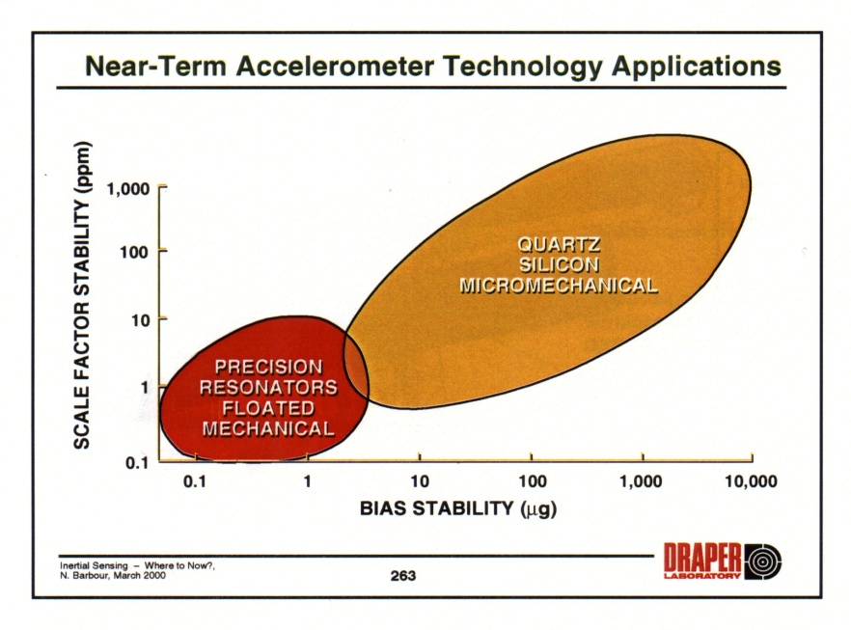
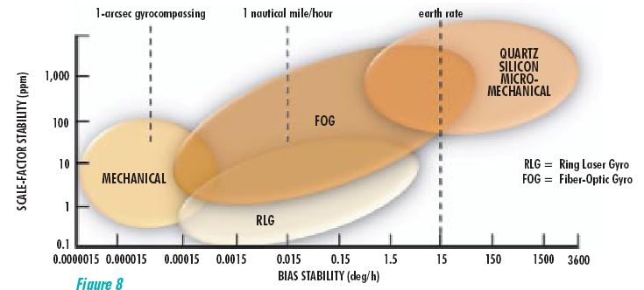
Sensor characteristics
Light-puse AI accelerometer characteristics
AI
Light-puse AI gyroscope characteristics
AI
Source: Proc. IEEE/Workshop on Autonomous Underwater Vehicles

Slide 5
Simple models for inertial force sensitivity
Gravity/Accelerations
Rotations
As atom climbs gravitational potential, velocity decreases and wavelength increases
Sagnac effect for de Broglie waves
(longer de Broglie wavelength)
g
Current ground based experiments with atomic Cs: Wavepacket spatial separation ~ 1 cm
Phase shift resolution ~ 10^{–5} rad
(Previous experiments with neutrons)

Slide 6
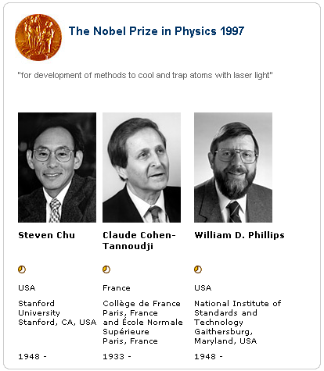
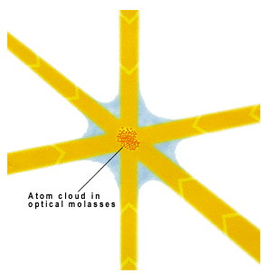
Laser cooling
Laser cooling techniques are used to achieve the required velocity (wavelength) control for the atom source.
Laser cooling: Laser light is used to cool atomic vapors to temperatures of ~10⁻⁶ deg K.
Image source:www.nobel.se/physics

Slide 7
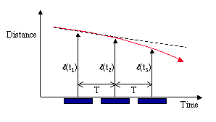
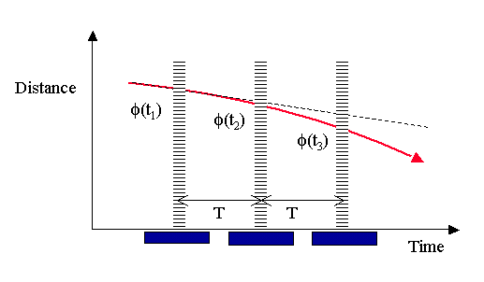
Approximate Kinematic Model
Falling rock
Falling atom
Determine trajectory curvature with three distance measurements (t₁), (t₂) and (t₃)
For curvature induced by acceleration a, a ~ [(t₁) - 2(t₂) + (t₃)]
Distances measured in terms of phases φ(t₁), φ(t₂) and φ(t₃) of optical laser field at position where atom interacts with laser beam
Atomic physics processes yield a ~ [φ(t₁)-2φ(t₂)+φ(t₃)]

Slide 8
Light-pulse atom sensors
Atom is in a near perfect inertial frame of reference (no spurious forces).
Laser/atomic physics interactions determine the the relative motion between the inertial frame (defined by the atom deBroglie waves) and the sensor case (defined by the laser beams).
Sensor accuracy derives from the use of optical wavefronts to determine this relative motion.
Sensor is kinematic: directly reads angular and linear displacements
Accelerometer
Sensor Case
Laser
Atoms
Gyroscope
Sensor Case
v
Atoms

Slide 9
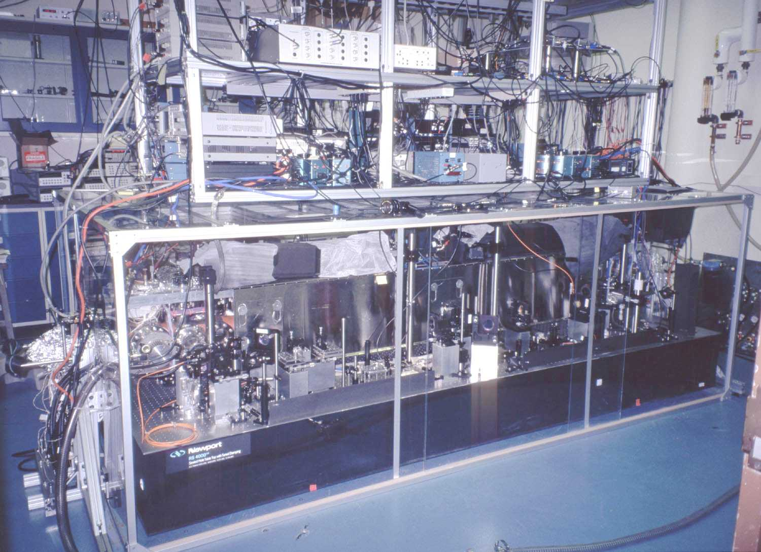
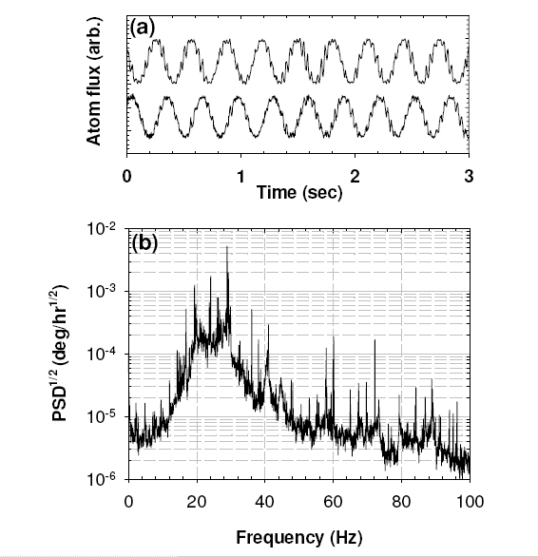
Laboratory gyroscope (1997)
Gyroscope interference fringes:
AI gyroscope
Sensor noise
Noise: 3 μdeg/hr^{1/2}
Bias stability: < 60 μdeg/hr
Scale factor: < 5 ppm
Lab technical noise
Atom shot noise
Gustavson, et al., PRL, 1997, Durfee, et al., PRL, 2006

Slide 10
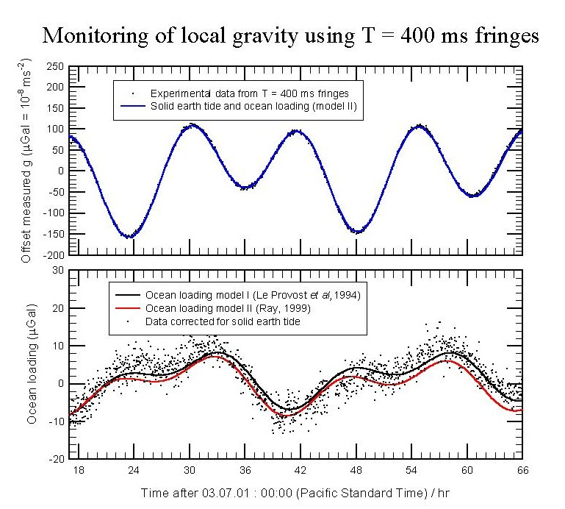
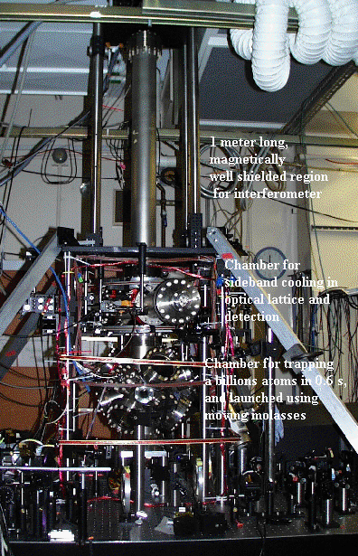
Stanford laboratory gravimeter (2000)
10⁻⁸ g
Courtesy of S. Chu, Stanford

Slide 11
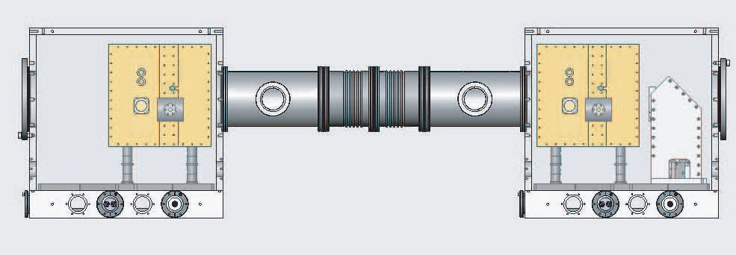
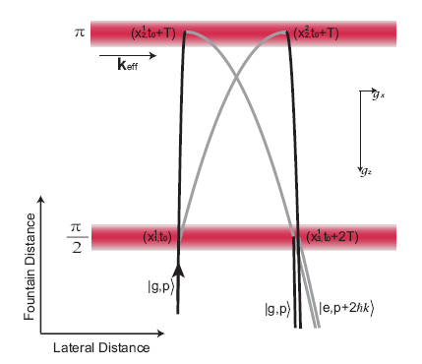
Differential accelerometer (2007)
~ 1 m
Applications in precision navigation and geodesy

Slide 12
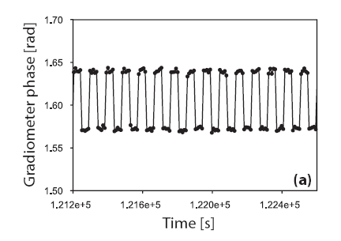
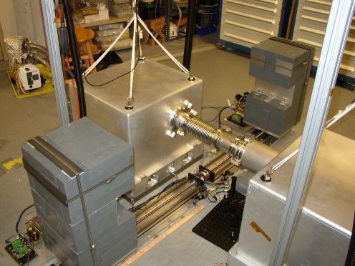
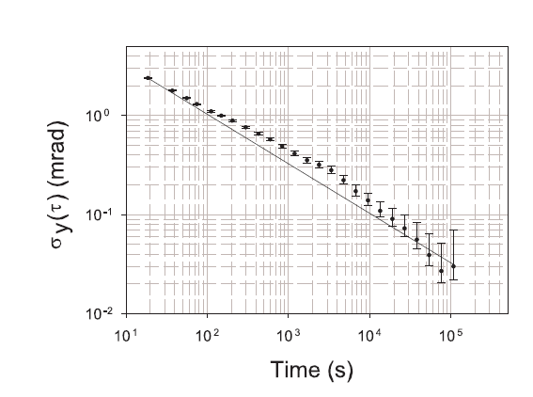
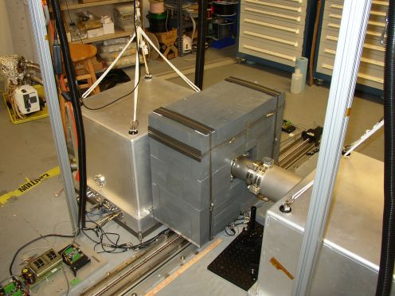
Gravity gradiometer (2007)
Demonstrated accelerometer resolution: ~10⁻¹¹ g.

Slide 13
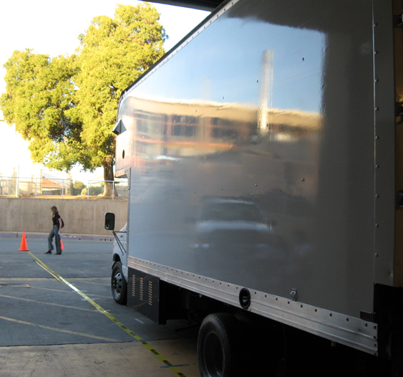
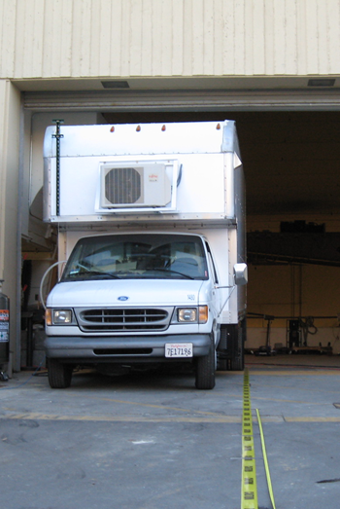
Truck-based gravity gradient survey (2007)
ESIII loading platform survey site

Slide 14
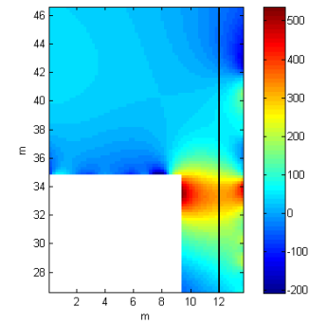
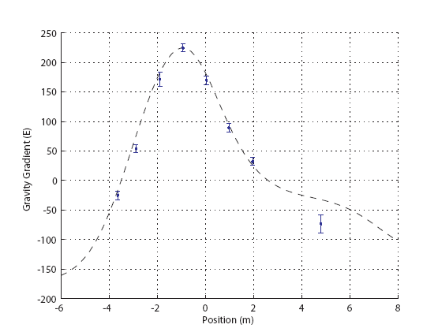
Gravity gradient survey
Gravity anomally map from ESIII facility
Gravity gradient survey of ESIII facility

Slide 15
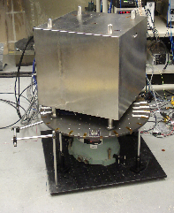
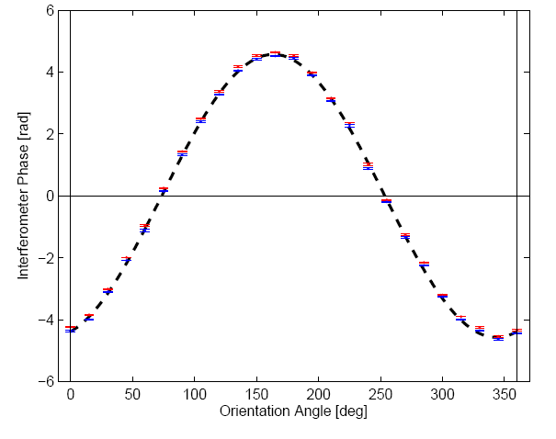
Hybrid sensor (2007)/Gyroscope mode
Measured gyroscope output vs.orientation:
Typical interference fringe record:
Inferred ARW: < 100 μdeg/hr^{1/2}
10 deg/s max input
<100 ppm absolute accuracy

Slide 16
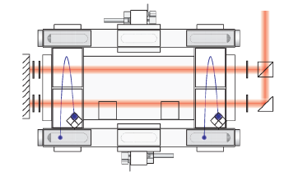
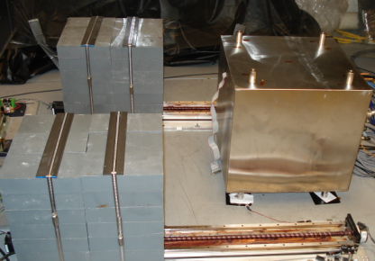
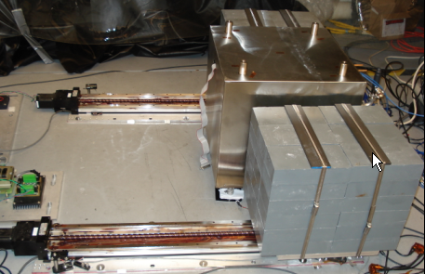
Hybrid sensor (2007)/Gravity gradient mode

Slide 17
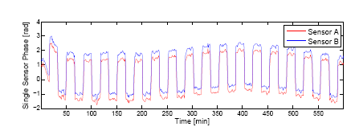
Hybrid sensor (2007)/Absolute accelerometer
Direct accelerometer outputs.
Horizontal input axis, microGal resolution.

Slide 18
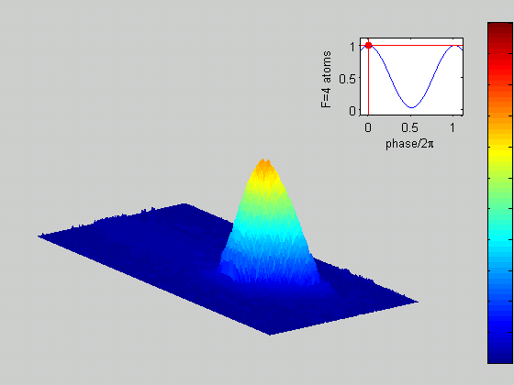
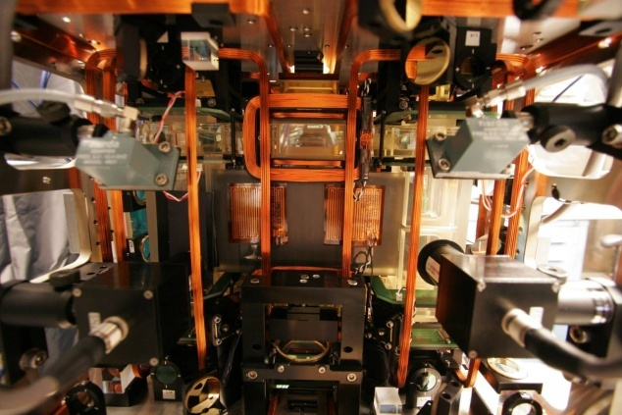
Gyroscope operation
F=4
F=3
Interior view
Interior view of sensor
Interference fringes are recorded by measuring number of atoms in each quantum state.
Fringes are scanned electro-optically.

Slide 19
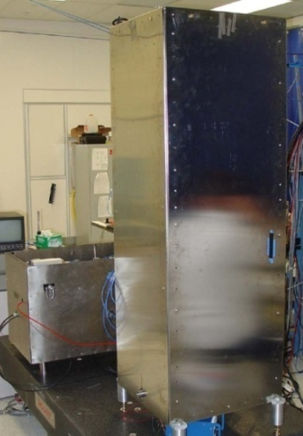
DARPA PINS Sensors
DARPA PINS sensors:
POC Jay Lowell, DARPA
Fabricated and tested at AOSense, Inc., Sunnyvale, CA.
Sensors designed for precision navigation.
Candidate for possible testing in ASL vault.
AOSense, Inc. DARPA DSO

Slide 20
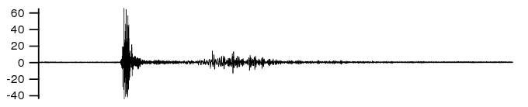
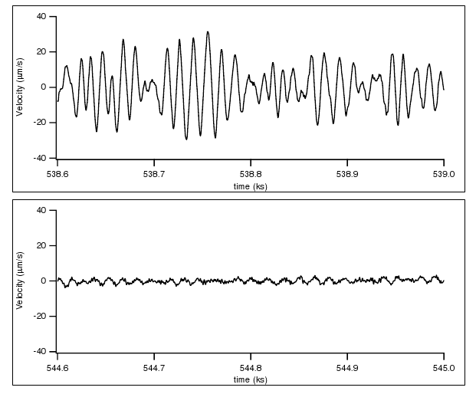
Seismometer mode
CMG-3
Honduras/offshore 7.3
+ 30 min
+ 2 hr
AOSense, Inc. DARPA DSO

Slide 21
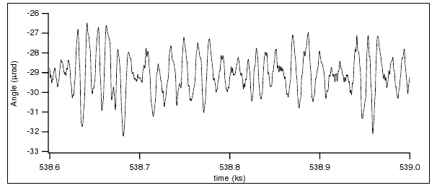
Gyroscope mode
+30 min
Gyroscope output necessary to disambiguate tilt from horizontal motion (navigation problem).
AOSense, Inc. DARPA DSO

Slide 22
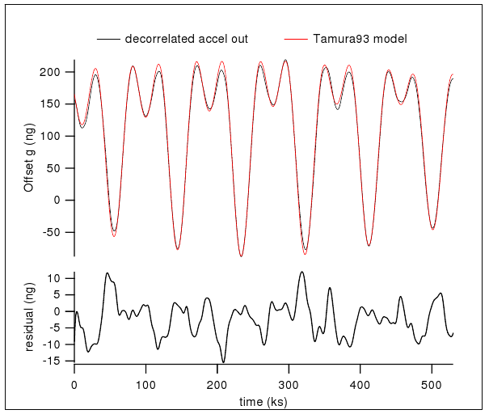
Gravimeter mode
AOSense, Inc. DARPA DSO

Slide 23
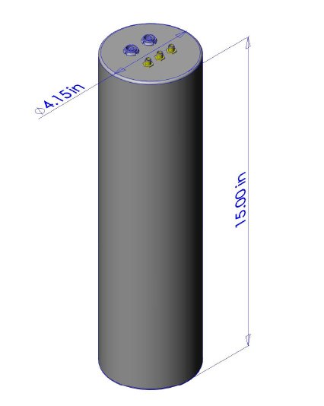
AOSense compact gravimeter
High accuracy absolute accelerometer.
Currently under fabrication at AOSense, Inc.
AOSense, Inc.
AOSense, Inc

