Slide 1


Anti-Harassment/Discrimination Workshop for REUs and Field Camps
Michael Hubenthal, Senior Education Specialist – 6/10/20
Acknowledgments: This material is based upon work supported by NSF under Grant Nos. EAR-1852339, AGS-1560419, & AGS-1659878, and SAGE, which is a major facility operated by the IRIS Consortium and funded by NSF under award EAR-1851048 and earlier NSF awards.

Slide 2
Workshop Goals
Describe a work environment that
consists of mutual respect
promotes respectful and congenial relationships
is free from all forms of harassment and discrimination
Summarize who is responsible for creating the work environment described above
Distinguish between behavior that is harassing or discriminating and non-harassing or non-discriminating
Describe how to report harassment or discrimination to the program, the program’s investigation procedures, and possible disciplinary outcomes
Plan how they would use the bystander interventions to respond to incidents of discrimination or harassment, including sexual harassment
Apply the program’s anti-harassment, anti-discrimination, and non-fraternization policy to a series of case studies

Slide 3
Group Agreements
Respect our safe space. The discussion (comments, stories, and perspectives) shared at meetings should remain with the group (e.g. the Vegas Rule).
Use “I” statements. Speak from your own experience rather than generalizing.
Listen. Listen actively by respecting others when they are talking, and respectfully by listening even if you disagree
Step Up/Step Back. Everyone has the right to be heard. Encourage participants who don’t talk much to “step up” (speak up, participate), and those who participate a lot to “step back” (say less) to make room for everyone to contribute.
Discuss ideas, not the person. Aristotle said "It is the mark of an educated mind to be able to entertain a thought without accepting it." It is okay to agree to disagree.
Notes:
Note that by its nature, this will be a sensitive discussion. Therefore before we being we need to create a safe space for learning.
If at any point the discussion becomes uncomfortable to you. Please feel free to step away. However, since this is a zoom we may not know that you have stepped away unless you tell us. Thus, we would ask that you use the chat feature to send a private note to Val Sloan.

Slide 4
Breakouts
Periodically throughout this workshop you will be sent into breakout rooms to work together as a group.
We will provide you with activities
Workshop staff will “float” into and out of these breakouts (like might happen if we were all in one room). This is intended to allow us to have a sense of how things are going and gain a sense of everyone's ideas.

Slide 5
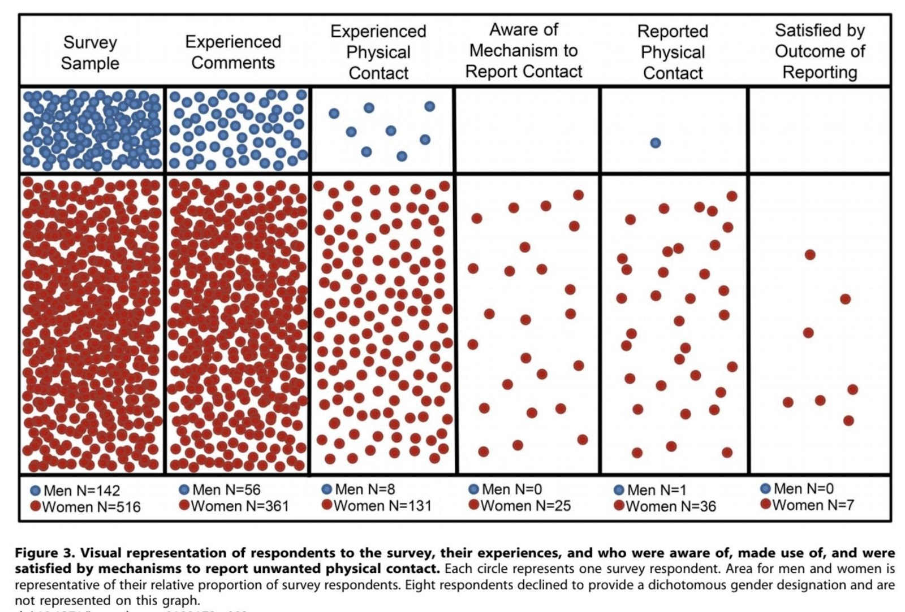
Breakout
As a small group reflect on and discuss the data shown in this figure.

Slide 6
Anonymous Poll
Which of the following most closely applies to you?
Never witnessed discrimination or harassment and never heard of someone who had experienced.
Heard of someone who experienced harassment or discrimination but never witnessed it.
Witnessed discrimination or harassment
Experienced harassment or discrimination

Slide 7
Pictionary Rules

Slide 8
Exploring Terms
Breakout
Each team has been provided with a set of terms to discuss each and create a consensus definition.
A ​consensus definition​ is a decision achieved through negotiation whereby a hybrid resolution through concessions made by all.
Allow about 2 minutes for each person to type their own definition
Everyone should copy and paste their definitions into the workspace
Review all definitions and sort by common themes
Create a first draft consensus definition that includes common themes.
Iterate on the consensus definition until all group members agree on it.
Repeat for remaining terms.
15 Min

Slide 9
Terms
Harassment
Illegal
Flirting
Mutual Respect
Unwanted
Investigation
Joke
Discrimination
Wanted
Power
Retaliation

Slide 10
Terms
Harassment - unwelcome behavior slurs, jokes, or verbal, graphic or physical conduct
Illegal – forbidden by law
Flirting – behaviors trying to attract someone to suggest interest in a deeper relationship, but for amusement rather than with serious intentions.
Mutual Respect - the recognition that two or more individuals have valuable/important contributions to make in a relationship.
Unwanted – not desired or gladly received
Investigation - a systematic examination
Joke - something said or done to provoke laughter
Discrimination - the unjust or prejudicial treatment of different categories of people
Wanted – desired
Power - the capacity or ability to direct or influence the behavior of others
Retaliation – to return in kind

Slide 11
Additional Terms
Hostile work environment – A workplace in which unwelcome comments or conduct based on gender, race, nationality, religion, disability, sexual orientation, age, or other legally protected characteristics unreasonably interfere with an employee’s work performance or create an intimidating or offensive work environment for the employee who is being harassed.
Quid pro quo - a favor or advantage granted or expected in return for something.

Slide 12
Handbook & Mini-Scenario Group Work
Breakout
Handbook
Representative
Harassment and discrimination is covered from pages 3 to 6
Breakout
Take a few minutes to read these pages individually
As a group read each scenario
Discuss the scenario in light of the handbook policies and questions provided
Be prepared to report out on your groups discussion
Questions – #1, #8 & #9
30 Min

Slide 13
Complaint Procedures/Investigation/Disciplinary Outcomes
NSF Ocean Sciences REU Group | Contacts at the REU* | Contacts in STumP’D Team
Scripps Institution of Oceanography REU | Mary Liesegang mbliesegang@ucsd.edu & Stuart Sandin | Nicole Nakata nnakata@uoregon.edu Rennie Meyers rmeyers@nsf.gov Richard Emlet remlet@uoregon.edu Val Sloan vsloan@ucar.edu
Pacific Northwest REU | Penny Rowe penny@nwra.com Jeffrey Early jearly@nwra.com
Rutgers (East Coast) REU | Christine Bean bean@marine.Rutgers.edu & Janice McDonnell
*More details to come in the next week.

Slide 14
Complaint Procedure (IRIS’s REU)
We encourage individuals to immediately inform the alleged harasser that the behavior is unwelcome.
Immediately report the conduct to the IRIS Internship Program Facilitator, or email complaint@iris.edu. The report should include all facts available to the individual regarding the discrimination, harassment or sexual harassment.

Slide 15
Investigation Procedure (IRIS’s REU)
Confidentiality - Absolute confidentiality is not promised nor can it be assured.
The investigation may include interviews with all involved individuals, including the alleged harasser, and any individuals who are aware of facts or incidents alleged to have occurred.

Slide 16
Investigation Outcomes (IRIS’s REU)
Restore any lost terms, conditions or benefits of an internship to the complaining individual.
Discipline the harasser. This discipline can include written disciplinary warnings and termination from the program. If termination occurs,
The intern’s college will be notified, and arrangements made for the return of the student to her/his home.
The mentor’s college/university human resource/Title IX department will be notified.
If the harassment or sexual harassment is from a graduate student, or other undergraduate at the intern’s placement, the IRIS Internship Program will work with the hosting mentor and their campus Title IX office to take appropriate action to stop the conduct.

Slide 17
What sorts of benefits might be derived from a work environment that consists of mutual respect, promotes respectful and congenial relationships and is free from all forms of harassment and discrimination vs one that is not?
55 Min

Slide 18
Diverse experiences and perspectives can increase innovation
Employers (and faculty) receive a better return on the investments that a university, department, or lab makes into employees/students.
“Environments where all employees feel included and valued are yielding greater commitment and motivation, which translates into fewer resources spent on employee turnover, grievances and complaints.” (OMP, 2019).

Slide 19
Who is responsible for creating such an environment?
In what ways does each person contribute?

Slide 20
Will everyone act?
Fear of embarrassment
Pluralistic ignorance (everyone else thinks — or seems to think — it’s okay)
Diffusion of responsibility
Fear of retaliation

Slide 21
5Ds Bystander Intervention
Direct: Confront the situation. Be firm, clear, and concise
Distract: Take an indirect approach to de-escalate
Delegate: Seek help from a third party
Delay: Check in with the person being harassed.
Document: If it is safe to do so, document the situation.

Slide 22
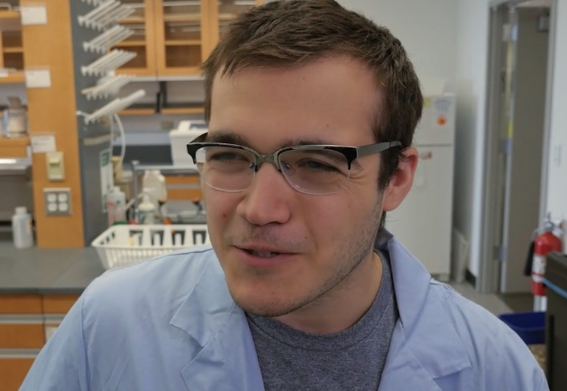
Clip 1
75 Min

Slide 23
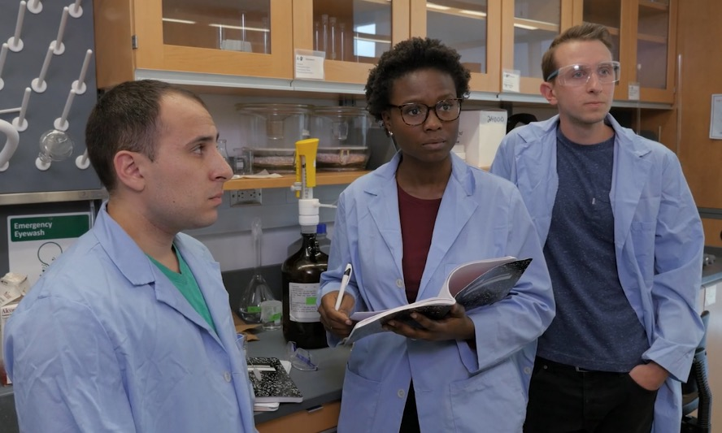
Clip 2

Slide 24
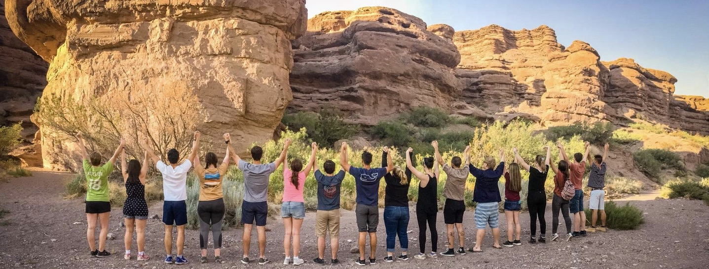
We are all part of a community... In the summer research internship programs you are participating in, and in the broader Earth Science community. Each of you can make a difference by caring, being thoughtful, and if necessary intervening and reporting.
90 Min
https://implicit.harvard.edu/implicit/takeatest.html

