Slide 1
How Do We Know Where an Earthquake Originated?
Locating the epicenter of an earthquake using seismic data
Incorporated Research Institutions for Seismology
Unlocki₁ng₂ the secre₃t₄s of a seismogram₅…
_ _ s _or_ _han jus_ w_ggl_s
1 4 5 3 4 4 1 3
[This slide presentation is to accompany the lesson found here: https://www.iris.edu/hq/inclass/lesson/439 ]
Notes:
This slide presentation was created to accompany the IRIS activity “Locating an Earthquake with Recent Seismic Data” available here:
https://www.iris.edu/hq/inclass/lesson/locating_an_earthquake_with_recent_seismic_data

Slide 2
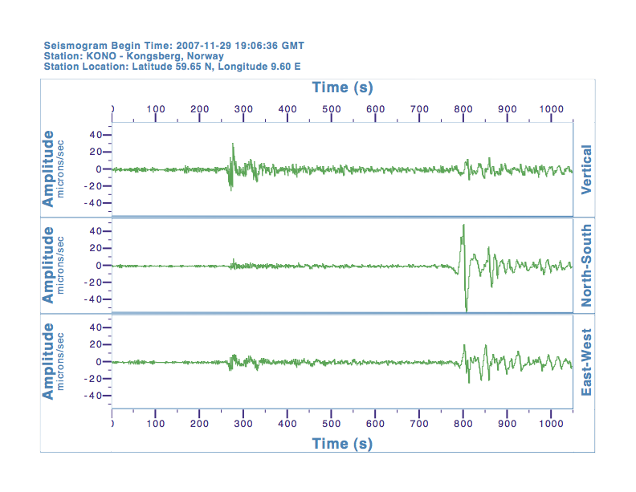
Interpreting Seismic Data

Slide 3
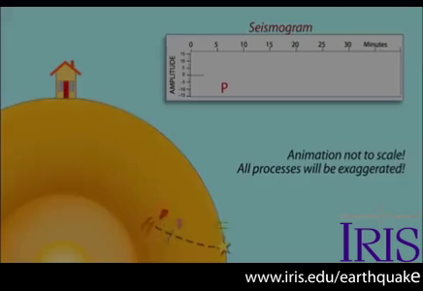
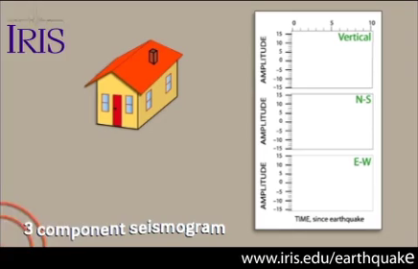
Animations of seismic wave motion
An earthquake generates seismic waves that (1) penetrate the Earth as body waves (P & S) or (2) travel as surface waves (Love and Rayleigh). Each wave has a characteristic speed and style of motion.
Modern seismometers include three (3) elements to determine the simultaneous movement in three (3) directions: up-down, north-south, and east-west.
[These animations are excerpts from longer narrated animations. See links in notes to full animations]
Notes:
Download full animations from:
https://www.iris.edu/hq/inclass/animation/114
https://www.iris.edu/hq/inclass/animation/115

Slide 4
Locating the Epicenter
Locate each seismic station on the globe/map
Identify S and P waves on seismogram
Determine S-P time (convert to sec)
Use travel time curve to determine distance from epicenter
Use string to determine possible locations
Compare with other group members

Slide 5
Interpreting Seismic Data
P wave arrives
~260 sec.
S – P
770 sec – 260 sec
S wave arrives
~770 sec.
= 510 sec
or 8.5 minutes
Notes:
Things to point out.
Three seismograms all recorded simultaneously at the same location (Vertical, North-South & East-west).
P wave arrives about 260 seconds; S wave arrives at about 770 seconds.
S minus P is 770 minus 260 =510 seconds
510 seconds divided by 60 seconds = 8 minutes 30 seconds.

Slide 6
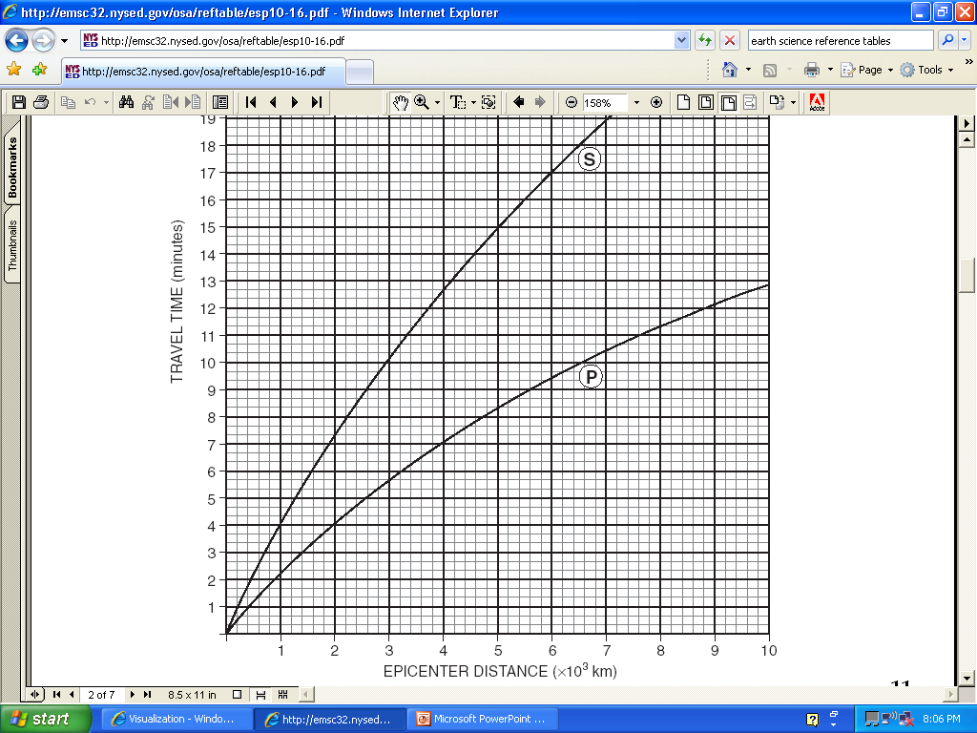
Using the travel-time curve
TAKE A PIECE OF PAPER, AND MARK OFF THE DIFFERENCE IN ARRIVAL TIME
8:30
8:30

Slide 7
Using the travel-time curve
MOVE THE PAPER UNTIL THE TWO TICK MARKS LINE UP WITH THE P AND S CURVES
8:30
WHEN TICK MARKS LINE UP, GO STRAIGHT DOWN AND READ THE EPICENTER DISTANCE
EPICENTER DISTANCE OF 6700 KM

Slide 8
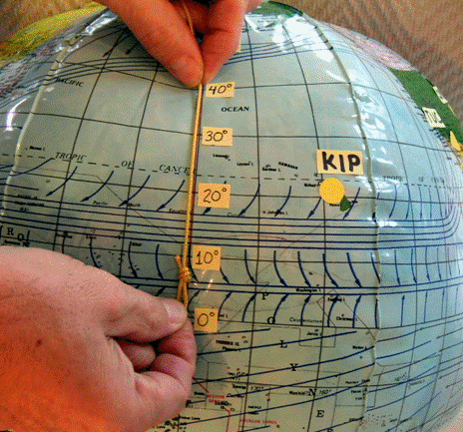
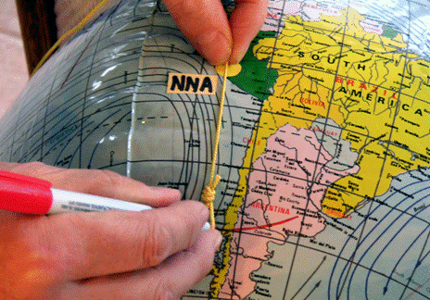
Figuring distance on a globe
Determining distance from the seismic stations (above station KIP; right station NNA)
Notes:
Photos courtesy of Larry Braile

Slide 9
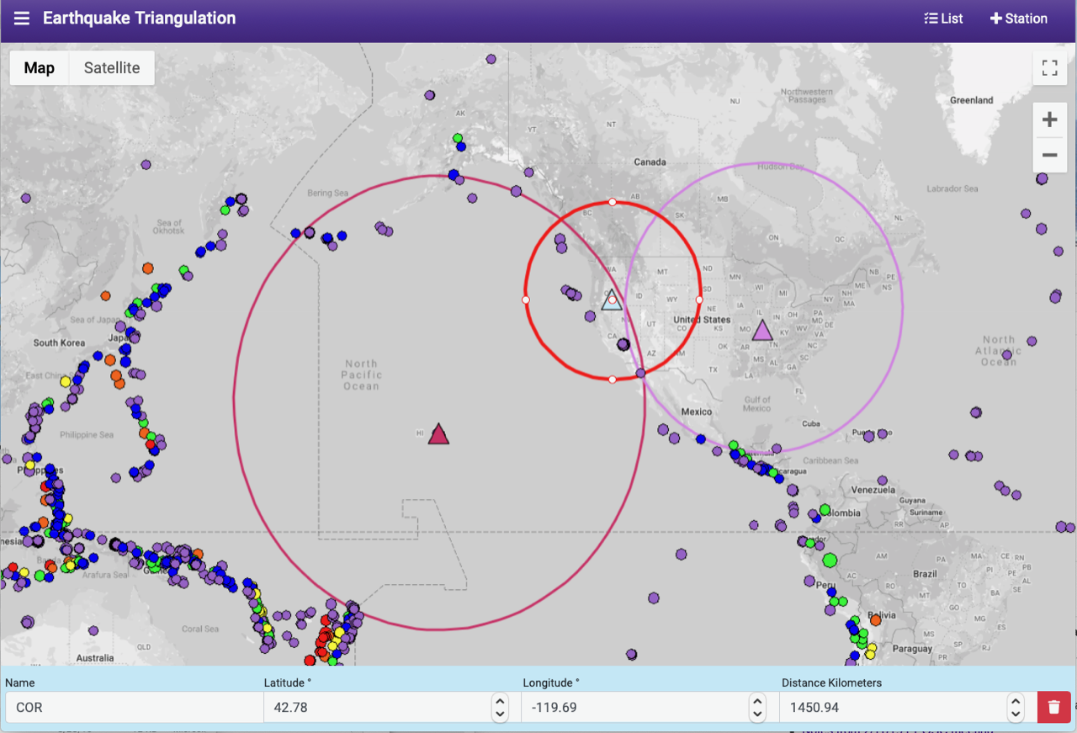
Example of triangulation
This example is derived from IRIS’s online app “Triangulation”. Download here: https://dev.iris.edu/app/triangulation
Notes:
How might you use this activity to improve future undergraduate responses?

Slide 10
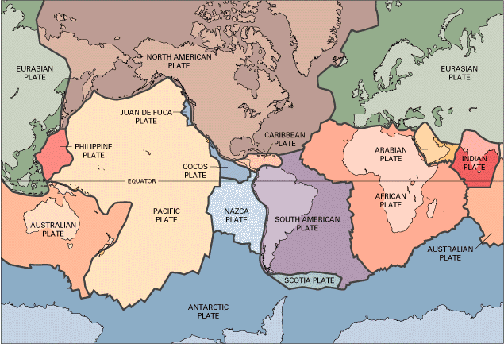
Tectonic Plates

Slide 11
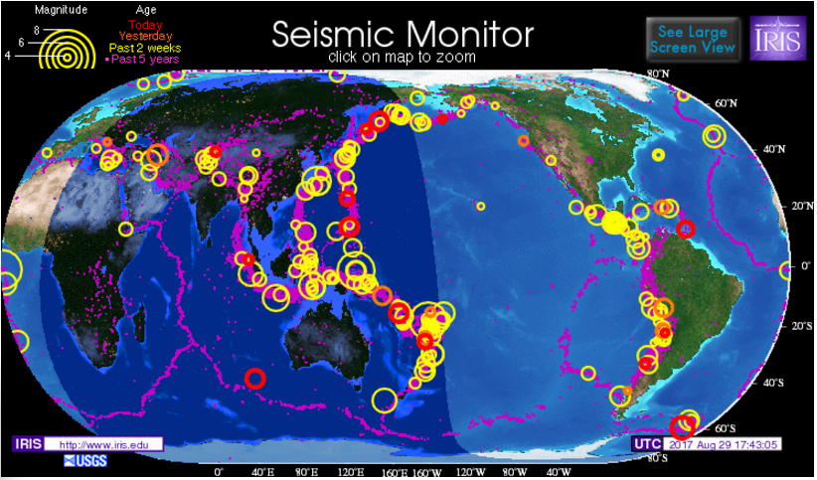
Seismic Monitor
Global Seismicity as of 8/29/17
Notes:
Updated versions of this map can be obtained from www.iris.edu

