Slide 1
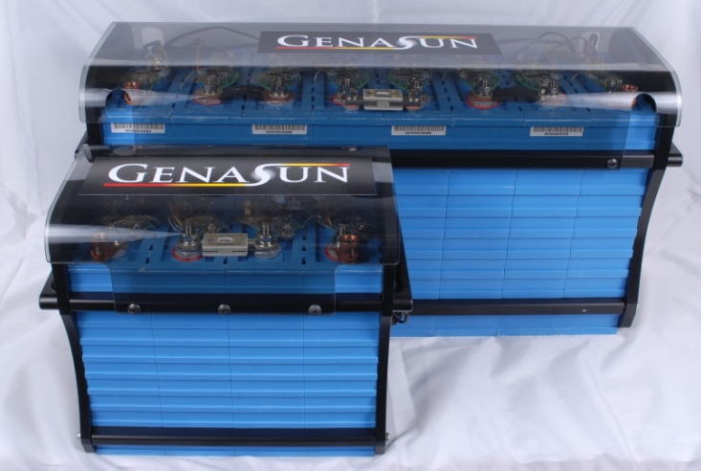
Lithium Batteries for Remote Power
Alex MeVay
Genasun LLC

Slide 2
Why go Lithium?
Lithium Batteries reduce logistical cost by reducing experiment size and weight.
Reduced Weight:
½ to ¼ of Lead-Acid
Reduced Size:
2/3 to 1/2 of Lead-Acid
Increased Electrical Efficiency:
Approaches 100%,
vs. 70-85% for Lead-Acid
Notes:
Motivations/Benefits
lighter weight
more efficient charging
longer Life
smaller size
Positive Feedback
Less overhead
Smaller case size->less weight and heating requirements
quicker deployment
Reduced charging requirements for some applications.
MORE SCIENCE with SAME LOGISTICAL RESOURCES

Slide 3
Common Lithium Chemistries
Lithium Cobalt/Manganese/Nickel/Polymer (most)
3.7V nominal cell voltage (~3.0-4.2V useable)
Sloping Discharge Curve
High Energy Density (~150-220+ Wh/kg)
Good Lifetime: 300-500 cycles
Unstable and vulnerable to manufacturing defects
Lithium Iron Phosphate
3.2V nominal cell voltage (~2.5-3.6V useable)
Flat Discharge Curve
Good Energy Density (~80-130Wh/kg)
Excellent Lifetime 2000-3000 Cycles
Good Safety Characteristics
Notes:
Lead ~50Wh/kg
Co life similar to well-treated lead-acid battery
Comment on safety
lots ‘o energy in small space
Flammable electrolyte
Large battery packs.
Lithium, Titanate, why?

Slide 4
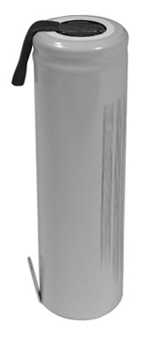
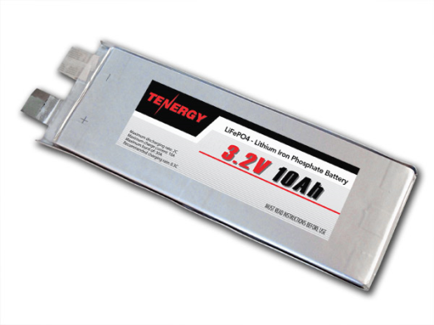
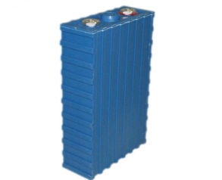
Packaging Options
Packaging | Sizes | Pros | Cons
Cylindrical | <1 to 20 Ah | Mechanically Robust Use in any position Pre-built packs available | May require tabs or spot-welding
Foil (Polymer) | <1 to 50Ah | Flat Lightweight Use in any position | Mechanically Vulnerable Connections Difficult
Large Format | 40 to 400+ Ah | Easy to Package Easy to Connect Mechanically Robust Cheap | Some require compression Best kept upright
Notes:
cylindrical
Spot-weld or pre built
Great for small systems.
Foil packs
Maybe good for difficult packaging
Our opinion-> not mechanically robust
Large format
Most convenient for large systems

Slide 5
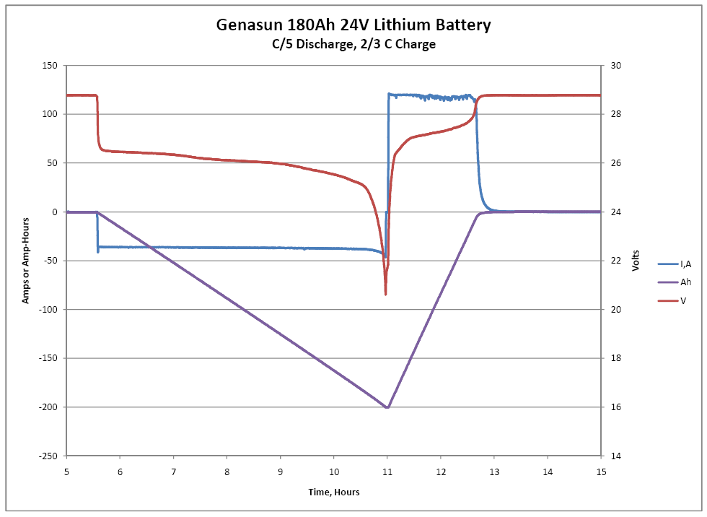
Lithium Iron Phosphate Characteristics
Notes:
Discharge curve
Stiffer
Flatter, may need fuel gauging
100% CEF (Pb 70-90%)
Typical voltages

Slide 6
Lithium Care and Feeding With great power comes great responsibility.
Lithium batteries are not as resilient as Lead-Acid: operation outside of ratings may cause cell damage and safety risks.
Cell Voltage
Protection limits typically 2.0 – 3.8V
EVERY group of paralleled cells must be monitored
Cell temperature
Charge: 0 – 45°C (some can charge colder)
Discharge: -20 – 60°C (some can discharge colder)
Thermal management necessary for cold temperature operation
Current
Fuse, circuit breaker, PTC, electronic.
Not generally a big concern for remote power

Slide 7
Lithium Care and Feeding 2: Cell Balance
Perfect Coulombic efficiency is a fantastic benefit as well as an implementation challenge.
Lead-acid (and NiCd) have a mechanism to bleed off overcharge, lithium doesn’t.
Lithium cells, like others, may have varying rates of self-discharge.
Result: SOC drifts, some cells may be overcharged or over-discharged even if total battery voltage is OK.
What lithium batteries lack chemically, we need to provide electrically.
Notes:
Discuss NiCd and lead-acid Bleed when full
Tolerance to trickle charging (also thermal-runaway)

Slide 8
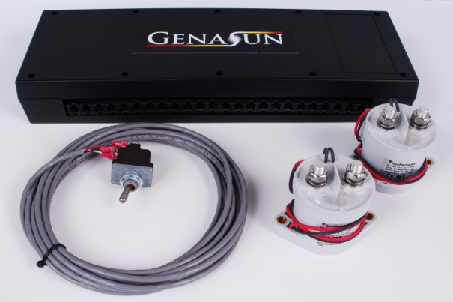
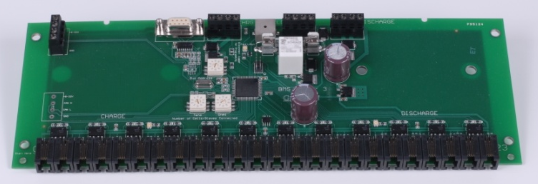
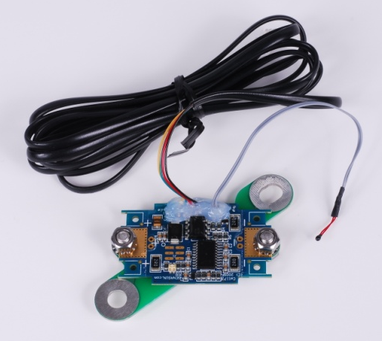
The Battery Management System
To meet all of the cell’s requirements, practical lithium systems include a battery management system (BMS).
BMS’s monitor some or all of:
Voltage of each parallel cell group
Temperatures within the pack
Current flowing through the pack
…and can take some or all of the following actions:
Redistribute charge to keep pack in balance
Connect or disconnect chargers or loads
Send data to other power management systems
Control fans, heaters, etc.
For small systems, cheap barebones systems are available
Often called “PCB’s” or “PCM’s”
Generally lack temperature measurement
Basic and sometimes infuriating load switching
Some lack cell balancing (watch out!)
Notes:
Would be useful for Pb!!!
History, cost, inertia
Active and passive balancing, 0.05% loss
PCM’s not so hot for solar.

Slide 9
System Philosophy
BMS disconnects are a backup
Electronics don’t like having their batteries disconnected
Separate buses for chargers and loads are best
Otherwise chargers feed loads, resulting in…?
If this is not possible, put loads on LVD, such as from solar charge controller
Notes:
Many modern chargers, battery monitors can be set up for lithium.

Slide 10
Putting it All Together
4 cells=12V with lithium-iron phosphate; very close match to lead-acid.
Charging is simple: typically straight float with no temperature compensation
Cells are sealed, no flammable or corrosive gases
Protect from short circuits and make cells mechanically secure
Test the edge cases!
Interesting things happen at boundaries…
Notes:
Many modern chargers, battery monitors can be set up for lithium.

Slide 11
Gotcha!
Over-discharge:
Does BMS/PCM/PCB disconnect chargers too?
If so, will chargers start up without a battery?
Over-Charge:
Sometimes other system components will complain first.
Don’t shoot the messenger!
Is cell balancing provided?
Were cells properly balanced before installation?
Initial balance can take hours to weeks
Does the BMS expect a specific charger to operate?
Notes:
Customer anecdotes…

Slide 12
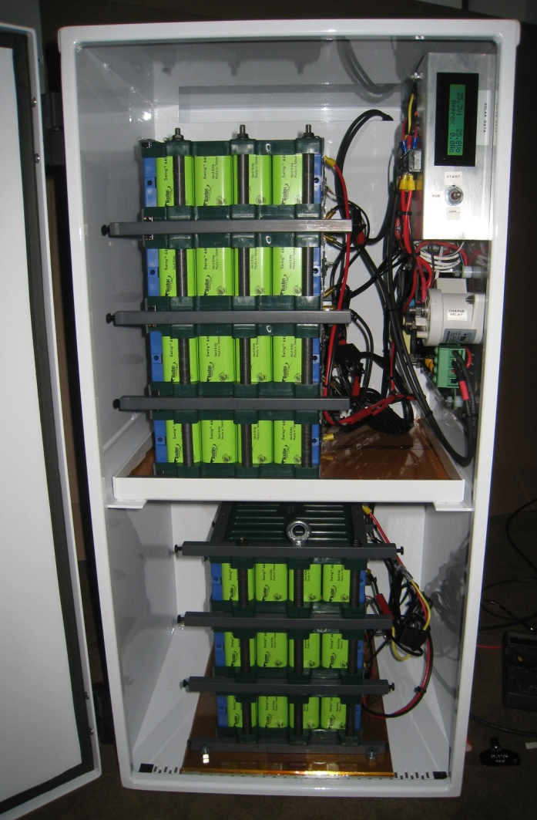
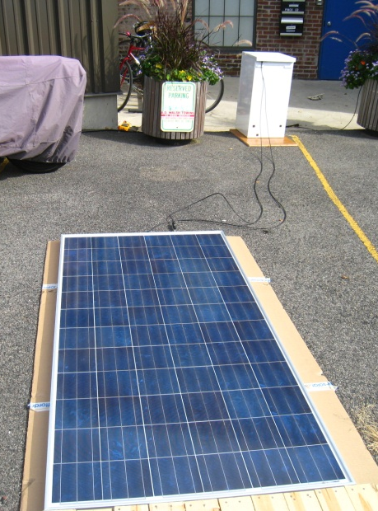
Example Application: Telecom
Designed to provide remote power for telecom installation
Small size and lighter weight allows power system to be mounted on telecom tower.
Less wire, wiring Loss
Vandal resistant
Cooler temperatures aloft

Slide 13
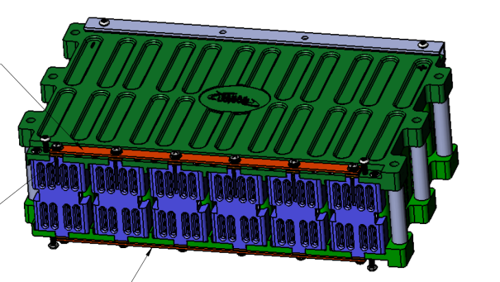
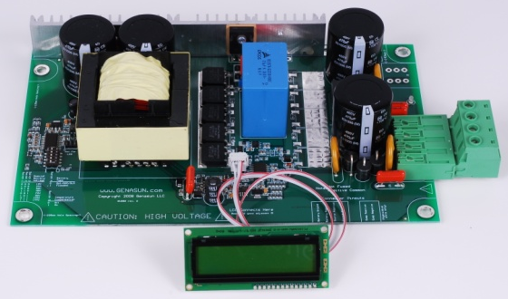
Telecom Components
Boston Power 7s48p Lithium Cobalt Battery
~$4,500
25.9V nominal, 211Ah
Genasun BMS
$675
~230W Solar Panel
$950
Genasun GVX-25 MPPT Solar Charge Controller
25A Output
Custom programmed for Lithium
$600

Slide 14
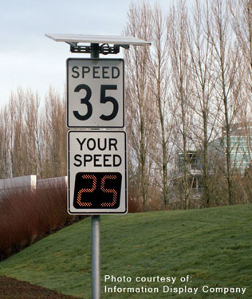
Example Application: Traffic Radar
Solar panel provides power for “Your Speed is..” traffic calming radar
Careful optimization of system efficiency eliminates grid connection.
Greatly simplified installation (no need to dig up sidewalks
No monthly billing
No AC electrical code hassles.
Notes:
In-city challenges and benfits

Slide 15
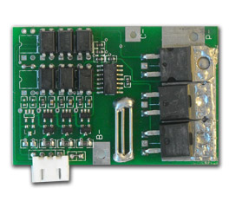
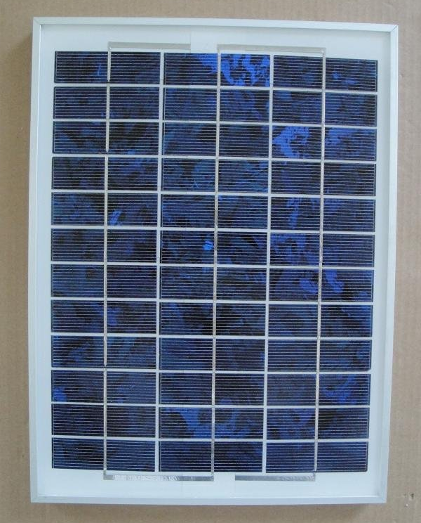
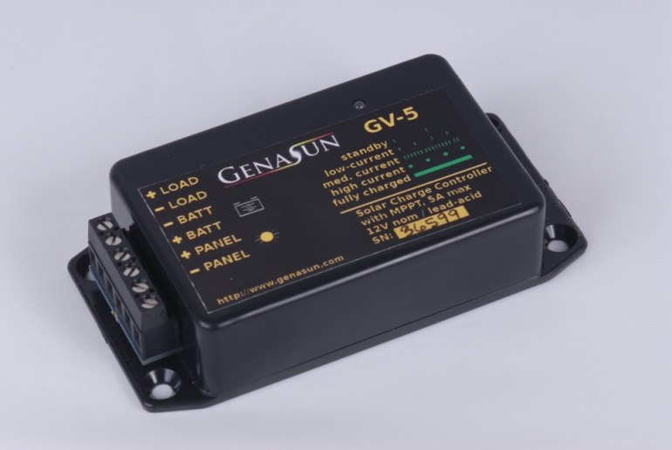
Traffic Radar Components
3s1p Lithium Iron Phosphate Battery pack
9.6V nominal, 10Ah
$90
Cheapo Chinese Battery Protection
$19
10W Dasol Solar Panel
$20!
Genasun GV-5-SP MPPT Solar Charge Controller
5A Output
1.5mW operating consumption
Programmed for Lithium
$75
Notes:
Reverse engineering china

Slide 16


Example Application: Marine
12V 200Ah to 24V 1800Ah, in dual banks
Charges from many sources:
Solar
Wind
Fuel Cells
Hydro Generators
Engine Alternators
Gensets
AC Shore Power
Loads range from instrumentation to washing machines
Genasun BMS forms heart of electrical system
Genasun accessories help coordinate charging
Alternator Regulators
Solar charge controllers

Slide 17

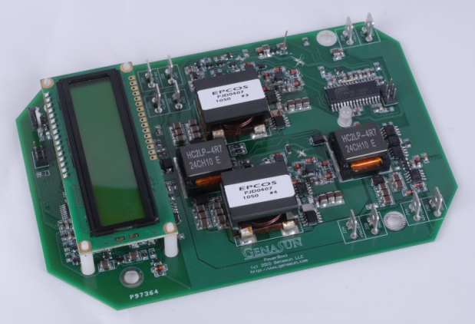
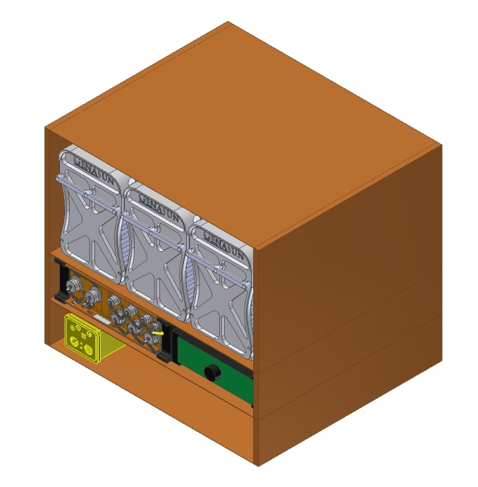
Future Work Development Partnership with IRIS/PASSCAL
Reduce BMS power consumption to <15mW
Provide wind and solar MPPT charge controllers with BMS data for smartest operation
Add heater control to maintain batteries at safe charging temperature when power is available.
Characterize cells at cold temperatures with slow discharge
Proposal for two cold-hardened lithium stations installed near McMurdo in February 2012

Slide 18
Resources
Genasun LLC
1035 Cambridge St., Suite 16B
Cambridge, MA 02141
617 369 9083
http://www.genasun.com
info@genasun.com
Lithium iron phosphate packs, 12V/24V 100+ Ah
MPPT solar charge controllers
MPPT controllers for small wind
Custom system configurations for lithium batteries
BatterySpace.com
860 South 19th street, Unit #A
Richmond, CA 94804
510-525-2328
http://www.batteryspace.com
sales@batteryspace.com
Lithium cobalt and lithium iron phosphate cells
Small and medium packs, stock and custom, <100Ah
BMS’s, PCM’s, PCB’s, etc.

