Slide 1
Using Autocorrelation to Identify Reflectors
By Alexander B. Snyder

Slide 2
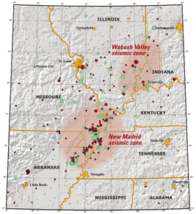
The New Madrid Seismic Zone
Responsible for a huge series of earthquakes from 1811-1812
Contains layers and layers of sediment that needs to be studies in more depth
Large Earthquakes in this area could cost:$300,000,000,000!

Slide 3
What are Reflectors
Notes:
Whenever there is a source of powerful noise, seismic waves are emitted toward the ground. The arrows “point towards the screen” illustrate a single ray from the wave. As you can see, this arrow goes downward through the ground, hits a surface, and then bounces back up towards the receiver.
Quick question, do you think that all of the wave is reflected, or does some of it go through to the next surface?

Slide 4
Snell’s Law
Notes:
If you go into any kind of career in seismology, this will be a crucially important concept. Whenever you hit an interface, some of the wave will be reflected as we saw in the previous slide and some of it it is refracted. Refraction is where the wave slightly changes direction due to the difference in sediment.

Slide 5
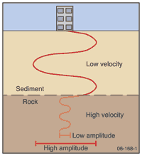
Why?
Knowing these sediments will better help us identify with better precision which areas are at increased risk for high magnitude earthquakes
Think Jello versus Ice
Notes:
Different sediments can amplify the shaking, making even a small energy source able to bring down buildings.
Imagine a pool filled with Jello versus one filled with ice, which one would you rather stand on during an earthquake?

Slide 6
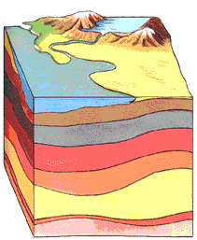
Common Misconceptions
There are many layers between the crust and the mantle
The crust-mantle boundary (MoHo) is not always easy to find
Most of what we know about the mantle is from seismograms
Notes:
Raise your hand if you have heard of the crust. How about the mantle. “Get a volunteer to explain both”
There are many sediment layers in the crust due to changes in climate, volcanoes, and erosion
Sometimes changes in the crustal layers are much less gradual than the change from crust to mantle.
Since we can’t dig and see very deep into the crust, most of what we know about the deep earth is inferred from seismograms

Slide 7
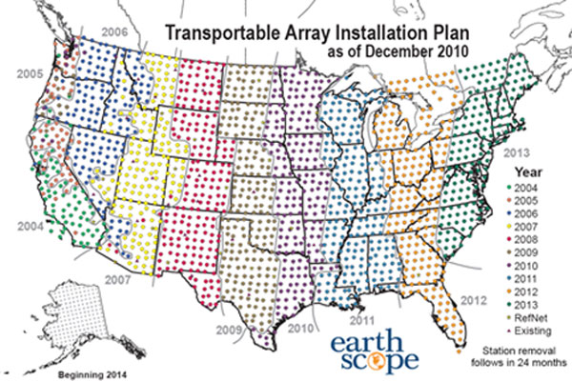
Equipment
Thank you Earth Scope
And the NSF!!!
Notes:
In the top right we have the equipment that we use to measure seismic activity. It is powered by a solar panel above ground, and works by using a sensor that is slightly under the surface
These broadband sensors are placed all over the country. This picture shows the map of the US with every dot representing a broadband sensor.
This wonderful project is called the Transportable Array project which was funded by the NSF and is thanks to the hard work of Earth Scope!

Slide 8
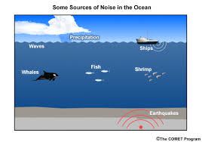
Autocorrelation
A function that evaluates how similar a seismogram is to itself
Reveals patterns within the seismogram
These patterns are from ambient noise
Notes:
The largest source of ambient noise is the ocean!

Slide 9
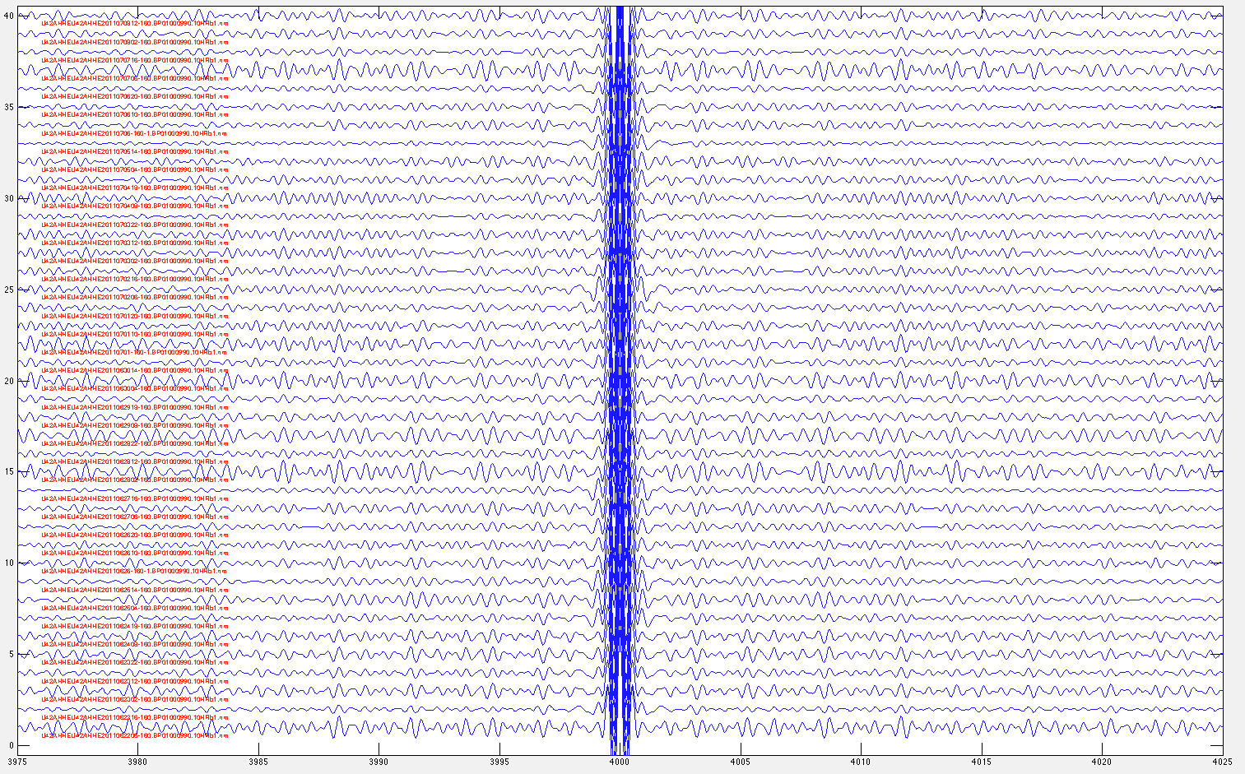
Finding the Reflectors
Once I correlate the large amount of data, I put it all together through stacking
The more data
I have, the
more obvious
the reflectors
are
Notes:
You can see that not all of the waves look the same, but when you put them all together, you can more easily see their similarities!
Each one of those jumps is a reflector, whether it is between sediments or a MoHo reflector

Slide 10
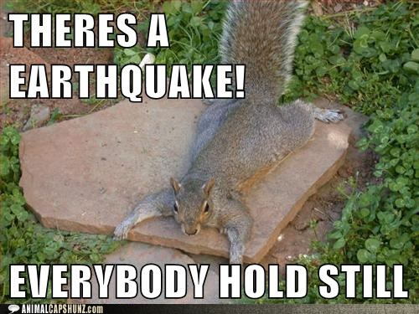
Questions?

