Slide 1

MEMS Applications in Seismology
Nov 11, 2009
Seismic Instrumentation Technology Symposium
B. John Merchant
Technical Staff
Sandia National Laboratories
Sandia is a multiprogram laboratory operated by Sandia Corporation, a Lockheed Martin Company, for the United States Department of Energy’s National Nuclear Security Administration under contract DE-AC04-94AL85000.

Slide 2
Outline
Overview of MEMS Technology
MEMS Accelerometers
Seismic Requirements
Commercial Availability
Noise & Detection Theory
Current R & D Efforts
Outlook

Slide 3
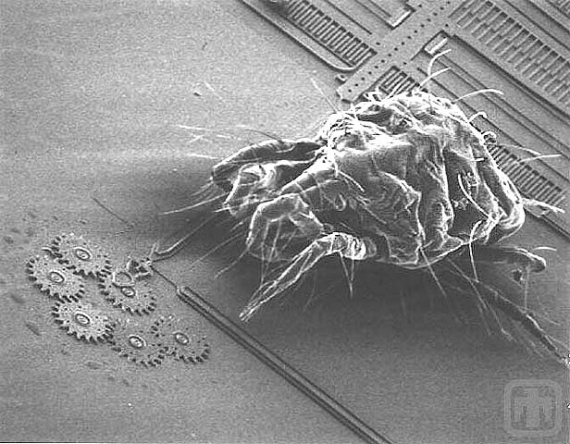
What are MEMS?
Micro-Electro-Mechanical Systems (MEMS)
Features range from 1 to 100 microns.
Similar fabrication techniques as Integrated Circuits (IC). However, MEMS fabrication is a trickier process due to the incorporation of mechanical features
Distinguished from traditional mechanical systems more by their materials and methods of fabrication than by feature size.
Courtesy of Sandia National Laboratories, SUMMiTTM Technologies, www.mems.sandia.gov

Slide 4
What are MEMS?
Materials | Fabrication | Applications
Silicon Single-crystal silicon makes a nearly perfect spring with very stable material properties. Polymers Metals gold, nickel, chromium, titanium, tungsten, platinum, silver. | Deposition Electroplating Evaporation Sputtering Lithography Photo, Electronic, Ion, X-ray Etching Wet Etching: Bathed in a chemical solvent Dry Etching: Vapor/Plasma | Automotive air bags Inkjet printers DLP projectors Consumer Electronics (Cell phone, Game Controllers, etc) Sensors (pressure, motion, RF, magnetic, etc)

Slide 5
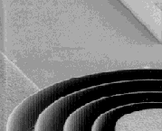
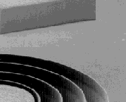
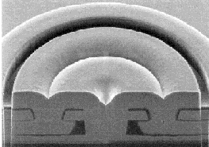
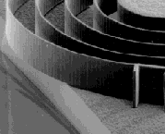
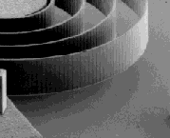
Three Dominant MEMS
Microfabrication Technologies
Surface Micromachining
Bulk Micromachining
LIGA
Structures formed by deposition and etching of sacrificial and structural thin films
Structures formed by wet and/or dry etching of silicon substrate
Structures formed by mold fabrication, followed by injection molding
Silicon
Substrate
Groove
Nozzle
Membrane
p⁺⁺ (B)
Wet Etch Patterns
Poly Si
Silicon
Substrate
Channels
Holes
Silicon Substrate
Metal Mold
Courtesy of SNL MEMS Technology short course
Dry Etch Patterns

Slide 6
MEMS History
1989 – Lateral Comb drive at Sandia National Laboratories
1970
1975
1980
1985
1990
1995
2000
2005
2009
Decreasing Costs
Increasing Commercialization
1970’s - IBM develops a micro-machined pressure sensor used in blood pressure cuffs
1986 – LIGA process for X-ray lithography enable more refined structures
1991 – Analog Devices develops the first commercial MEMS accelerometer for air bag deployment (ADXL50)
Decreasing
Costs
Increasing Commercialization
1979 - HP develops inkjet cartridges using micro-machined nozzles
1988 – first rotary electro-static drive motors developed at UC Berkley
1994 – Deep Reactive-Ion Etching (DRIE) process developed by Bosch.
1993 – Texas Instruments begins selling DLP Projectors with Digital Mirrors.

Slide 7
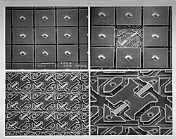
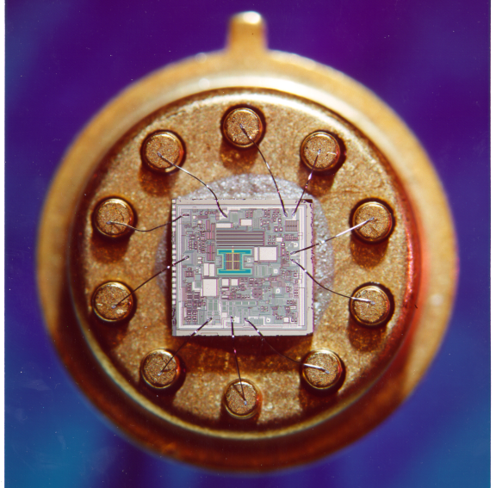

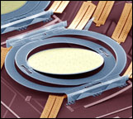
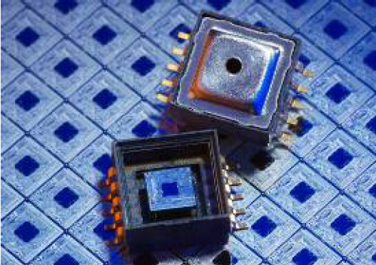
MEMS Commercial Applications
Digital Mirror Device
Texas Instruments
Accelerometer
Analog Devices
Ink Jet Cartridge
Hewlett Packard
Micromirror switch
Lucent Technologies
Pressure Sensor
Bosch MEMS
Courtesy of SNL MEMS Technology short course
Notes:
These are examples of MEMS Technologies which have transformed their market. Every new automobile will have multiple accelerometer, pressure sensors, etc. which can be manufactured cheaply in high volume by MEMS.

Slide 8
MEMS Accelerometer History
2002 – Applied MEMS (now Colibrys) releases low-noise Si-Flex Accelerometer:
+/- 3 g Peak
300 ng/√Hz Noise
1993
1995
1997
1999
2001
2003
2005
2007
2009
1991
1991 – Air Bag Sensor Analog Devices (ADXL50)
+/- 50 g Peak
6.6 mg/√Hz Noise
2006 – Nintendo Wii Controller (Analog Devices ADXL330).
+/- 3 g Peak
350 ug/√Hz Noise
Improvements in performance
2004 – Colibrys VectorSeis Digital 3 Channel Accelerometer
2 – 1000 Hz
+/- 0.335 g Peak
~50 ng/√Hz Noise
2005 – Sercel 428XL-DSU3
2 – 800 Hz
+/- 0.5 g Peak
~40 ng/√Hz Noise

Slide 9
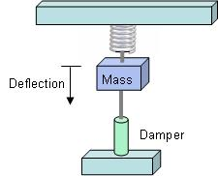
What makes a MEMS Seismometer
A MEMS Accelerometer with:
Low noise floor (ng’s/√Hz)
~1 g upper range
High sensitivity
Modeled as a spring-mass system
Proof mass measured in milli-grams
Bandwidth below the springs resonant mode (noise and response flat to acceleration)

Slide 10
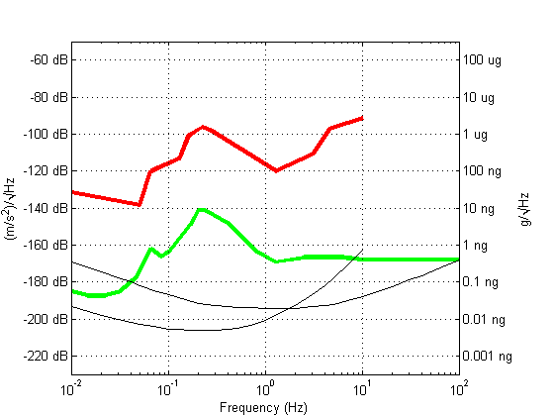
Seismology Requirements
Noise floor
(relative to the LNM)
Peak acceleration
(Strong vs weak motion)
Sensitivity
Linear dynamic range
Bandwidth
(short-period, long-period, broadband)
High
Noise
Model
Low
Noise
Model
Current Best MEMS
SP Target Region
KS54000
GS13
Requirements are ultimately application dependent

Slide 11
Strong Motion Requirements
Many of the strong motion requirements may be met by today’s MEMS Acclerometers:
Noise | < 1 ug/√Hz
Bandwidth | > 1-2 Hz
Peak Acceleration | 1-2 g’s
Dynamic Range | ~100 dB

Slide 12
Weak Motion Requirements
Weak motion requirements are more demanding:
Noise | < 1 ng/√Hz
Bandwidth | SP: 0.1 Hz to 10’s Hz LP: < 0.01 Hz to 1’s Hz BB: 0.01 Hz to 10’s Hz
Peak Acceleration | < 0.25 g
Dynamic Range | >120 dB
There are no MEMS accelerometers available today that meet the weak motion requirements.

Slide 13
Commercially Availability
There are many manufacturer’s of MEMS Accelerometers.
Most are targeted towards consumer, automotive, and industrial applications.
Only a few approach the noise levels necessary for strong-motion seismic applications
Manufacturers
Analog Devices
Bosch-Sensortec
*Colibrys
*Endevco
Freescale
*GeoSIG
*Kinemetrics
Kionix
MEMSIC
*PCB
*Reftek
Silicon Designs
STMicroelectronics
Summit Instruments
*Sercel
*Wilcoxon
*Noise Floor < 1 ug/√Hz

Slide 14
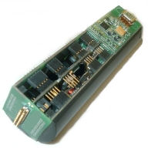
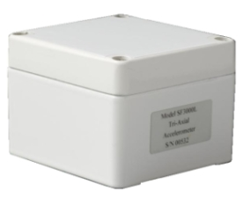
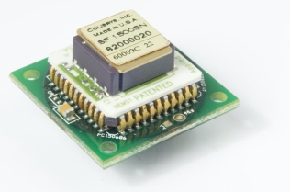
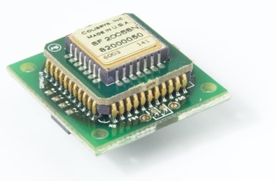
Colibrys
Formerly Applied MEMS, I/O.
Oil & Gas Exploration
Produces VectorSeis which is sold through ION (www.iongeo.com)
Manufacturer | Colibrys | Colibrys | Colibrys | Colibrys
Model | SF 1500 | SF 2005 | SF3000 | Digital-3*
Technology | Capacitive | Capacitive | Capacitive | Capacitive Force Feedback
Output | Analog | Analog | Analog | Digital
Format | Chip | Chip | Module | Module
Axis | 1 | 1 | 3 | 3
Power | 100 mW | 140 mW | 200 mW | 780 mW
Acceleration Range | +/- 3 g | +/- 4 g | +/- 3 g | +/- 0.2 g
Frequency Response | 0 – 1500 Hz | 0 – 1000 Hz | 0 – 1000 Hz | 0 – 1000 Hz
Sensitivity | 1.2 V/g | 500 mV/g | 1.2 V/g | 58 ng/bit
Self Noise | 300 – 500 ng/√Hz | 800 ng/√Hz | 300 - 500 ng/√Hz | 100 ng/√Hz
Weight | Not Specified | Not Specified | Not Specified | Not Specified
Size | 24.4 x 24.4 x 16.6 mm | 24.4 x 24.4 x 15 mm | 80 x 80 x 57 mm | 40 x 40 x 127 mm
Shock Range | 1500 g | 1500 g | 1000 g | 1500 g
Temperature | -40 to 125 ◦C | -40 to 85 ◦C | -40 to 85 ◦C | -40 to 85 ◦C
*discontinued

Slide 15
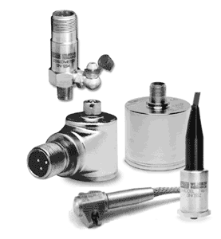
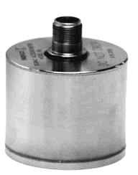
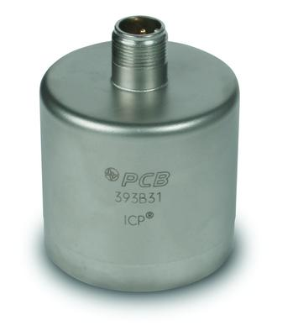
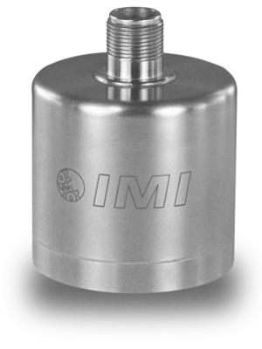
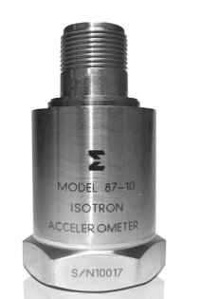
Endevco, PCB, Wilcoxon
Manufacturer | Endevco | Endevco
Model | Model 86 | Model 87
Technology | Piezoelectric | Piezoelectric
Output | Analog | Analog
Format | Module | Module
Axis | 1 | 1
Power | 200 mW | 200 mW
Acceleration Range | +/- 0.5 g | +/- 0.5 g
Frequency Response | 0.003 – 200 Hz | 0.05 – 380 Hz
Sensitivity | 10 V/g | 10 V/g
Self Noise | 39 ng/√Hz @ 2 Hz 11 ng/√Hz @ 10 Hz 4 ng/√Hz @ 100 Hz | 90 ng/√Hz @ 2 Hz 25 ng/√Hz @ 10 Hz 10 ng/√Hz @ 100 Hz
Weight | 771 grams | 170 grams
Size | 62 x 62 x 53 mm | 29.8 x 29.8 x 56.4 mm
Shock Range | 250 g | 400 g
Temperature | -10 to 100 ◦C | -20 to 100 ◦C
Not strictly MEMS, but they are small and relatively low-noise.
All three companies make fairly similar Piezoelectric accelerometers
Industrial and Structural applications

Slide 16
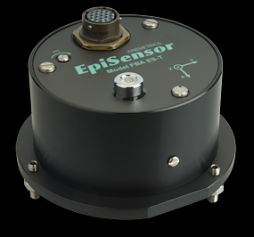
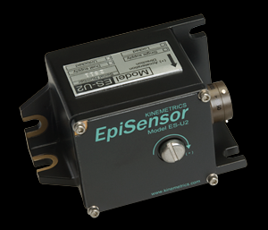
Kinemetrics
Strong motion, seismic measurement
Force Balance Accelerometer
Available in single and three axis configurations
Manufacturer | Kinemetrics | Kinemetrics
Model | EpiSensor ES-T | EpiSensor ES-U2
Technology | Capacitive MEMS | Capacitive MEMS
Output | Analog | Analog
Format | Module | Module
Axis | 3 | 1
Power | 144 mW | 100 mW
Acceleration Range | +/- 0.25 g | +/- 0.25 g
Frequency Response | 0 – 200 Hz | 0 – 200 Hz
Sensitivity | 10 V/g | 10 V/g
Self Noise | 60 ng/√Hz | 60 ng/√Hz
Weight | Not Specified | 350 grams
Size | 133 x 133 x 62 mm | 55 x 65 x 97mm
Shock Range | Not Specified | Not Specified
Temperature | -20 to 70 ◦C | -20 to 70 ◦C

Slide 17

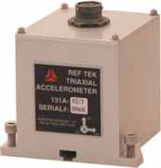
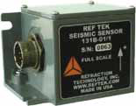
Reftek
Strong motion measurement for seismic, structural, industrial monitoring
Available in single, three axis, and borehole configurations
Manufacturer | Reftek
Model | 131A*
Technology | Capacitive MEMS
Output | Analog
Format | Module
Axis | 3
Power | 600 mW
Acceleration Range | +/- 3.5 g
Frequency Response | 0 – 400 Hz
Sensitivity | 2 V/g
Self Noise | 200 ng/√Hz
Weight | 1000 grams
Size | 104 x 101 x 101 mm
Shock Tolerance | 500 g
Temperature | -20 to 60 ◦C
* uses Colibrys Accelerometers

Slide 18

Sercel
Used in tomography studies for Oil & Gas Exploration
Sold as complete turn-key systems and not available for individual sales
Manufacturer | Sercel
Model | DSU3-428
Technology | Capacitive MEMS
Output | Digital
Format | Module
Axis | 3
Power | 265 mW
Acceleration Range | +/- 0.5 g
Frequency Response | 0 – 800 Hz
Sensitivity | Not Specified
Self Noise | 40 ng/√Hz
Weight | 430 grams
Size | 159.2 x 70 x 194 mm
Shock Range | Not Specified
Temperature | -40 to 70 ◦C

Slide 19
MEMS accelerometers
Advantages
Small
Can be low power, for less sensitive sensors.
High frequency bandwidth (~ 1 kHz)
Disadvantages
Active device, requires power
Poor noise and response at low frequencies (< 1 Hz), largely due to small mass, 1/f noise, or feedback control corner.
Noise floor flat to acceleration, exacerbates noise issues at low frequency (< 1 Hz)

Slide 20
Theoretical Noise
Thermo-mechanical noise for a cantilevered spring
Two main sources of noise:
Thermo-mechanical
Brownian motion
Spring imperfections
Electronic
Electronics
Detection of mass position
Noise characteristics unique to detection technique
Boltzman’s Constant k_{B}=1.38x10⁻²³ J/K
Temperature T = 300 K
Resonant Frequency w_{o}=314.16 rad/s (50Hz)
Quality Factor Q = 1000
Proof Mass m = 1 gram (10⁻³ kg)
a_{n} = 2.3 x 10^-9 m / s² / √Hz
= 0.2 ng / √Hz
Traditional Seismometer | MEMS Accelerometer
Large mass (100’s of grams) | Small mass (milligrams)
Thermo-mechanical noise is small | Thermo-mechanical noise dominates
Electronic noise dominates | Same electronic noise issue as traditional

Slide 21
Detection of mass position
Variety of ways to determine mass-position
Piezoelectric / Piezoresistive
Capacitive
Inductive
Magnetic
Fluidic
Optical (diffraction, fabry-perot, michelson)

Slide 22
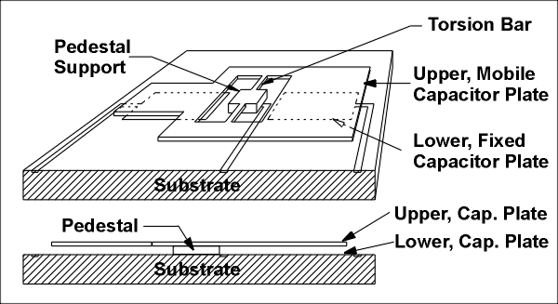
Capacitive Detection
The most common method of mass position detection for current MEMS accelerometers is capacitive.
Capacitance is a weak sensing mechanism and force (for feedback contrl) which necessitates small masses (milligrams) and small distances (microns).
Feedback control employed for quietest solutions. Differential sampling for noise cancelation.
Colibrys bulk-micromachined proof mass sandwiched between differential capacitive plates
Silicon Designs capacitive plate with a pedestal and torsion bar.

Slide 23
R&D Challenges
Large proof mass and weak springs required. This makes for a delicate instrument.
Capacitance less useful as a detection and feedback mechanism for larger masses.
Feedback control required to achieve desired dynamic range and sensitivity.
R&D requires access to expensive MEMS fabrication facility
1/f electronic noise could limit low-frequency

Slide 24
DOE Funded R&D Projects
Several posters on display
Additional details and proceedings available at http://www.monitoringresearchreview.com/
Characteristics:
Significantly larger proof mass (0.25 – 2 grams)
Non-capacitive mass position sensing (inductive, optical, fluidic)
Feedback control

Slide 25
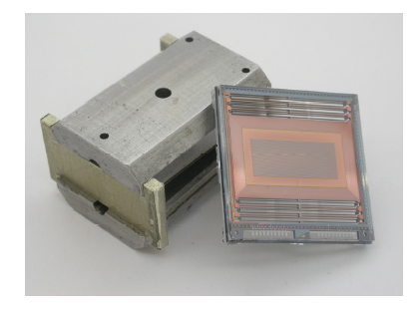
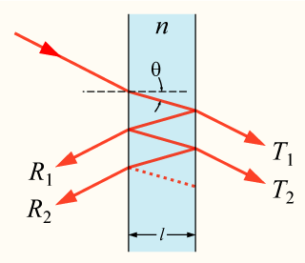
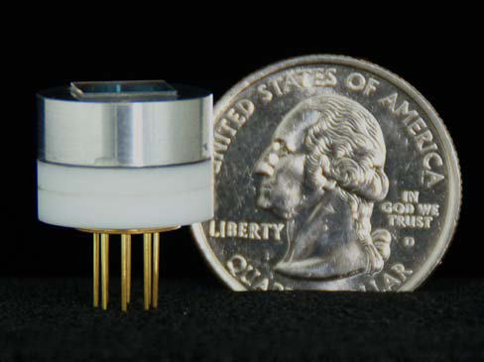
DOE Funded R&D Projects
Kinemetrics / Imperial College
Inductive coil with force feedback
Proof mass of 0.245 grams
0.1 - 40 Hz bandwidth, resonant mode at 11.5 Hz
Demonstrated noise performance of 2-3 ng/√Hz over 0.04 – 0.1 Hz, higher noise at frequencies > 0.1 Hz
Symphony Acoustics
Fabry-Perot optical cavity
Proof mass of 1 gram
0.1 - 100Hz bandwidth
Demonstrated noise performance of 10 ng/√Hz
Theoretical noise performance of 0.5 ng/√Hz

Slide 26
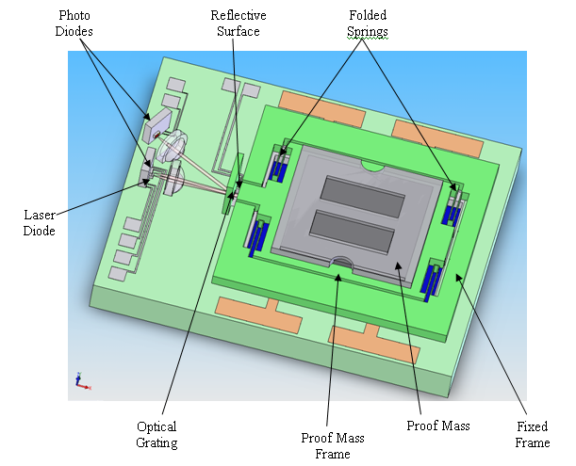
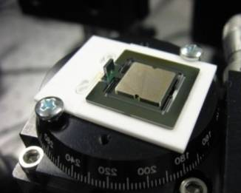
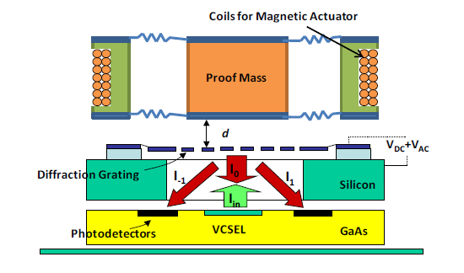
DOE Funded R&D Projects
Sandia National Laboratories
Large proof mass (1 gram, tungsten)
Meso-scale proof mass with MEMS diffraction grating and springs.
Optical diffraction grating
Theoretical thermo-mechanical
noise 0.2 ng/√Hz over 0.1 to 40 Hz
Photo Diodes
Reflective Surface
Folded Springs
Optical Grating
Proof Mass Frame
Proof Mass
Fixed Frame
Silicon Audio
Large proof mass (2 gram)
Meso-scale construction with MEMS diffraction grating
Optical diffraction grating
0.1 to 100 Hz target bandwidth
Theoretical thermo-mechanical noise 0.5 ng/√Hz over 1 to 100 Hz

Slide 27
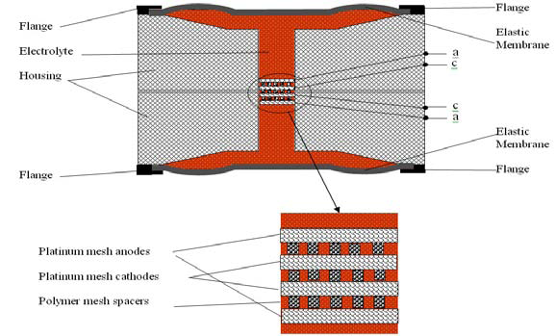
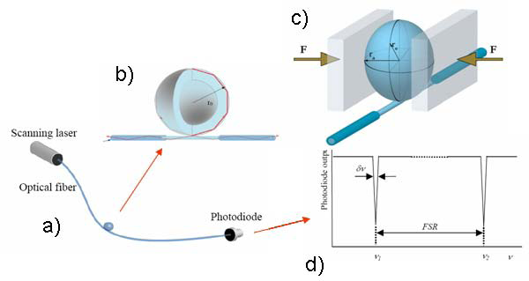
DOE Funded R&D Projects
PMD Scientific, Inc.
Electrochemical fluid passing through a membrane
Theoretical noise 0.5 ng/√Hz over 0.02 to 16 Hz
Michigan Aerospace Corp.
Whispering Gallery Seismometer
Optical coupling between a strained dielectric microsphere and an optical fiber
Theoretical noise of 10 ng/√Hz

Slide 28
5 year outlook
Over the next 5 years, there is a strong potential for at least one of the DOE R&D MEMS Seismometer projects to reach the point of commercialization.
This would mean a MEMS Accelerometer with:
a noise floor under the < LNM (~ 0.4 ng/√Hz)
Bandwidth between 0.1 and 100 Hz,
> 120 dB of dynamic range
small ( < 1 inch^3).
Low power (10’s mW)

Slide 29
Enabling Applications
Flexible R&D deployments
Why simply connect a miniaturized transducer onto a traditional seismic system?
Will require highly integrated packages:
Digitizer
Microcontroller
GPS
Flash storage
Communications
Battery
Power Source
Antenna
Battery Backup
Radio / Ethernet
orientation
Microprocessor
Data Retrieval
Algorithms
Communications
Storage
Waveforms
Parameters
Detection templates
Compass
GPS
location, time
waveform
time series
3-axis
Accelerometer

Slide 30

10 year outlook
MEMS Accelerometers have only been commercially available for ~18 years.
Where were things 10 years ago?
Further expansion into long period (~ 0.01 Hz)
Small, highly integrated seismic systems

Slide 31
Questions?

