Slide 1
Long-Period Seismometry
Jonathan Berger
Institute of Geophysics and Planetary Physics
Scripps Institution of Oceanography
University of California San Diego

Slide 2
Basics
Measure motion of Earth’s surface relative to some inertial reference frame
Applied to a mass-on-a-spring suspension, in the Laplace domain:
Notes:
I start with just a reminder of the simple model of a seismometer as a mass on a spring; a simple damped harmonic oscillator.
The acceleration of the earth’s surface applies a force to the sensor’s mass producing motion. The constant G depends on the moment of inertia of the test mass.
A transducer converts this motion to an electrical or optical signal which can be recorded.
Of Course, real seismometers are more complicated than this but the model serves to illustrate the important elements of the mechanical suspension.

Slide 3
For frequencies much smaller than the resonant frequency, ω₀ , mass position is proportional to ground acceleration.
The smaller the resonant frequency the larger the mass motion for a given ground acceleration.
Notes:
Making a suspension with a free period of a few seconds or shorter is easy.
Making stable suspensions with free-periods longer than say 10 seconds is non-trivial.

Slide 4
WHAT ARE THE REQUIRMENTS?
What do we want to measure - SIGNALS
How accurately do we want to measure – RESOLUTION
Over what frequencies do we want to measure - BANDWIDTH
Notes:
These are the basic requirements for any seismometer.
Of course there are many other requirements that must be considered like linearity, directionality (cross-talk among orthogonal components of the ground motion),. etc

Slide 5
What Bandwidth is Required
Gravest Normal Mode – 0.3 mHz
Top end of Teleseismic signals ~ 1 Hz
Top end of Regional Signals ~ 10 Hz
Top end of Strong Motion ~ 30 Hz
Notes:
Normally, the lowest frequency of propagating elastic energy is taken to be that of the lowest frequency normal mode ₀S2
But there are other phenomena with longer periods such as the yet to be observed “Slichter” mode and, of course earth tides with principal components at 11 and 22 µHz.
There are effects of pressure variations in the atmosphere, ocean loading effects, and slow motions due to tectonic forces.
And who knows what is yet to be discovered in this long-period continuum.

Slide 6
WHAT IS THE REQUIRED RESOLUTION?
WHAT IS THE EARTH’S AMBIENT NOISE FIELD?
LOOK AT LOWEST OBSERVED NOISE LEVELS TO ESTIMATE REQUIRED RESOLUTION - A MOVING TARGET
Notes:
A good instruments should be able to clearly resolve the ambient noise field so that one has a hope of observing new signals that are masked by what we think of as noise.
50 years ago, the observation of the Earth’s normal modes excited by huge earthquakes were just barely possible.
Now with improved instruments is routine for even moderate quakes.
The Earth’s hum is a good recent example of “noise” turning out to be signal.

Slide 7
NOISE

Slide 8
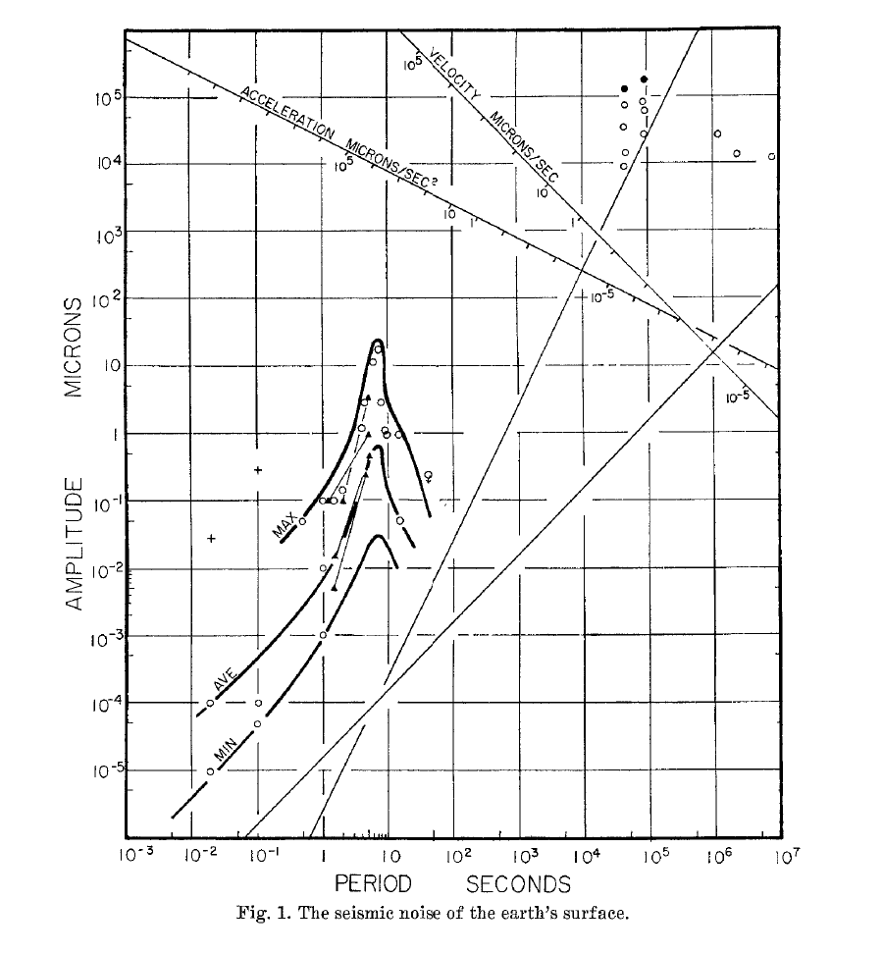
Brune & Oliver, 1959
“There are virtually no data on noise in the range of periods between 20 seconds and the earth tide periods.”
Notes:
As late as 1960 there were very few instruments capable of observing background noise a periods beyond about 20 seconds.
It was actually the interest of governments in detecting and characterizing underground nuclear tests that spurred the interest in long period seismic waves and consequently support the development of appropriate instruments.
With the signing of the 1963 Limited Test Ban Treaty (LTBT) which banned atmospheric & oceanic testing this area of seismology got serious support for nearly a generation to address the problems of detection and discrimination.

Slide 9
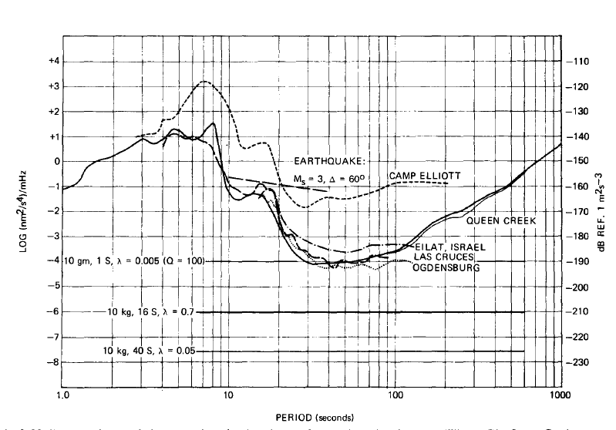
Melton, 1976
Notes:
So by the mid-70s there were a new generation of instruments capable of beginning to push back the “noise” frontiers across most of the seismic band.
This summary by Melton indicates the state of knowledge at that point in time. Notice that there are only 5 stations’ data in this plot.
Also is theoretical thermal noise of some existing seismometers.

Slide 10
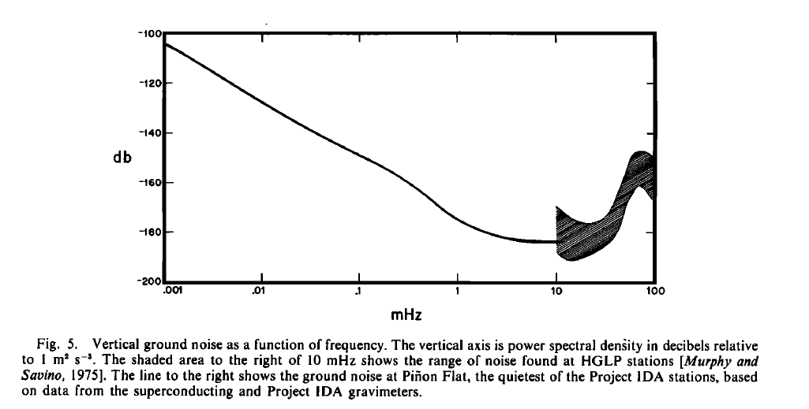
Agnew & Berger (1978)
Notes:
In 1974, a network of modified LaCoste gravimeters (vertical-component seismometers) , the IDA global network, was begun. By 1978 there were enough stations (9) to be able to develop a new long-period noise estimate here shown extending to 1 µHz.

Slide 11
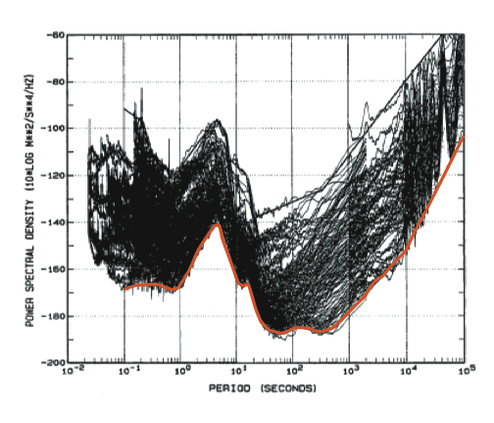
Peterson 1993
(aka USGS NLNM)
Notes:
By the early 90’s with the deployment of the IRIS Global Seismographic Network there were enough stations with global distribution to begin to apply statistical analysis to the noise observations.
The study undertaken by Jon Peterson at the USGS ASL analyzed the data from some 75 stations. Carefully choosing epochs with no large earthquakes or obvious artifacts in the records, he produced collection of spectral estimates.
The envelope of the minimum, as indicated here, become known as the USGS (or Peterson) New Low Noise Model that covered the entire seismic band.

Slide 12
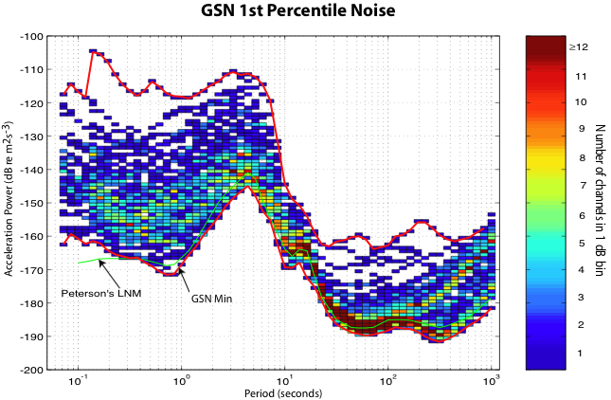
Notes:
With the development of the IRIS data management center, the availability and access to a large collection of seismic data, particularly from the GSN was such that is was fairly easy to analyze very large quantities of data to develop robust statistical estimates.
118 GSN stations for the year 2001-2002.
In this analysis some 738,000 hourly spectral estimates were used to characterize the ambient noise field.
Noise estimated in 50% overlapping 1/7 decade (∂f/f=0.33, ~1/2 octave) bands.
Binning each frequency estimate allows the estimation of statistics at each station and across the network as a whole.
Here the network wide 1st percentile is shown with the old new low-noise model of Peterson.
You can clearly see significant differences between these models.

Slide 13
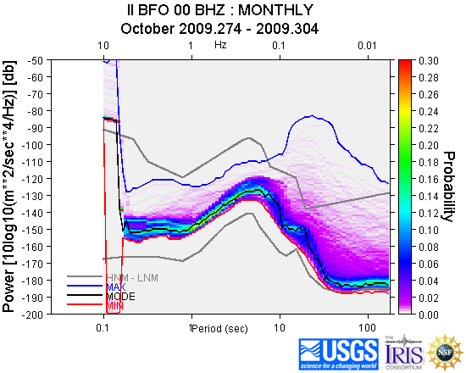
Routine Noise Estimation
Notes:
Using similar techniques on a station-by-station basis now provides valuable diagnostic tool for network operators to monitor seismometer state of health and for data users to understand the data limitations for a particular station during a particular epoch.

Slide 14

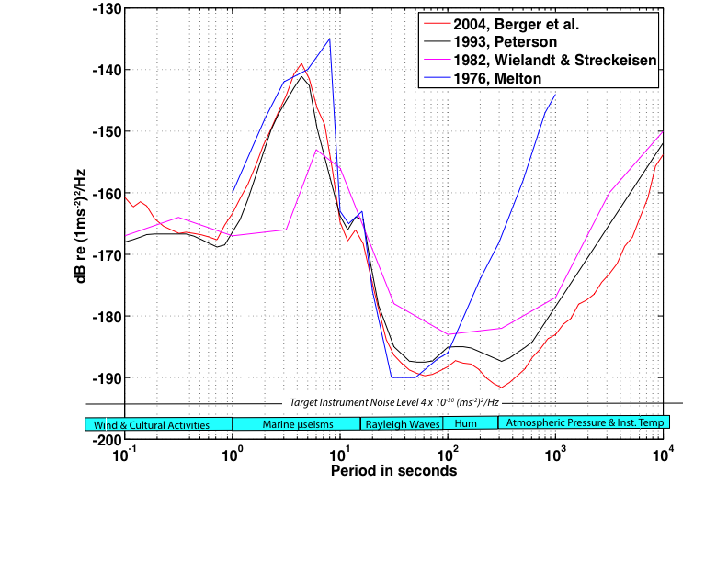
Evolution of Noise Models
Notes:
So here’s the evolution of the estimates of the Earth’s ambient noise field over time.
Not that the real field evolves but we can see presumably how instruments have improved particularly in the long period part of the spectrum.
I also indicate in the plot what we think are the principal sources on the ambient field.
So the end of all this is to indicate what would be a good long-period instrumental noise level – sufficiently below the current noise estimates to offer some hope of seeing new phenomena.

Slide 15
Want to resolve 4 x10⁻²⁰(m²s⁻⁴)/Hz
Which at long periods corresponds to
rms. mass displacement = 5 x⁻¹² * P₀² m/√Hz
[Radius of H atom ~ 4x10⁻¹¹ m]
Notes:
Okay, so say we wanted to be able to resolve the target power level.
What mass motion need we resolve?
Now we can clearly see the advantage of a long=period suspension.

Slide 16
Thermal Issues
Thermal noise of a damped harmonic oscillator
Thermal expansion of seismometer suspension
Thermoelastic effect of seismometer spring
Environmental protection
Notes:
In addition to the challenge of detecting small motions of the test mass, we have to consider thermal effects.
First there is the thermal noise that has its source in the total damping of test mass, mechanical or electrical.
Next there is the effects of geometry changes in the seismometer structure due to thermal expansion.
Finally there are effects due to the thermal coefficient of young’s modulus that effects the restoring force of the spring. This is of particular importance in a vertical component seismometer where the static force of gravity must the balanced by the suspension spring.
The latter two effects lead to the need for good environmental protections which in turn leads to requirements on the stations construction…

Slide 17
Where
K – Boltzmans Constant
T – Temperature in Kelvin degrees ~ 290K˚
m – Mass (kg), P₀ – Free Period (s)
Q – Quality Factor of spring (damping)
Example, m= 0.5kg, P₀ = 10s, Q= ½ mP₀Q = 2.5
Thermal Noise = 4 x 10⁻²⁰ (ms⁻²)²/Hz
Notes:
Here is the theoretical thermal noise of a damped harmonic oscillator.
At room temperature the TN is about 10-19/MPQ in acceleration power units
For an undamped HO, of course there would be no thermal noise as Q would be infinity.
For a given Q, the longer the period, the lower the thermal noise.
And of course the larger the mass the lower the TN.
Note that for a micro-mass one would need a extremely Q to get the TN down to a required level. For example, a proposed MEMS design has a mass of 2.6e-4 kg, P0 = 0.1 and Q =330 so that TN ~ 10-17 acc power units.
One would need to increase Q to about 33000 to get the required TN!

Slide 18
Temp coefficient of seismometer “material” > 10⁻⁵/C˚
Want to resolve long-period accelerations ~ 10⁻¹¹ ∂g/g
Implies temperature stability ~ 1 µC˚
How to get µC˚ temperature stability?
Thermostating is impractical.
Want to minimize seismometer’s ability to exchange thermal energy with its surroundings.
Vault, borehole, enclosure, …
Notes:
The second thermal effect of concern is the thermal coefficient of the suspension.
That is a combination of the thermal expansion of the seismometers structure itself.
And the thermal effect on Young’s modulus of the spring material.
The former say for an aluminum structure is about 2 x e-5 /C˚
For special spring materials such as Ni-SPANc or Elinvar (for which earned the discoverer a Nobel prize). It is also on the order of 10-5/C˚

Slide 19
Where u = u(t, x, y, z) is temperature as a function of time and space.
α - Thermal Diffusivity in m²/s = κ/ρ c_{p}
Substances with high thermal diffusivity rapidly adjust their temperature to that of their surroundings, because they conduct heat quickly in comparison to their volumetric heat capacity or 'thermal bulk'.
- Thermal conductivity in W/m.K˚
c_{p} – Volumetric Heat Capacity in J/m³.K˚
Notes:
So lets recall some basic physics. The Heat Flow equation.
We want to attenuate the effects of temperature changes at seismic frequencies and so
We want to find materials with a low thermal diffusivity in order to low-pass filter the temperature changes felt by the suspension.

Slide 20
Thermal Time Constant
The time constant for heat applied at the surface of a 1-D insulating body with thermal diffusivity α to penetrate a distance L

Slide 21
STS1 Suspension
Spring is a bi-metal structure designed to reduce temperature effects.
Observed TC of suspension ~ 3.5 x 10⁻⁵ m/C˚or, with a free period of 20 s ~ 4.5 x 10⁻⁶ ms⁻²/C˚
To resolve long-period rms of 10⁻¹⁰ ms⁻² we need long-period temperature stability of ~20 µC˚
Notes:
We set up an experiment to determine the basic TC of the STS1 suspension. Imposing a slow temperature step of about 2 C˚ and monitoring the mass motion interferrometrically, we observed a TC of 3.5e-5 m/C˚

Slide 22
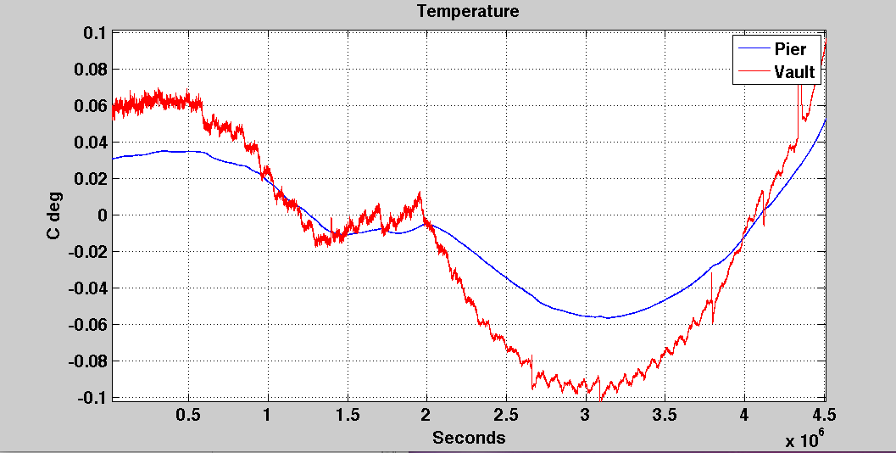
Temperature in the Pinon Flat Observatory Vault
Notes:
To give you some idea of the thermal environment in a good underground seismic vault I show this record of temperature over a 53 –day period in the seismic test facility at Pinon Flat Observatory.
The “vault” is an underground room buried under a few meters of soil. The record marked “pier” was taken on the seismic pier is at a depth of about 7 m.
Inside a “LastAFoam” enclosure about 10 cm thick.

Slide 23
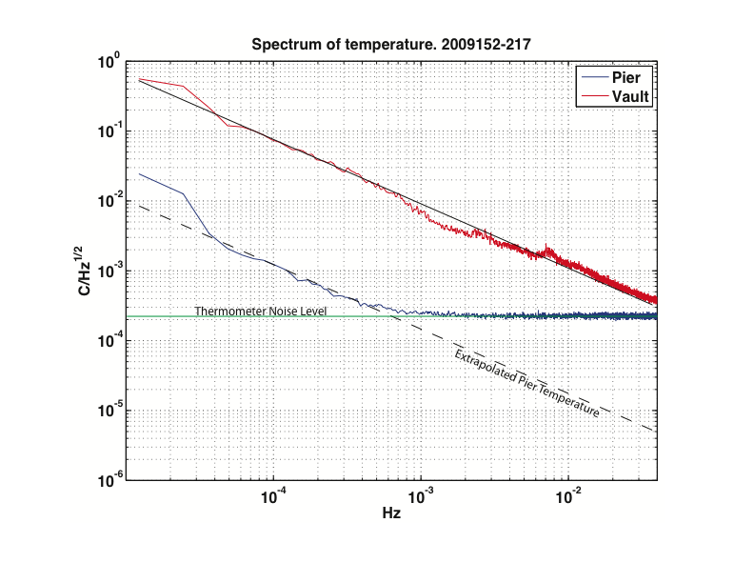
5 x 10⁻⁵
5 x 10⁻⁶
Acceleration ms⁻²/√Hz
5 x 10⁻⁷
5 x 10⁻⁸
5 x 10⁻⁹
Target 10⁻¹⁰ ms⁻²
5 x 10⁻¹⁰
5 x 10⁻¹¹
Notes:
Here is the spectrum of those temperature records. The thermometer can only resolve about 50µC˚
From the extrapolation we suspect that, with the measured TC of the STS1` suspension and a period of 20 seconds, we are probably going to be dominated by thermal contamination for periods longer than about several hundred seconds.
But a caveat is that the measured temperature is not the seismometer temperature.

Slide 24
SIGNALS
Notes:
Enough of Noise already!

Slide 25
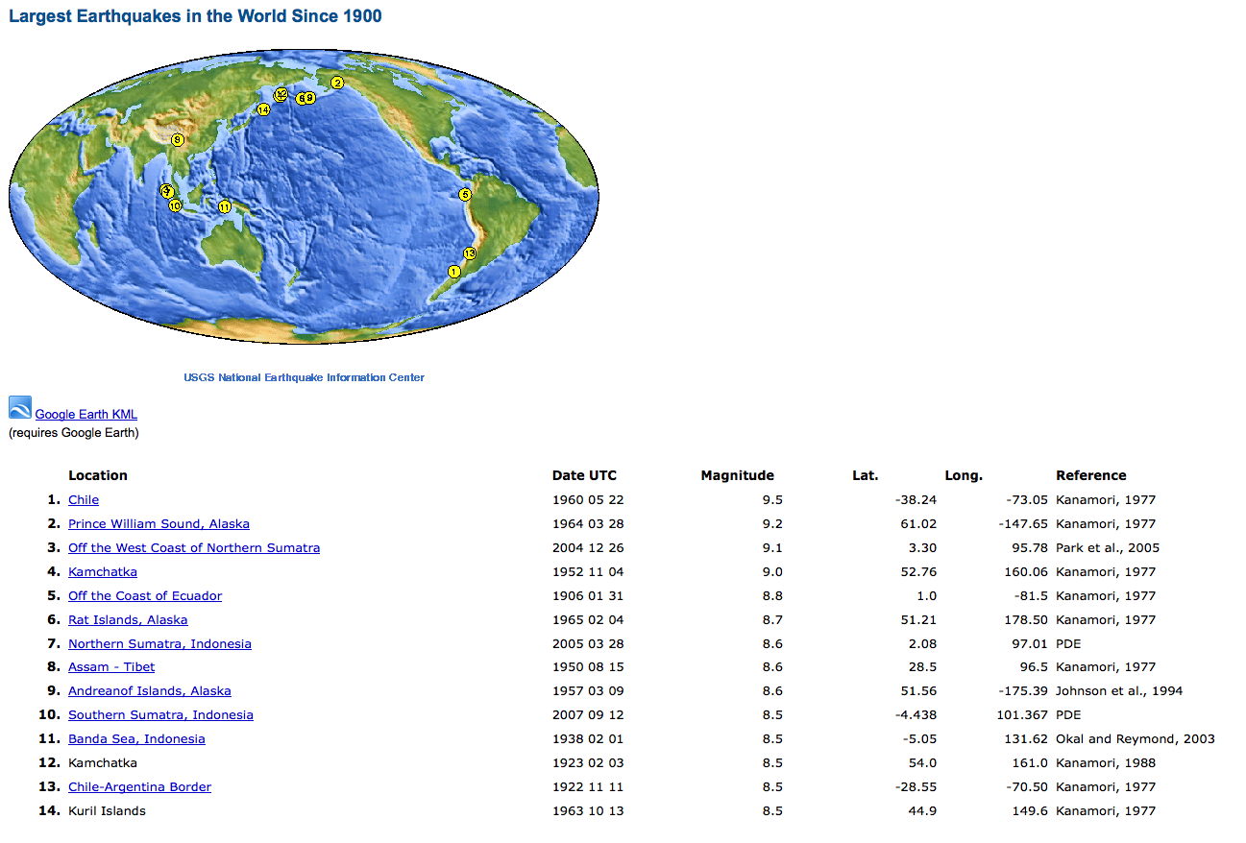
Earthscope - Permanent Array
Prior to 1969 there were only a handful of Normal Mode observations, all from earthquakes > Mw 8.5
Notes:
But enough observations were made to whet the appetite of the theoreticians who began to develop quite accurate codes to predict the frequencies and eigenfunctions of the various modes. By the late 60s, normal mode theory had far outpaced observations.

Slide 26
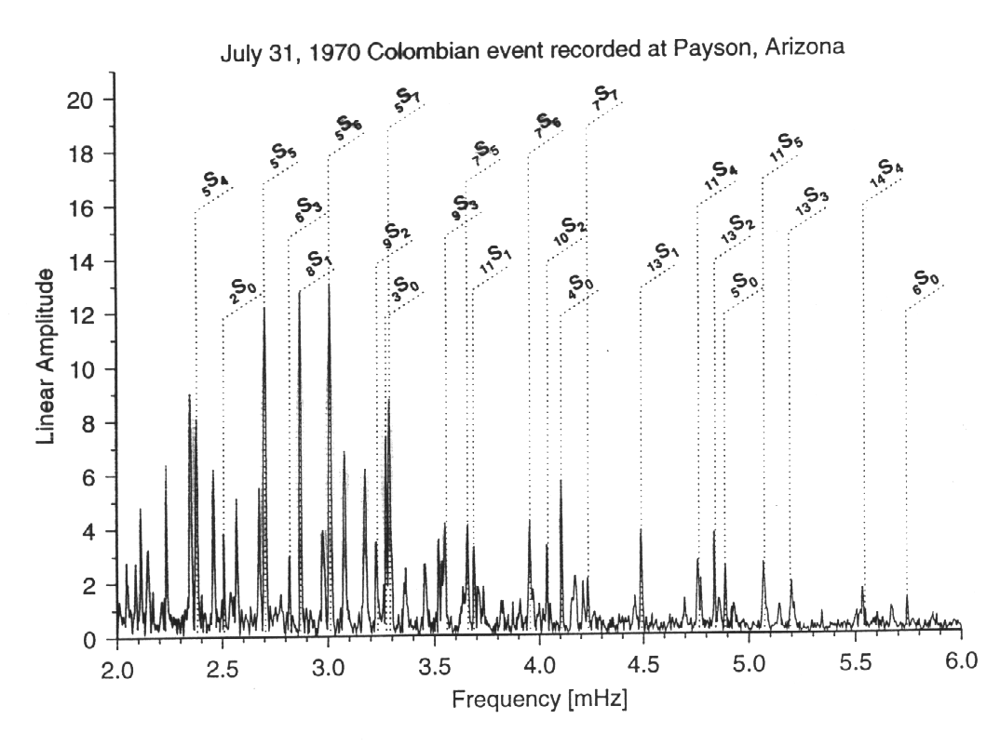
1970 Columbia Earthquake Mw 8.0 produced first observations of mode overtones using LaCoste gravimeters modified with feedback for electronic recording.
Notes:
These observations were obtained by a modified LaCoste gravimeter set up in Arizona to study the effects of tidal loading in the Gulf of California.
Bill Farrell, a graduate student at the time had just installed the instrument near Payson, recording on adding matching paper at one sample every 10 minutes. On returned to San Diego from the installation field trip, he was met by Freeman Gilbert who had just received word of a large deep-focus earthquake under Columbia, and sent packing back to Payson to increase the sample rate to 10 seconds and stand by with additional paper rolls.
This led to the first observations of mode overtones and provided the impetuous to deploy a global network of such instrumentation which became known as Project IDA after Ida Green who with her husband Cecil endowed the project with much of the instrumentation.

Slide 27
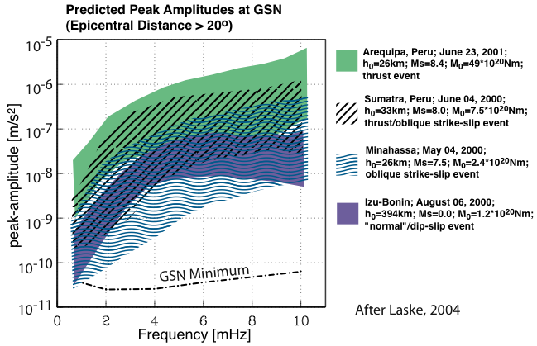
Now routine processing Mw > 6.6
Notes:
So in the intervening period we have progressed for just being able to see modes from Mw 8.5 earthquakes to routine processing of most Mw 6,6 and greater events.
And, of course we have a global network, the GSN and its Data Centers to provide easy and rapid access to the records.

Slide 28
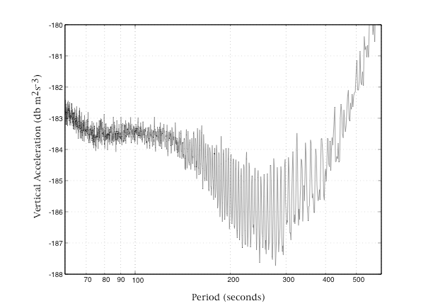
Earth Hummmmm
In 1998, almost forty years after the initial attempt by Benioff et al (1959), continuous free oscillations of the Earth were finally observed.
Earth is constantly excited by spheroidal fundamental modes between about 2 and 7 mHz (from ₀S₁₅ to ₀S₆₀) with nearly constant acceleration and are about 3 – 5 x 10⁻¹² ms⁻².
Notes:
Incidentally the 1959 investigation team was composed of
Hugo Benioff, Chris Harrison, Lucien LaCoste, Walter Munk, and Louis Slichter!
If they couldn’t find the hum, no wonder nobody looked again for 40 years.
Good example of the old adage “One persons noise is another persons signal”

Slide 29
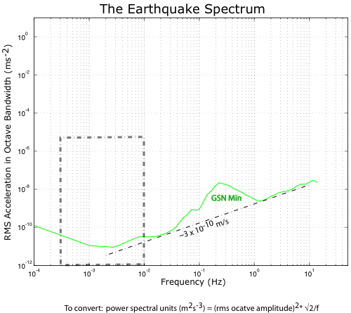
Period: 0.3 to 10 mHz
Amplitudes: to ~10⁻⁵ ms⁻²
(“Slichter” Mode: 35 – 70 µHz ?)
Normal
Modes
Notes:
Note that in this and the next series of plots I use the RMS acceleration averaged over a one-octave bandwidth. In these units a constant Velocity of 3 x 10⁻¹⁰ m/s
Skirts along the GSN noise model.
This is one argument for having the output of broadband seismometers proportional to ground velocity

Slide 30
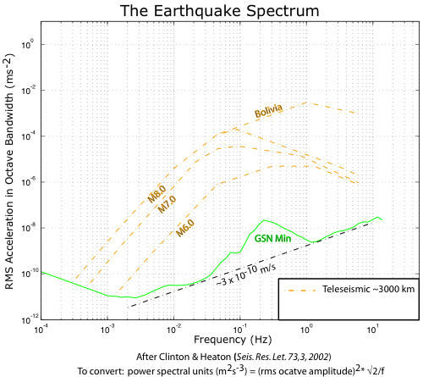
Sources >_ 3000km
Period: a few mHz to several Hz
Amplitudes: to ~10⁻³ ms⁻²
Notes:
If we look at the individual elastic wave packets arriving at a station at teleseismic range, > 3000Km we begin to delineate the seismic spectrum

Slide 31
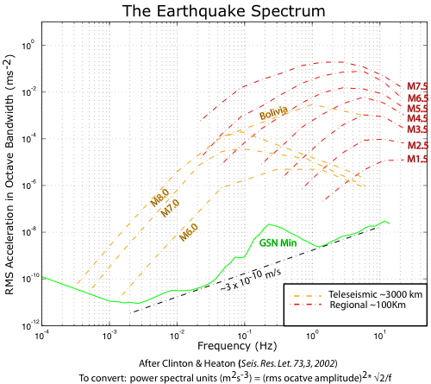
Sources >_ 100km
Period: a few 10’s s to ~10 Hz
Amplitudes: to ~10⁻¹ ms⁻²
Notes:
In fact some of the largest signals likely to be observed are from crustal phases at regional distances. For example a recent M 6.9 EQ in the Gulf of California observed at PFO some

Slide 32
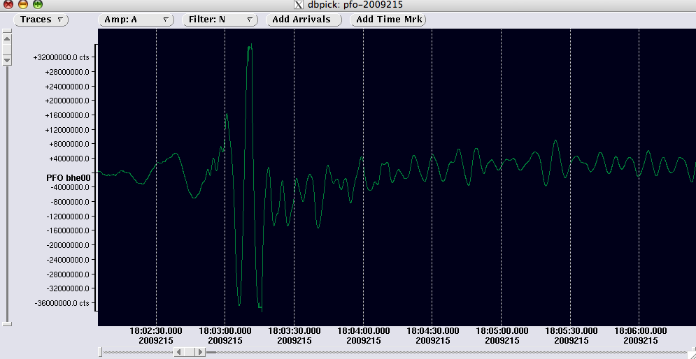
Lg Phase observed at PFO, M6.9, Distance 630Km
Clip Level
Clip Level
Notes:
Raw counts from STS1 recorded on Q300HR. Clip level is

Slide 33
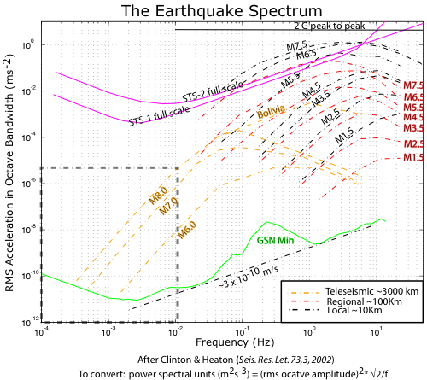
Sources >~10km
Period: a few seconds to ~30 Hz
Amplitudes: to ~10 ms⁻²

Slide 34
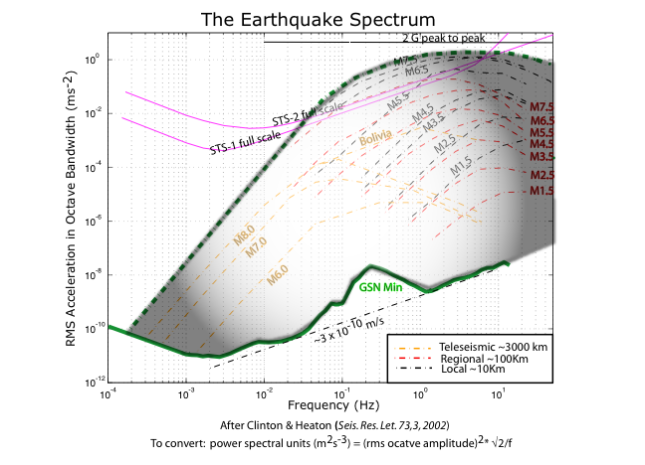
220 dB
Notes:
So a broadband seismometer to record the seismic spectrum needs about 220dB of dynamic range to resolve ground noise at 300 seconds and local earthquakes at a few Hz.

Slide 35
Instruments

Slide 36
Feedback Model
Mass Motion
Ground Acceleration
Suspension
Displacement Xducer
Mass forced to oppose ground acceleration
Forcer
Feedback Controller
Acceleration
√elocity
Notes:
Since at least the 70’s, feedback in seismometers has been the norm. The advantages are manifold and the draw-backs few.
Limits the dynamic range and linearity requirements of the displacement transducer as the test-mass displacement is reduced by gain of feedback loop
Can easily shape overall response to compensate for suspension free period and Q
Can provide electrical outputs proportional to displacement, velocity, or acceleration
Nonetheless it is worthwhile to recall the feedback is a feature not a requirement of a good seismometer.

Slide 37
Commercial Broadband Seismometers
Notes:
Here’s a summary of the most popular high-quality broadband seismometers used today.

Slide 38
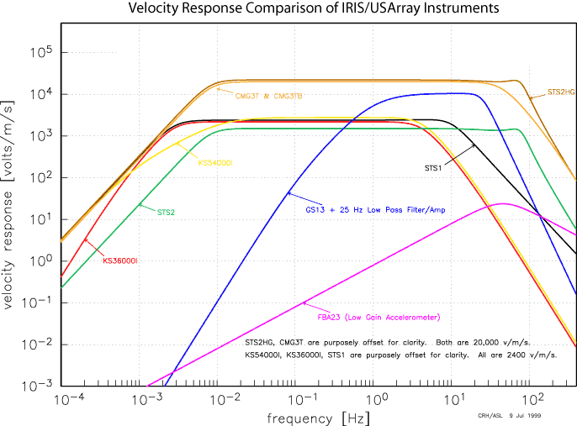

Slide 39
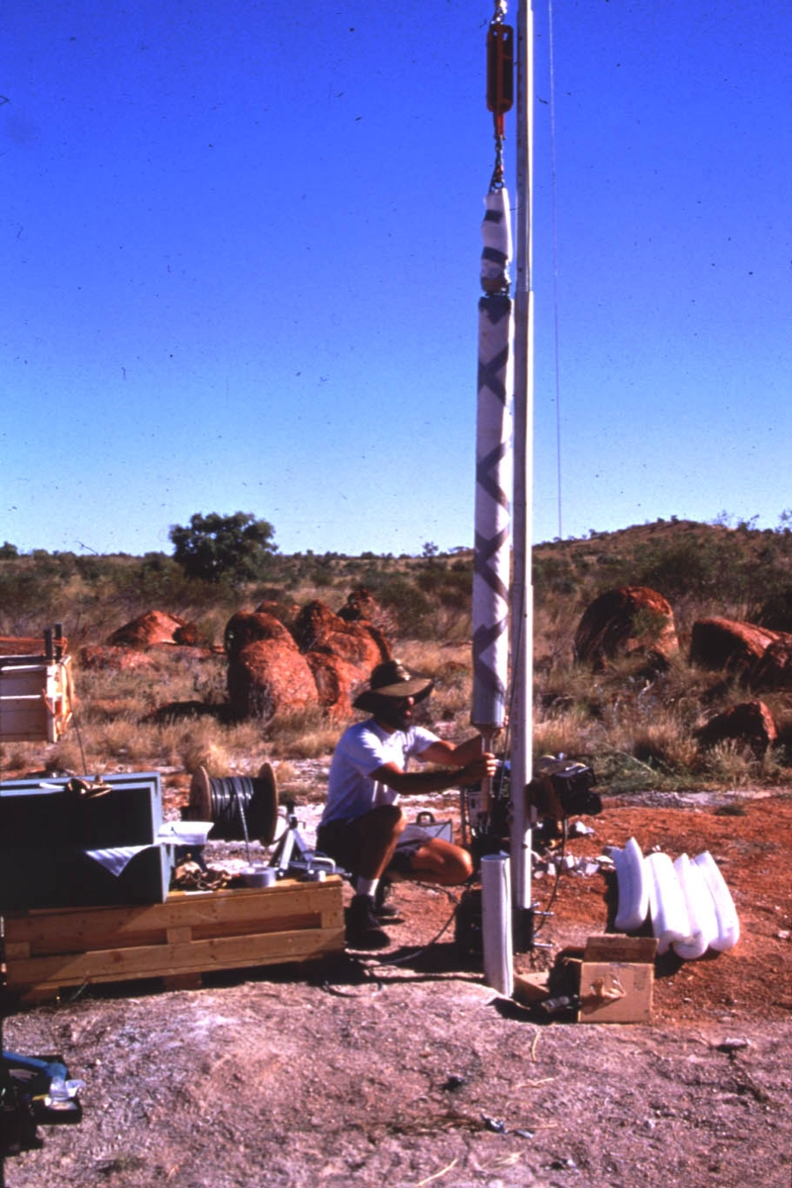
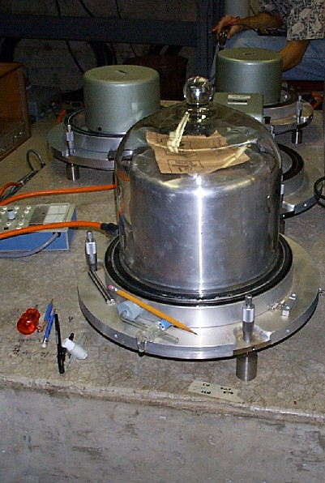
STS1 with bell jar
KS54000 ready to go
down WRAB Borehole

Slide 40
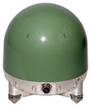
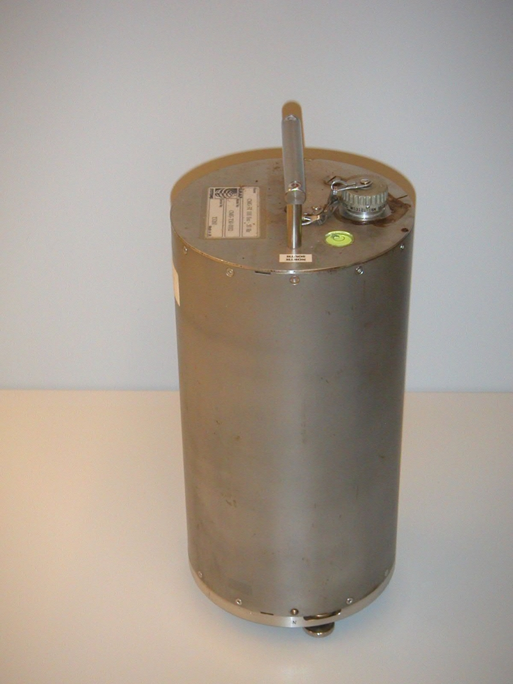
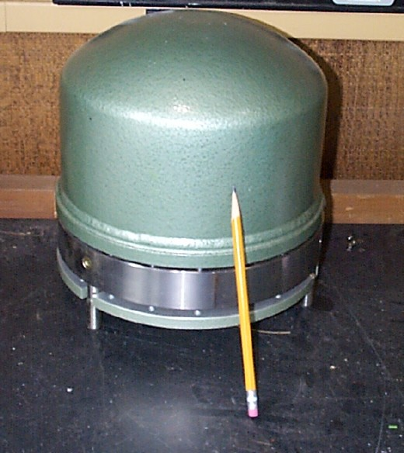
Trillium 240
CMG-3T
STS-2

Slide 41
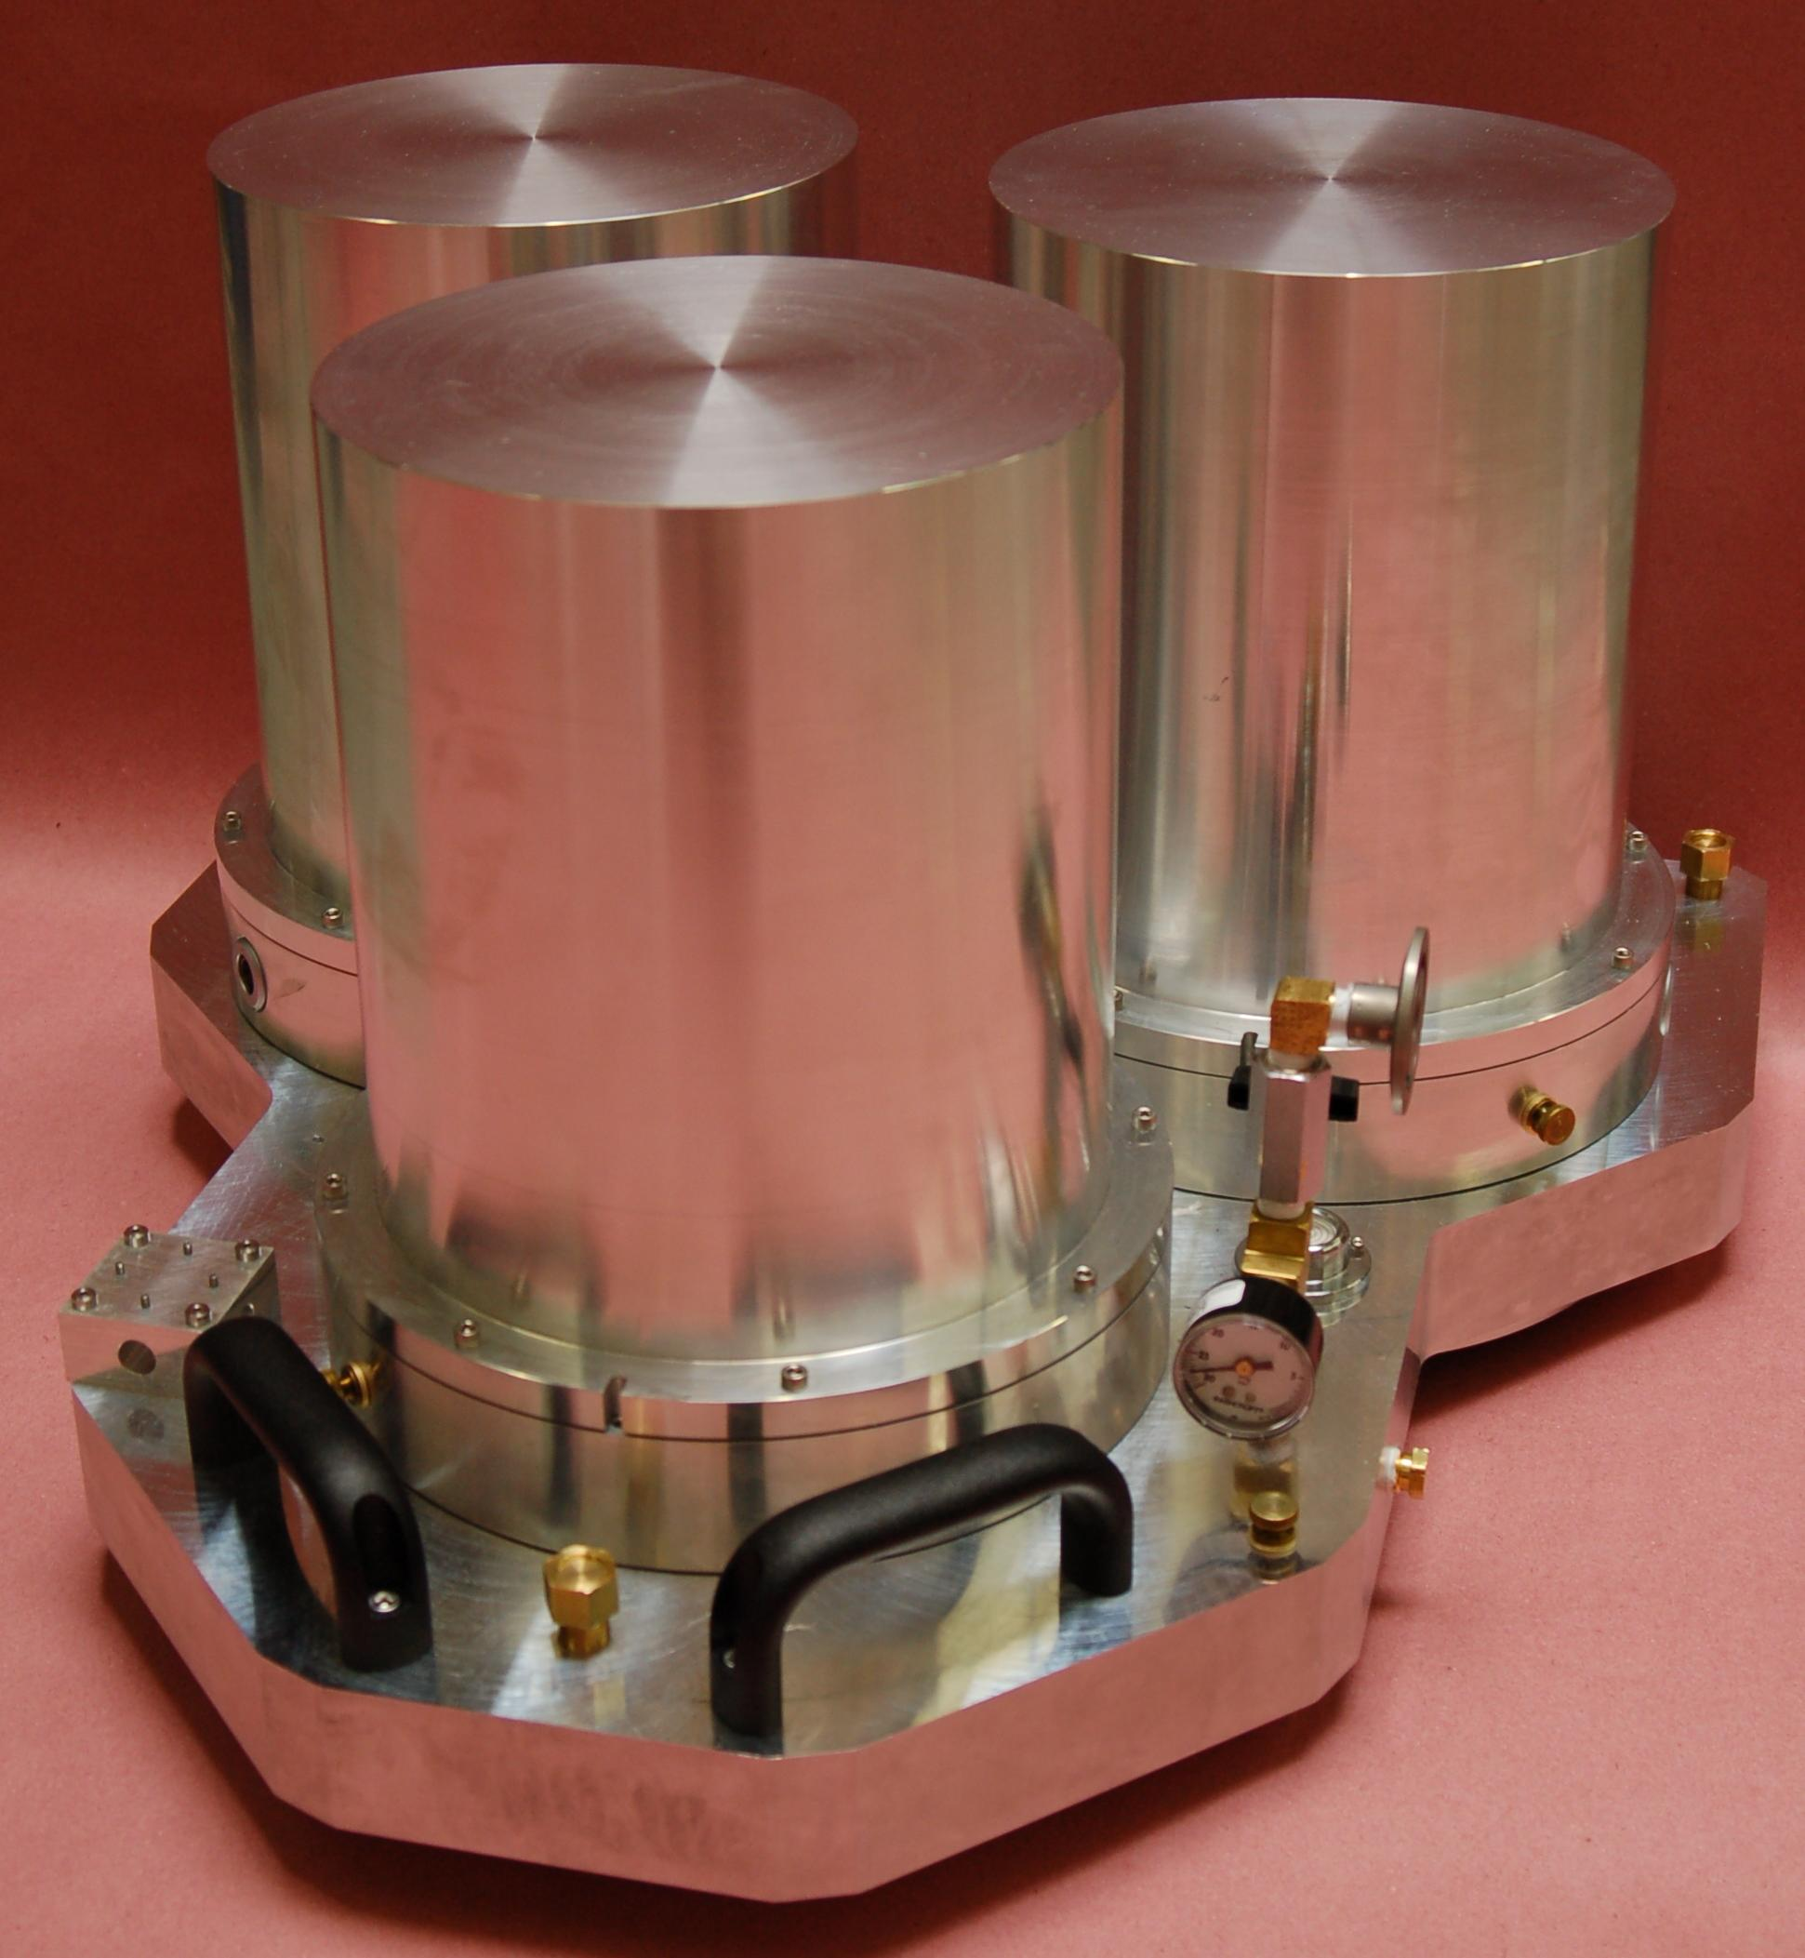
Some Features of the New version STS-1
Non-Galperin: Separate H and V Sensor Designs
Factory-Leveled: Plug and Go in Leveled Package
360 Second to 15 Hz Passband
Self-Noise Comparable to Original Sensors
Incorporates Wielandt/ASL “Warpless Baseplate” Design
Three Aluminum Vacuum Chambers on Single Baseplate; All-Metal Valve
Integrated Magnetic Shield for V Sensor
Galvanic Isolation from Pier
See Poster by VanZandt

Slide 42
Interferometric Seismometer
Interferometric Displacement Transducer
Large Bandwidth & Dynamic Range
No Feedback; No enclosed electronics; No Electrical Connections
Capable of operating in extreme temperatures
See Poster by Otero et al.

Slide 43
Station Requirements for Long Period Observations
Good thermal stability
Solid rock foundations for local tilt suppression
Far from coast (Yet island stations are required)
Human Factor ….
Notes:
Local tilt considerations – topography and strain-tilt coupling.
Human factor includes technical ability of operator/mainter,
Keeping interest
Making station relevant to local hosts (scientifically if possible else monetarily)

Slide 44
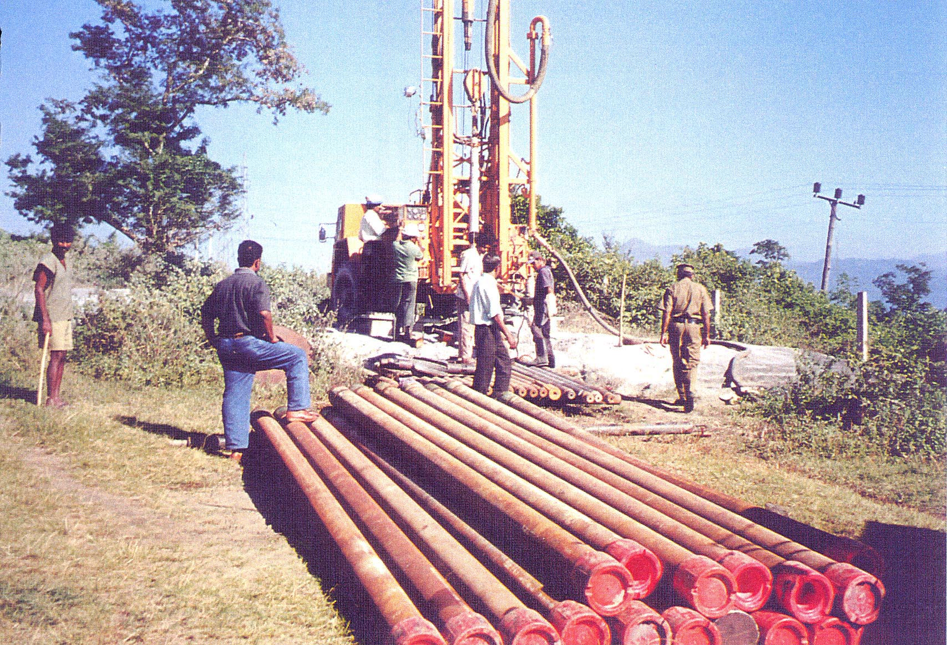
The GSN Station PALK
100m, steel-cased, Borehole
Notes:
One way of providing a suitable environment is to use a borehole seismometer.
Practice is to drill about 100m and cement in a steel casing sealed at the bottom.
Usually an expensive undertaking, especially in places where appropriate technology is unavailable – particularly islands
Borehole seismometer tends to be complex and expensive with its down-hole leveling and orientation mechanisms.

Slide 45
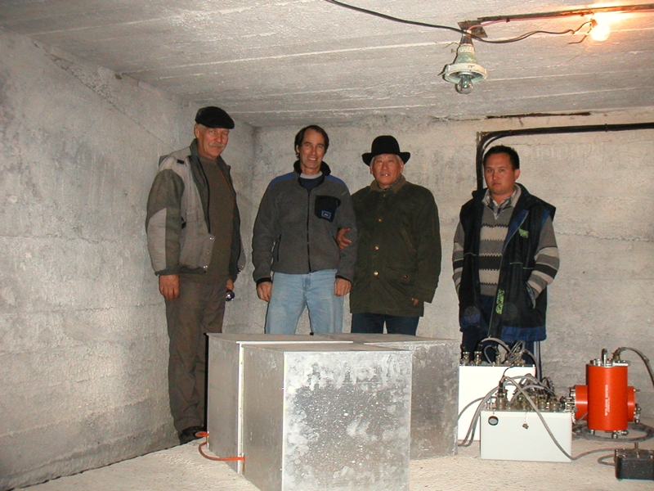
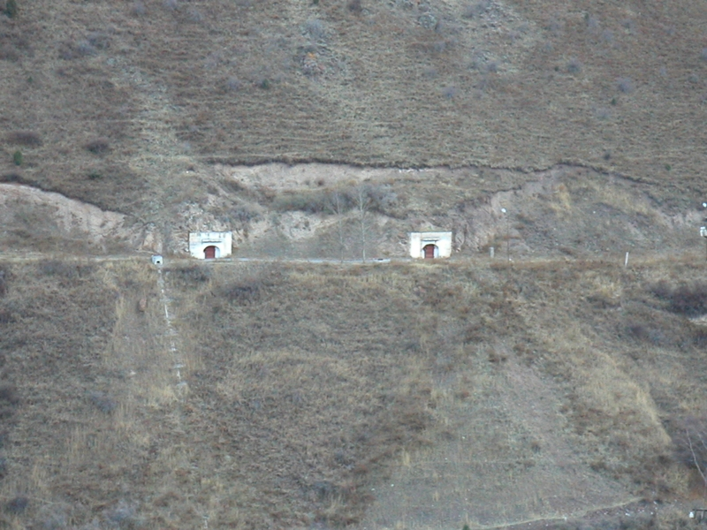
The GSN Station AAK
The tunnel entrance
The GSN Station AAK
One of the vaults
Notes:
Another method is to drive a horizontal shaft into a hillside. This can be done with normal constructions methods and technology,
But still expensive

Slide 46
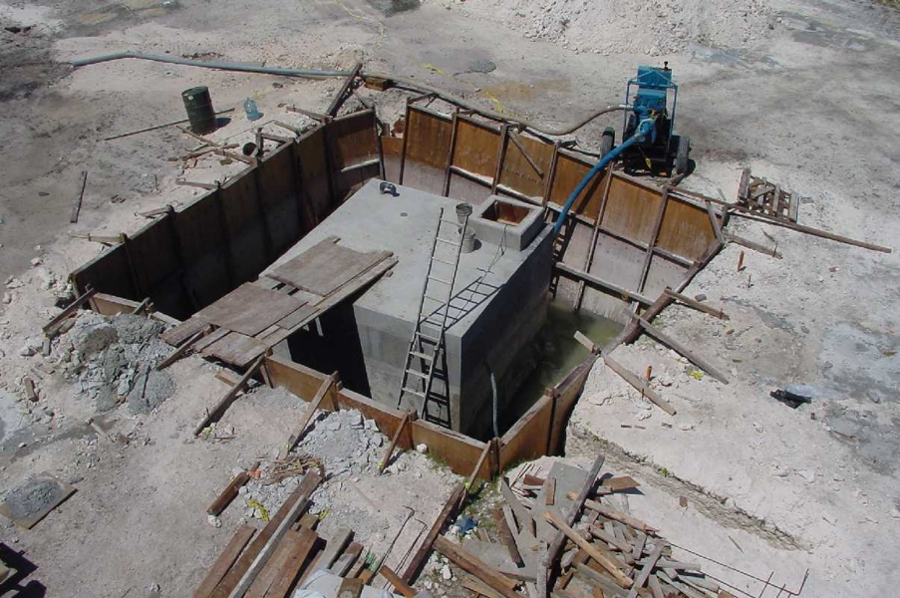
DGAR - Vault under construction
Notes:
Here’s an example of a shallow “surface vault” that provides good thermal protection but is often not a good environment for horizontal-component instruments.
The vault rocks with temperature and rainfall effects on the soil.

Slide 47
Final Thoughts
Modern Broadband Seismometer are pretty good. What more would we like?
Additional Bandwidth – long period end
Reduced long-period noise – small market
Improved environmental protection
Long-term, telemetered, Ocean-bottom instruments
Notes:
At least for the GSN, the station infrastructure is usually much more expensive that the instrumentation.
So instrumentation that would work well without such elaborate installations would be nice.
Reliability is general is pretty good but it greater reliability and ease of maintenance would produce significant savings in the operation of the GSN.
But most of all we need to figure out how to make affordable ocean bottom stations. Affordable in this context is $ 0.5 – 1 M for capital costs and order $100k/yr for O&M

Slide 49
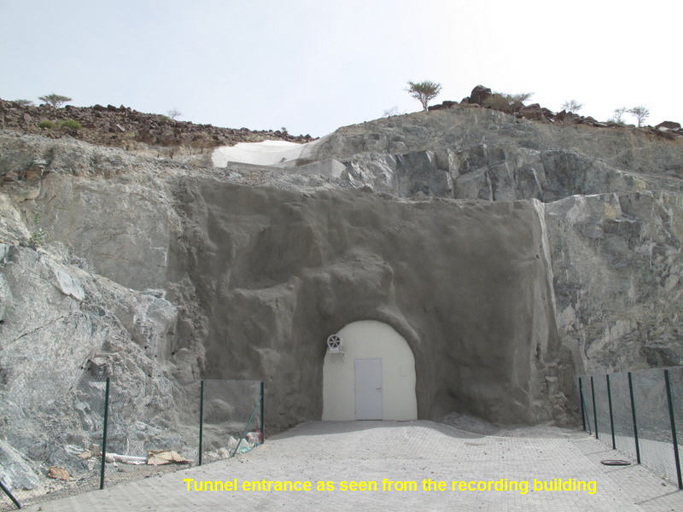
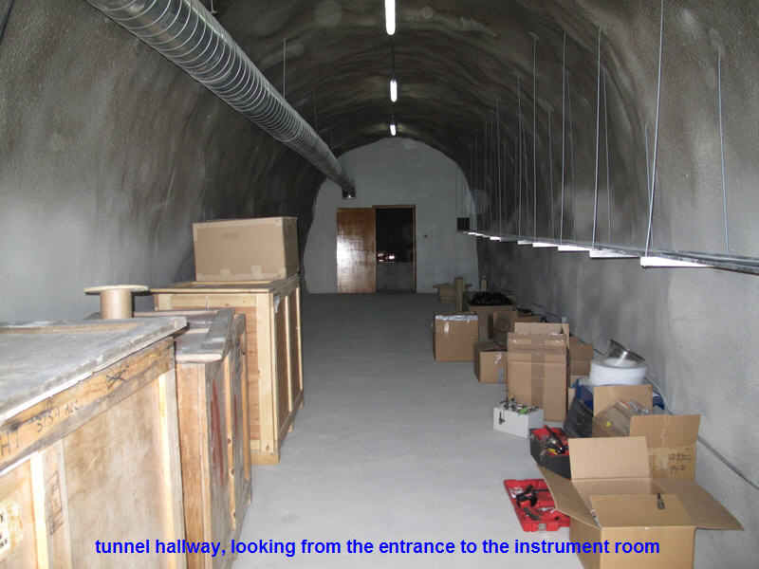
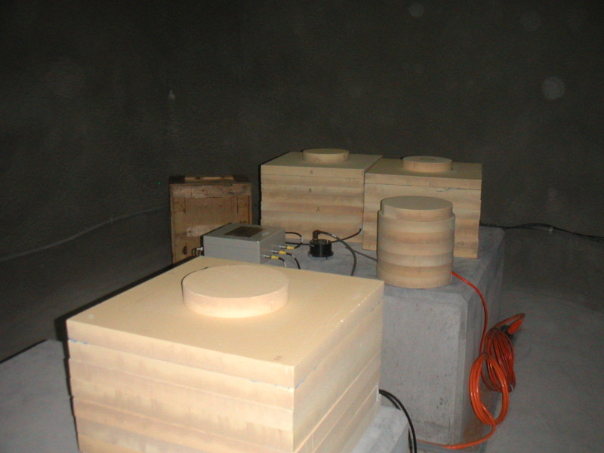

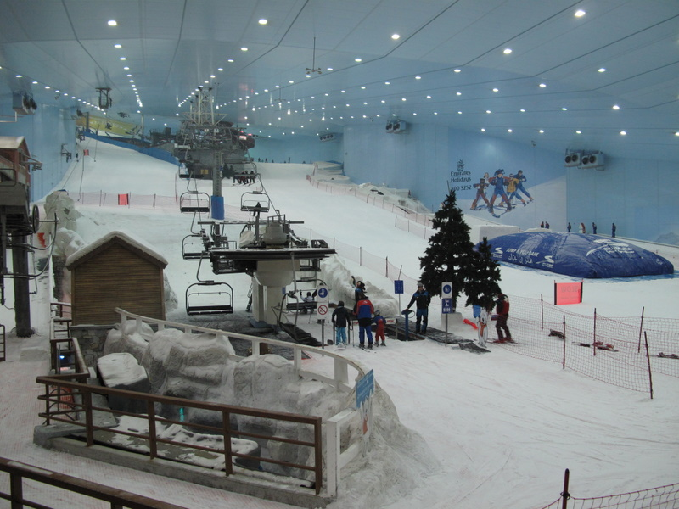
GSN Station UOSS
Notes:
Another method is to drive a horizontal shaft into a hillside. This can be done with normal constructions methods and technology,
But still expensive
The shots show the recently opened GSN station UOSS in the UAE. The tunnel and recording building were built by the government of the Emirate of Sharajah.
Its an interesting place combining the usual desert camel traffic with modern amenities such as an indoor ski resort

Slide 50
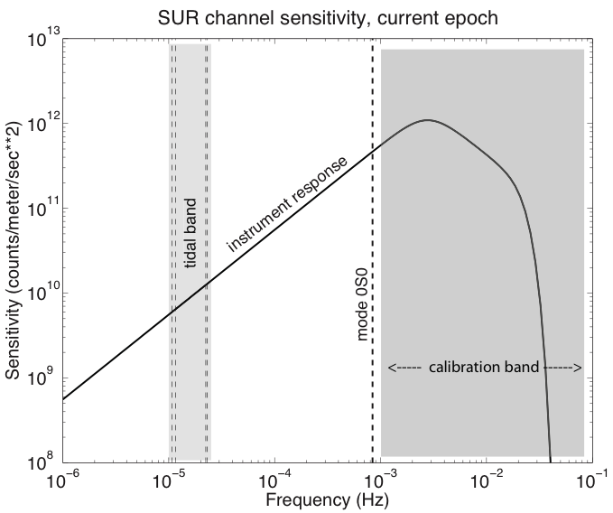
Nature’s Calibration Signal: Earth Tides
Notes:
I just mention in passing that the Earth tides provide an ever-present calibration signal for those instruments with the capability of recording such very-long period signals. From astronomy and Oceanography we can predict the earth tides including the effects of non-equilibrium ocean tidal loading to better than 1 percent. In fact these signals have been used to calibrate the GSN STS1 equipped stations giving us about a 2-percent calibration on the network.

Slide 51
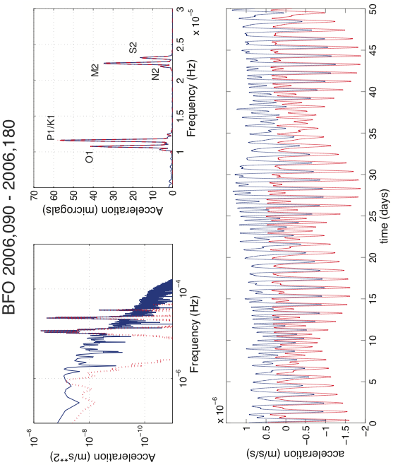

Slide 52
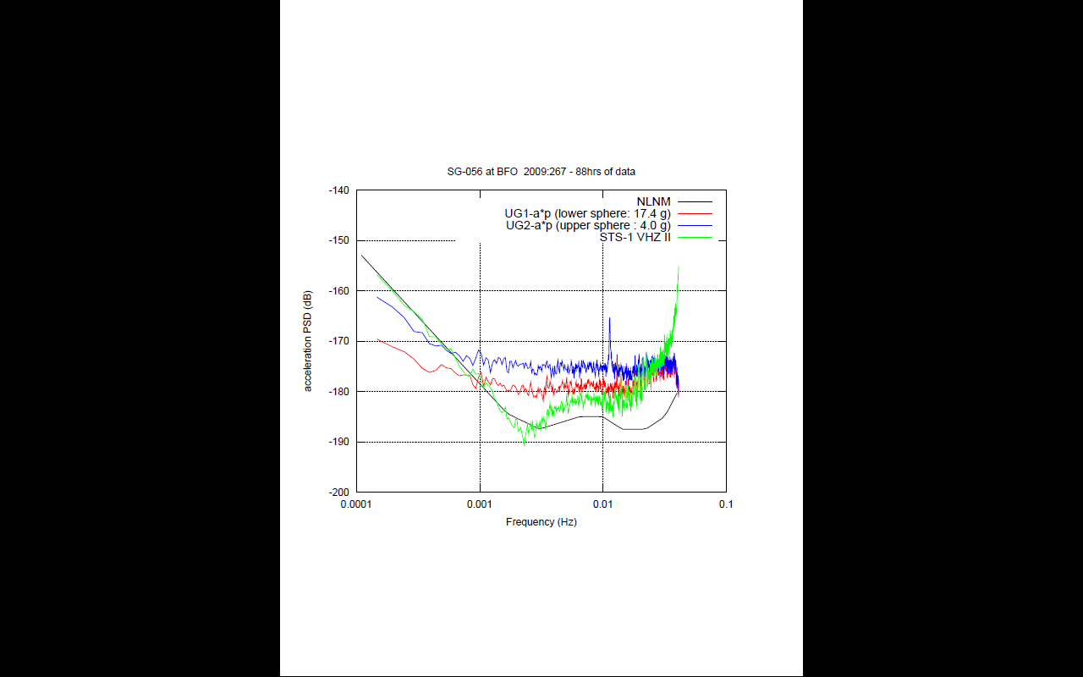
Effect of increasing mass in Superconducting Gravimeter
Notes:
Here is a practical example of lowering the noise by increasing the mass in this case from 4 to 17 grams. Got close to the theoretical 6 dB improvement

Slide 53
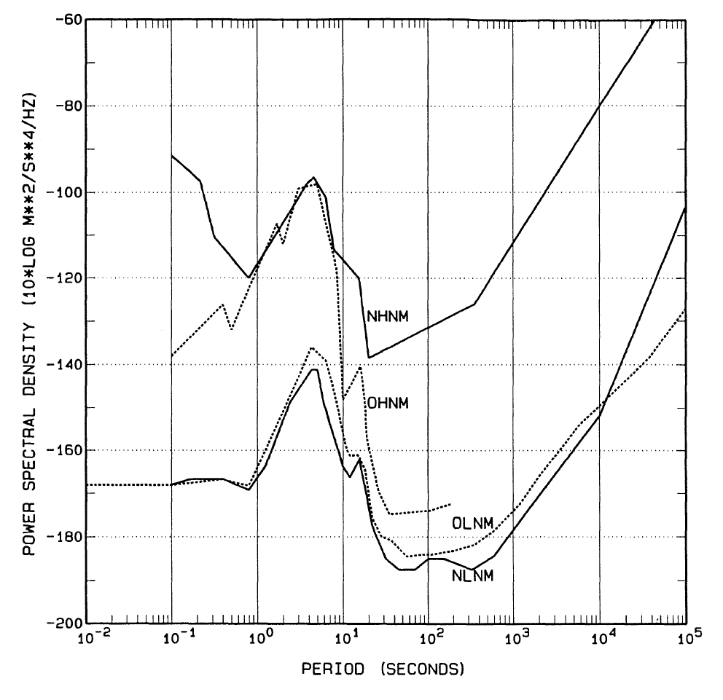
USGS Old (1980) & New(1993) Noise Models

Slide 54
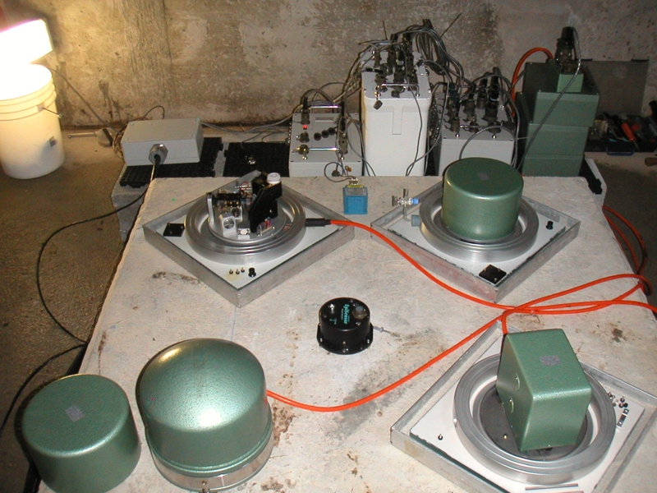
DGAR - Inside the Vault

Slide 55
Berger et al., 2003
118 GSN Stations of the IU and II networks for the year July 2001 through June 2002.
Each station-channel data segmented into hourly, 1 to 11 hour segments.
noise estimated in 50% overlapping 1/7 decade (∂f/f=0.33, ~1/2 octave) bands.
Notes:
With the development of the IRIS data management center, the availability and access to a large collection of seismic data, particularly from the GSN was such that is was fairly easy to analyze very large quantities of data to develop robust statistical estimates.
118 GSN stations for the year 2001-2002.
In this analysis some 738,000 hourly spectral estimates were used to characterize the ambient noise field.
Noise estimated in 50% overlapping 1/7 decade (∂f/f=0.33, ~1/2 octave) bands.

Slide 56
Features of Feedback
Limits the dynamic range and linearity requirements of the displacement transducer as the test-mass displacement is reduced by gain of feedback loop
Can easily shape overall response to compensate for suspension free period and Q
Can provide electrical outputs proportional to displacement, velocity, or acceleration

