Slide 1
WildBlue Communications
A ViaSat Company
January 2011

Slide 2
WildBlue Communications
WildBlue is a “Broadband Internet via Satellite”
service provider with approximately 420,000
customers in the 48 contiguous United States.
WildBlue is a ViaSat Company
  Acquired by ViaSat in December 2009
  ViaSat is publically traded (NASDAQ: VSAT)
Headquartered in Denver, Colorado in the western U.S.
  Approximately 250 direct employees
U.S. nationwide infrastructure with
  2 Ka-band spot beam satellites, additional leased capacity on a third
  13 Gateway Earth Stations
  Network Operations Center
  Business Systems Data Center
  Customer Call Center

Slide 3
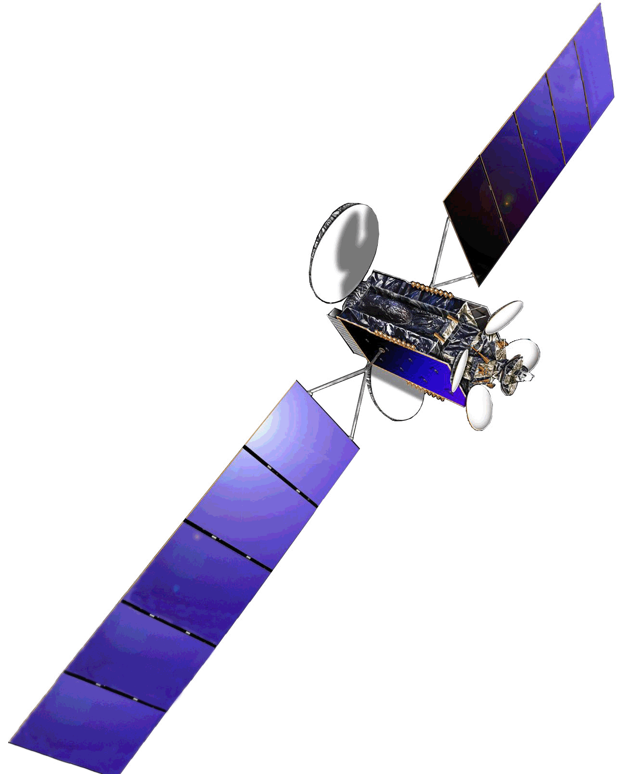
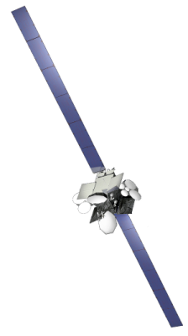
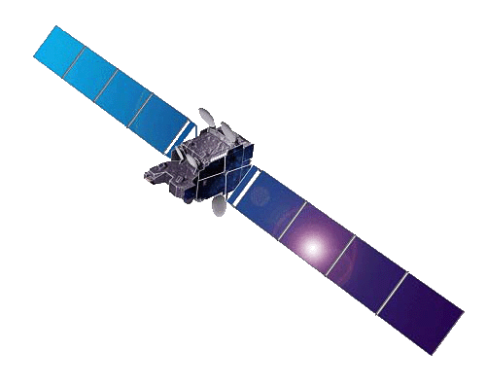
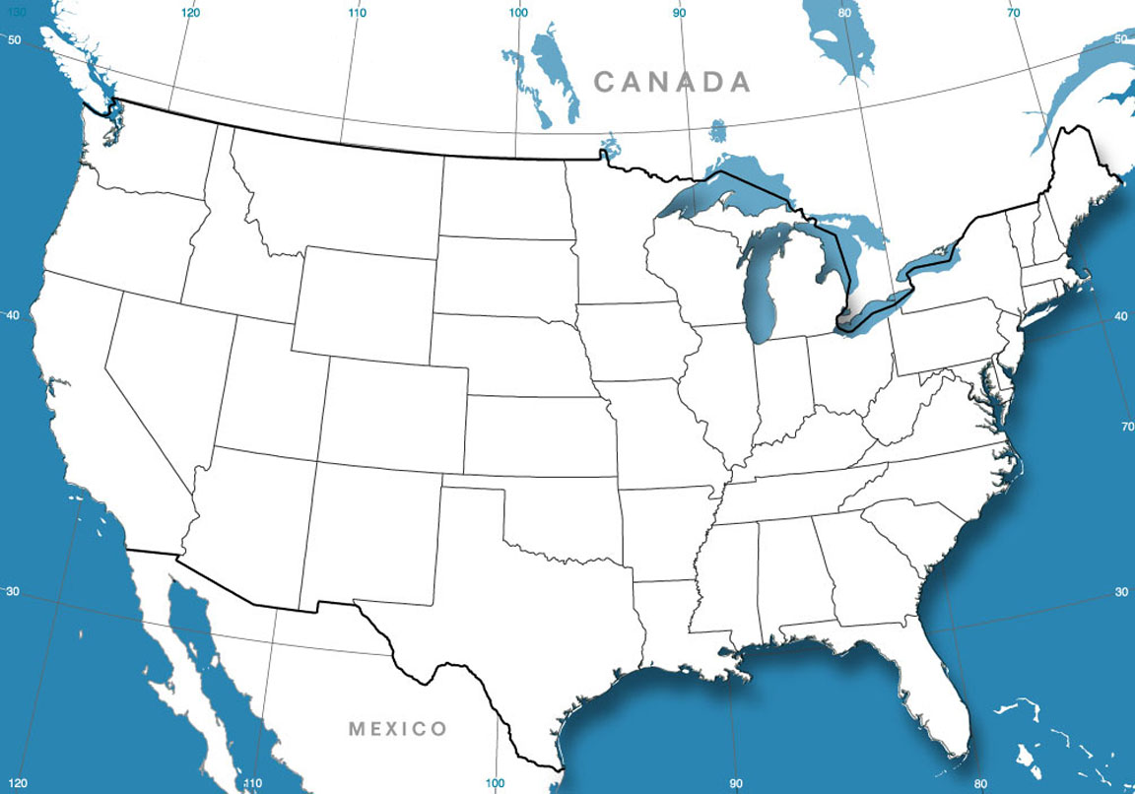


Current Network Geography
WildBlue-1
111.1W
Satellite Ops
AMC 15
105.0W
Anik F2
111.1W
Calgary, ALB
(Telesat)
Satellite Ops
Winnipeg, MAN
Seattle, WA
Ottawa, ONT
(Telesat)
Duluth, MN
Syracuse, NY
Cheyenne, WY
Denver, CO
Headquarters
Riverside, CA
Satellites | 3
Spot Beams | 68
Gateway Earth Stations | 13
Gateway Sites | 8
8.1-9.0m Antennas | 15
5.6m Antennas | 5
Downstream Carriers | ≈ 170
Upstream Carriers | ≈ 2,700
Phoenix, AZ
Laredo, TX
Telesat Operates the 14 Canadian Beams on Anik F2.

Slide 4

Our Target Market is the Rural U.S.
We have Historically Targeted Rural Markets
Customer Demographics: Population Density
Over 90% of WildBlue customers are in rural areas with <50 homes/km²
WildBlue will provide higher speeds and better service quality on the new ViaSat-1 satellite, competitive with DSL and terrestrial wireless in less rural markets.

Slide 5
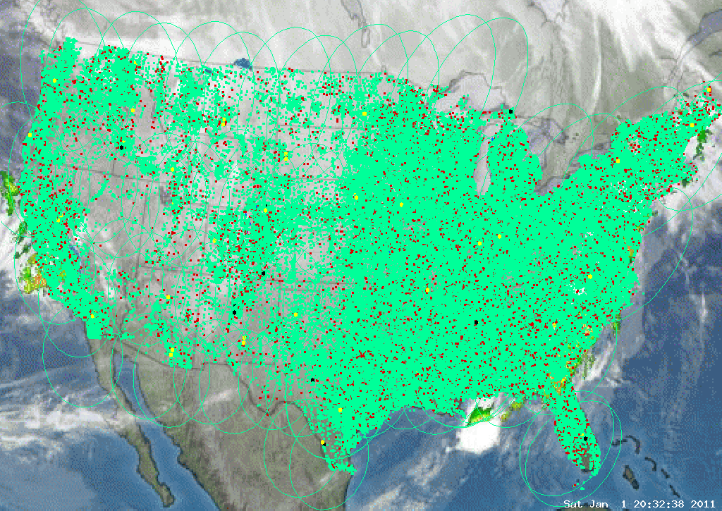
WildBlue Customer Density
Green dot in the center of each ZIP+4 postal code with at least one customer.

Slide 6
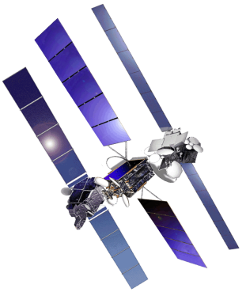
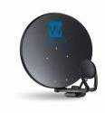
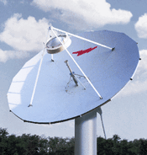
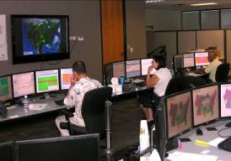

WildBlue Network Architecture
Subscriber
Terminals
Satellite
Connectivity
Gateway
Earth Stations
Fiber
Connectivity
Operations &
Business
Internet
SurfBeam-1 subscriber terminals
High power, bent-pipe
spot beam satellites
Unmanned
remotely operated
Gateway Earth Stations
Fiber connectivity
Google email, web hosting, portals
Network operations
Business systems
Denver, Colorado

Slide 7
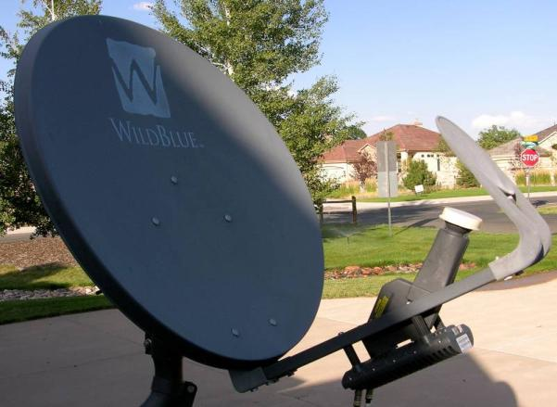
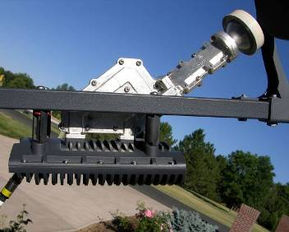
Subscriber Terminal: Outdoor Unit
Outdoor Unit
Transmit-Receive Integrated Assembly (TRIA)
Feed Assembly Cover Removed
Stamped steel reflector 65×75 cm with a 15 cm subreflector
Mechanically configurable between LHCP and RCHP polarizations
AZ-EL mount with fine adjust in both azimuth and elevation
Transmit: 19.7 – 20.2 GHz
Receive: 29.5 – 30.0 GHz

Slide 8
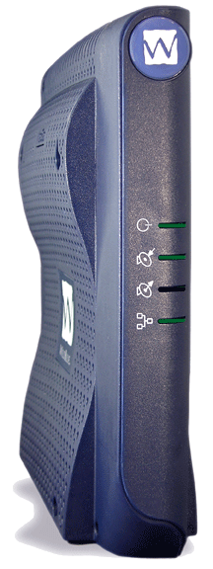
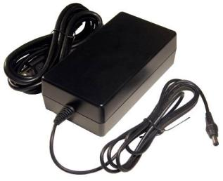
Subscriber Terminal: Indoor Unit
ViaSat Surfbeam-1 Satellite Modem
  Based on DOCSIS standards
Optimized for space-earth satellite links
  Automatic rain fade mitigation
  Adaptive modulation and coding
  Multiple burst rates
  Uplink power control
Ethernet interface
Embedded security certificates
No software required on the customer’s PC
Optimizer utility used to configure PCs for
faster web surfing speeds
Satellite Modem
(ViaSat)

Slide 9
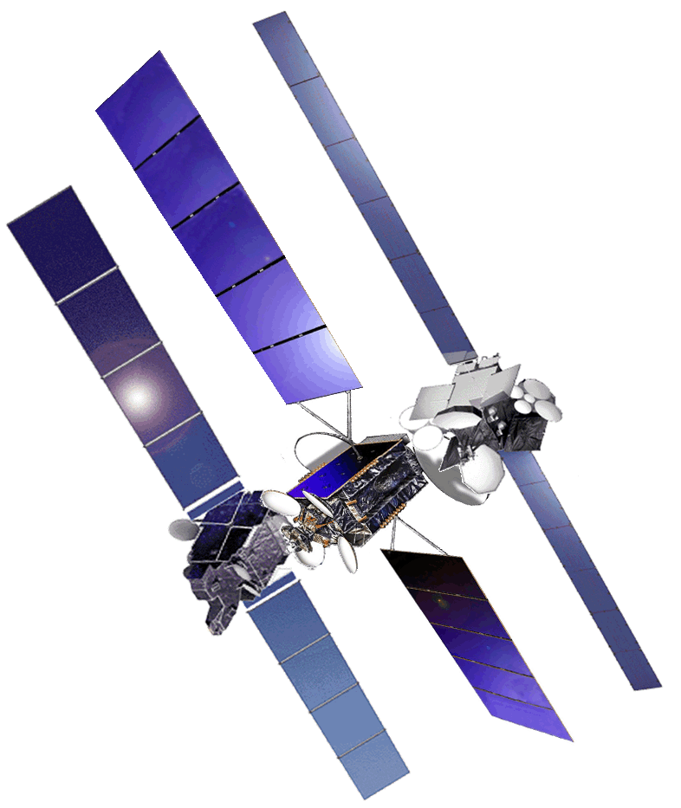
Satellite Connectivity
Ka-band capacity on three satellites
  Anik F2, launched 17 Jul 2004
  AMC-15, launched 14 Nov 2004
  WildBlue-1, launched 08 Dec 2006
Spot beam payloads designed
specifically for Internet access
  Gateway → satellite → customer (downstream)
  Customer → satellite → gateway (upstream)
Low cost two-way satellite bandwidth
  Anik F2 has approximately 4000 MHz (US capacity)
  AMC-15 has approximately 1500 MHz
  WildBlue-1 has approximately 6000 MHz
Combined capacity to serve over 700,000 customers
Anik F2
111.1W
(Telesat)
WildBlue-1
111.1W
AMC-15
105.0W
(Echostar)

Slide 10
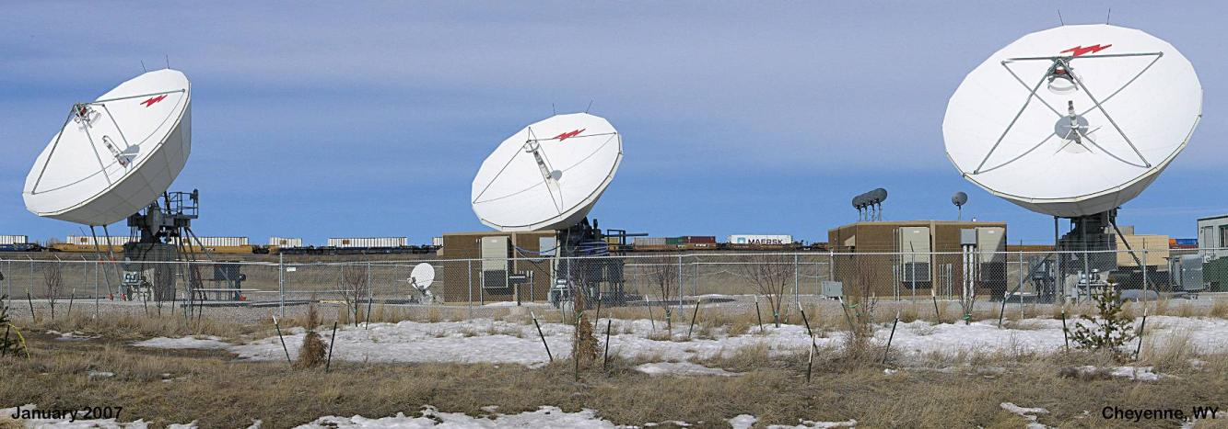
Gateway Earth Stations
Cheyenne, WY
Unmanned Gateways are operated remotely from WildBlue’s Network Operations Center in Denver, CO
  Two 8.1m main antennas plus one 5.6m backup
  One 40m² equipment shelter per satellite
  Diesel generator and UPS for each satellite
  Physical security

Slide 11
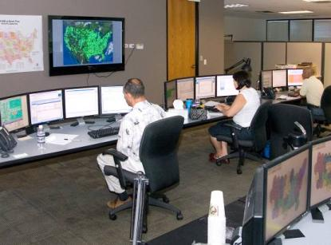
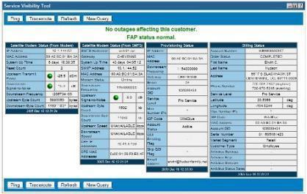
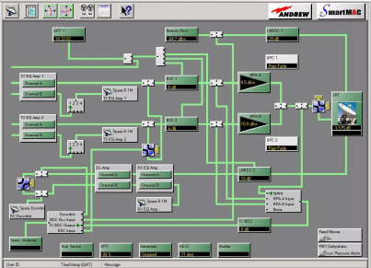
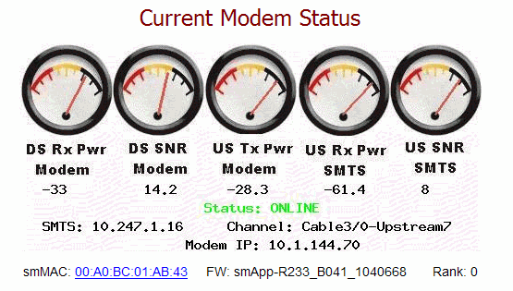
Network Operations Center
Denver, Colorado
WildBlue Gateways (13)
E
V
E
N
T
D
B
System
Manager
Views
Satellite-Ethernet Traffic
TCP/IP Services
Local
Element
Manager
VPN
System
Manager
Views
SNMP traps
MIB values
Configuration files
System
Manager
Views
Gateway
Antenna
Network Operations Center
Entire network is remotely managed from WildBlue’s NOC in Denver, CO.
Real-time Status of Customers
Integrated Performance, Provisioning and Billing
Remote Management of Gateways

Slide 12
Next Generation Network

Slide 13
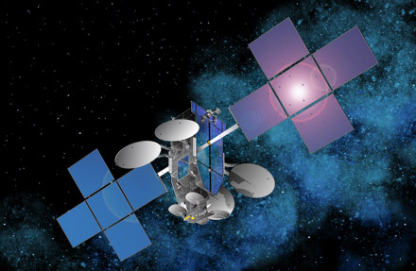
ViaSat-1 Satellite
Launches in 2Qu 2011
Breakthrough level of capacity
via satellite
  120-130 Gbps throughput
  70% coverage of the US
  Includes Alaska, Hawaii coverage
  17 U.S. gateways
ViaSat-1 satellite will provide
  12-15× increase in total satellite
  capacity
  20-25× capacity increase in highest
  demand markets
  6-8× gain in speed & bandwidth
Anticipating rapid customer growth with the launch of the ViaSat-1 satellite
  Faster speeds at lower prices
  Up to 10 Mbps download speeds
ViaSat-1 Satellite
Space Systems/Loral

Slide 14
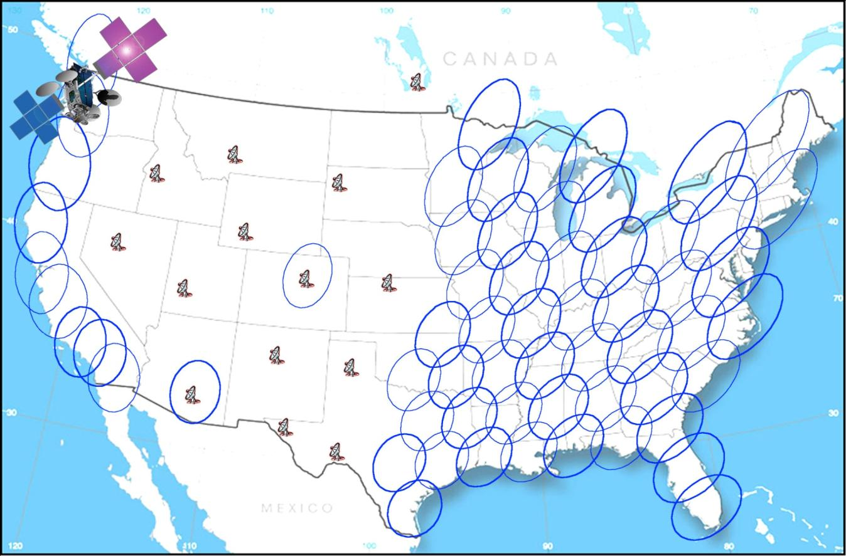
ViaSat-1 Network Geography
U.S. Contiguous 48-States Coverage Region
Canadia, Alaska, Hawaii Coverage not Shown

Slide 15
Viasat-1 – Extraordinary Capacity
ViaSat-1 has more capacity than all current satellites above No. America combined.
Notes:
When we say we are increasing capacity – we are really, really serious. Here is an amazing chart. The left hand side shows the baseline designed capacity of ViaSat-1. (It may be significantly higher). The right hand side shows the combined capacity of every single Ka band, C band & Ku band satellite we can find over the United States. That includes the Ka capacity of ANIK F2, WildBlue 1, the advertised capacity of Spaceway 1, 2 & 3 all put together (even though Spaceway 1 & 2 aren’t even being used for data now), the Ka capacity on Echostar’s AMC-15 & 16 satellites & over 1000 36 MHz equivalent transponders on FSS satellites across the country. All that still does not equal the capacity on this 1 satellite. That should give you an idea of how substantially we are changing the game in terms of our ability to deliver cost effective bandwidth vs. any challenger in the US.
The situation in Europe isn’t quite the same – but we & Eutelsat will have at least as big an edge in the data business there. There are no dedicated Ka band satellites in Europe & you can see that makes up about half the total data capacity in the US.
We also want to make the point that this capacity is not just an attribute of the satellite we are buying from Loral. You cannot make a satellite that yields this capacity without the ground segment technology we have & are incorporating into next generation Surfbeam. We have spent a year working closely with Loral to get to the design we have. No one has yet even caught up with our first generation system. It is going to be very difficult to get where we are going in a single step. We think this is a big reason we have been able to make the strategic relationship agreements that are such a big part of our plans.
15

Slide 16
Summary

Slide 17
Summary
WildBlue has established a highly successful Internet via Satellite business in the United States
With the launch of ViaSat-1 in July, we will have more capacity than all other U.S. satellite operators combined
ViaSat-1 will allow us to offer speeds up to 12 Mbps
  ViaSat-1 will make us much more competitive with extended DSL and wireless alternatives
  We will have the capacity to grow well beyond a million subscribers
ViaSat and WildBlue are providing broadband solutions to other satellite operators to allow them to offer a WildBlue-like service in their region of the world
  Eutelsat in Europe
  YahSat in the Middle East
  Barrett in Canada
  O3B in southern Africa

Slide 18
WildBlue Communications
  WildBlue Communications
  349 Inverness Drive South
  Englewood, CO 80112
  United States
  Main: +1-720-493-6000

