Slide 1
ShakeNet – A Wireless Network for Structural Monitoring
Ramesh Govindan, USC
Monica Kohler, Caltech
Bob Nigbor, UCLA
Nilesh Mishra, USC
Shuai Hao, USC

Slide 2
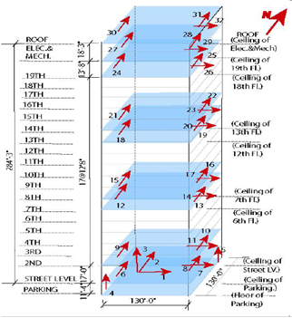
Current Building Seismic Monitoring Arrays

Slide 3
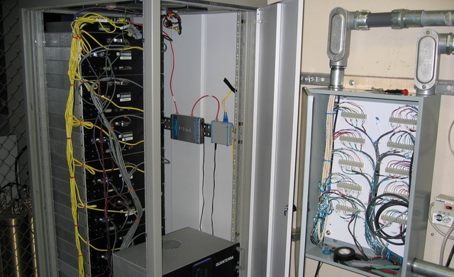
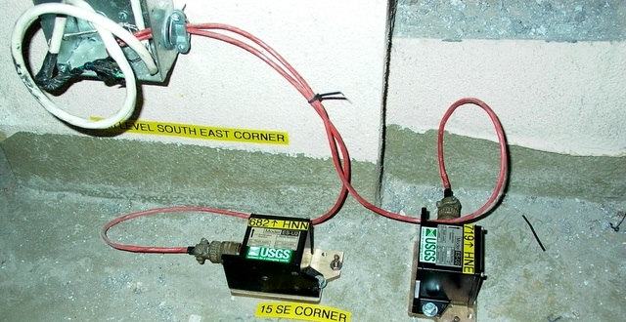
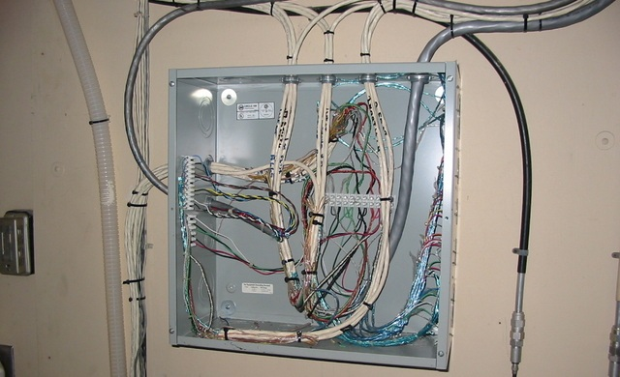
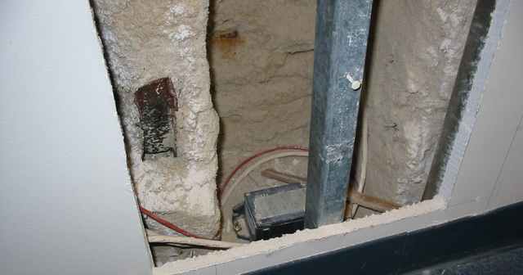
Problem: Installing traditional, wired, structural monitoring networks in buildings has severe physical, hardware, cost, and time limitations.
PROS
Robust commercial hardware.
High-quality waveform data.
Secure telemetry.
Flexible data formats.
Platform-independent processing.
Flexibility in sensing and processing .
CONS
100s-1000s of m of cable.
Physically invasive installation.
Expensive.
One centralized digitizer and processor.
No computing at sensors.
Single, one-way, fixed-path comm.
Cannot relocate hardware.
Months to years to install; permissions.
Centralized processor
Sensors and cables
Sensor signal junction box
Sensor/cables behind wall cutout

Slide 4
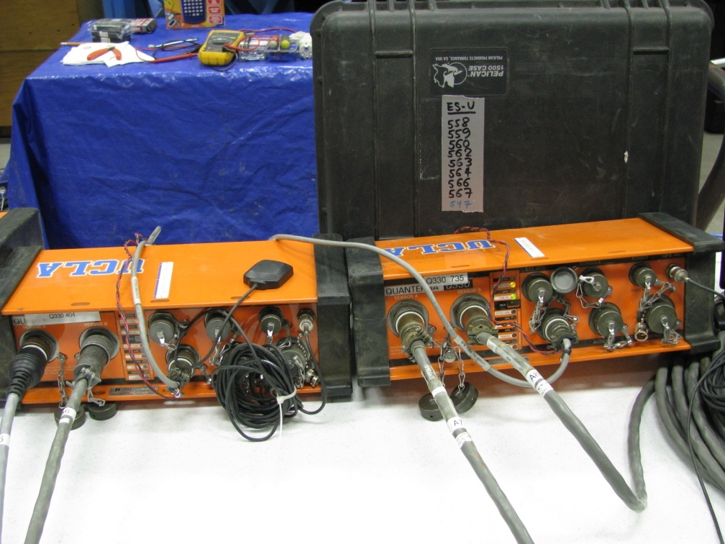
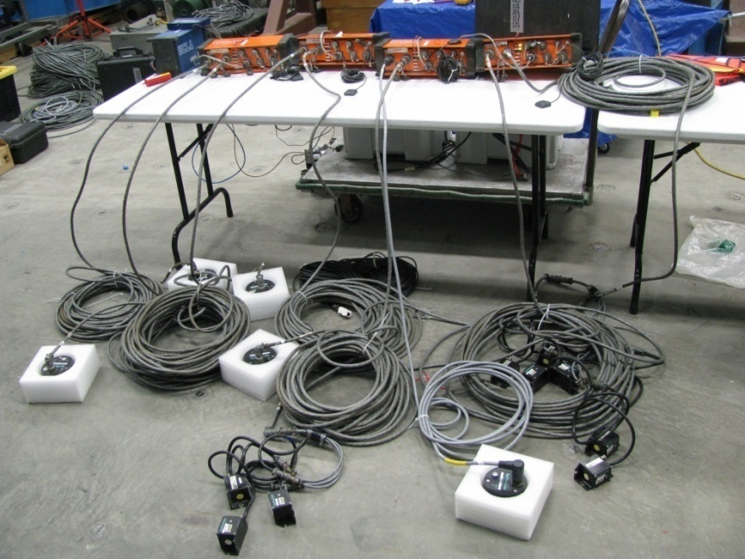
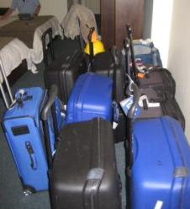
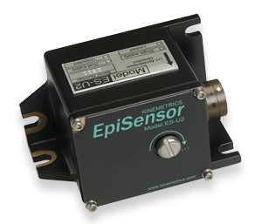
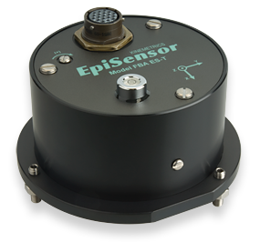
Temporary Structural Monitoring
Array – Wired Sensors + GPS + Cat5
LOTS of cables

Slide 5
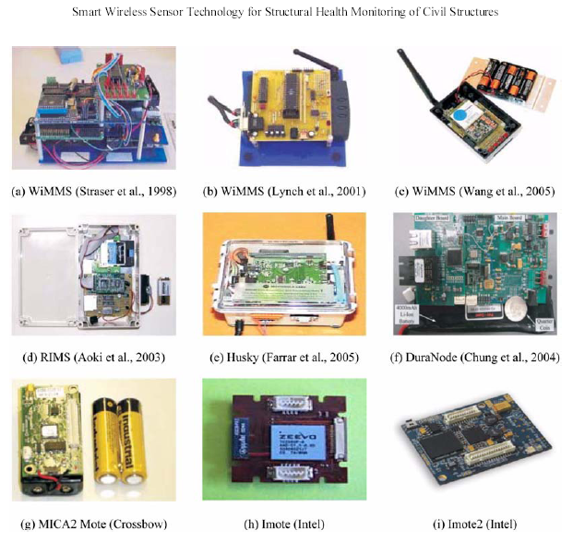
Various Smart Wireless Sensor Platforms
From: Smart Wireless Sensor Technology for Structural Health Monitoring of Civil Structures
Soojin Cho, Chung-Bang Yun, Jerome P. Lynch, Andrew T. Zimmerman, Billie F. Spencer Jr., and Tomonori Nagayama (2008)

Slide 6
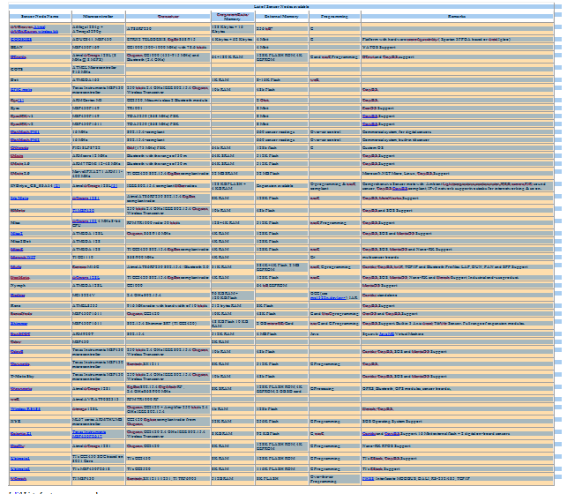
Table of available prototype and commercial motes/sensor nodes
Wikipedia – Sensor Nodes

Slide 7
SOSEWIN: Self-Organizing Seismic Early Warning Information System

Slide 8
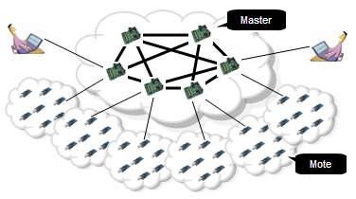
ShakeNet: tiered wireless seismic network
Developed with NSF, CENS, and USGS funding

Slide 9
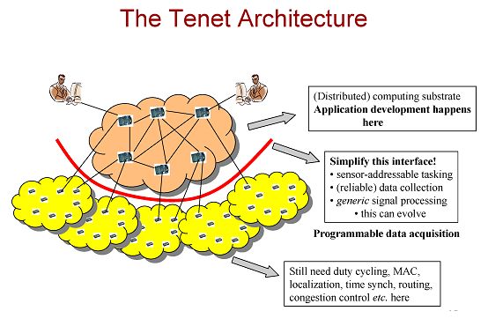
Tenet: An Architecture for Tiered Embedded Networks

Slide 10
Application run on master and tasks the motes
Any complicated algorithm or data fusion resides at the master
Masters provide generic interface to task the sensors
Motes responds to the task
Motes provide limited library of generic functionalities such as timers ,sensors, filters, and other form of local processing

Slide 11
ShakeNet Components
Master tier
- Higher-level w/ processor running algorithms continuously, storage.
- Provides greater network capacity through larger spatial reach.
- Applications run on masters; masters task motes.
Sensing tier
Motes collect and process data.
Initial Configuration: 24-bit ADC, 3-comp 120db ±3g accel., imote2, 802.15.4 radio, 2.4 GHz antenna.
Final Configuration: Reftek 155 semi-custom box, 24-bits, Colybris accelerometer, 802.11 radio w/lower power
In constant communication with at least one master-tier node.
Enables flexible deployment of dense instrumentation.
Tenet
Programmable wireless sensing software
Complex routing structures and in-network collaborative processing.
Node modularity, reusability, and manageability at the sensing level.
Network-level timing options (NTP, custom)

Slide 12
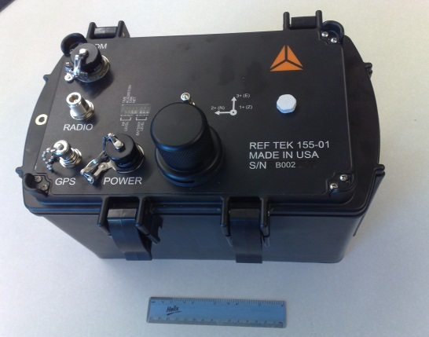

ShakeNet Deployments in 2011
- Master tier (10 Stargate processors)
- Sensing tier (40 “ShakeBox” motes)
ShakeBox
Santa Ana River Bridge: Water distribution feeder pipe, Riverside, CA
Seven Oaks Dam: 550-ft by 2980-ft earth-and-rock-fill dam, San Bernar-dino County, CA
1100 Wilshire, L.A.: 21-story steel
MF triangular prismatic pentahedron
over 15-story concrete cube

Slide 13
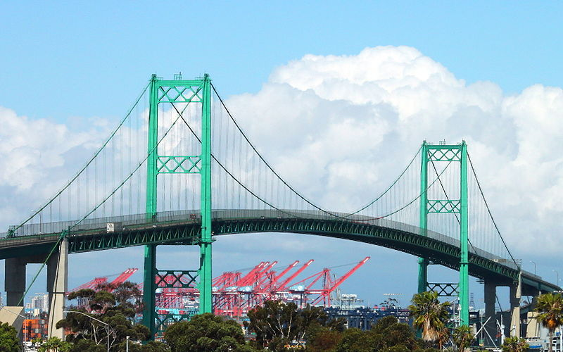
Prototype Test 2008:
Vincent Thomas Bridge, L.A. Harbor

Slide 14
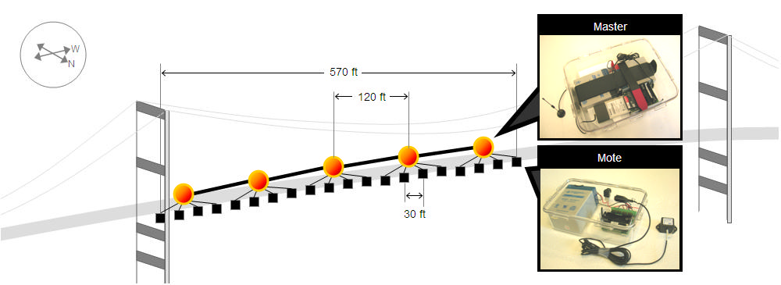
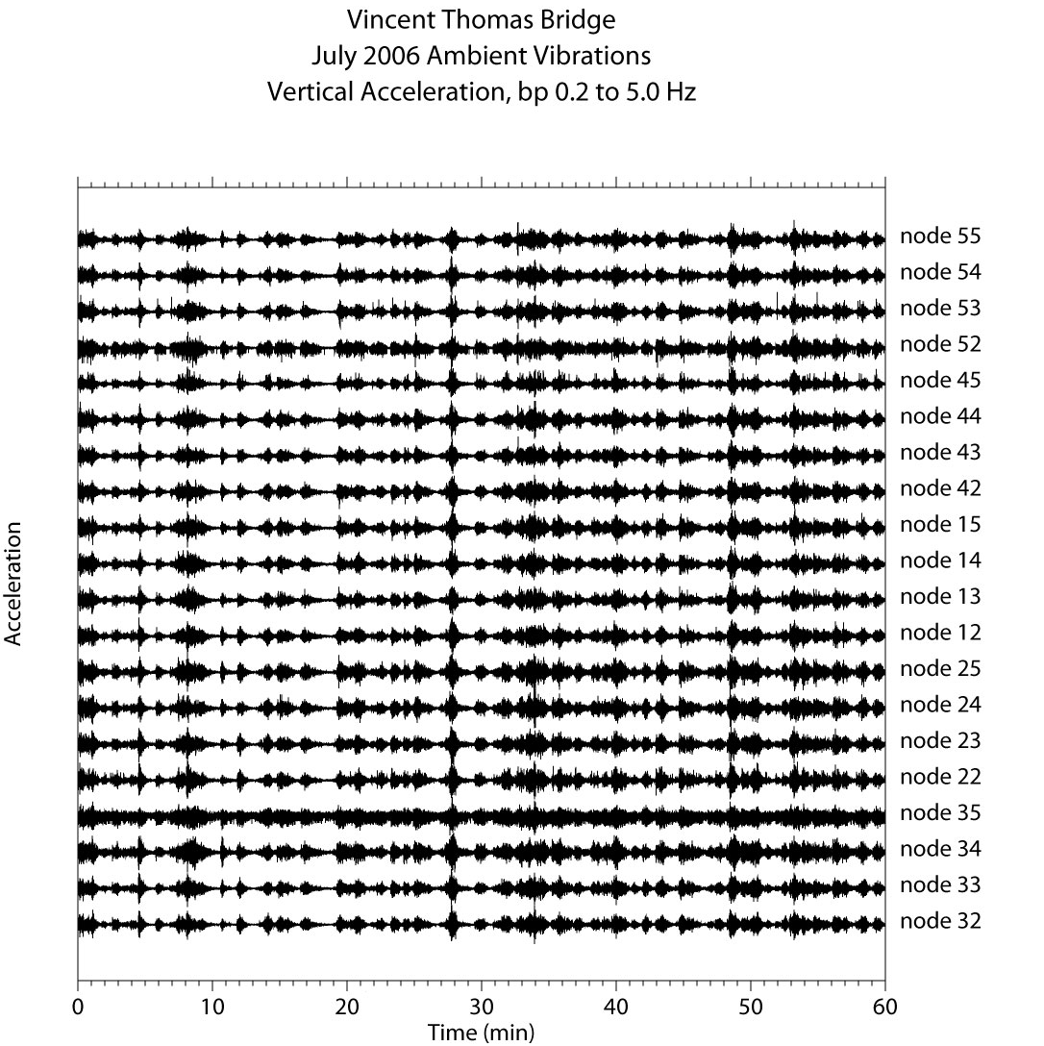
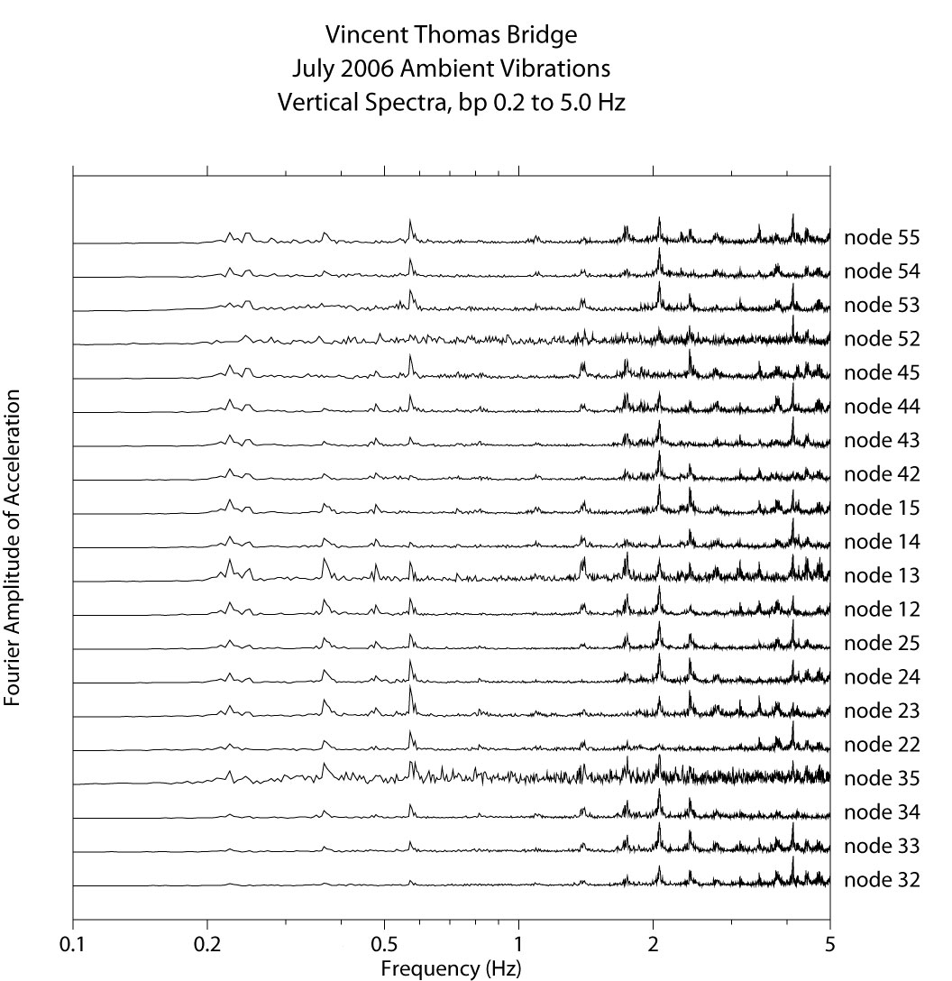
Prototype test: Vincent Thomas Bridge, L.A. Harbor

Slide 15
ShakeNet Deployments in 2011
- Master tier (10 Stargate processors)
- Sensing tier (40 “ShakeBox” motes)
ShakeBox
Santa Ana River Bridge: Water distribution feeder pipe, Riverside, CA
Seven Oaks Dam: 550-ft by 2980-ft earth-and-rock-fill dam, San Bernar-dino County, CA
1100 Wilshire, L.A.: 21-story steel
MF triangular prismatic pentahedron
over 15-story concrete cube

Slide 16
Special Issues in Buildings
Floor slab RF attenuation
Interior wall RF attenuation
Glass RF attenuation for WiFi and GPS
Multipath

Slide 17
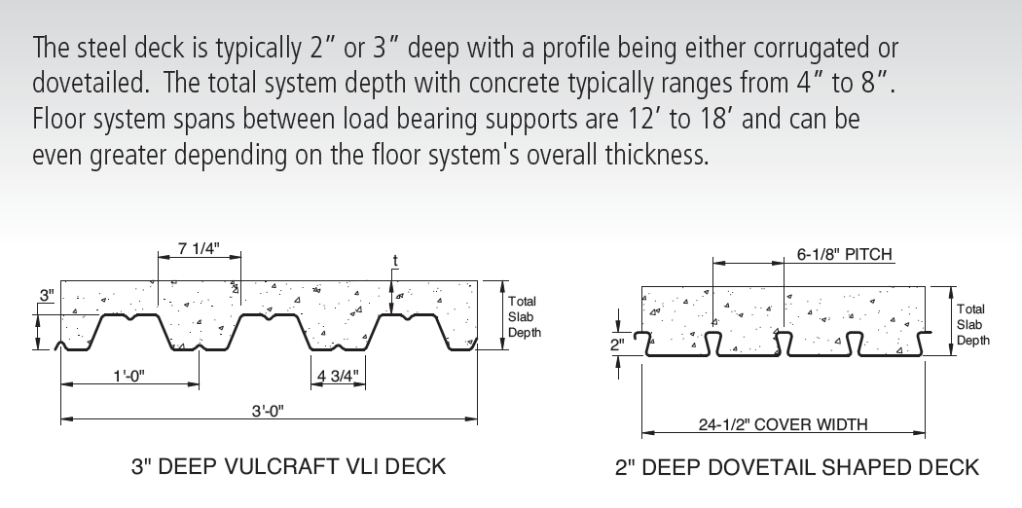
Steel Deck Floor Slabs:
An Efficient RF Barrier

Slide 18
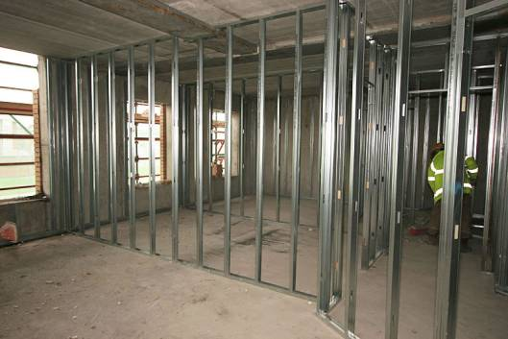
Metal Stud Partitions:
An Effective RF Barrier

Slide 19
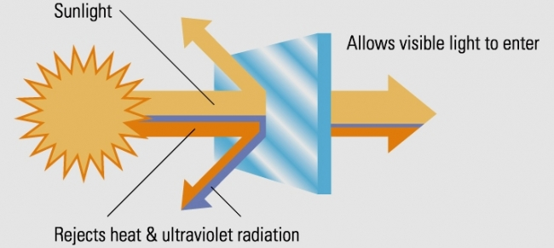
Low-E Glass
Measured UHF Attenuation 29dB for Low-E windows in a building
Weisenfeld & Riise (2011)

Slide 20
Summary
ShakeNet will provide a wireless solution for structural monitoring
Seems to work well with line-of-sight (bridges, dams)
Problems in buildings remain to be characterized
Deployments in Summer 2011 will characterize real performance
Tenet.usc.edu
Kohler.caltech.edu/shakenet

