Slide 1
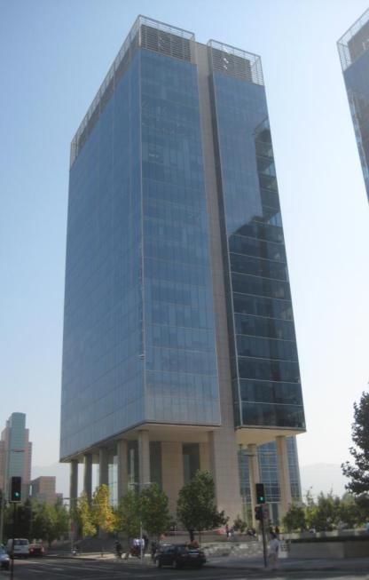
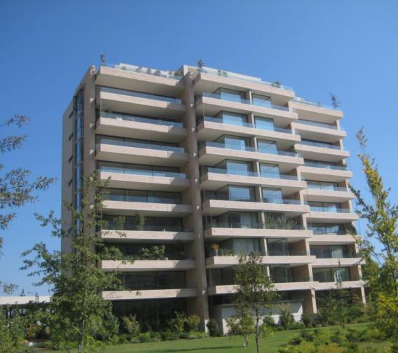
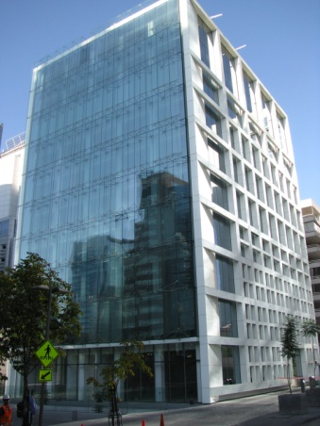
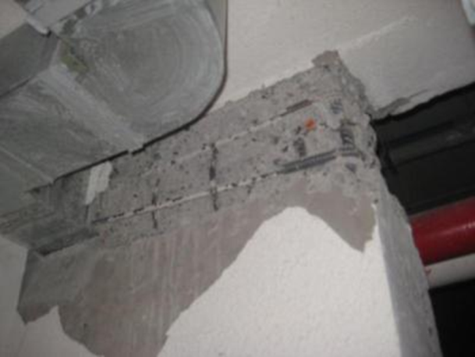
Rapid Post-Earthquake Building Monitoring
Bob Nigbor
NEES@UCLA

Slide 2
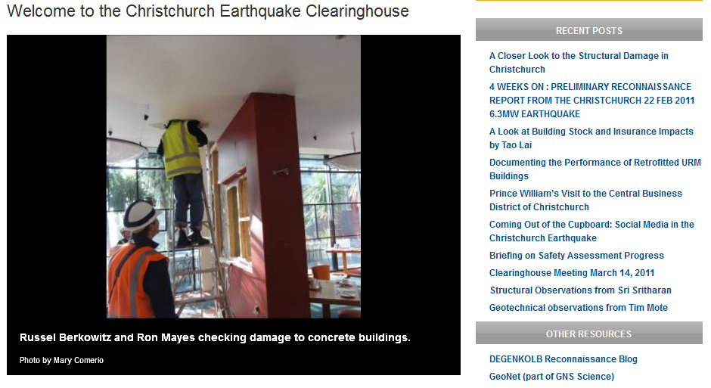
Engineering Post-Earthquake Reconnaissance

Slide 3
EERI “Learning From Earthquakes” Program
In 1973, EERI formally initiated the Learning from Earthquakes (LFE) Program. This program, funded by the U.S. National Science Foundation, sends out multi-disciplinary teams of researchers (e.g., earth scientists, engineers, social scientists) into the field to investigate and to learn from the damaging effects of earthquakes and tsunamis. The reconnaissance team makes a rapid, general damage survey of the affected area, documents initial important observations from the tsunami and/or earthquake, and assesses the need for follow-up areas of research.

Slide 4

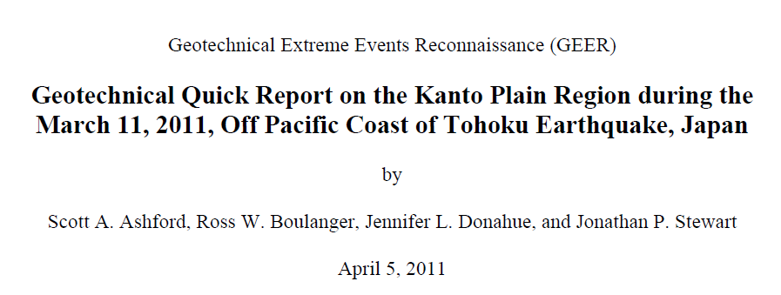

Slide 5
Rapid Aftershock Monitoring of Reinforced Concrete Buildings in Santiago, Chile by NEES@UCLA following the February 27, 2010 Mw=8.8 Earthquake
Project Collaborators and Contributors:
John Wallace, PI (UCLA)
Bob Nigbor co-PI (UCLA)
Anne Lemnitzer (Cal State Fullerton)
Alberto Salamanca (NEES@UCLA)
Derek Skolnik (Kinemetrics)
Leonardo Massone (Univ. of Chile, Santiago)
Juan Carlos de la Llerra (Catholic University of Chile, Santiago)
+ the EERI Reconnaissance Team

Slide 6
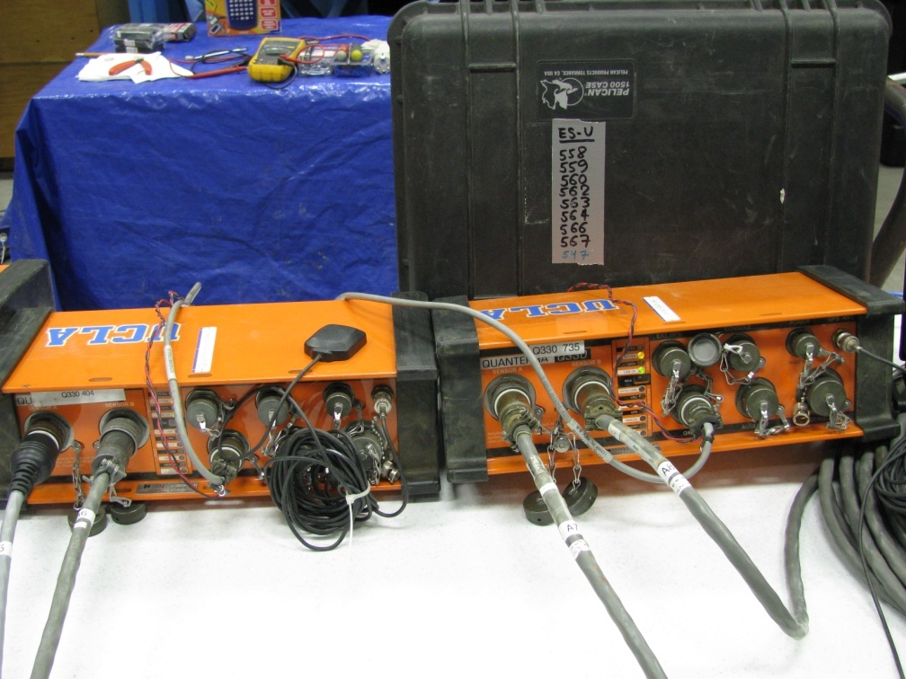
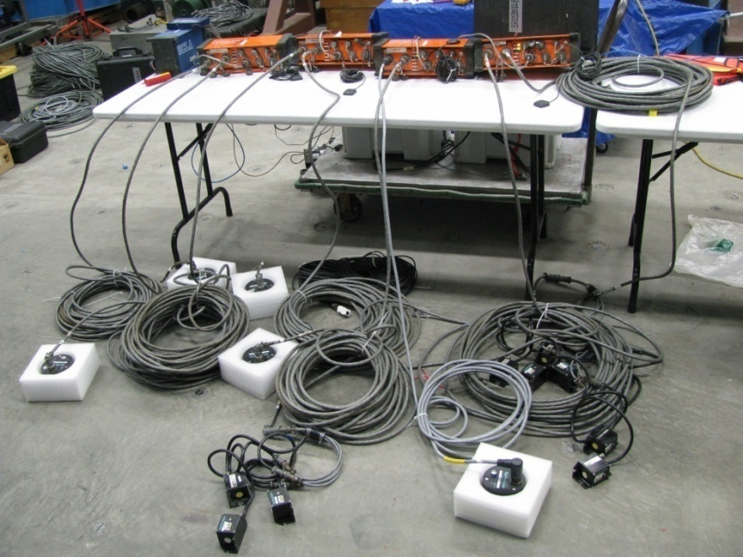
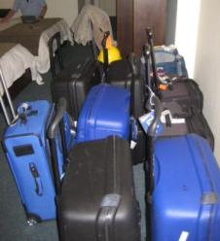
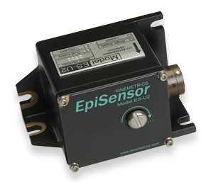
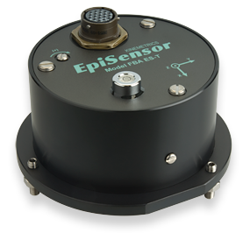
Preparation of Instrumentation
provided by NEES@UCLA

Slide 7
Instrumentation
Two 24-channel systems:
4 Q330s
Ethernet LAN
GPS timing
Netbook running Rockhound, continuous and triggered recording
Accelerometers
Displacement sensors (LVDTs)
Battery power
Packing
Generic suitcases
Letters with lots of logos & stamps

Slide 8

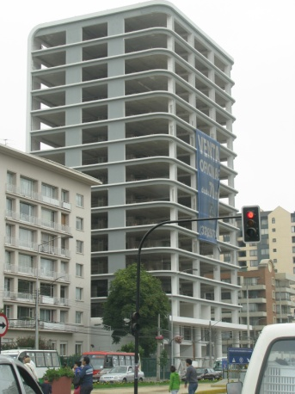
Instrumented Buildings
Located in Santiago, Chile
Buildings selected based on:
- Access and permission
Typical design layouts representative for Chile and the US
Local collaborator for building selection: Juan Carlos de la Llerra
Ambient Vibration
2 Aftershocks
Ambient Vibration
30 Aftershocks
Ambient Vibration
4 Aftershocks

Slide 9
Building B:
-10 story RC residential building
- Structural system:
Shear Walls
Post Earthquake damage:
Shear wall failure,
Column buckling,
Extensive non-structural failure,
slab bending & concrete spalling

Slide 10
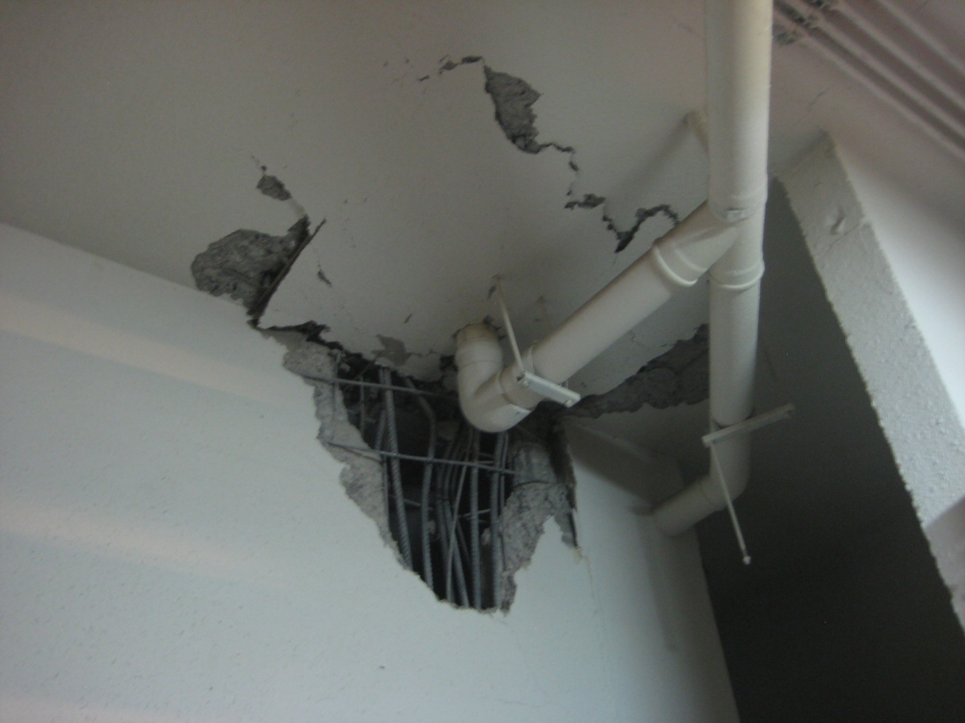

Observed Damage in the 10 story shear wall building:
Repetitive Damage at the -1 level (Parking level):
Wall-Slab intersections

Slide 11
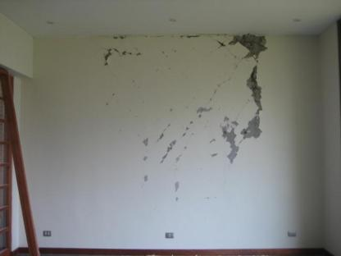
1st floor shear wall damage

Slide 12
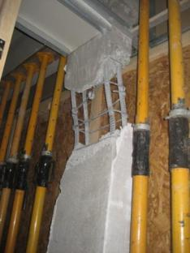
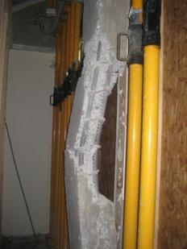
Column buckling at first floor

Slide 13

Story Accelerations
Roof
9th
2nd
-1 st

Slide 14
Story Displacements
Roof
9th
2nd
-1 st

Slide 15
Particle Motion

Slide 16
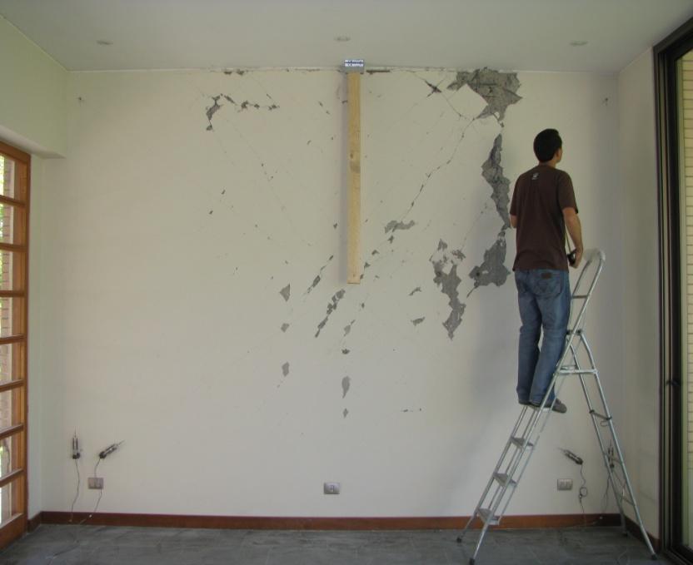
Shear and Flexure Deformations
Figure 4: Shear-flexure interaction for a wall subject to lateral loading. (adapted from Massone and Wallace, 2004)

Slide 17
Shear and flexure deformations
The rotation for flexure was taken at the base of the wall (so the top displacement is multiplied by the wall height), which is the largest value expected for flexure. If we assume that the flexure corresponds to a rotation at wall mid-height, the flexural component should be multiplied by 0.5.

Slide 18
Some Lessons Learned
Getting equipment in (luggage vs shipping, invitation letters, label equipment as non permanent)
Local collaboration is critical (building access, installation, translations)
GPS antenna location is critical
Ethernet cables have variable quality, bring your own plenum-rated & shielded
Trigger and recording needs optimization, consider continuous recording for few-day installations
Local student operation is possible but requires training & Skype

Slide 19
Needs
Needs
Reduced cabling or wireless
Simpler systems (Black Box) that can accompany the recon engineers and be deployed by non-experts

