Slide 1

Rapid Response: Instrumentation Needs and Technical Challenges
Jamison Steidl - UC Santa Barbara
Portable Broadband Instrument Center (PBIC)
Southern California Earthquake Center

Slide 2
Talk Outline
Point of View / Perspective
Urban vs. Remote
Technology that helps facilitate station security
Size matters
Real-time telemetry benefits and issues
Continuous Recording
Current Technology vs. Previous Generation

Slide 3
Point of View / Perspective
20+ years of experience working with the SCEC PBIC equipment at UCSB
1992 Joshua Tree and Landers RAMP
1994 Northridge Ramp
1999 Hector Mine Ramp
2003 San Simeon Ramp
2004 Parkfield Ramp
2010 El Mayor Ramp

Slide 4
Rapid Response: Urban vs. Remote
Urban Ramp
Clear view of sky for GPS timing is often an issue
Small footprint makes building/land owners more comfortable
Smaller AC Power supply with charge controller and small battery
Coupling sensor to Earth for ground response observations
SSI – Free Field or building response
Remote Ramp
Secure location
Low power, autonomous, with ability to telemeter state of health at a minimum
Often marginal or no land-based communications service
Costly to maintain if the sites have to be visited regularly
Costly to integrate the data into the regional network after the fact.

Slide 5
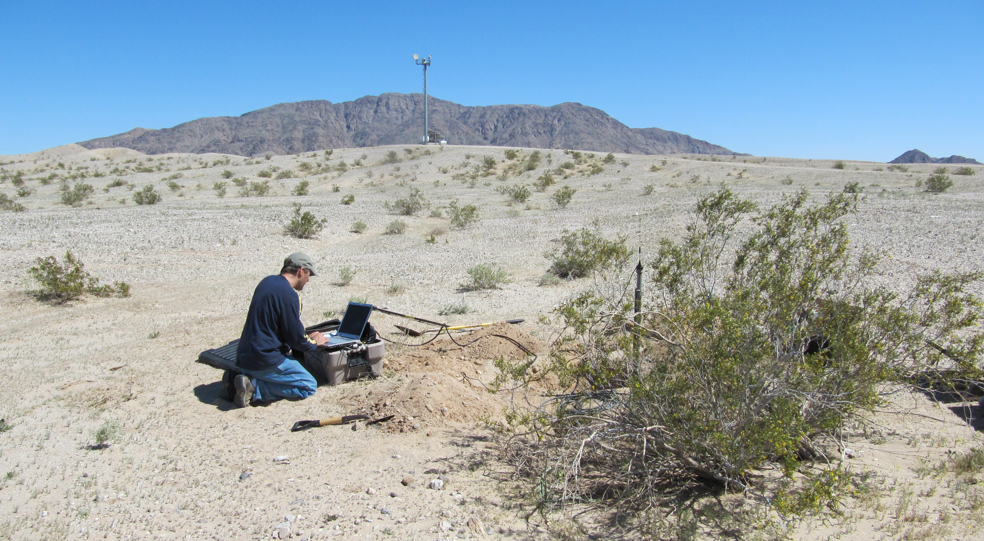
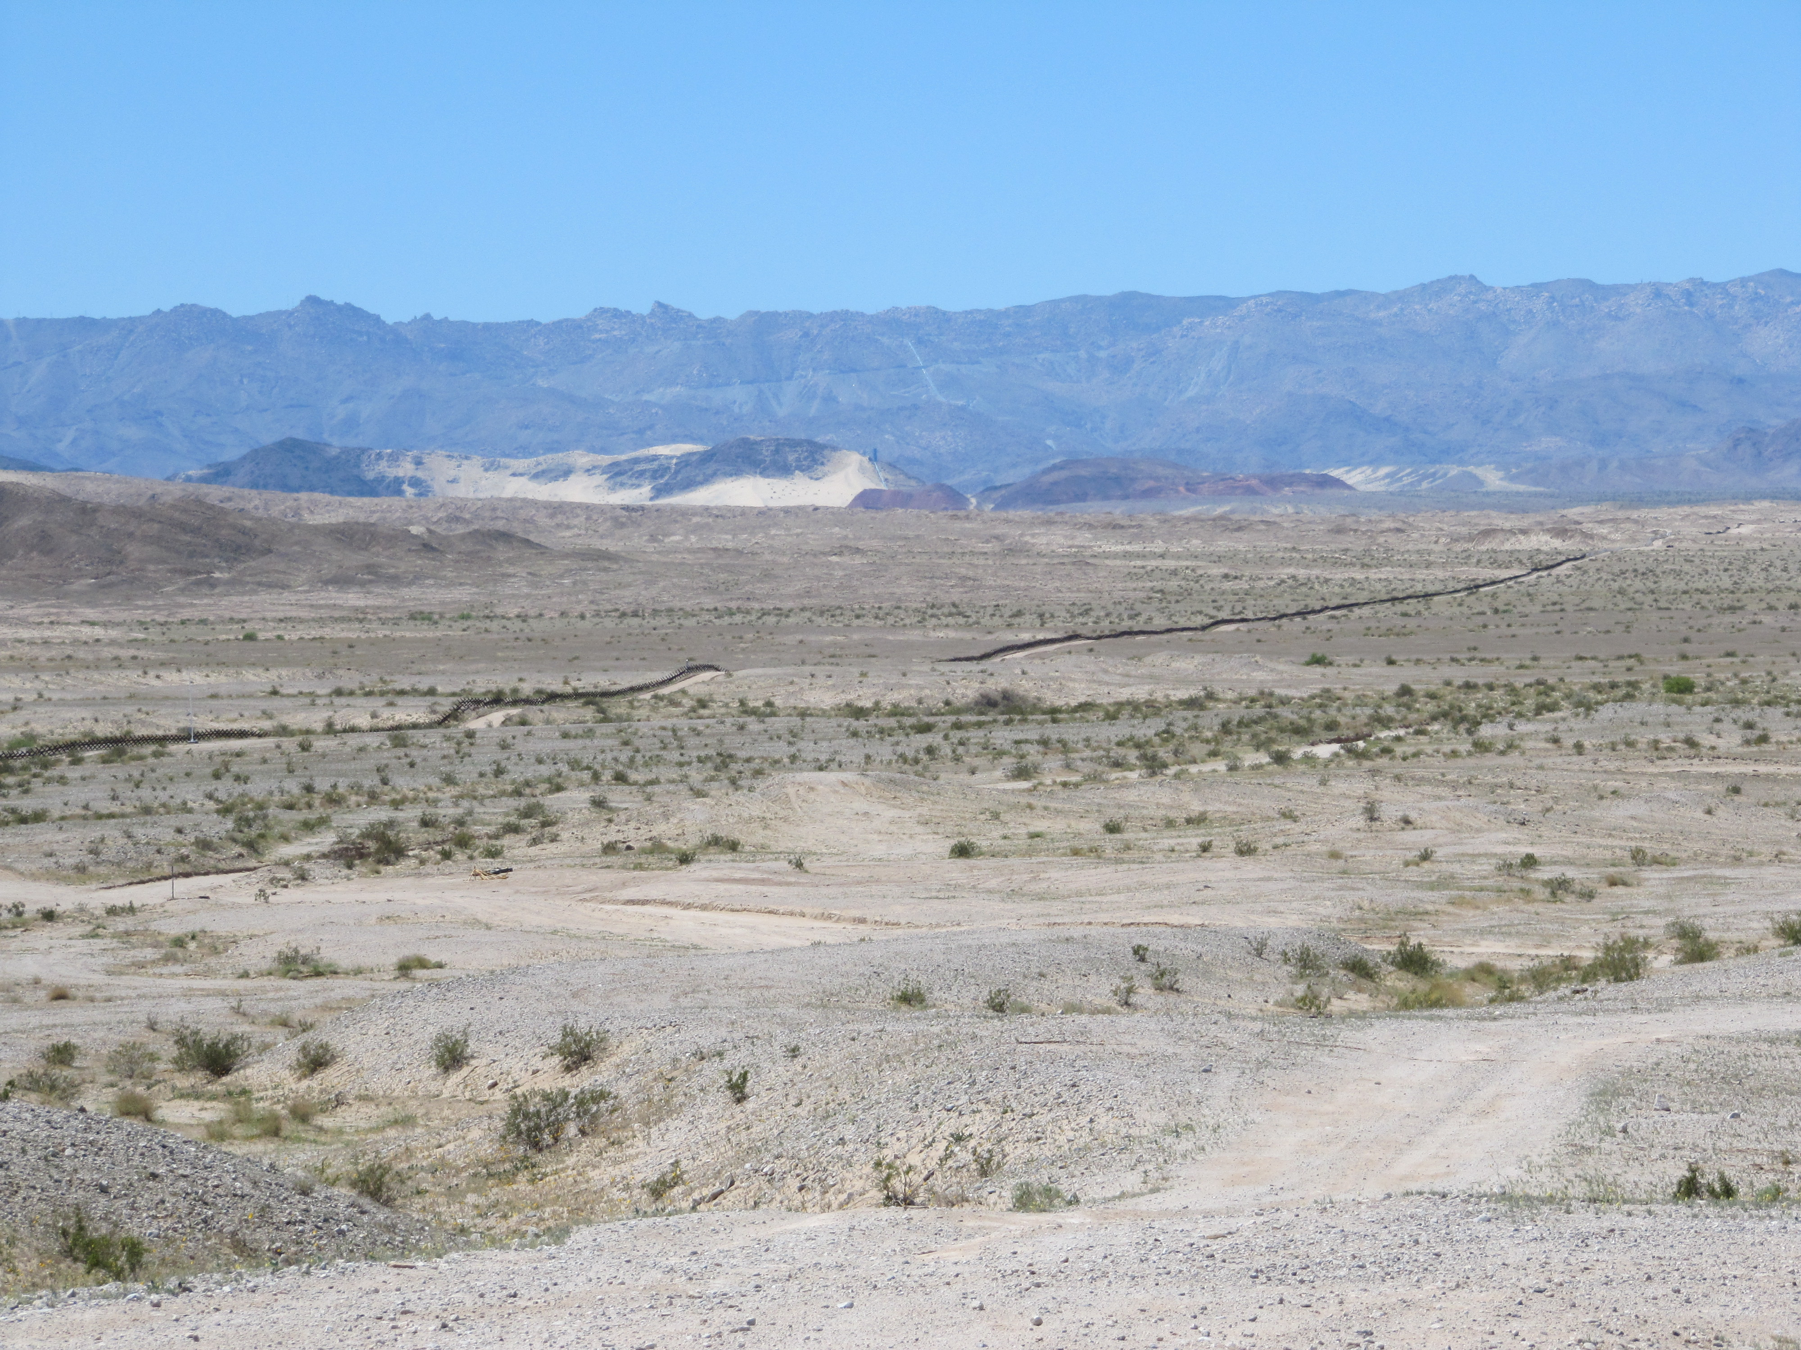
Station Security
El Mayor RAMP 2010 – Unmanned Border Patrol camera towers

Slide 6
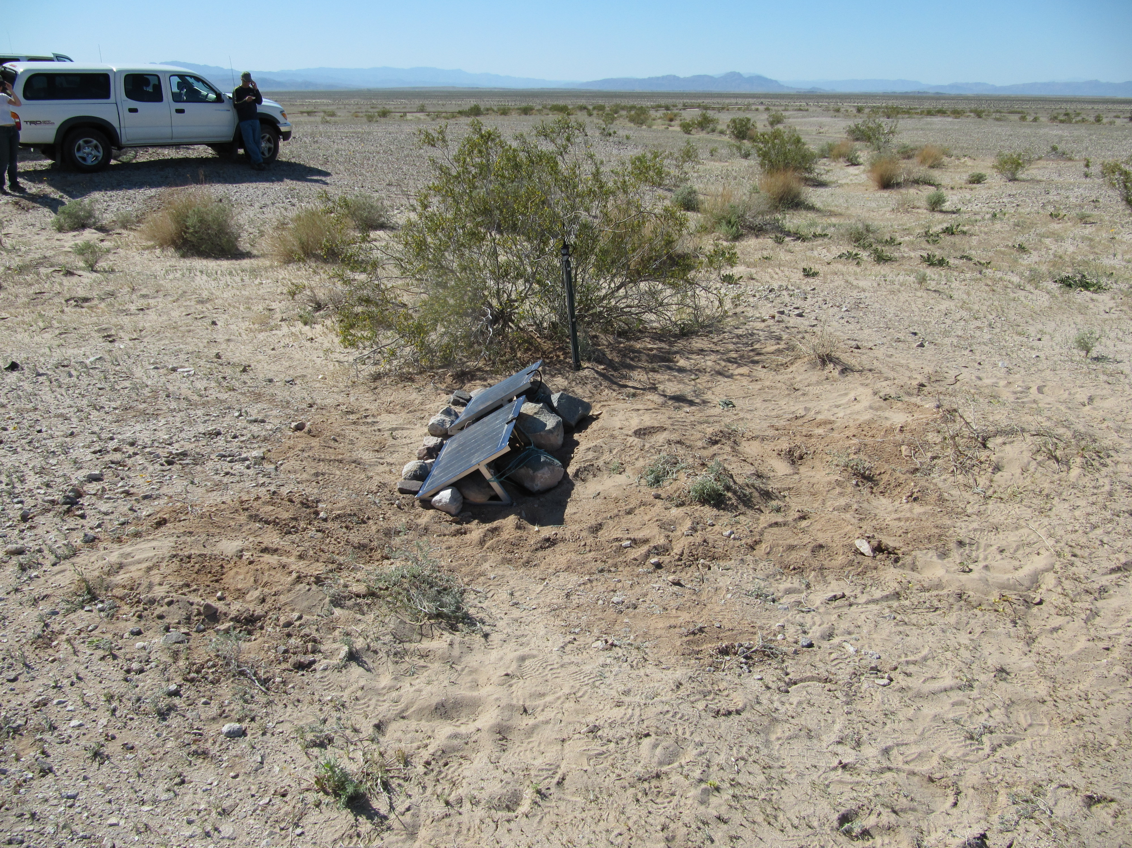
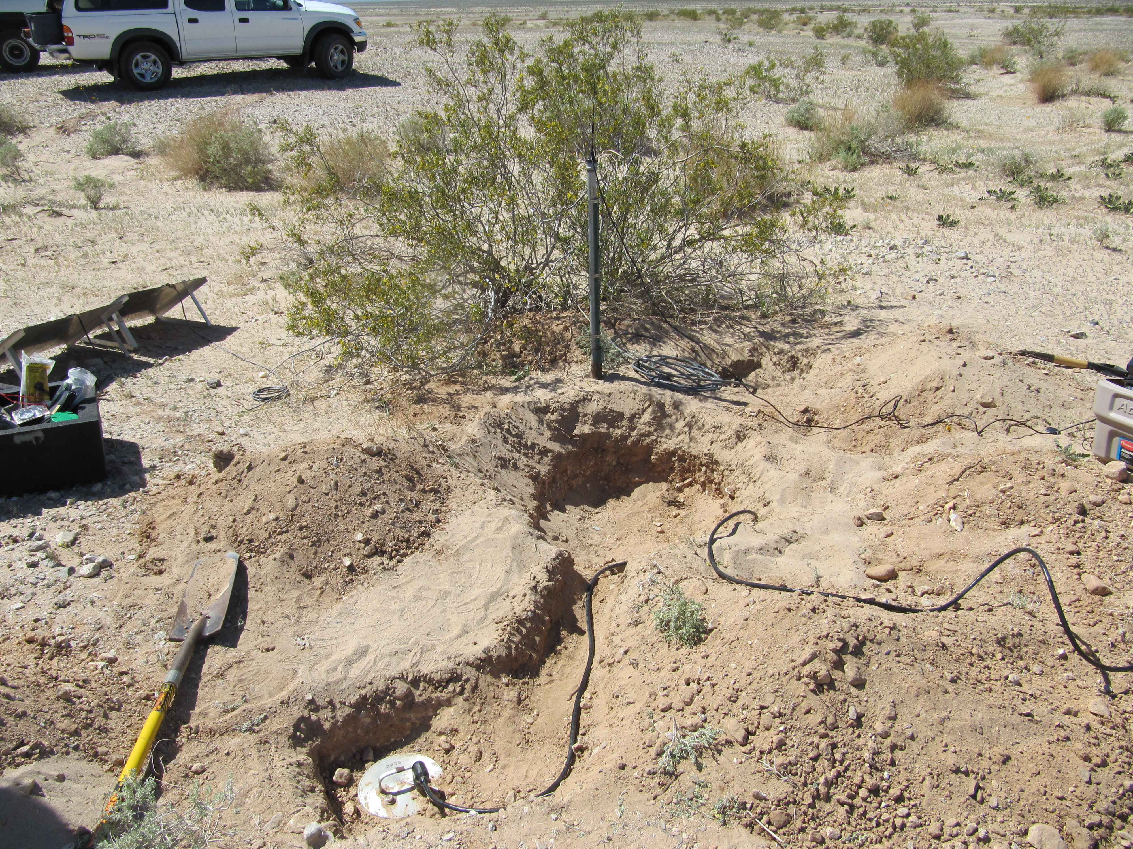
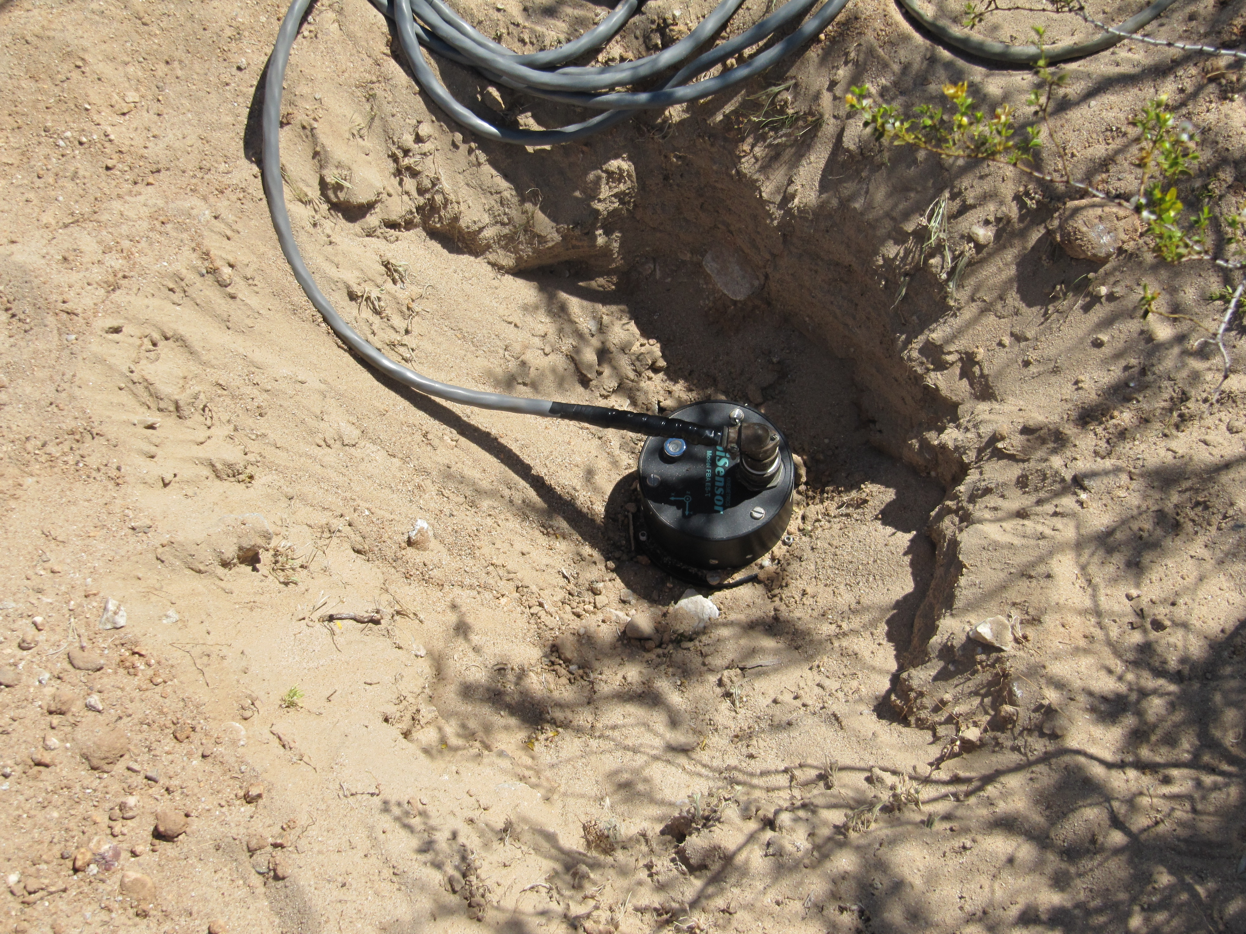
Velocity and Acceleration Sensors
Completed site is low profile with equipment box buried

Slide 7
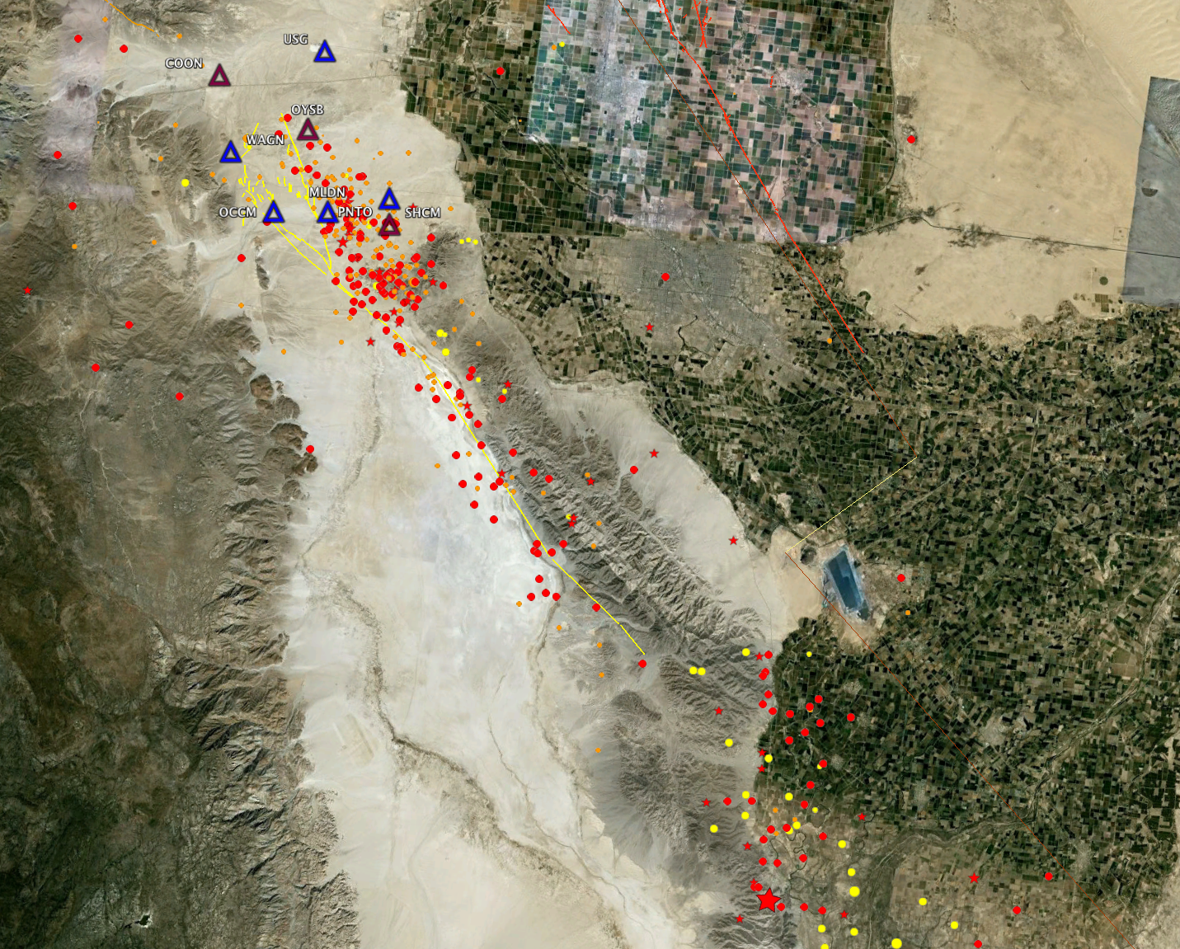
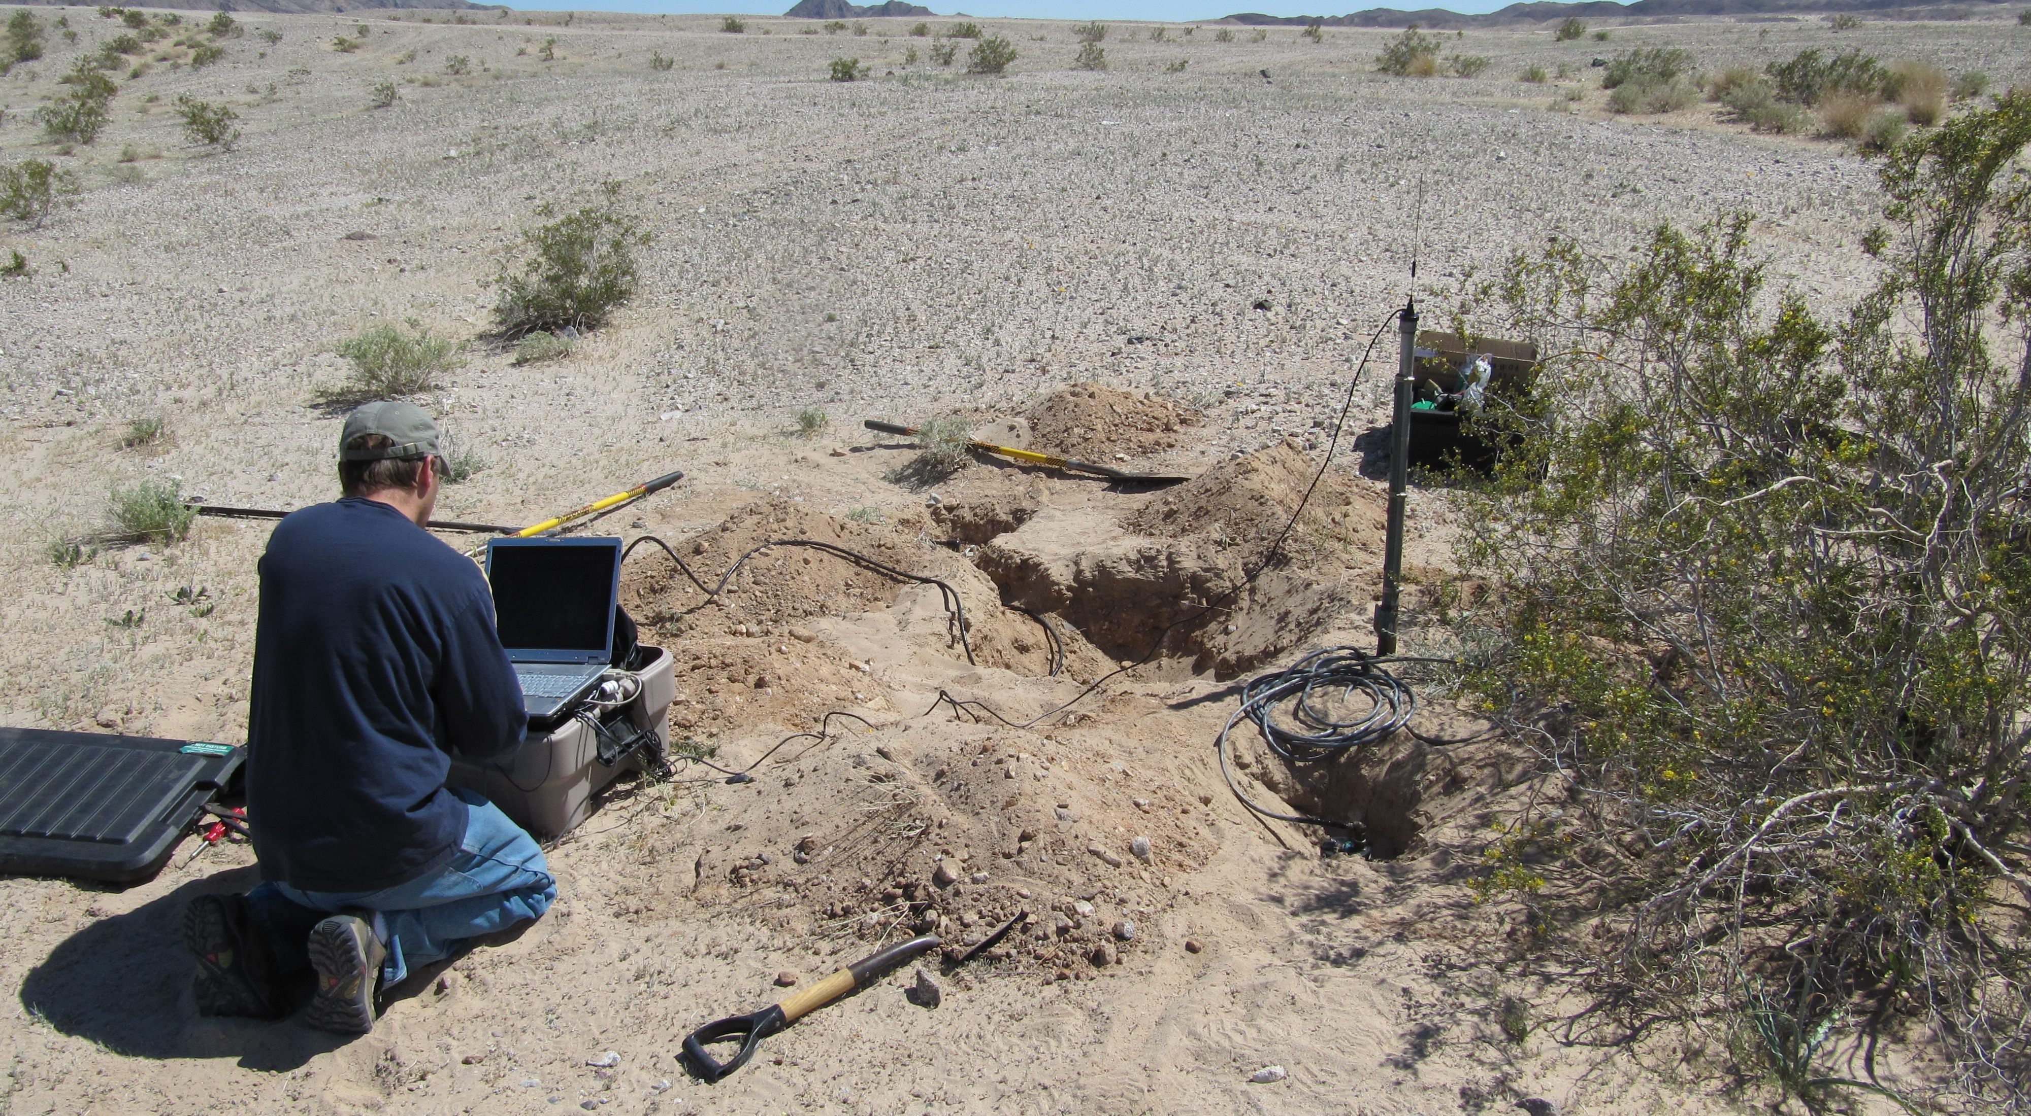
Telemetry Issues Close to the Border

Slide 8
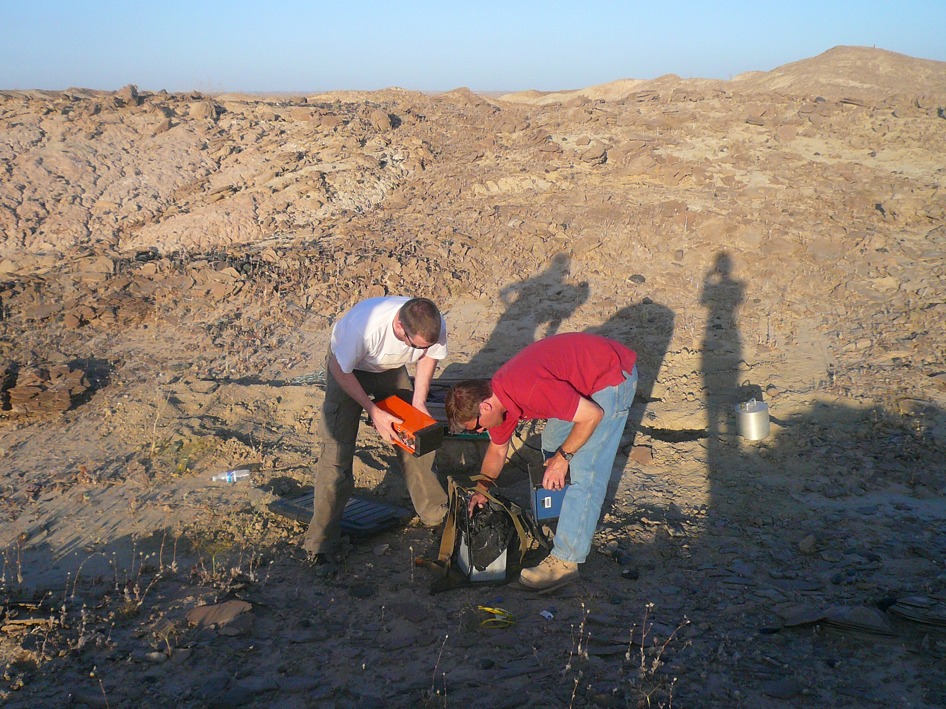
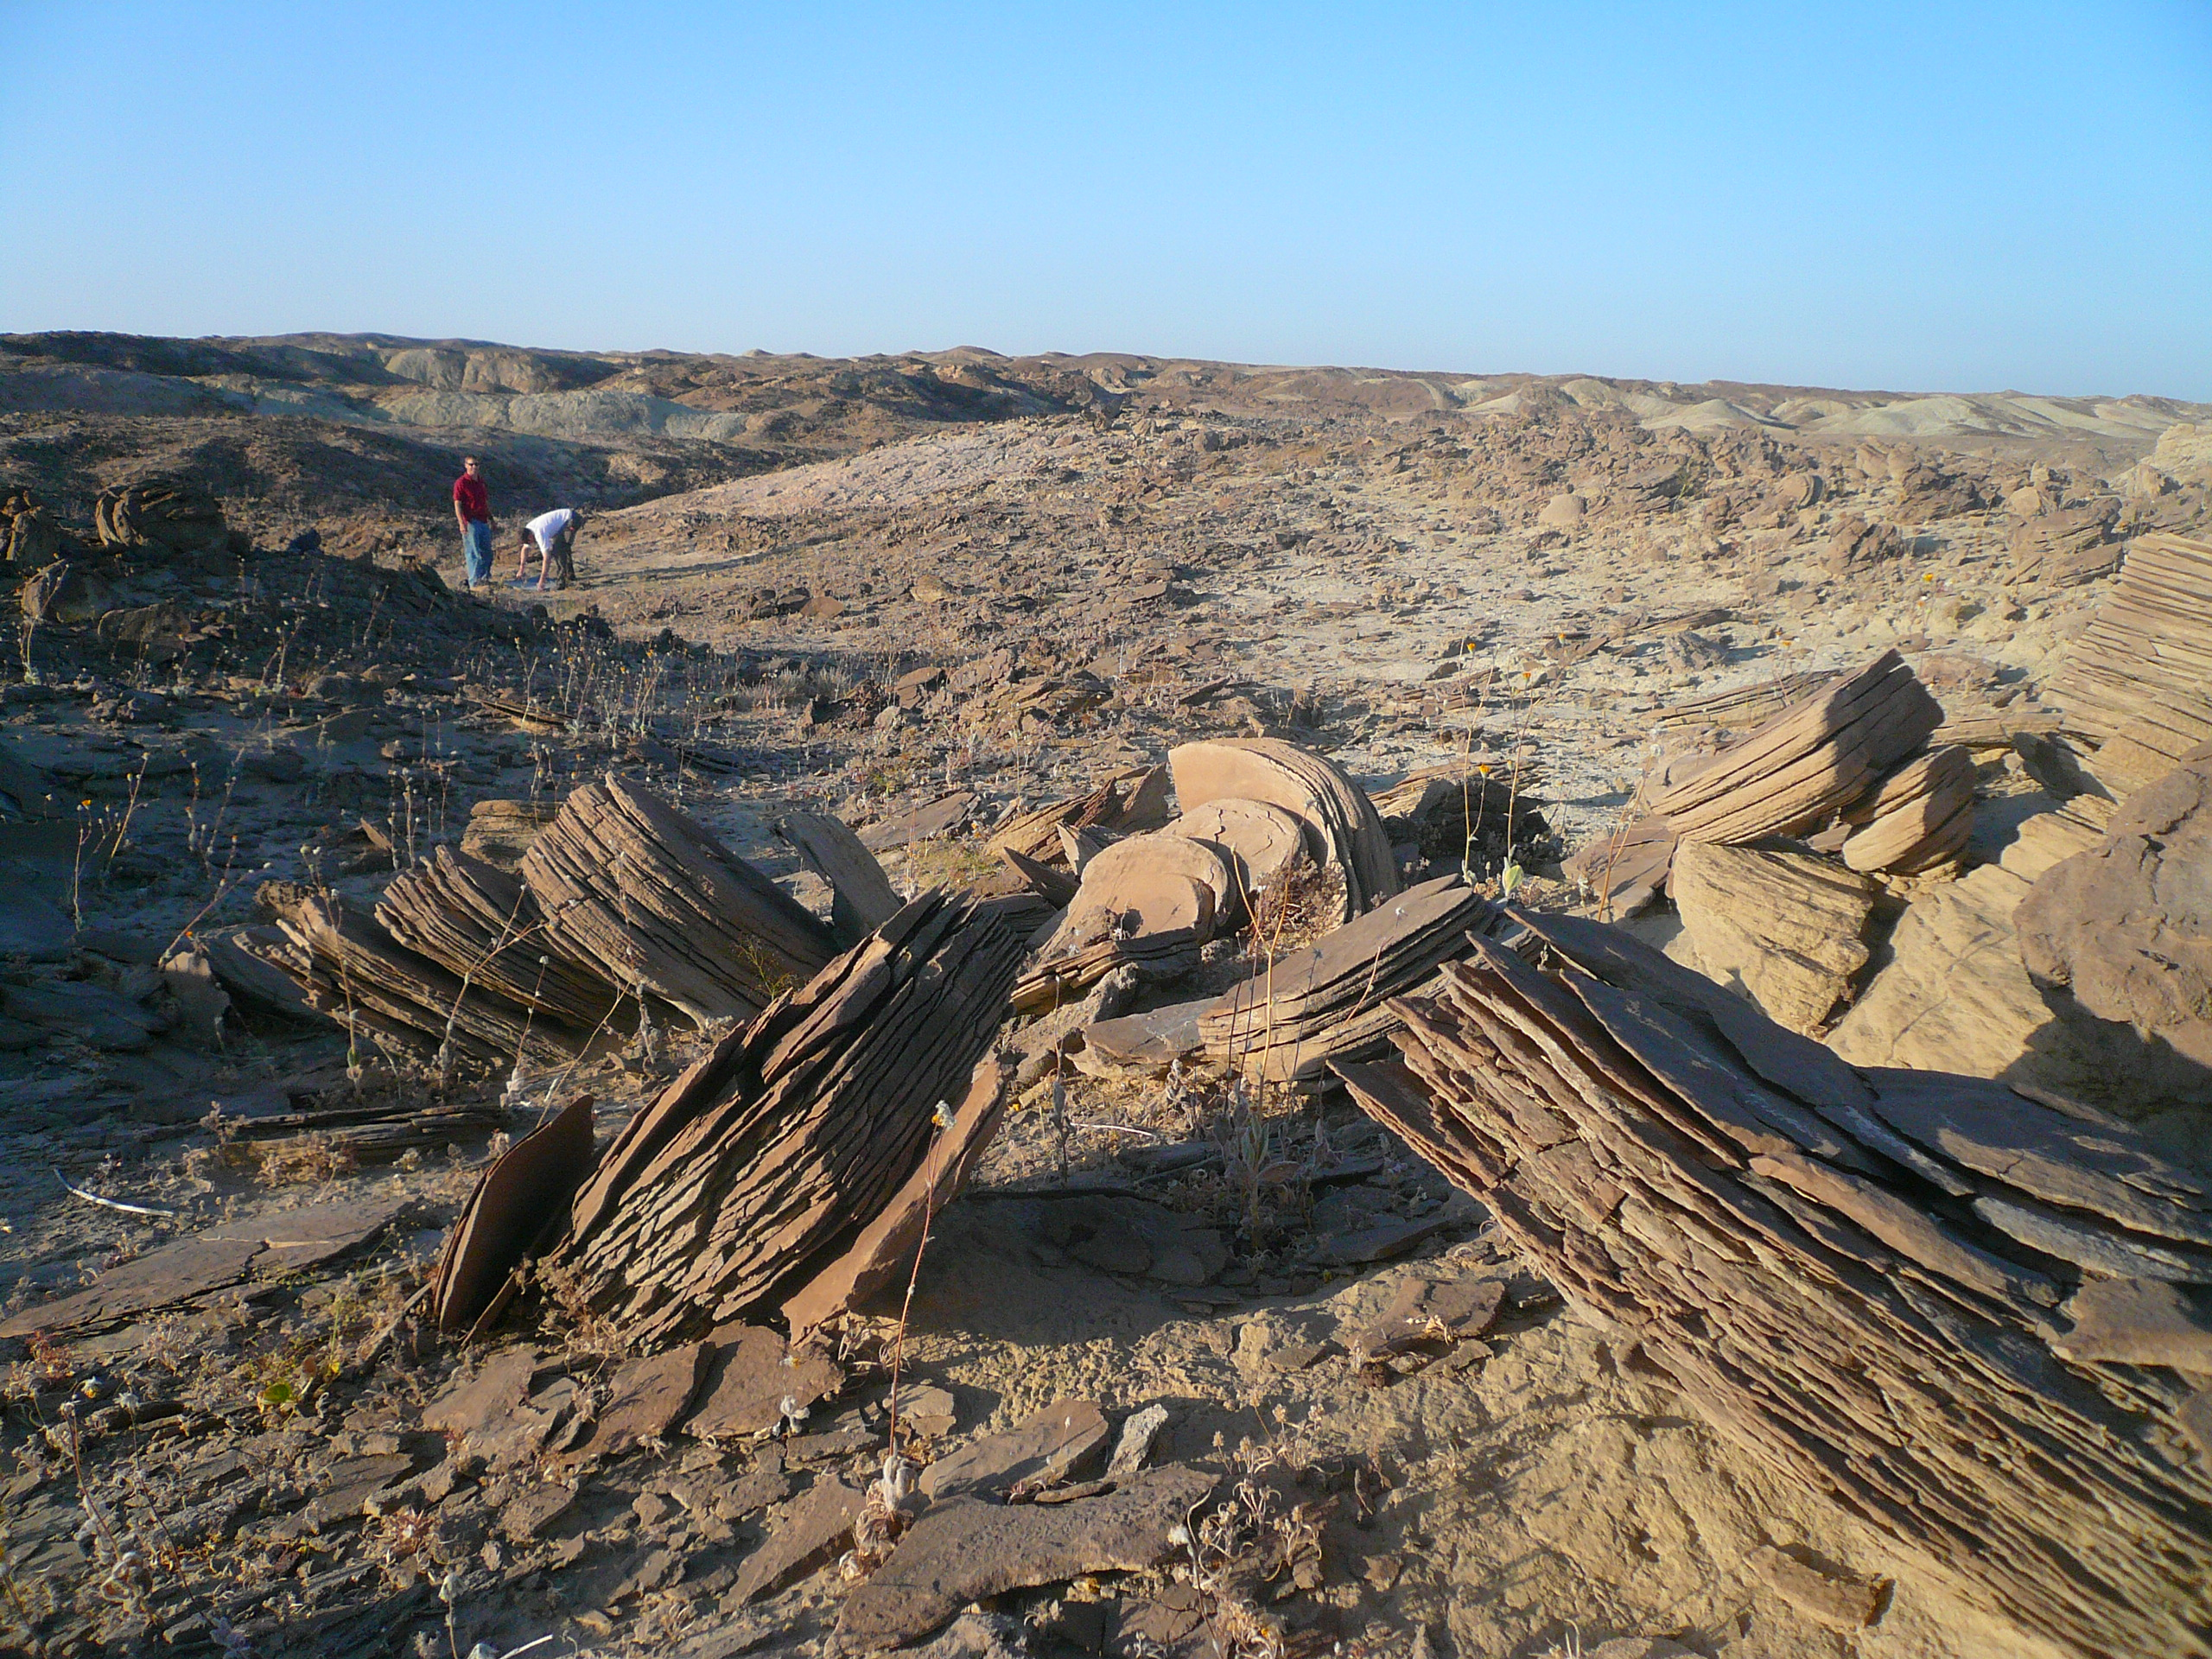
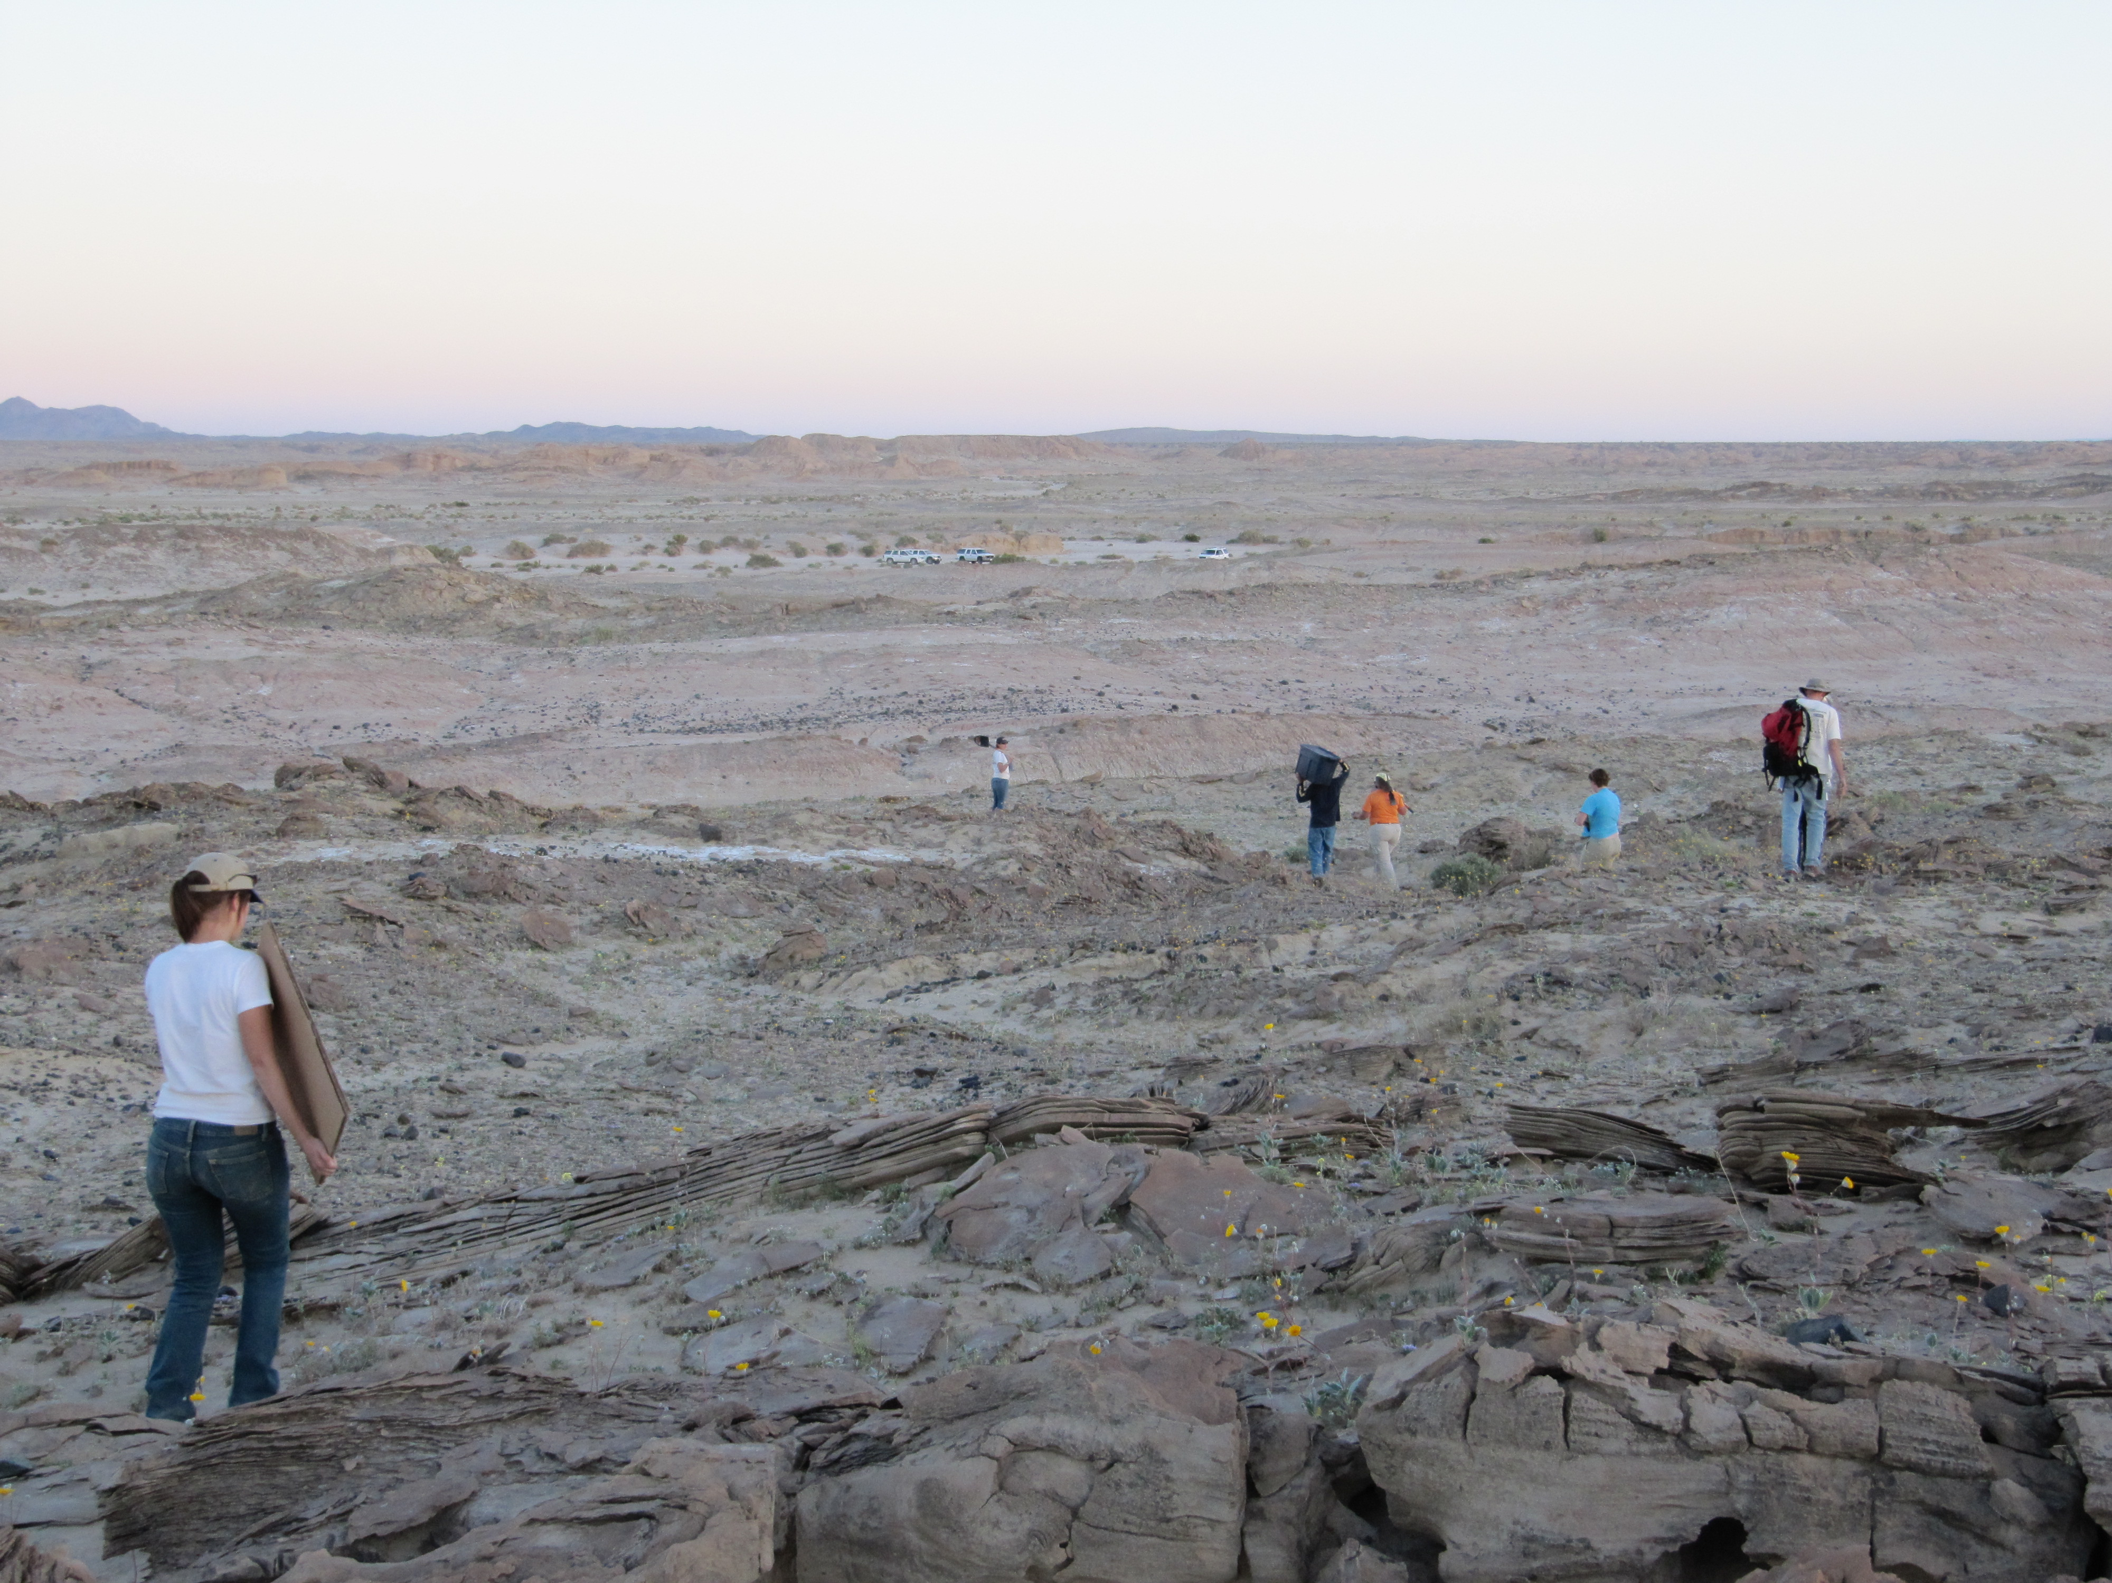
Remote RAMP – Size / Weight Matters!
El Mayor RAMP 2010 – Station OYSB

Slide 9
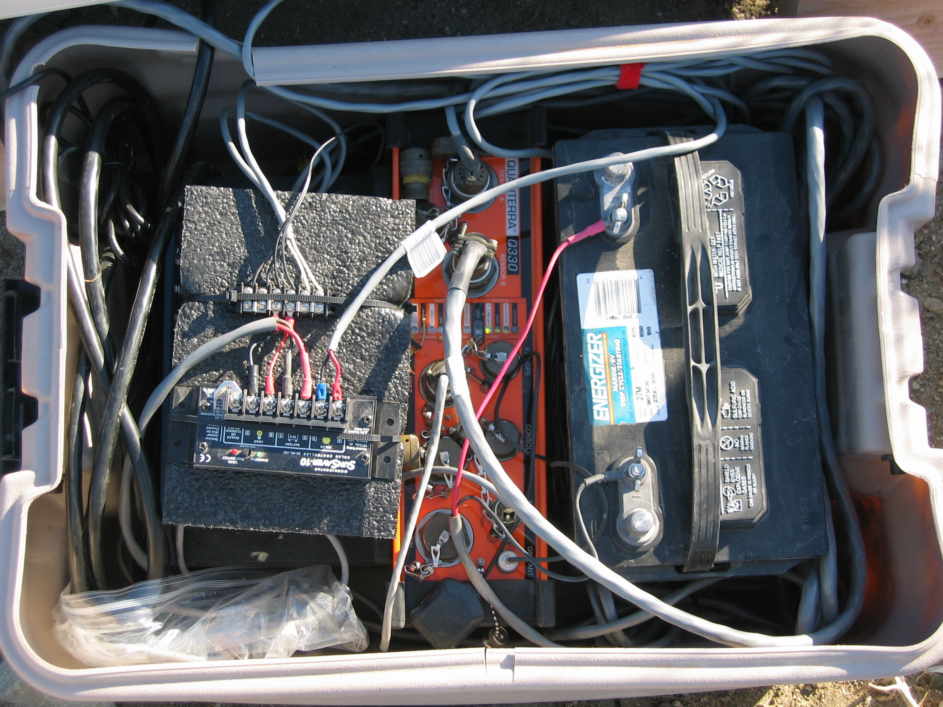
Portable Equipment Box
No time for Vault set up

Slide 10
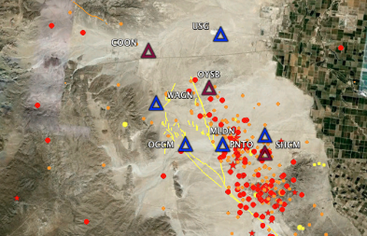
Telemetry Matters
Integration of data directly into regional networks

Slide 11
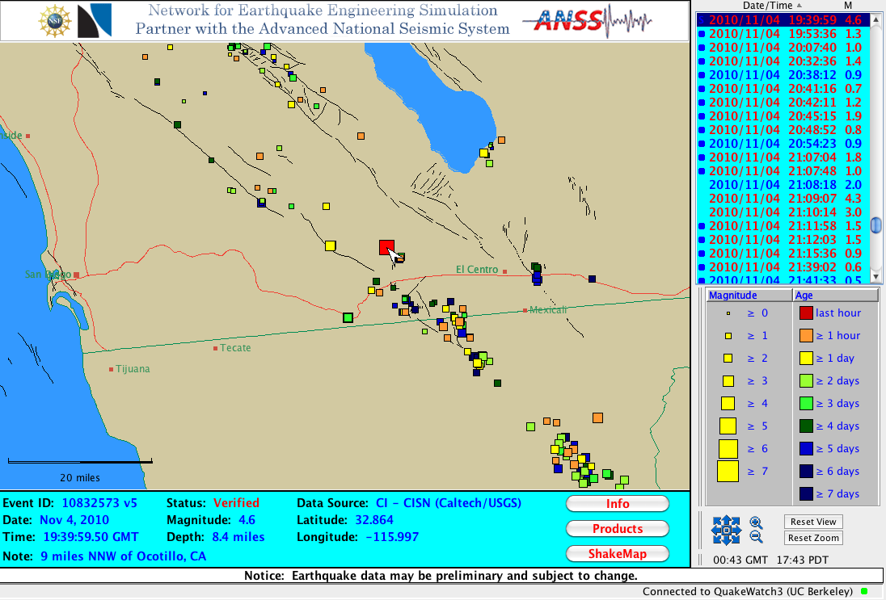
Telemetry Matters
Integration of data directly into regional networks

Slide 12
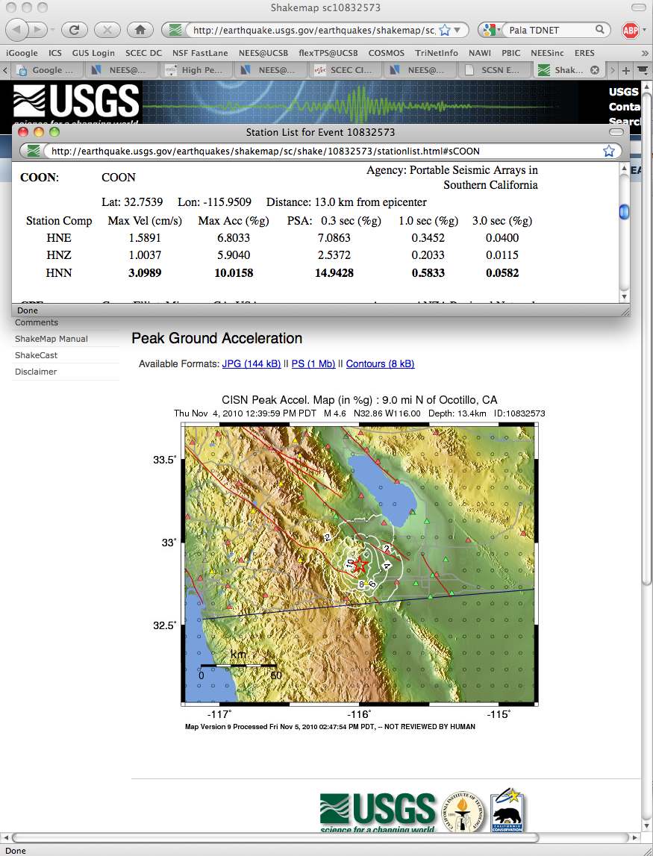
Telemetry Matters
Integration of data directly into regional networks

Slide 13
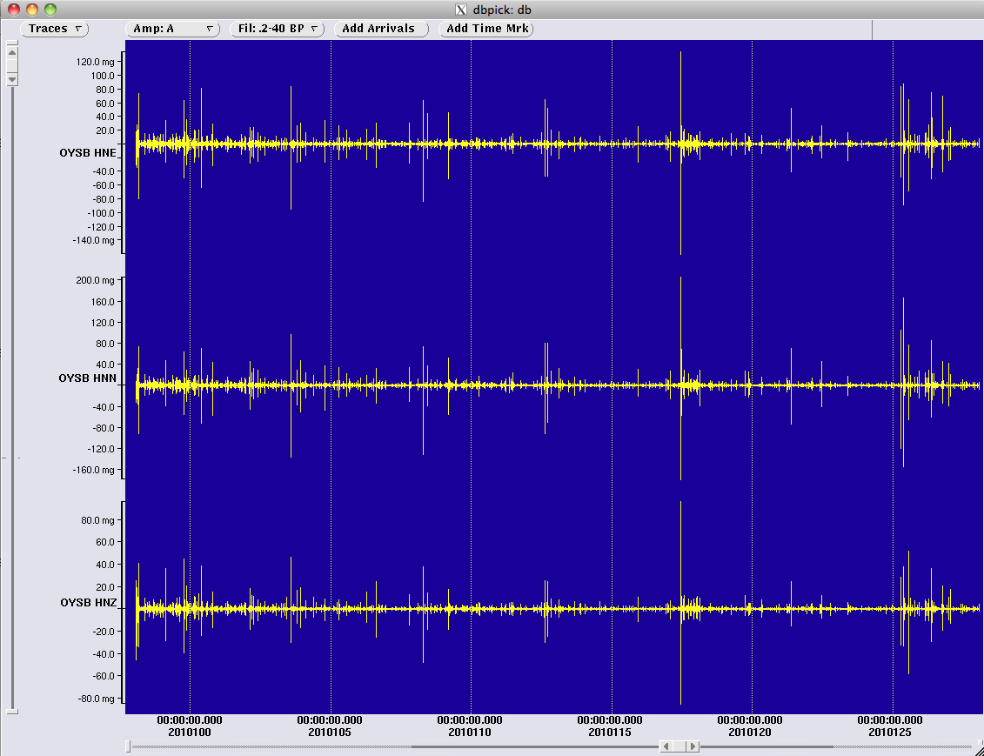
Continuous Recording Matters
OYSB – 1 Month Continuous Data

Slide 14
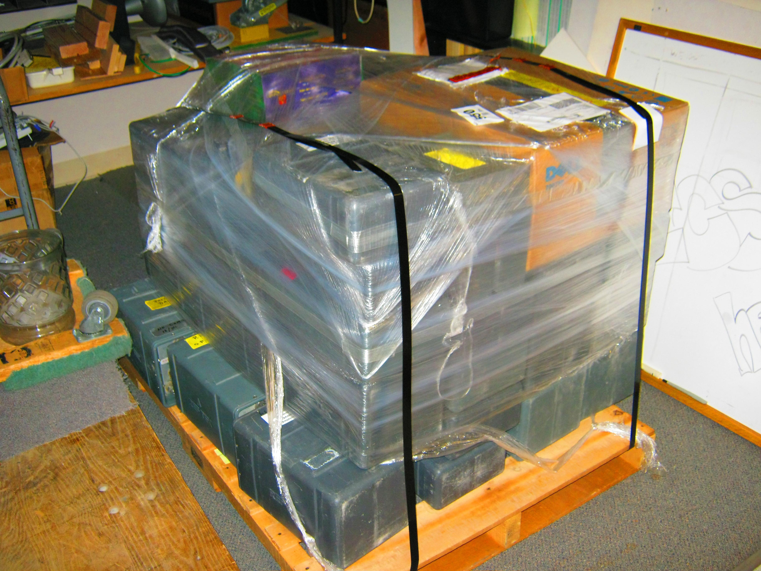
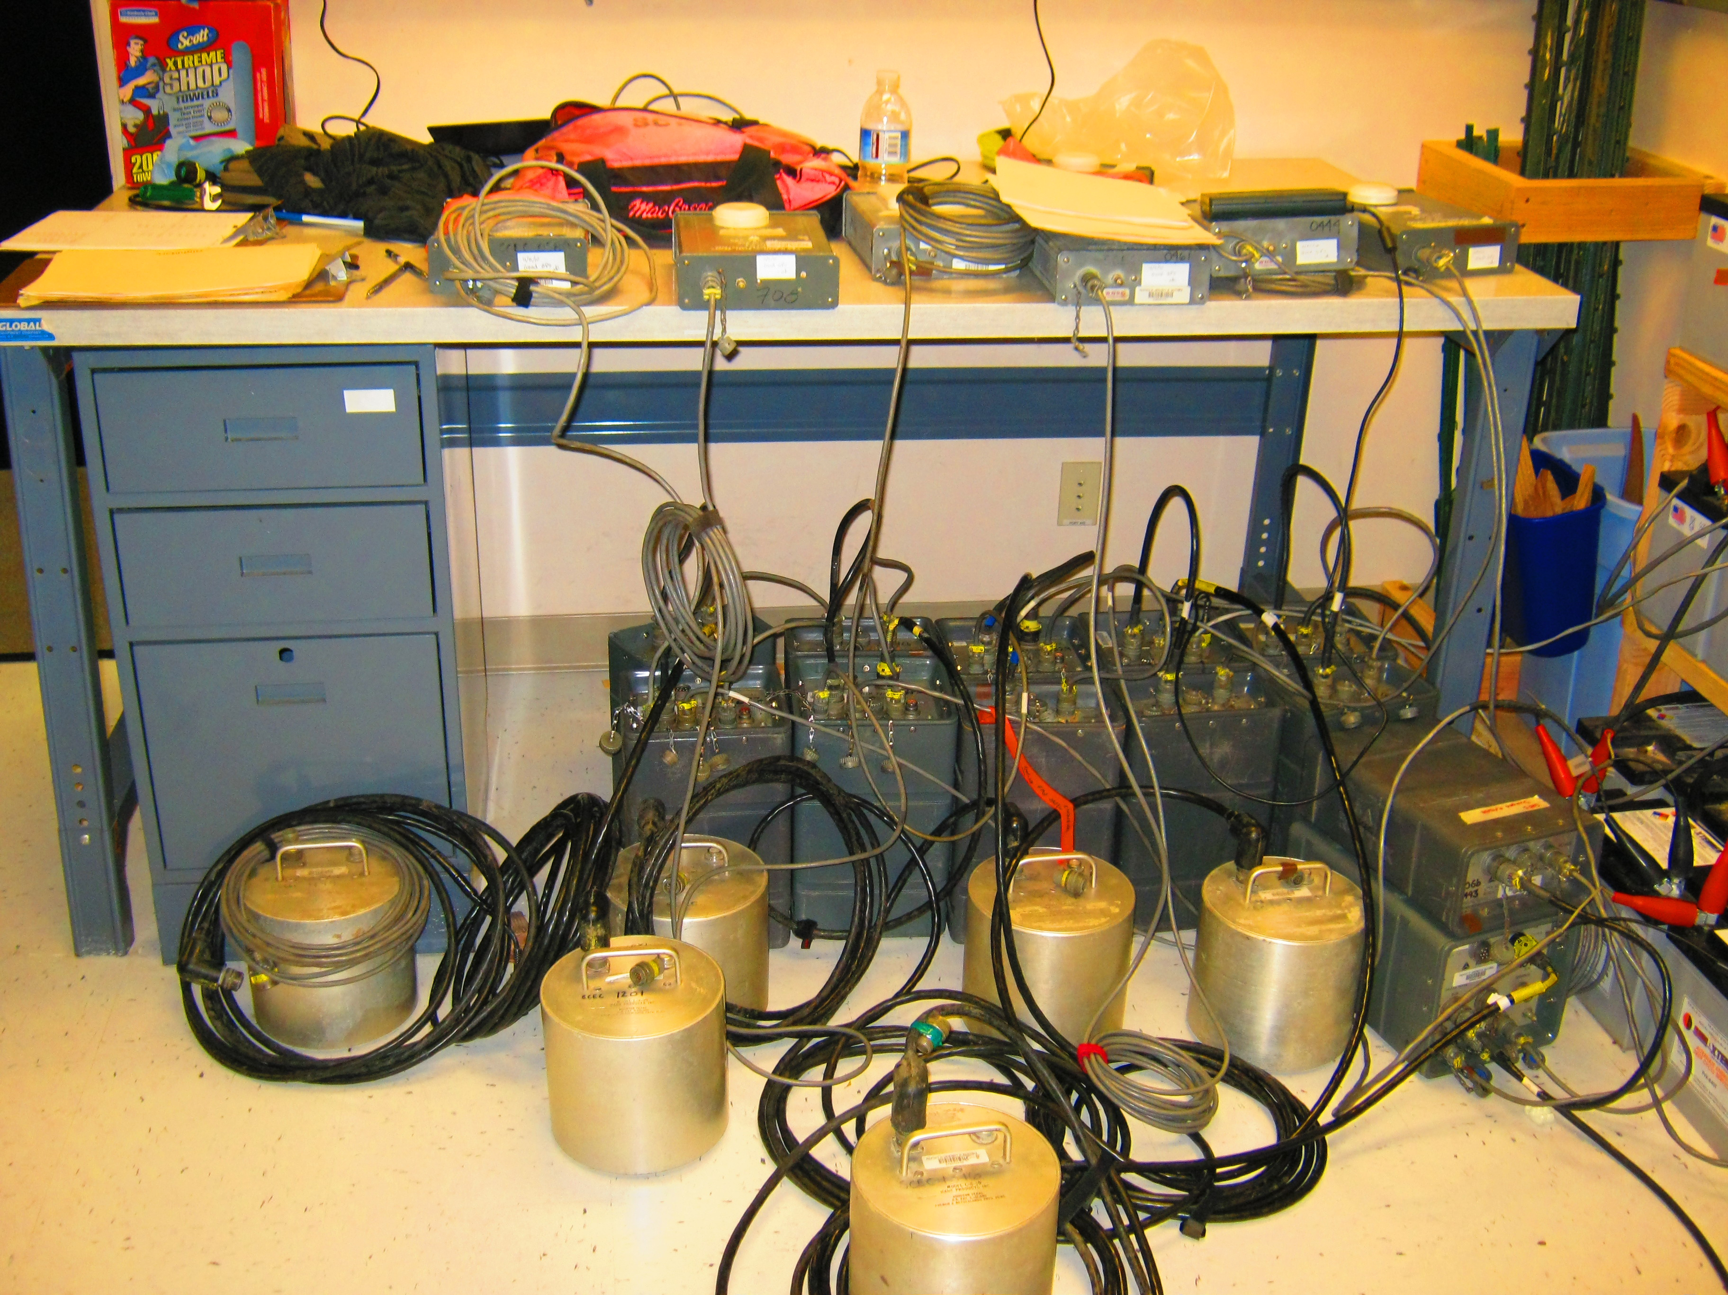
Most PBIC Equipment
DOE leftovers (left) 20 year old technology
Difficult to integrate data into regional network

Slide 15
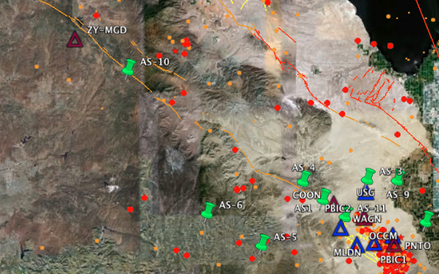
Current Technology integrates into Regional Networks Easily
Station MGD deployed along Elsinore Fault

Slide 16
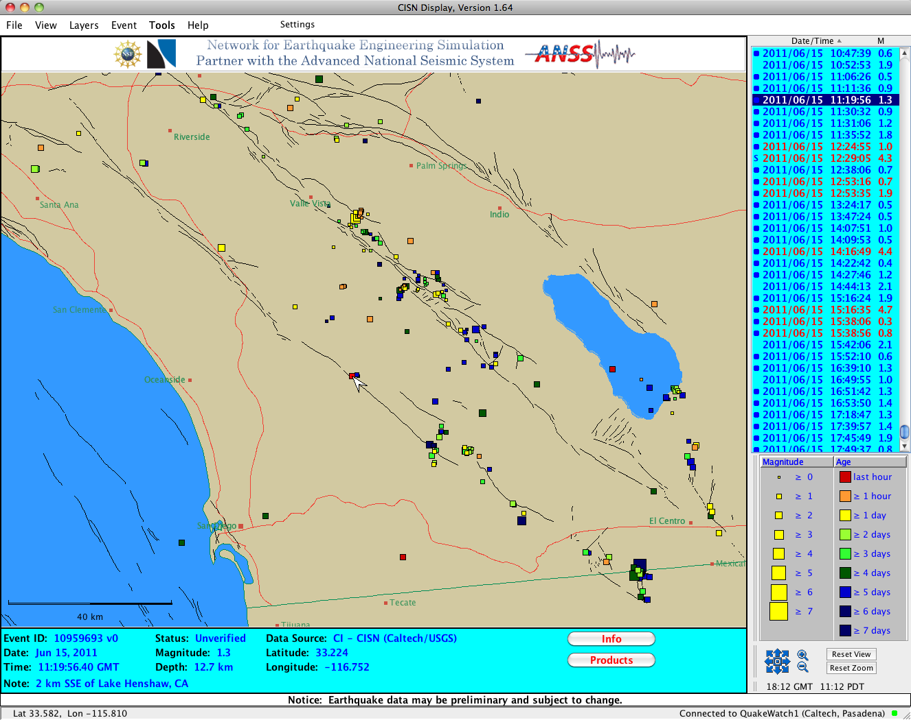
Current Technology integrates into Regional Networks Easily
Station MGD deployed along Elsinore Fault

Slide 17
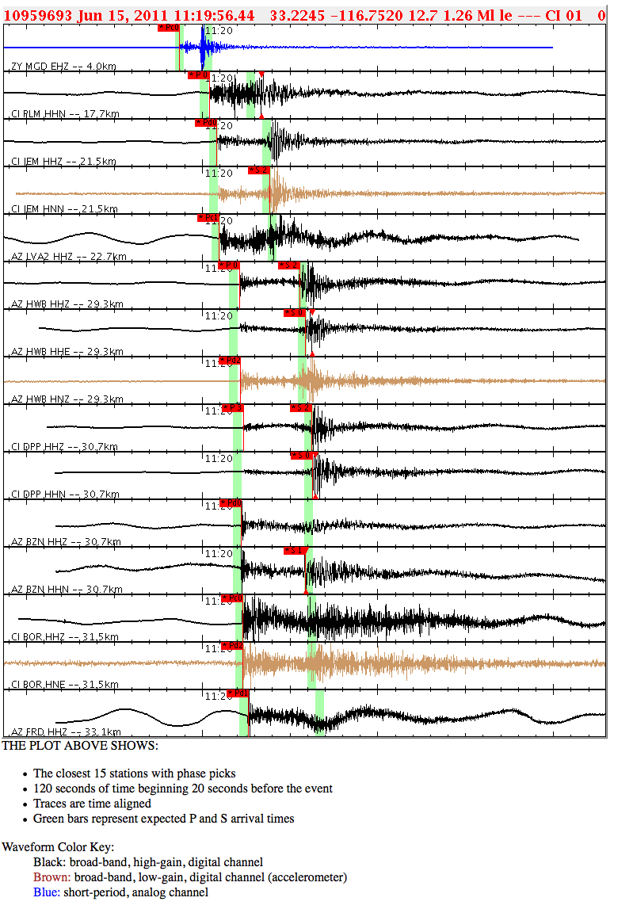
Current Technology integrates into Regional Networks Easily
Station MGD deployed along Elsinore Fault used to locate earthquake by the regional network
Currently only 2 of 20 PBIC stations are new technology

