Slide 1
Earthquake Early Warning
Tom Heaton
Egill Hauksson
Georgia Cua
Masumi Yamada
Maren Bӧse

Slide 2
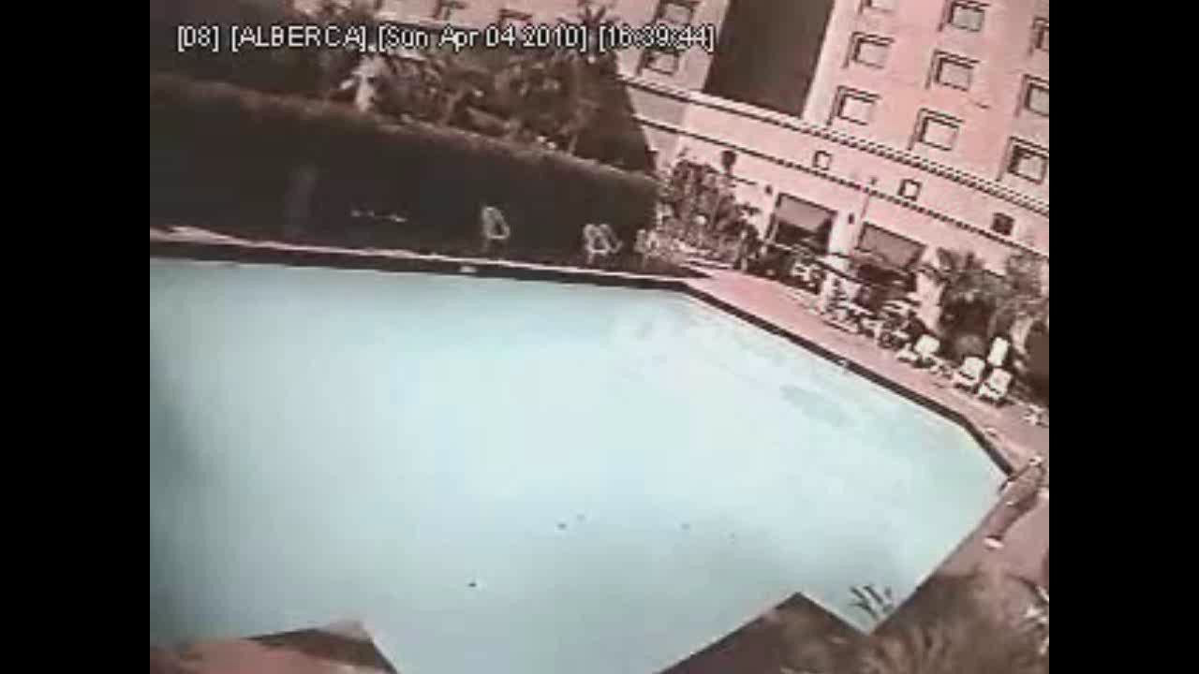
In Mexicali during 2010 M 7 Cucapah-ElMajor

Slide 3

But who needs a swimming pool EEW system??

Slide 4
Station Requirements
Must be fast (processing/telemetry latency less than 1 sec.)
Must be onscale
Must be at least two sensors in the epicentral region

Slide 5
Desired
Broad band/high dynamic range
True displacement (GPS)
Ability for onsite processing
Plug and play
And all that other stuff that we want for next to nothing

Slide 6
SCSN
250 stations with 24-bit Quanterras recording STS-2’s and Episensors
Network was designed with early warning in mind
Been a great tool for EEW research and is the basis for our prototype system

Slide 7
What is Early Warning?
Most of the time it is from a M < 5 ½ … it is entertainment
Do not underestimate entertainment
Sometimes it is from M 5 ½ M 6 ¾ … source can be treated as a point … warning times to damaged areas are small
Rarely it is from M > 6 ¾ … some large warning times but must deal with a finite source (hard problem)

Slide 8
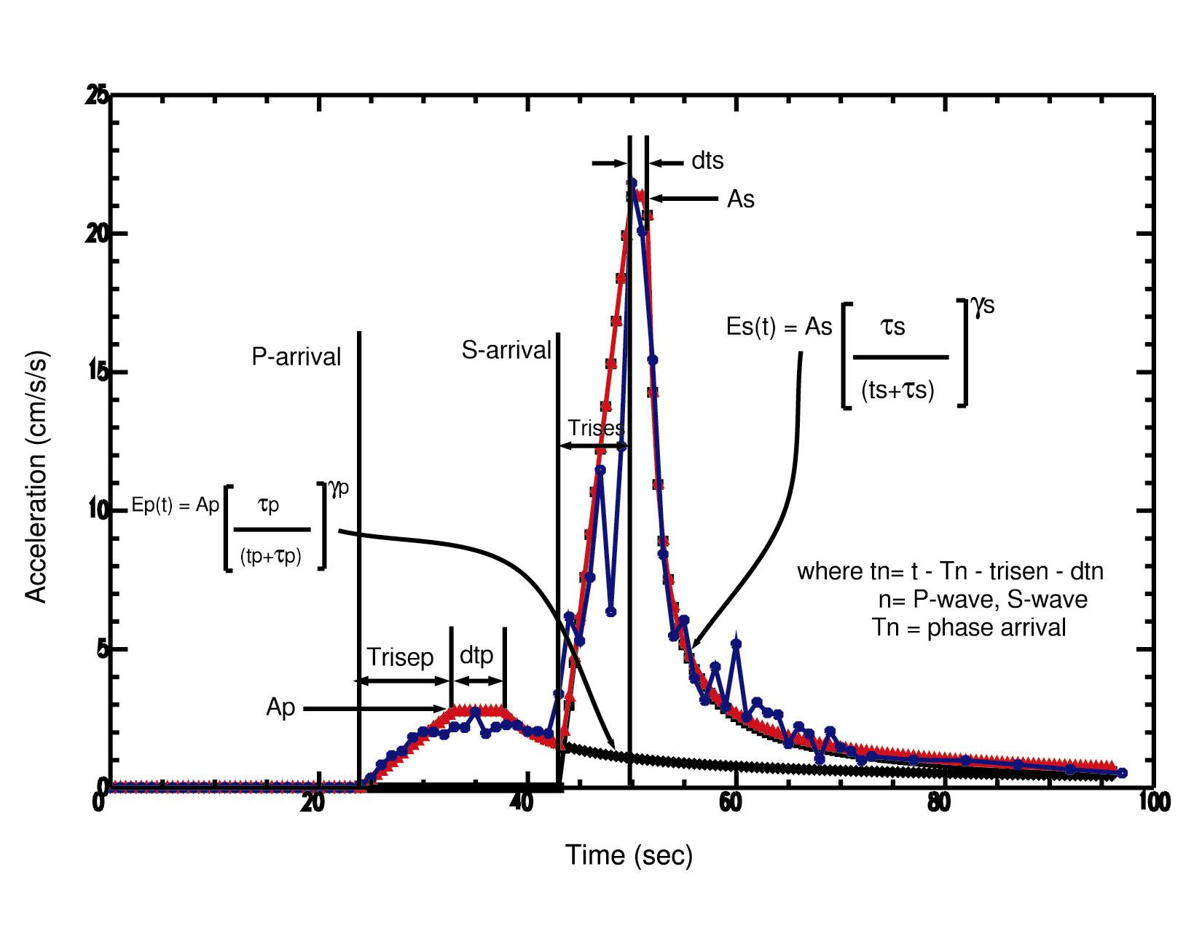
Modeling ground motion envelopes
Cua and Heaton
P,S-wave envelopes – rise time, duration, constant amplitude, 2 decay parameters
Noise - constant
model for observed envelope

Slide 9
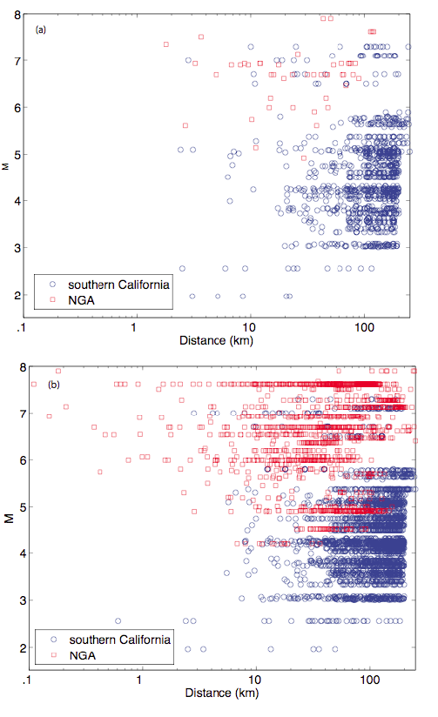
Distribution of Data
(a) rock sites
(b) soil sites

Slide 10
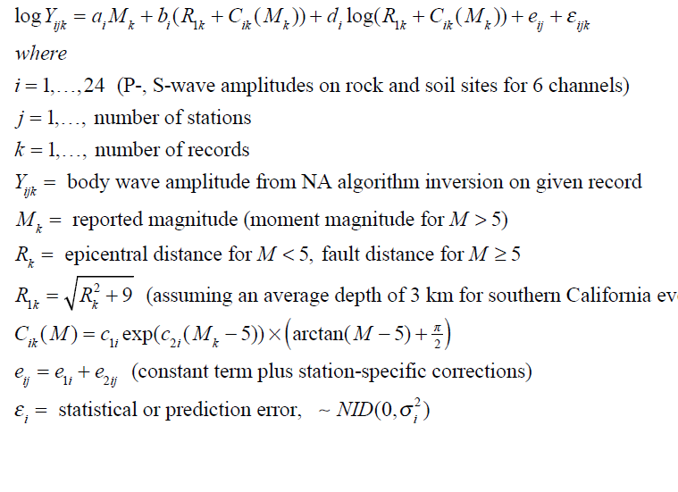

Slide 11
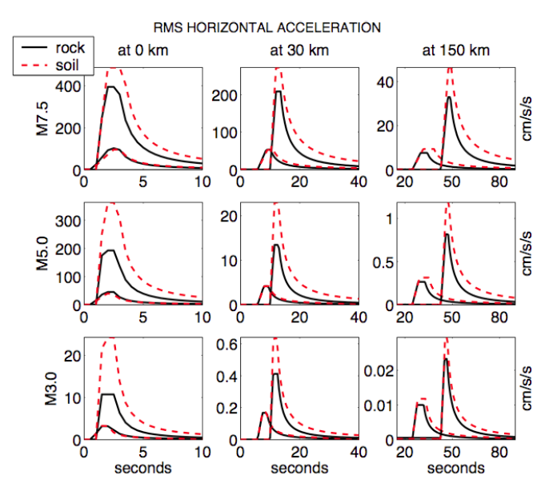

Slide 12
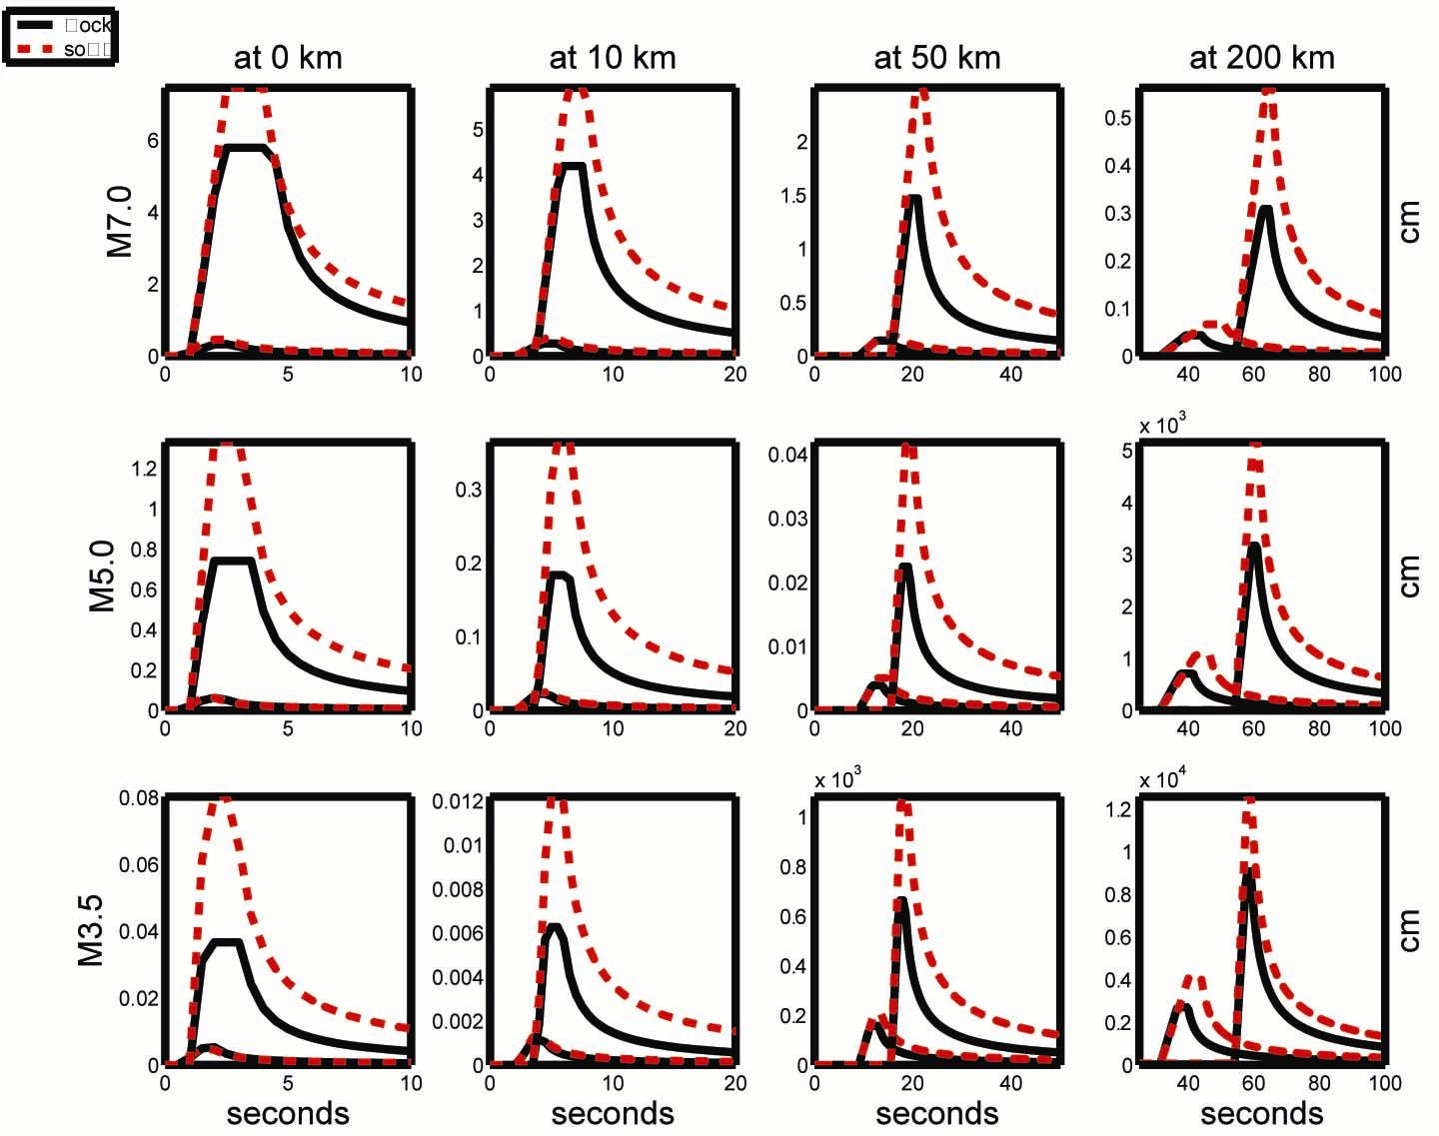
Average Rock and Soil envelopes as functions of M, R
(filtered) DISPLACEMENT

Slide 13
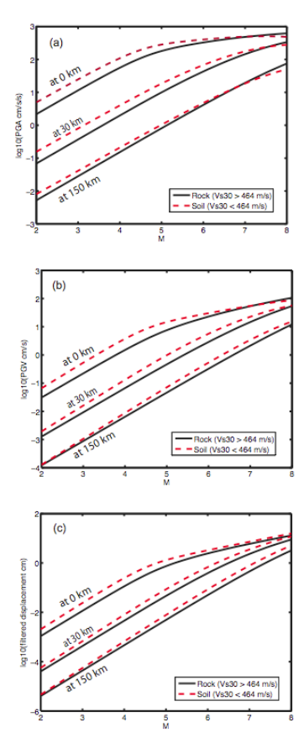
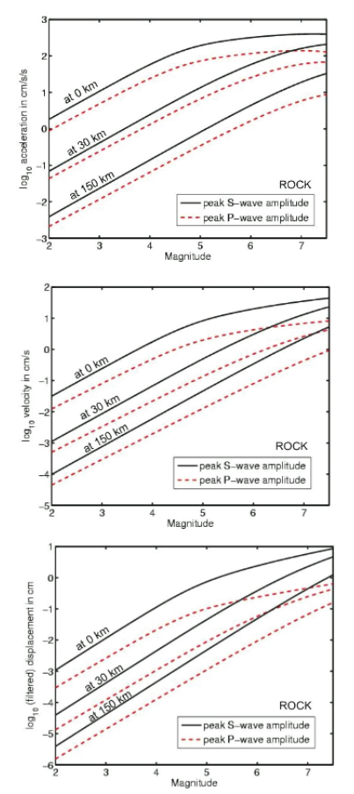

Slide 14
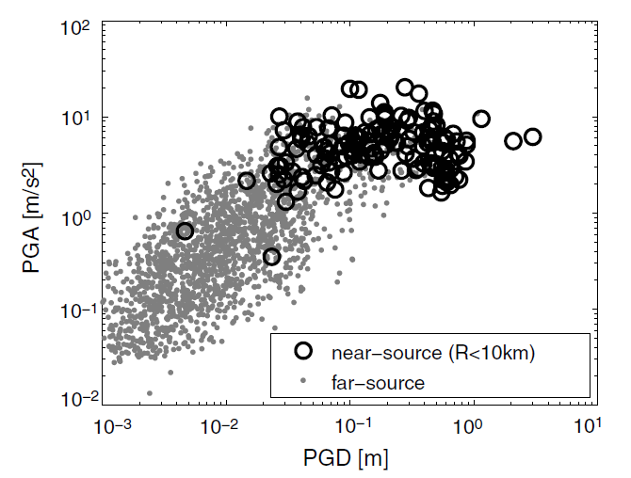

Slide 15
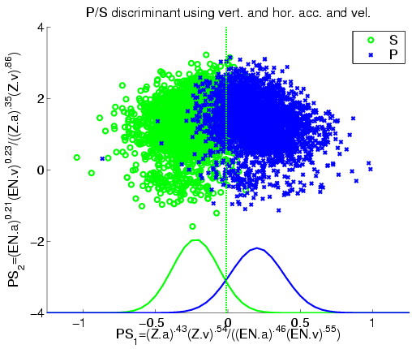

Distinguishing between P- and S-waves

Slide 16
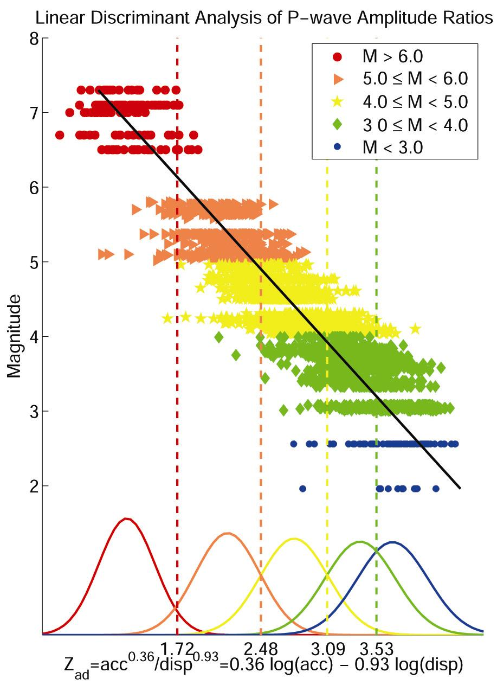


Estimating M from ratios of ground motion
P-wave frequency content scales
with M (Allen and Kanamori, 2003, Nakamura, 1988)
Find the linear combination of log(acc) and log(disp) that minimizes the variance within magnitude-based groups while maximizing separation between groups (eigenvalue problem)
Estimating M from Z_{ad}

Slide 17
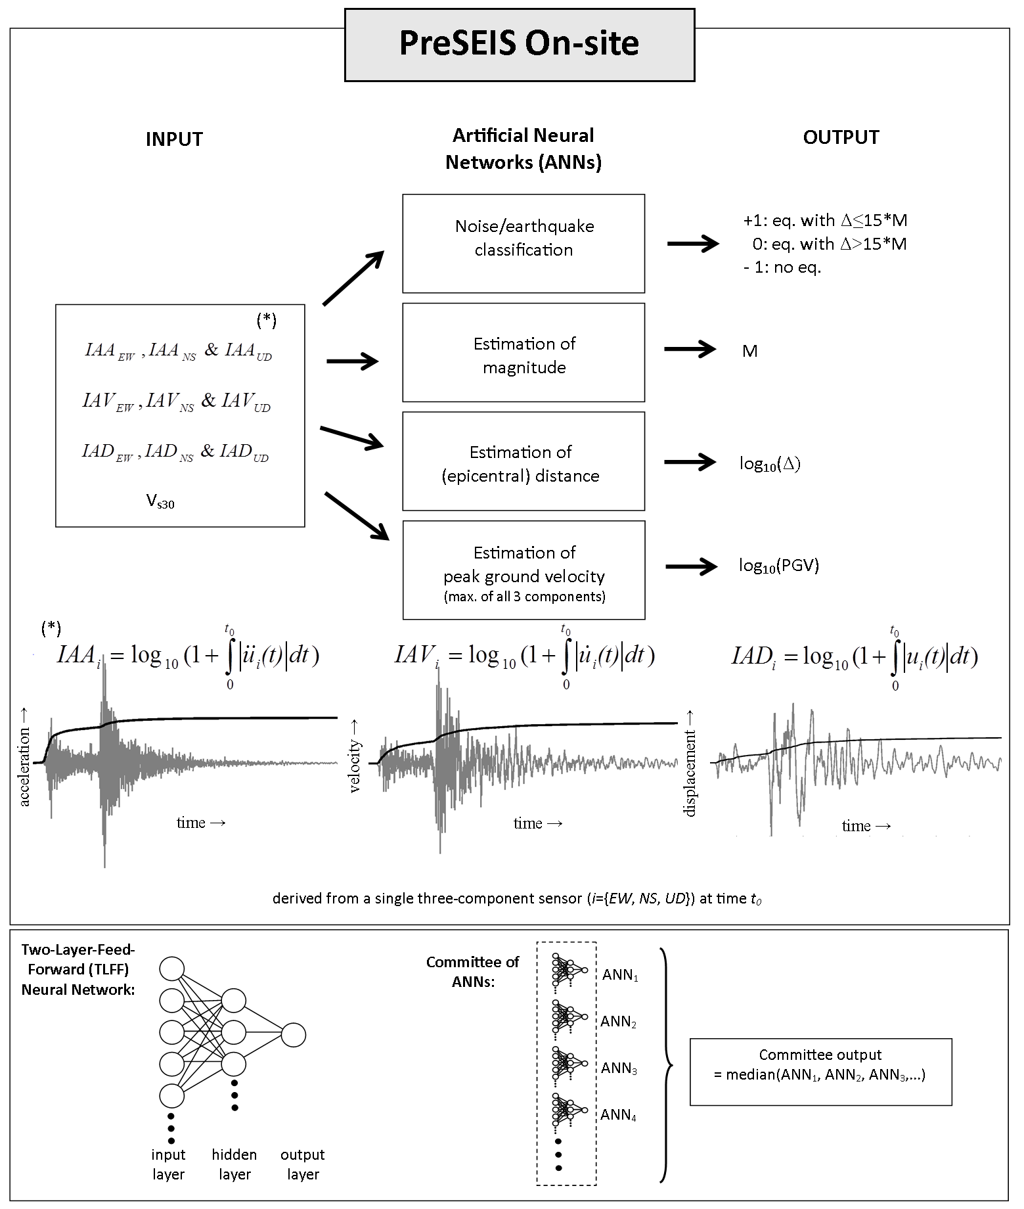
Bӧse, Hauksson, and Heaton 2011

Slide 18
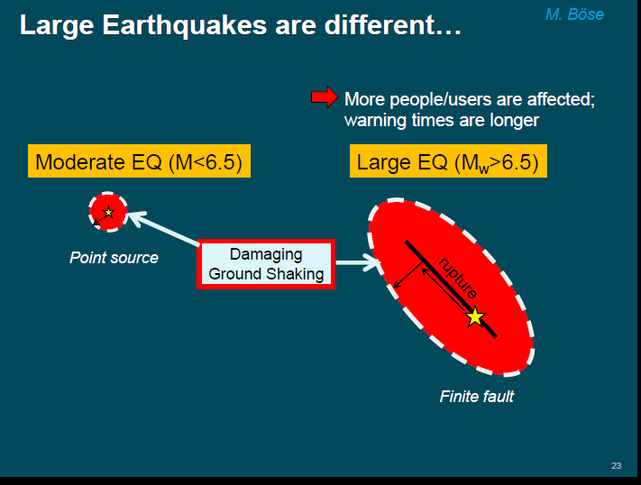

Slide 19
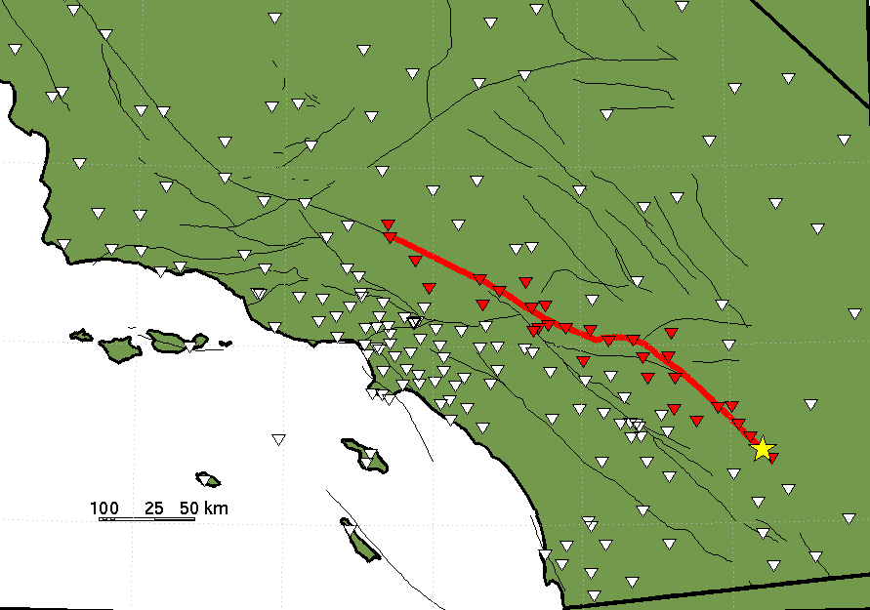
Alert
M. Boese
CISN Shake
Problem:
Point source approximation
Expected intensity in LA:
point source: IV light shaking

Slide 20
Alert
M. Boese
CISN Shake
Problem:
Point source approximation
Expected intensity in LA:
point source: IV light shaking
finite fault: VIII severe shaking

Slide 21
Finite Fault Detector
M. Boese
Near/far-source Classification
e.g, 7.233*log₁₀(Za) + 6.813*log₁₀(Hv)-15.903 ≥ 0 . (Yamada et al., 2007)
Za: vertical acceleration cm/s²
Hv: horzontal velocity cm/s
near-source

Slide 22
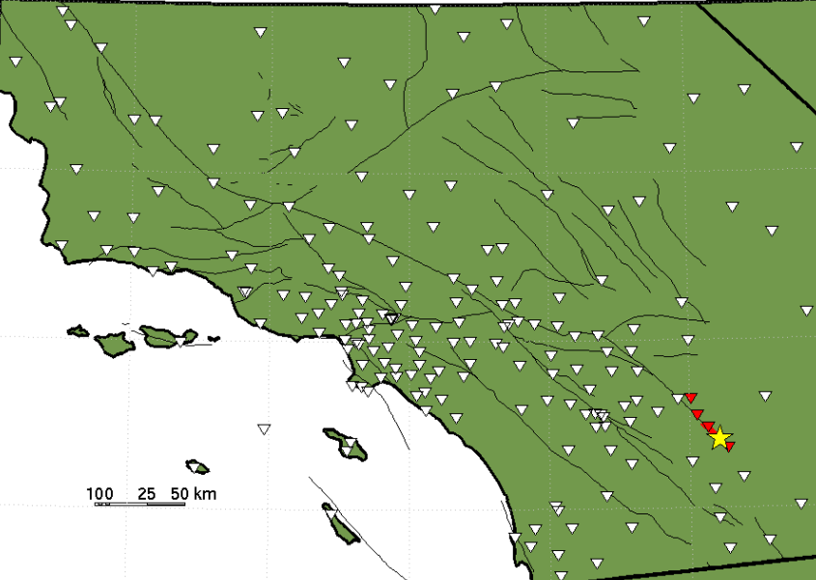



Finite Fault Detector
M. Boese
Real-time near/far-source classification
1. Estimated Magnitude: 6.6
2. Estimated Magnitude: 6.9
3. Estimated Magnitude: 7.1
4. Estimated Magnitude: 7.5

Slide 23
Peak Ground Displacement per unit fault slip
Construct a slip function from the results of the ground motion simulation.
Displacement (m)
For strike-slip fault,
(Aagaard et al. 2001)
Notes:
Why we need to estimate the rupture extent?
Rupture extent is important for large earthquakes.

Slide 24

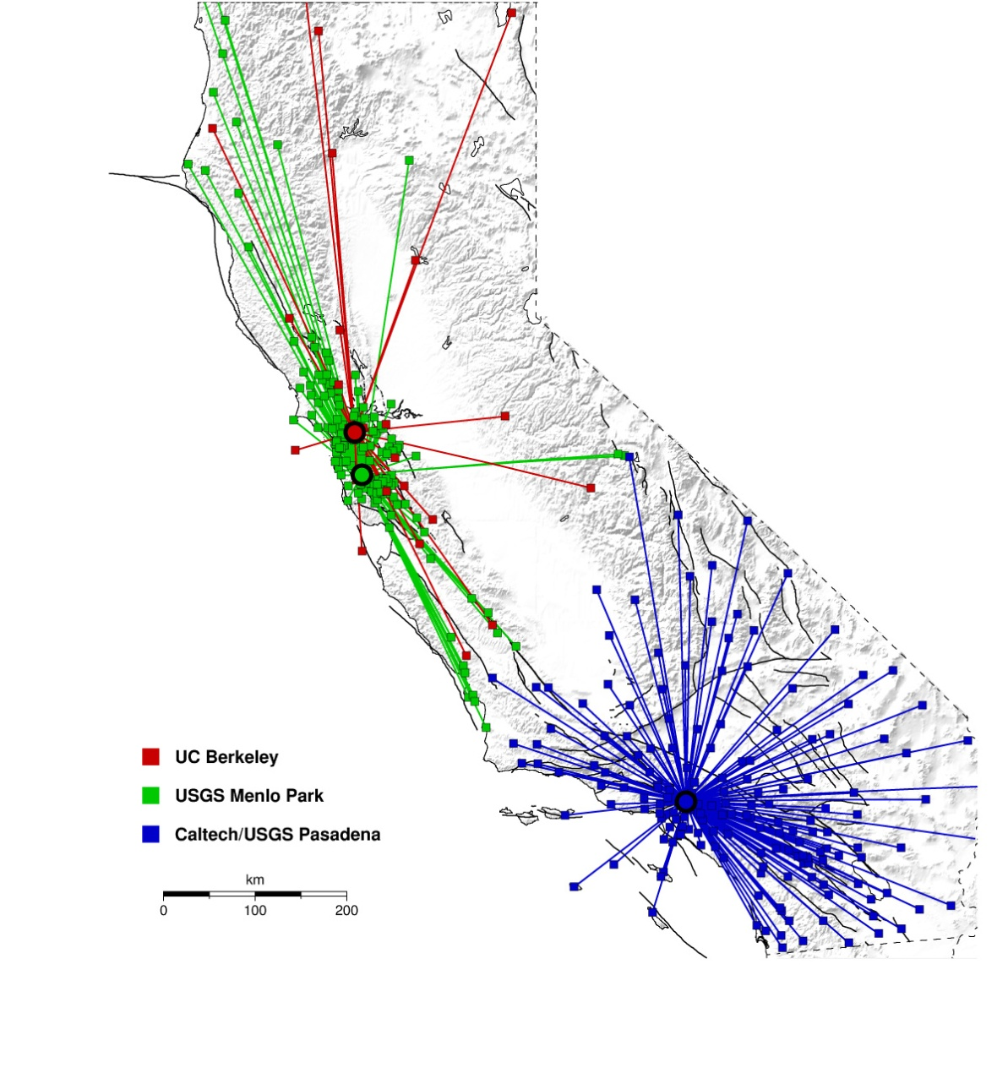
Earthquake Early Warning Research and Development in California, USA
Hauksson E., Boese M., Heaton T.,
Seismological Laboratory, California Institute of Technology, Pasadena, CA,
Given D., USGS, Pasadena, CA,
Oppenheimer D., USGS, Menlo Park, CA,
Allen R. , Hellweg P. ,
Seismological Laboratory, UC Berkeley, Berkeley, CA,
Cua G. , Fischer M. , Caprio M.
Swiss Seismological Service, ETH Zurich
California
Notes:
Magnitude error estimates based on: 1) 2sigma Gaussian errors for each event and for a set of events. 2) presume these are added

Slide 25

ANSS/CISN Early Warning R&D Project
Collaboration:
USGS
Caltech
UC-Berkeley
ETH, Zurich
USC/SCEC
Develop EEW algorithms to detect and analyze earthquakes within seconds
Identify needed improvements to the existing monitoring networks
Implement an end-to-end prototype test system
EEW requirements:
-- Rapid earthquake detection
-- Early Mag. estimation
-- Ground shaking prediction
-- Robust seismic networks
-- Well trained uses
trigger time
+ 1 sec
+ 3 sec

Slide 26
CISN EEW Algorithm Testing (2007-2009)
Single sensor
Sensor network
Sensor network
τ_{c}-P_{d}
On-site Algorithm
Virtual Seismologist (VS)
ElarmS
Caltech
ETH Zurich/Caltech
UC Berkeley
Progress:
CISN real-time testing of 3 algorithms
τ_{c}-P_{d} On-site algorithm, VS, & ElarmS
State-wide implementation
382 stations with 585 broadband & strong motion
instruments
Many small to moderate earthquakes
2007 M_{w}5.4 Alum Rock & 2008 M_{w}5.4 Chino Hills
2010 Mw7.2 Baja California
CISN EEW Testing Center established
at University of Southern California (USC)/SCEC

Slide 27
(2009-2012)
Alert
CISN Shake
Project Goals
System specifications
Code design specifications
Code development
Define formats and protocols
Year 1 (2009/10):
Implementation
Implement end-to-end processing
Testing with archived data
Testing with real-time data
Improve performance
Testing at the SCEC Testing Center
Testing with selected users
Year 2 (2010/11):
Testing/Optimization
Prototype system in operation
Add features to Decision Module
Research adding GPS RT positions
Research on finite sources
Plans for future systems
Year 3 (2011/12):
Evaluation

Slide 28
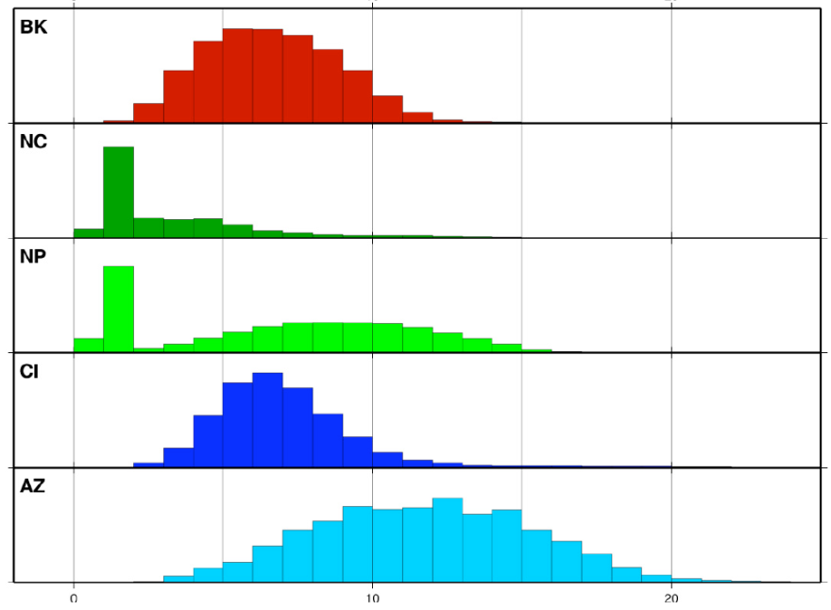
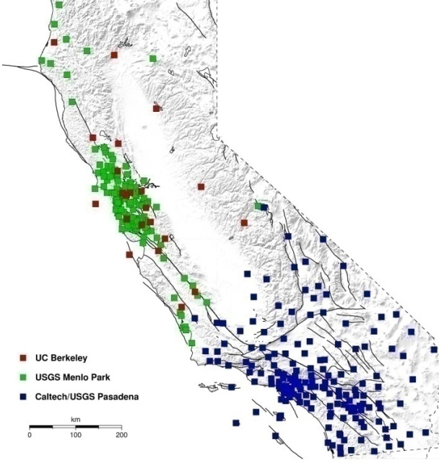

CISN EEW Algorithm Testing (2007-2009)
Single sensor
Sensor network
Sensor network
τ_{c}-P_{d}
On-site Algorithm
Virtual Seismologist (VS)
ElarmS
Speed:
Results
What causes delays?
Data latency (datalogger/telemetry delays)
Station density
Median: ~ 5.2 sec
California
R. Allen
0 10 20 sec

Slide 29
CISN EEW Algorithm Testing (2007-2009)
Single sensor
Sensor network
Sensor network
τ_{c}-P_{d}
On-site Algorithm
Virtual Seismologist (VS)
ElarmS
Results
Speed:
How can these delays be reduced in the future ?
1. reduce data latency
up-grade of ~220 CISN stations with new Q330s
dataloggers (~1-2 sec delay) before Sept-2011
(ARRA stimulus funding)
2. increase processing speed
current delays: ~5 sec
3. Increase station density
4. Decrease number of stations required for trigger
Data latency (datalogger/telemetry delays)
Station density
California
R. Allen
0 10 20 sec

Slide 30
CISN EEW Algorithm Testing (2007-2009)
Single sensor
Sensor network
Sensor network
τ_{c}-P_{d}
On-site Algorithm
Virtual Seismologist (VS)
ElarmS
Speed:
Results
> 5 sec ~20 sec ~30 sec
after O.T.
Examples:
M_{w}5.4 Alum Rock: 5 sec before peak shaking in San Francisco.
M_{w}5.4 Chino Hills: 6 sec warning at Los Angeles City Hall.
M_{w}7.2 Baja Calif. 70?? sec warning at Los Angeles City Hall.
Reliability:
Mag.: M_{w}:
± 0.5 ± 0.2 ± 0.4*
MMI: ±0.7
*includes M>7 data from Japan
false alerts:
(M>6.5)
1* 0 0
* three month period

Slide 31
(2009-2012)
Alert
CISN Shake
Single sensor
Sensor network
Sensor network
τ_{c}-P_{d}
On-site Algorithm
Virtual Seismologist (VS)
ElarmS
Task 1:
increase
reliability
Decision Module
(Bayesian)
- most probable
… M_{w}
… location
… origin time
… ground motion
and uncertainties
probability of false trigger, i.e. no earthquake
CANCEL message if needed
Bayesian approach
up-dated with time

Slide 32
(2009-2012)
Alert
CISN Shake
Single sensor
Sensor network
Sensor network
τ_{c}-P_{d}
On-site Algorithm
Virtual Seismologist (VS)
ElarmS
Task 1:
increase reliability
Task 2:
demonstrate
Decision Module
(Bayesian)
feed-back
SCEC/ EEW Testing Center
USER Module
- Single site warning
- Map view
Test users
predicted and observed ground motions
available warning time
probability of false alarm
…

Slide 33
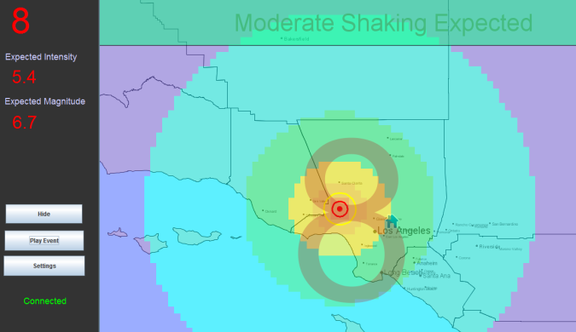
Alert
M. Boese
CISN Shake
τ_{c}-P_{d}
On-site Algorithm
Virtual Seismologist (VS)
ElarmS
Decision Module
(Integration Module)
feed-back
by test users
CISN EEW Testing Center
User Display

Slide 34

Alert
M. Boese
CISN Shake
User Display
platform independent (Java)
ability to add multiple map layers & navigational features (OpenMap application programming interface)

Slide 35

Alert
M. Boese
CISN Shake
User Display
remaining time until S-wave arrival

Slide 36
Alert
M. Boese
CISN Shake
User Display
remaining time until S-wave arrival
expected intensity at user site

Slide 37
Alert
M. Boese
CISN Shake
User Display
remaining time until S-wave arrival
expected intensity at user site
(moment) magnitude

Slide 38
Alert
M. Boese
CISN Shake
User Display
epicenter
user
locations of epicenter & user

Slide 39
Alert
M. Boese
CISN Shake
User Display
S-wave
P-wave
locations of epicenter & user
locations of P- /S-wavefronts

Slide 40
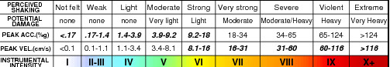
Alert
M. Boese
CISN Shake
User Display
locations of epicenter & user
locations of P- /S-wavefronts
intensity map (ShakeMaps color-code)

Slide 41

Alert
M. Boese
CISN Shake
User Display
siren
voice announcement:
count-down
“weak shaking”, “strong shaking”…
future: different announcements depending on distance

Slide 42
Basic Research Projects
Development of algorithms to analyze long ruptures (Heaton, Böse, and Karakus; Allen and Brown)
Development of User Decision module based on cost/benefit (Beck and Wu)
Development of slip detectors based on real-time GPS (Hudnut and Herring)

Slide 43
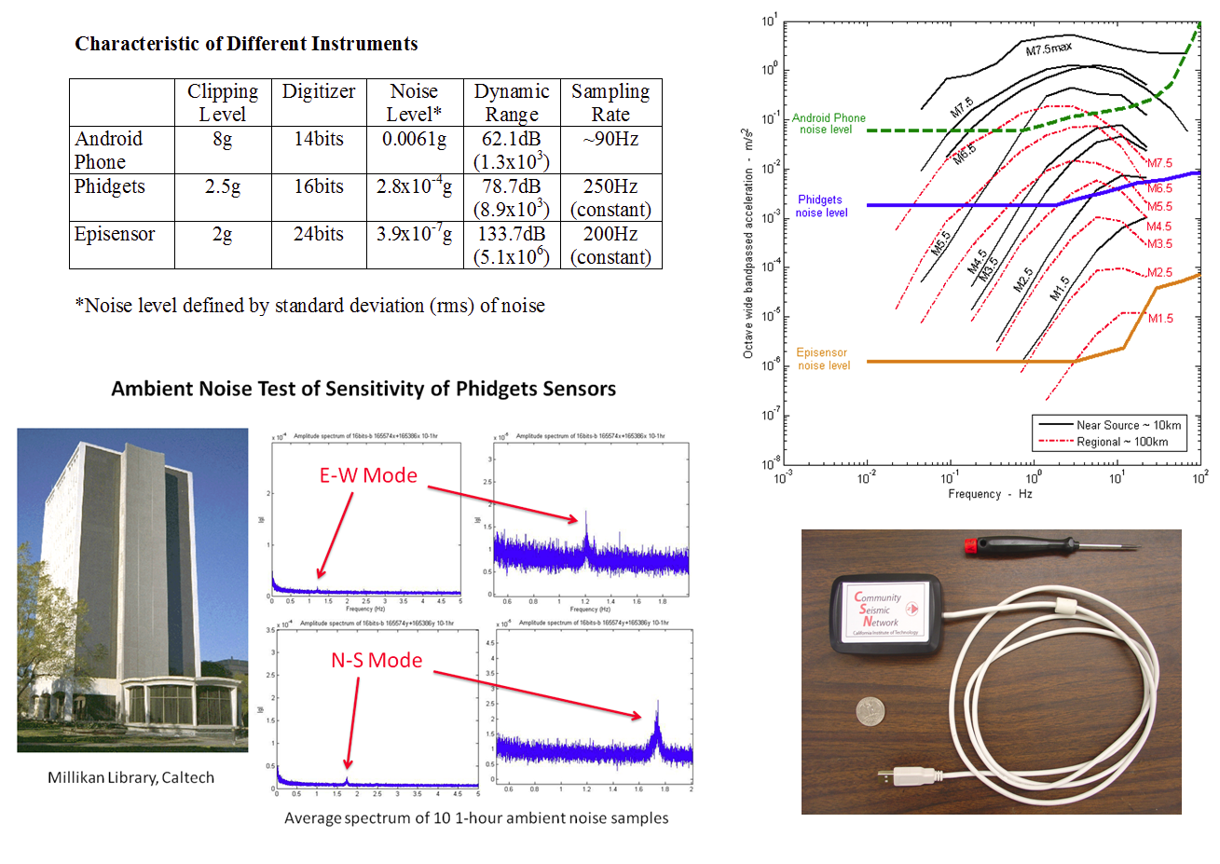

Slide 44
Conclusions
Finally have put the elements together to produce real-time alerts
much work remains to produce a reliable system for general use

