Slide 1


Operating Modern Seismic Instrumentation in Challenging Environments in Alaska
Roger Hansen, State Seismologist
Steve Estes, Network Engineer

Slide 2
AEIC Regional Network
Permanent installations
Near-Real-Time data flow and operations
Need modernization of analog telemetry
Require Strong Motion stations
Struggle with harsh environments and large animals
Trade-offs and compromises with available funding

Slide 3
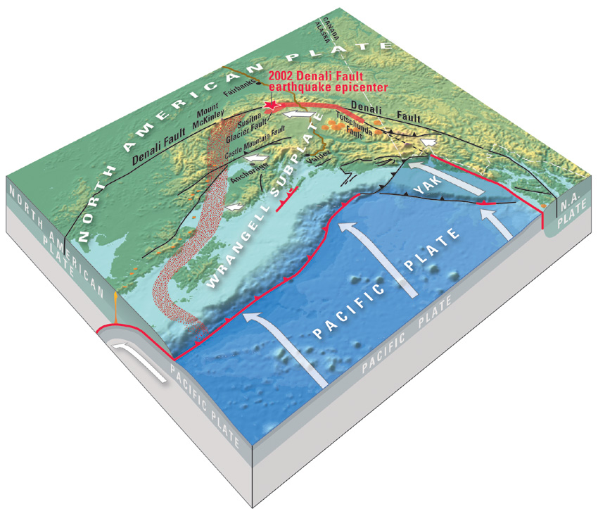
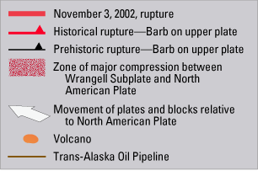
Diagram by P. Haeussler
Notes:
This is the rupture of the magnitude 7.9 Denali fault earthquake along the central Denali fault system. It ruptured 3 different faults: Susitna Glacier Thrust, the Denali and Totschunda faults.
And again showing Pacific plate subducting underneath the North American plate.
The Yakutat block is the piece of crust that sits on top of the Pacific plate and has been colliding with the North America for the past 25-30 million years. This collision is causing earthquakes in interior Alaska and south-west extrusion of southern Alaska. These collisional forces were the cause of the 2002 Denali earthquake sequence.

Slide 4
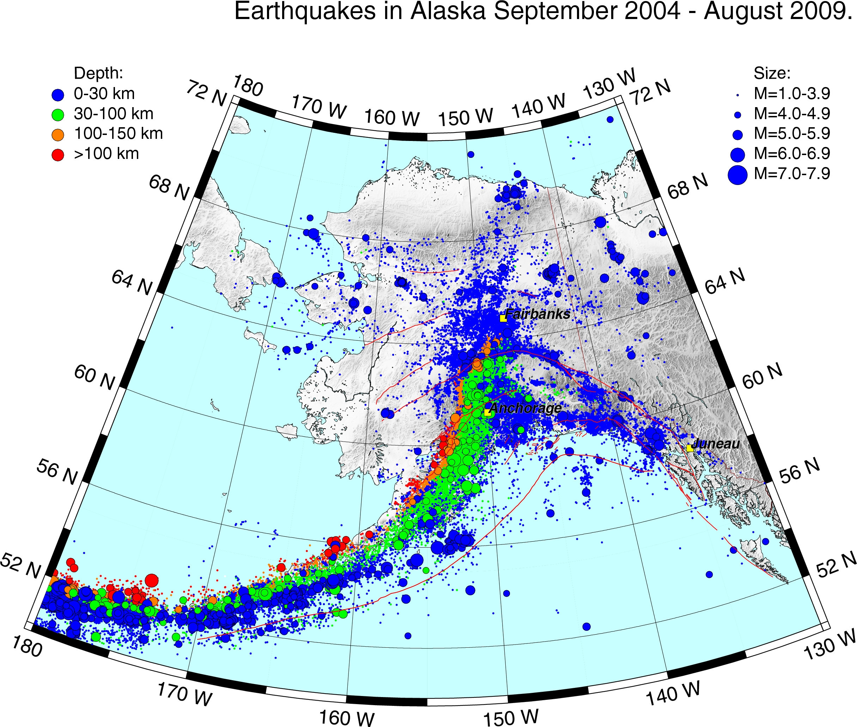

Slide 5
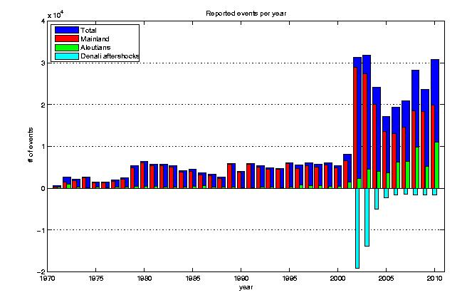
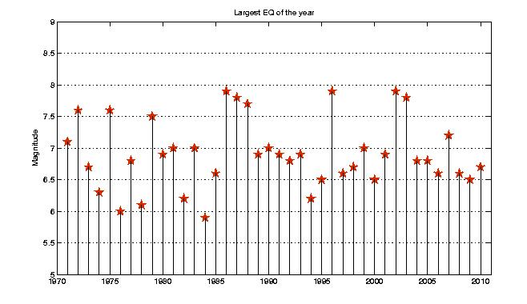
The plots illustrate how many earthquakes were reported each year in Alaska and the Aleutians since 1970 (top) and magnitude of the largest recorded earthquake for that year (bottom).

Slide 6

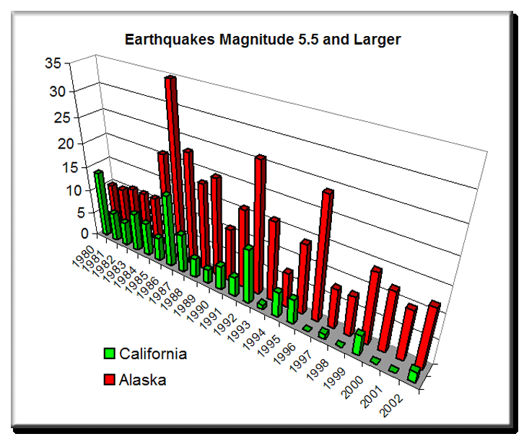
The Seismic Threat in Alaska
World’s Largest Earthquakes
Chile 1960 9.5
Alaska 1964 9.2
Sumatra 2004 9.1
Kamchatka 1952 9.0
Ecuador 1906 8.8
Sumatra 2005 8.7
Alaska 1965 8.7
Alaska 1957 8.6
Assam-Tibet 1950 8.6
Kurile Islands 1963 8.6
75 % of N. American earthquakes annually
20,000 – 30,000 events per year

Slide 7
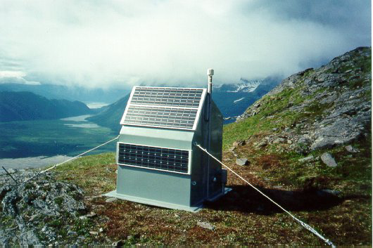
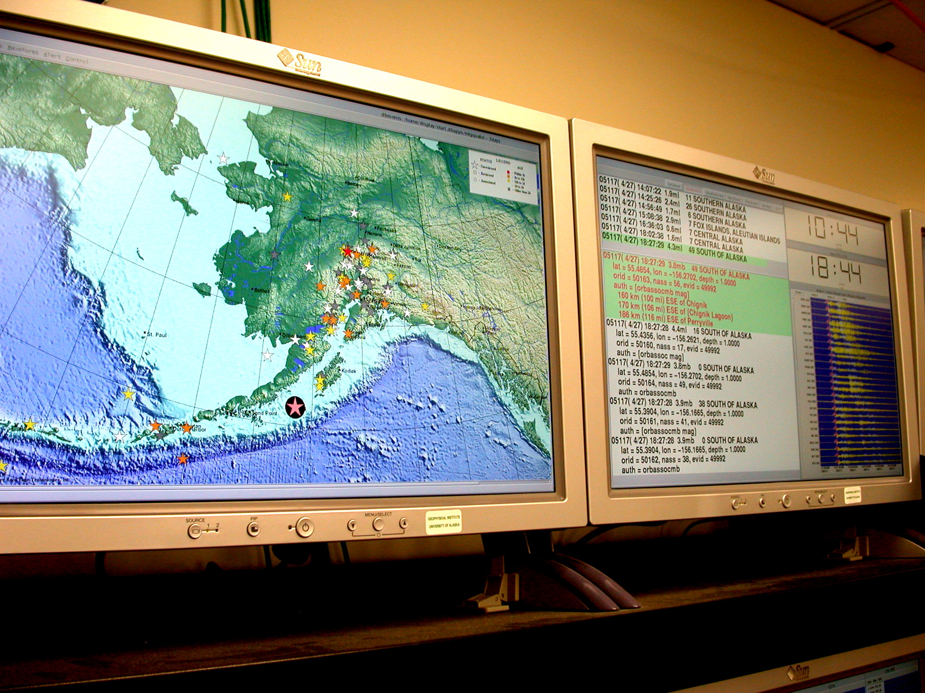
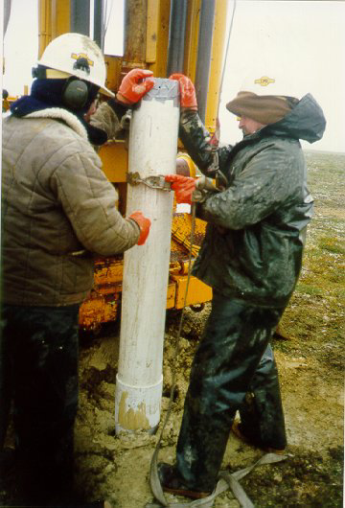
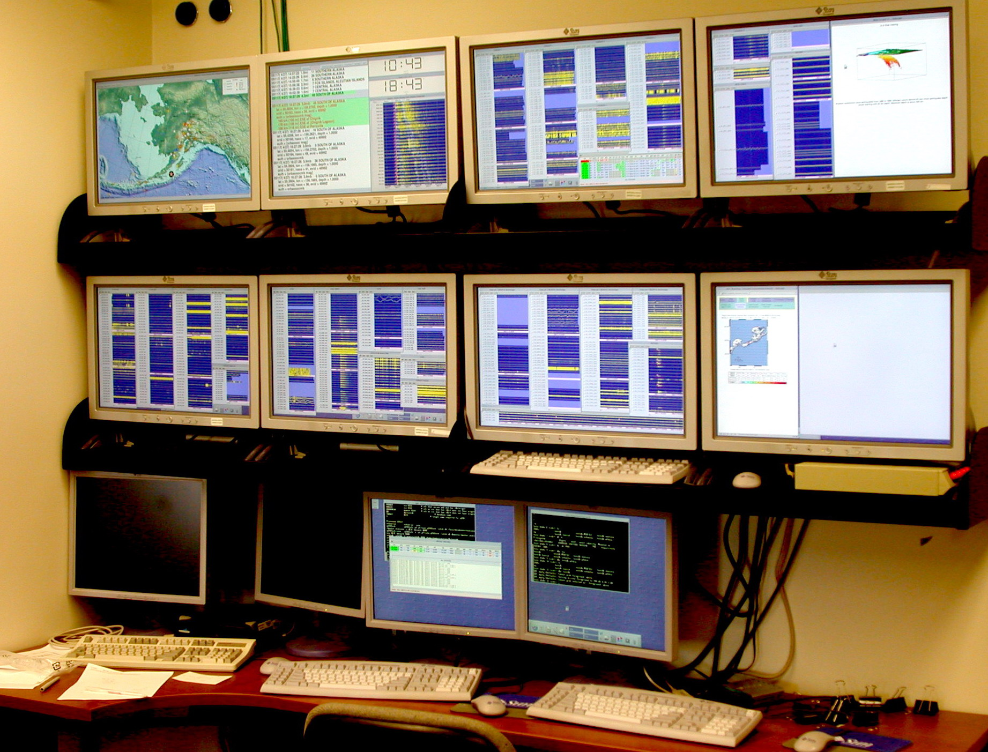
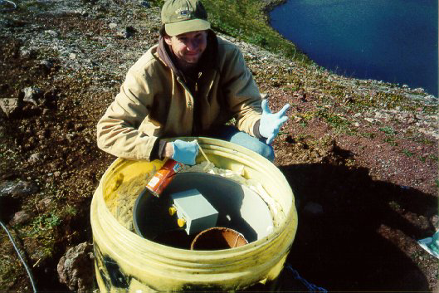
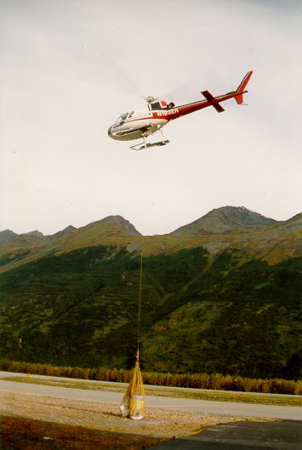
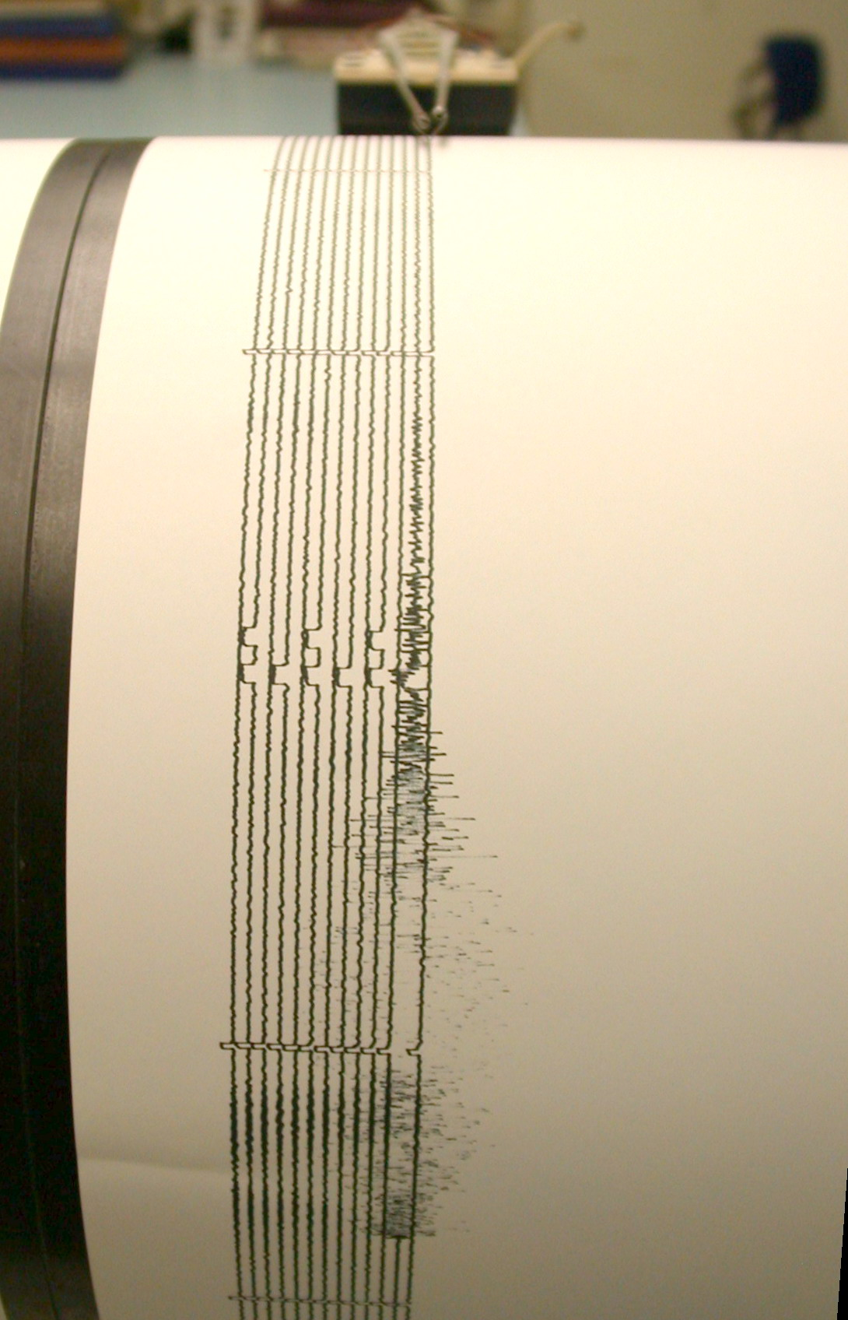
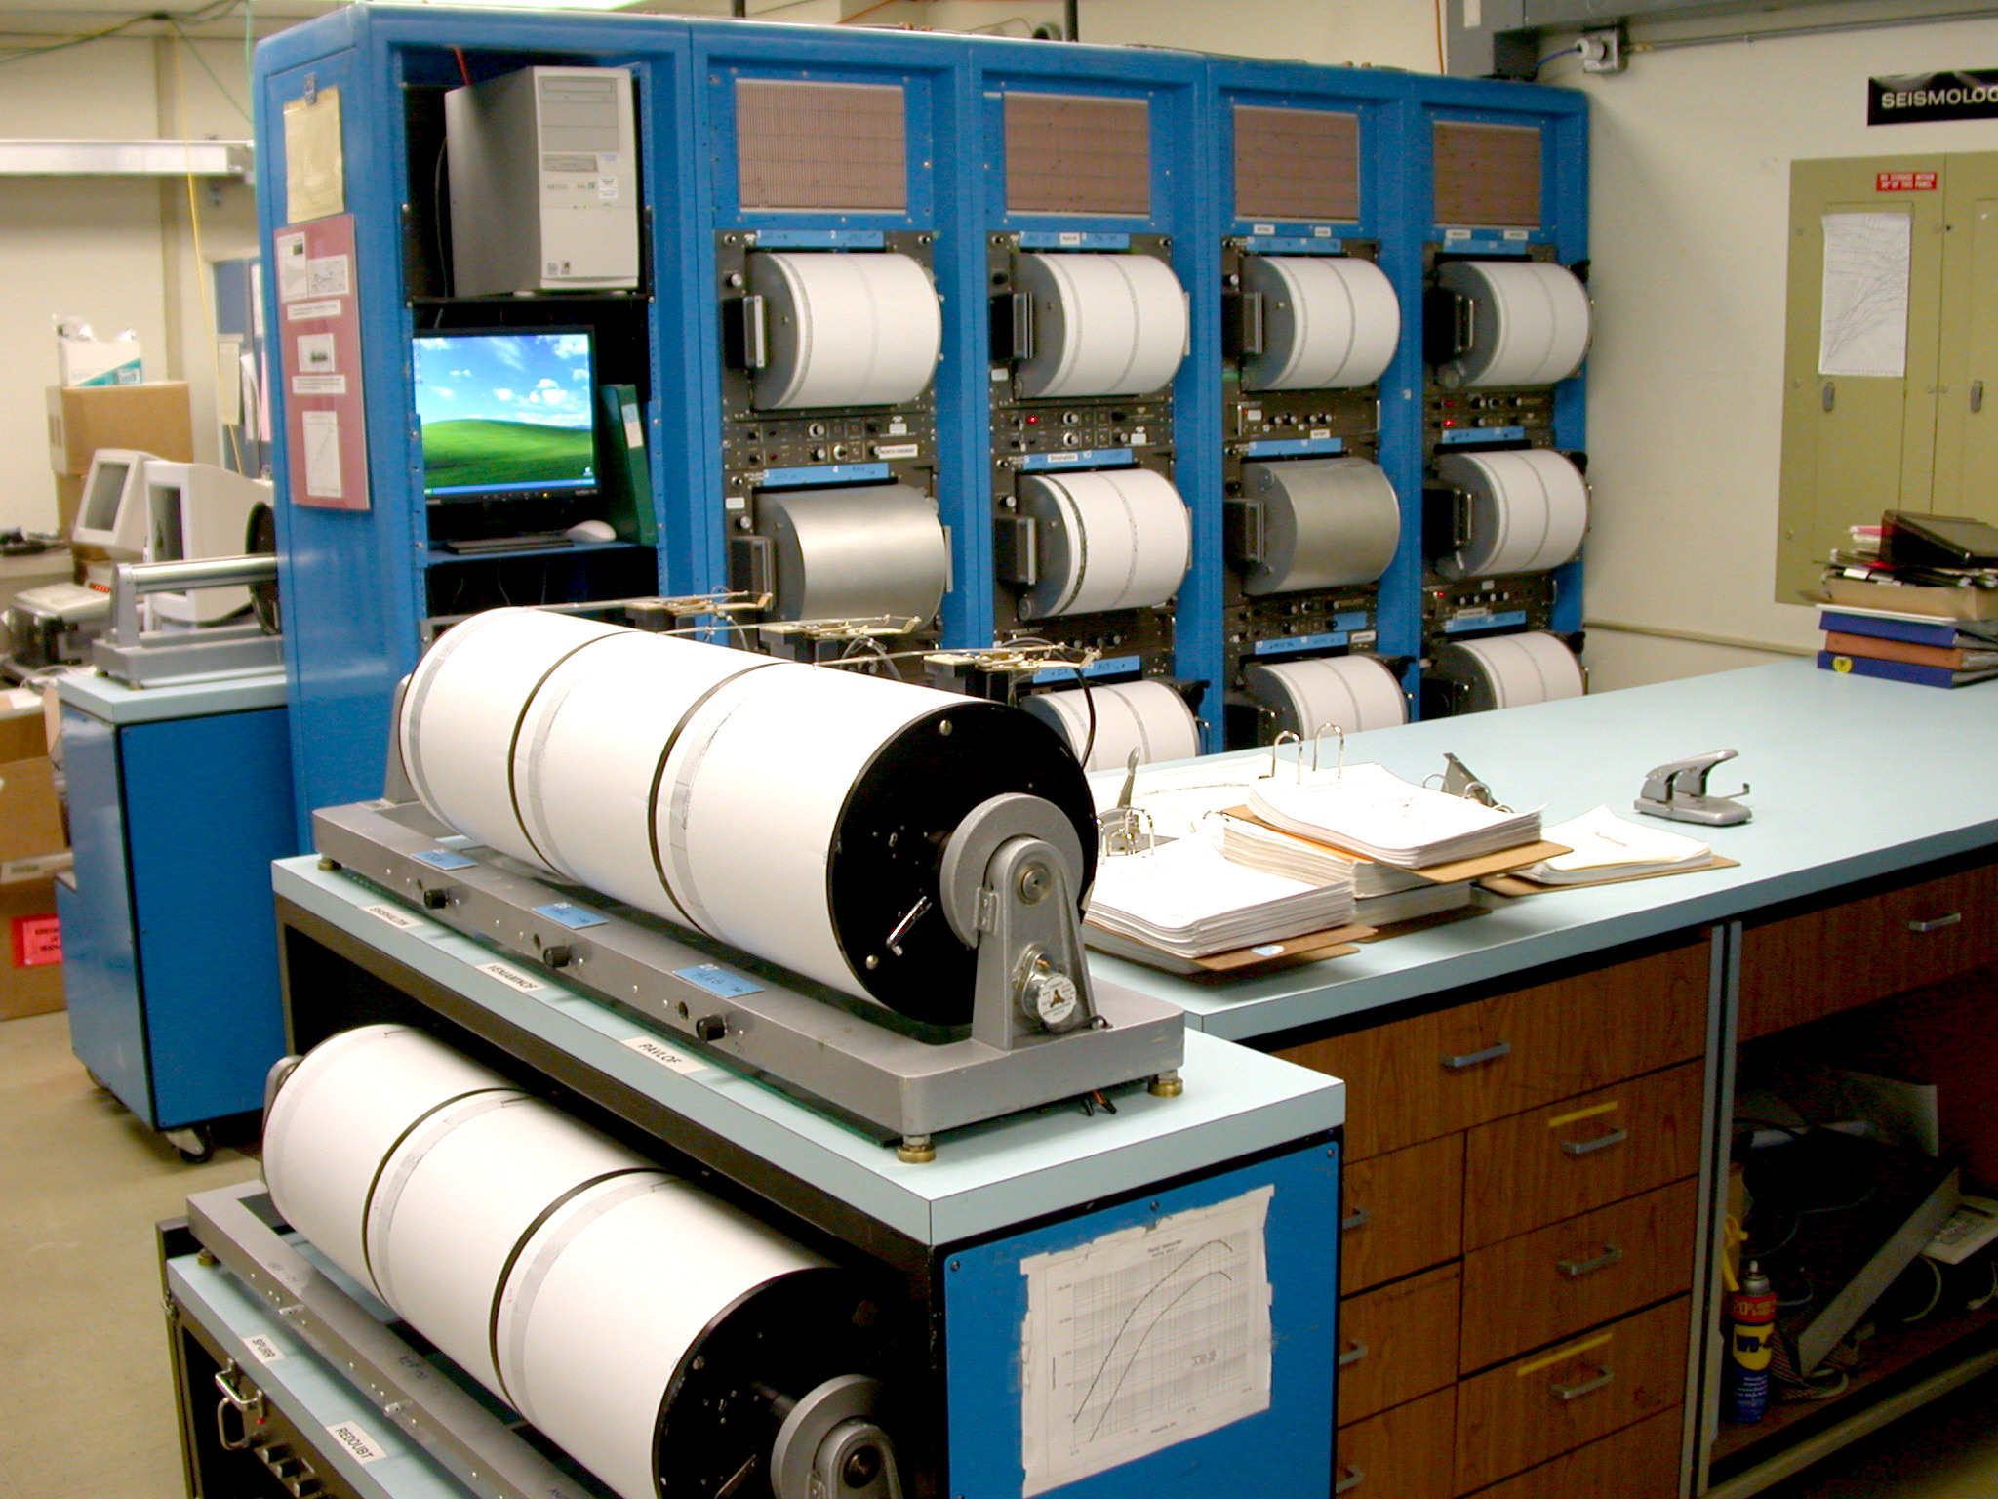
Alaska Earthquake Information Center
Seismic Data Analysis,
Archiving,
and
Reporting
Remote
Seismic
Monitoring Stations

Slide 8
Alaska Earthquake Information Center
Integration of Alaska Seismic Network Data
Combined UAF network ~200 stations
ATWC ~15 stations
AVO ~200 stations
UAF Anchorage Strong Motion ~22 stations
Anchorage ANSS Strong Motion - 18 stations
Fairbanks Strong Motion Network – 10 stations
NSMP ~13 stations co-located with regional network
Real-time data exchange with Canada, Japan, Golden
Real-time processing of combined network
Joint archiving of continuous and segmented data
Waveforms and event data stored in relational databases
Data telemetry with state microwave, phone, radio links, VSAT, cell phone modems, and internet/intranet
Real-time delivery of broadband data to IRIS DMC

Slide 9
Alaska Earthquake Information Center Products
Automatic earthquake locations and magnitudes – 1-2 minutes
Sent immediately over EIDS to ANSS Recent Eq
24/7 alarm capability – pager/cell phone
Appears on GUI for rapid analyst review
E-mail notification for selected criteria
Analyst reviewed information – 5-30 minutes
Updates sent over EIDS to ANSS Recent Eq
Information release sent for large and/or felt events
E-mail, fax, cell phone, and internet delivery
Community Internet Intensity Map: CIIM
Daily processed data – ANSS catalog
Weekly reports and monthly catalogs
Follow-up reports for large events
Real-time faulting parameters
Real-time locations on the internet
Rapid distribution of shake maps

Slide 10
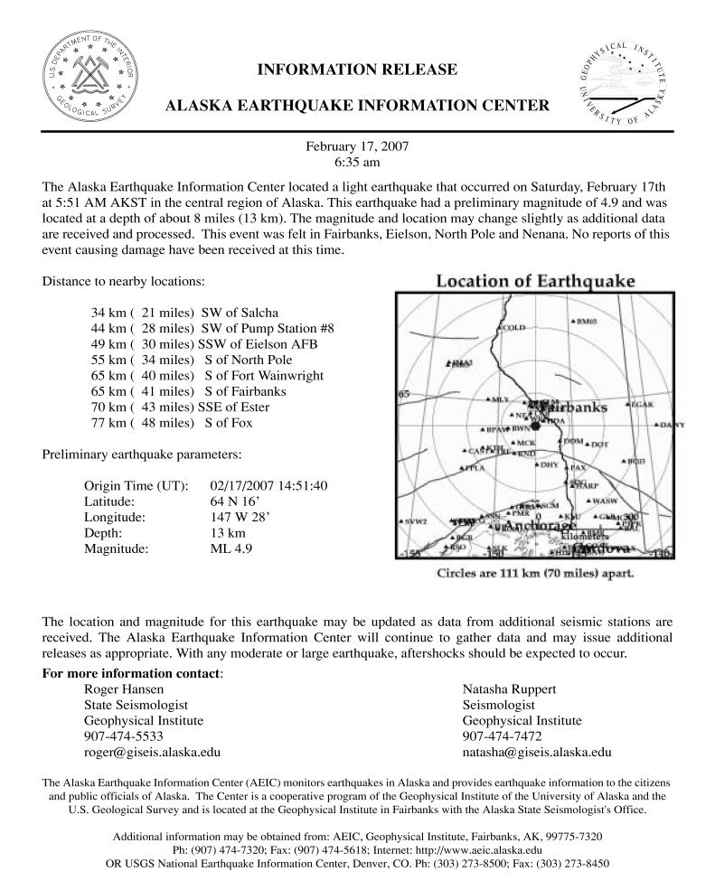
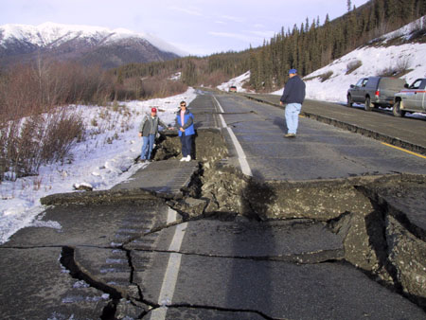
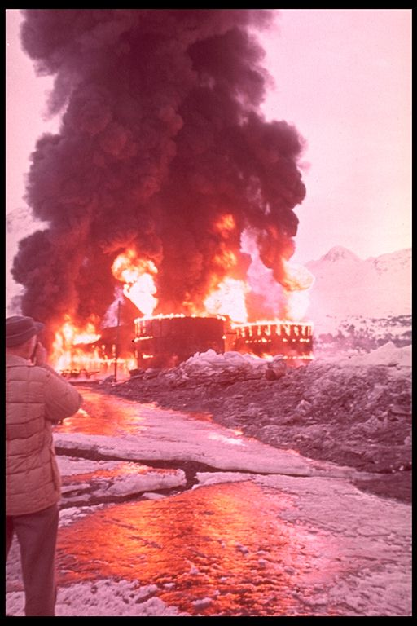
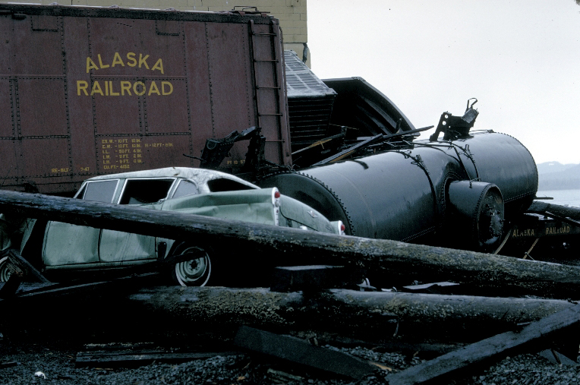
Earthquake information provided to...
The Public www www.aeic.alaska.edu
Emergency Managers
Corporations

Slide 11
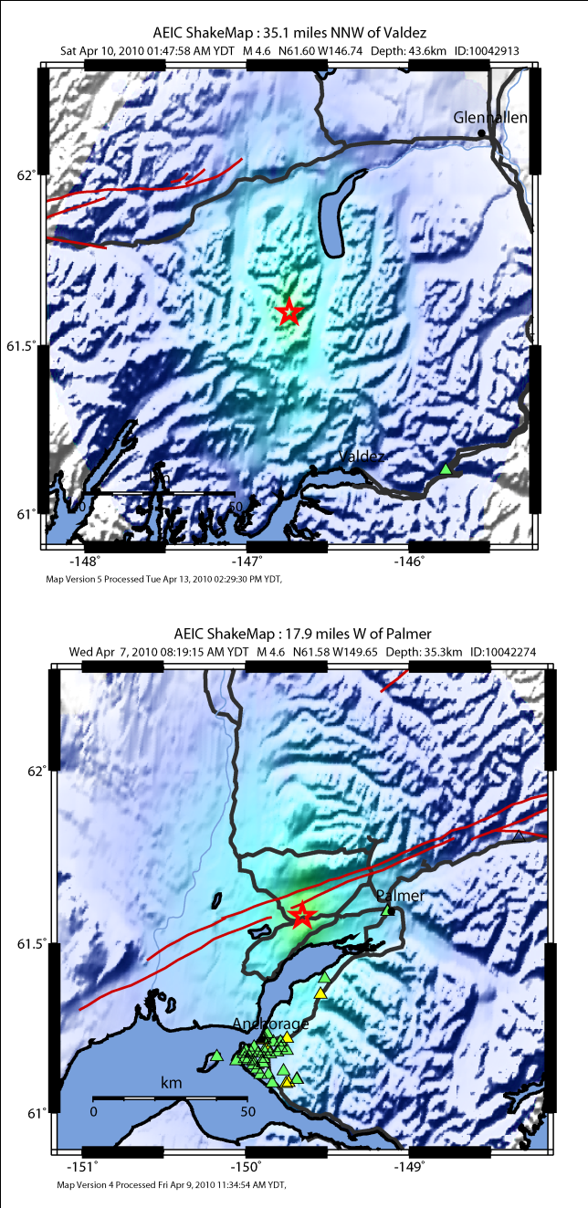
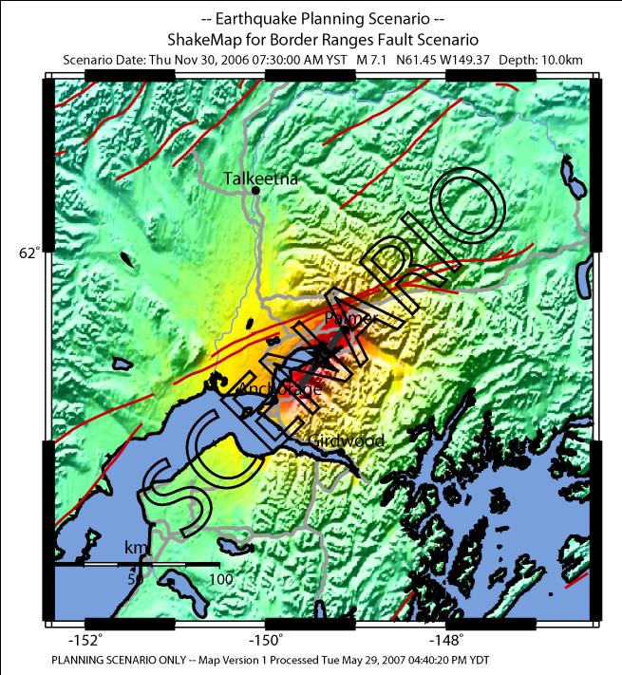
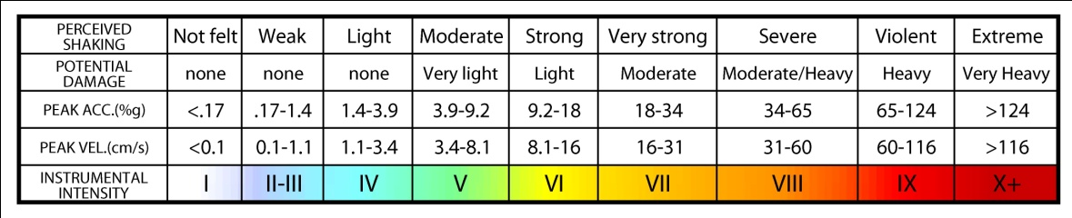
The Antelope-ShakeMap Interface is a collection of programs and configuration files developed by the AEIC to implement the USGS ShakeMap system within the Antelope real-time data acquisition and processing environment.
shake_watch
monitors the summary event database for new origins,
checks origins for eligibility and initiates a ShakeMap generation (shake) or cancellation (cancel).
This package also allows the
AEIC to generate scenario
ShakeMaps that can be used to
predict the ground shaking in the
event of a large event in high
probability regions.

Slide 12
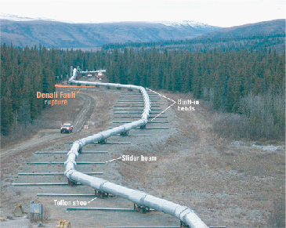
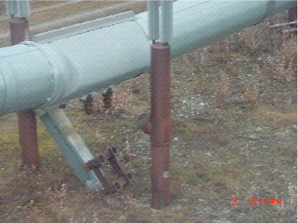
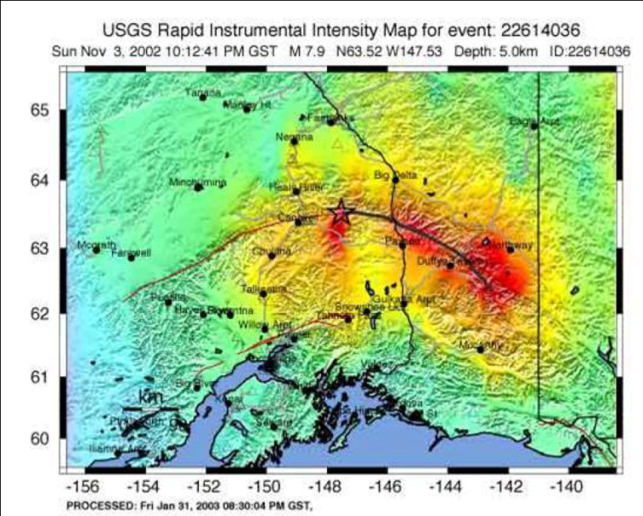
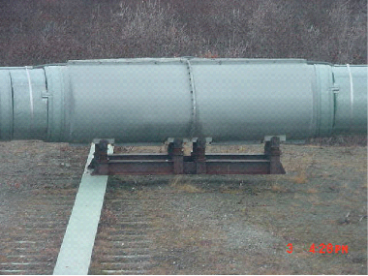
AEIC has become a partner in the new Trans-Alaska Pipeline System (TAPS) Earthquake Monitoring System (EMS).
Seismic stations at ten pump stations and the Valdez Marine Terminal monitored using dlmon GUI.
AEIC is responsible for recording, processing and archiving these data.
Antelope Real-Time System (ARTS) and the Antelope Seismic Information System (ASIS).
Acceleration Threshold Exceedence (ATE-exceedence of one or more ground acceleration thresholds) Alarms, Event Detection (EQD) Alarms, and System fault Alarms.
Operations Control Center (OCC) and AEIC duty seismologist can rapidly assess the situation.
The AEIC provides
ShakeMaps to the OCC for
events that meet criteria
determined to affect the
pipeline through a mySQL
database and the internet.
A redundant system is run
to ensure no loss in data
between the AEIC and OCC
servers.

Slide 13
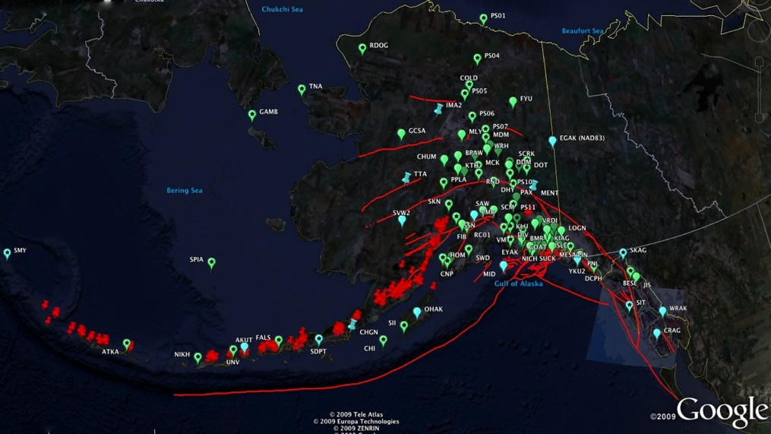

Alaskan Seismic Stations
PS01
PS04
TAPS
Trans-Alaska Pipeline System
PS08
VMT

Slide 14
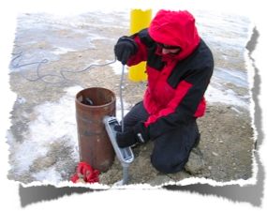
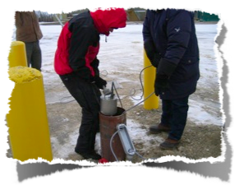
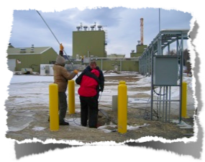
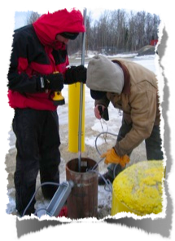
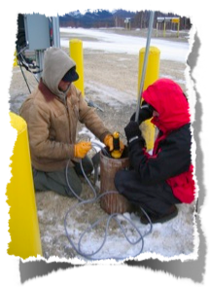
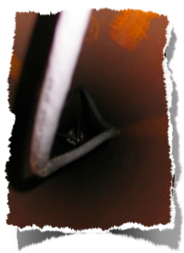
Installing the broad band seismometer
PS08

Slide 15
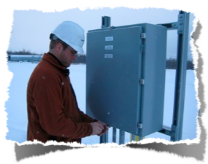
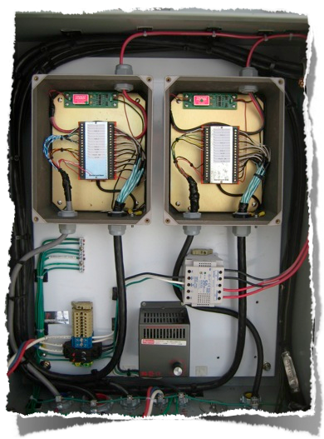
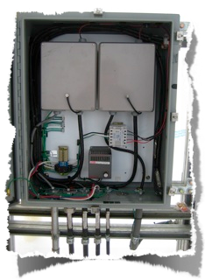
The Well Head Box
PS08

Slide 16
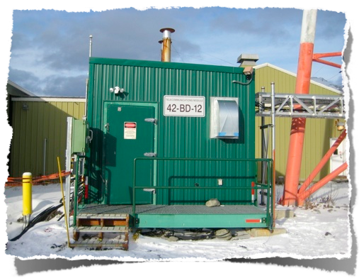
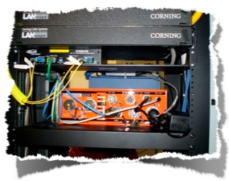
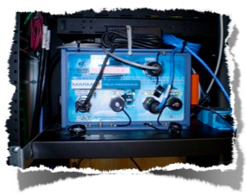
Coms building
GPS, Commercial Coms (fiber, microwave, satellite)

Slide 17

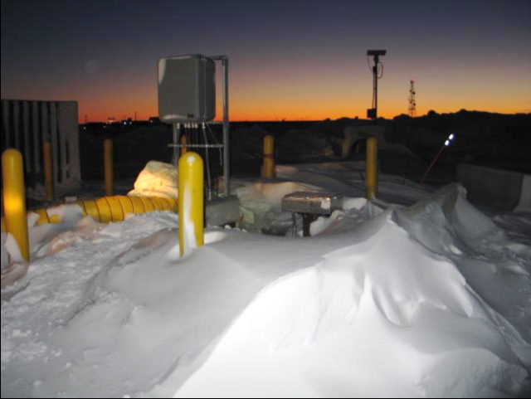
Pump Station 1 Prudhoe Bay

Slide 18
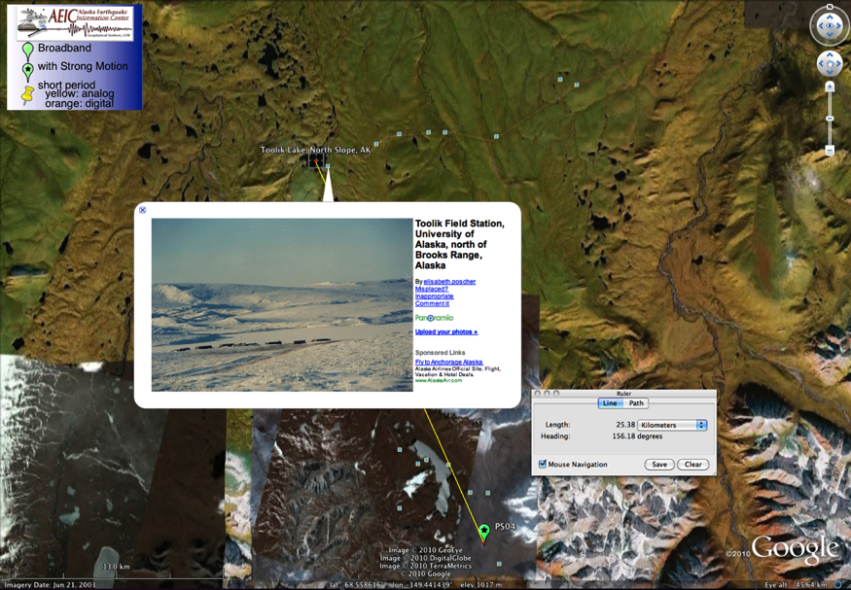
Toolik Lake & Pump Station 4

Slide 19
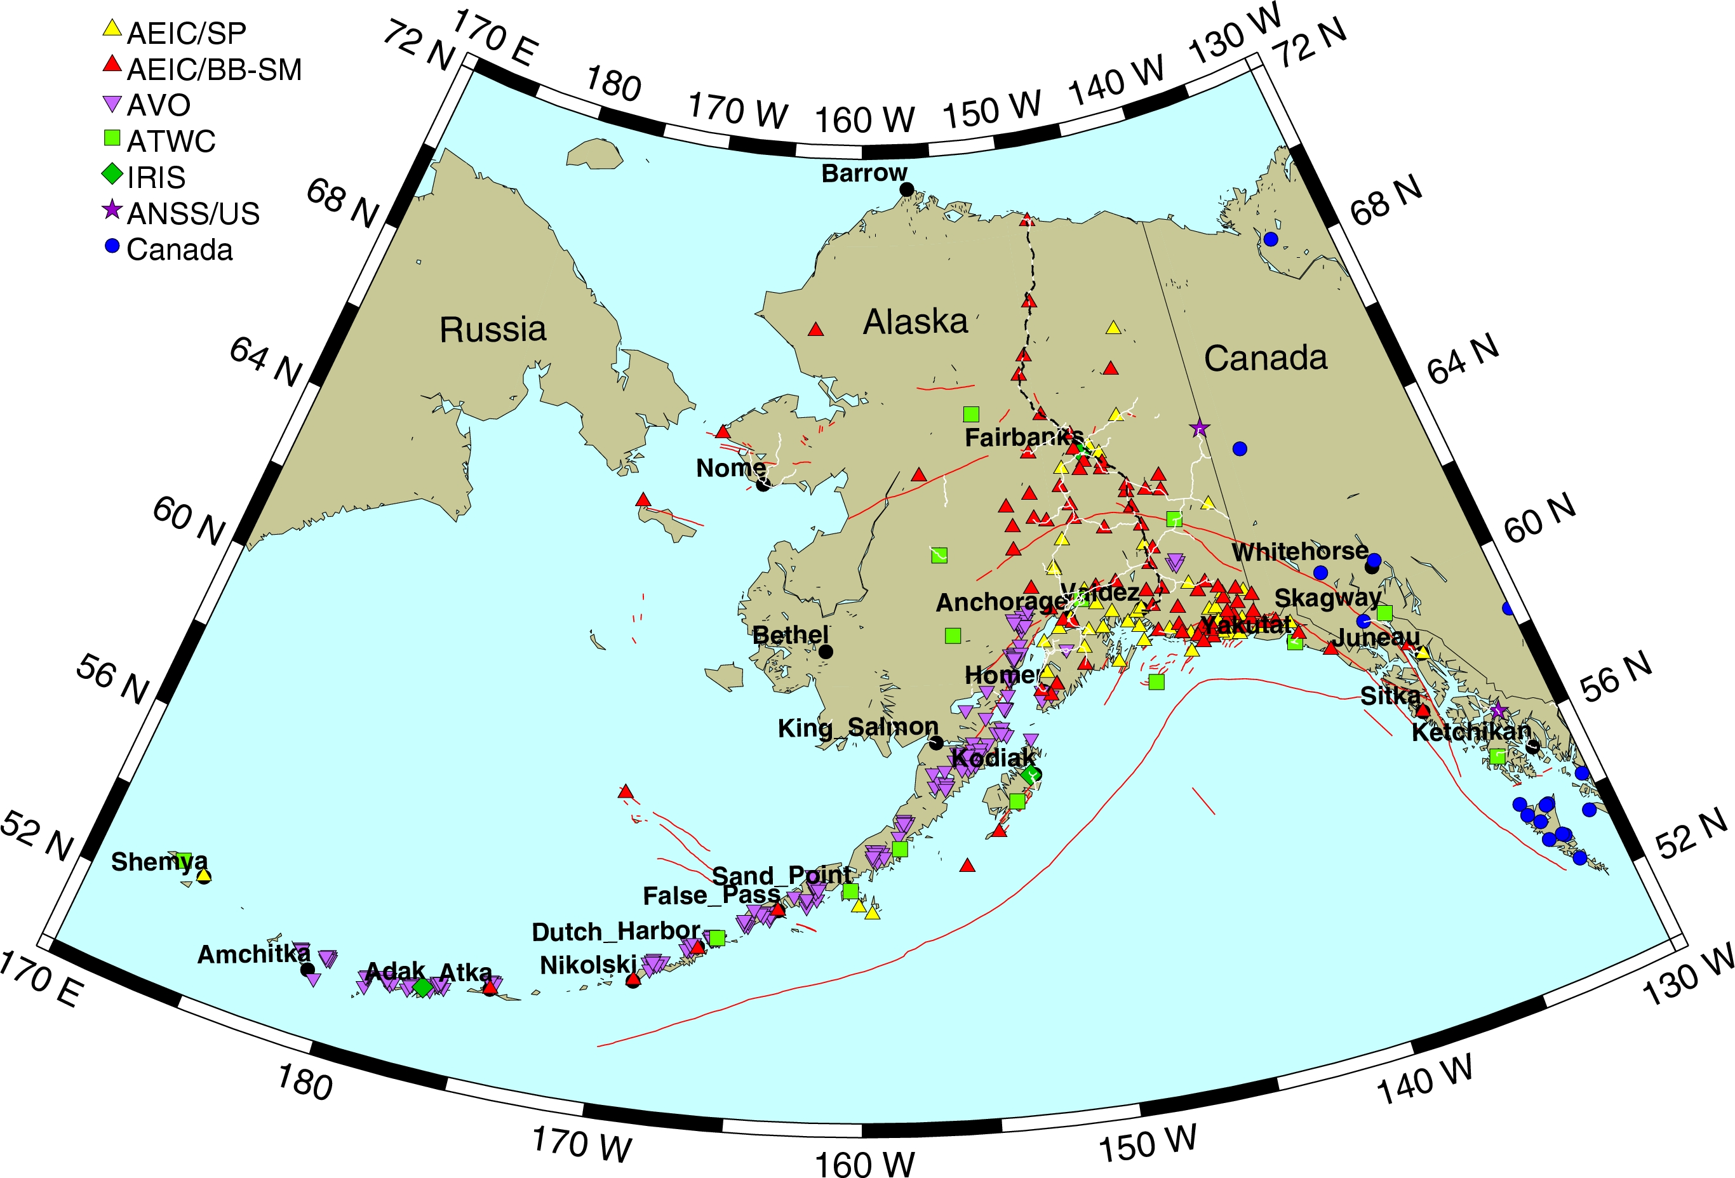

Slide 20
Funding Challenges
Expense of doing business
Initial cost of equipment
Cost of installation
Cost of routine visits
Telemetry
Reliability
Telemetry
Power system
Well built vaults
Robust equipment
Communication to all pieces of the system
Data Quality and Product Accuracy
Measureable standards

Slide 21
Challenging Environment
Remote Access
Few roads – Requires off road vehicles – expensive
Rough Terrain
Weather restricted year round – some seasons worse
Mostly Restricted to Hand Tools
Need a reliable and clean power system
Telemetry
Leased phone lines – where available – expensive/reliable
Radios to concentration centers – Outages possible
Available internet – School Access
DSL phone lines
Cell Phone Modems – Subject to severe weather
Remote VSAT Systems
Adequate Power System
Vandalism by Large Animals
Require equipment that can reliably return from low power, or other outages, into an operational state

Slide 22
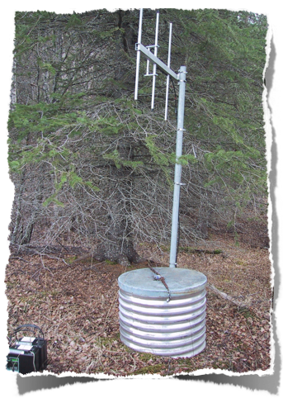
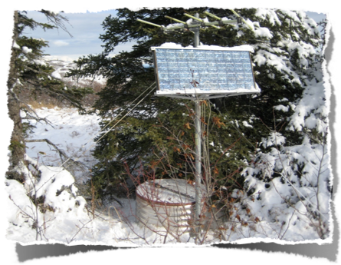
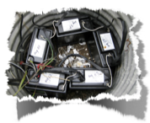
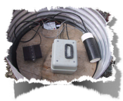
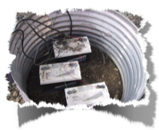


Back in the good ol’ days
Device | Power
Sensor | 0.00 w
VCO | 0.12 w
Tx | 0.60 w
Total | 0.72w
SKN, Skwentna
MSP, Moose Pass
Cellair 2AS10-2
Solar Reg, A1VCO, Tx
GelCel 12V100B
analog seismic station

Slide 23
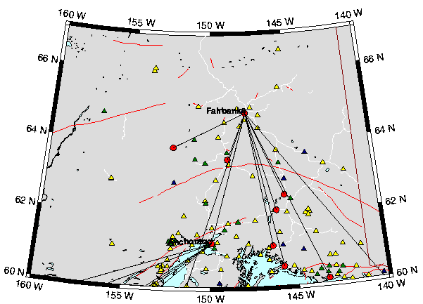
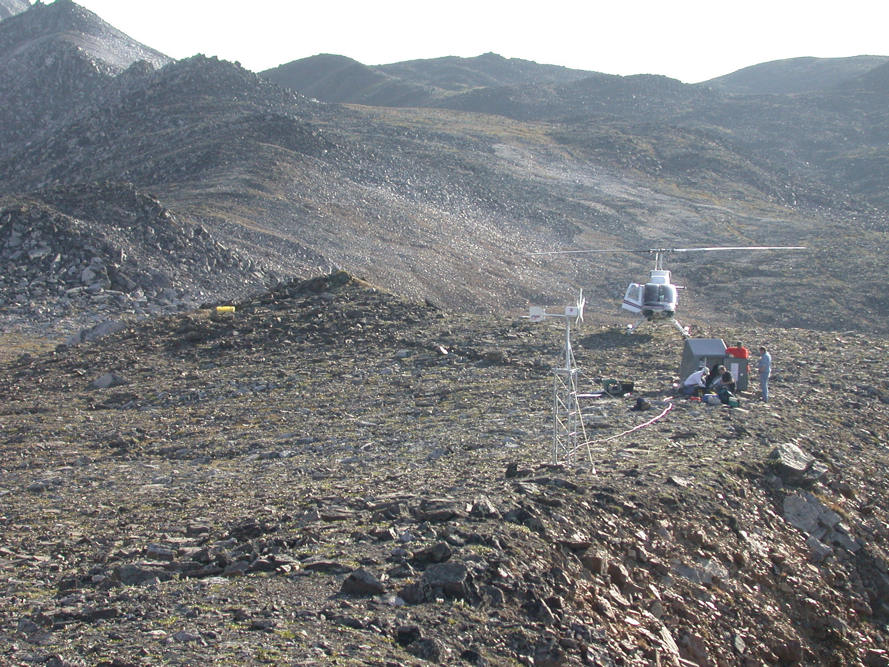

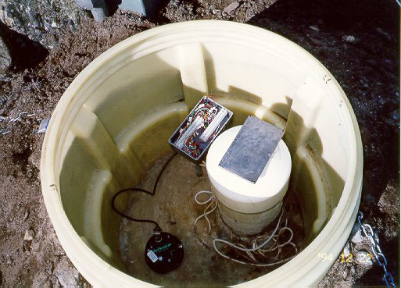
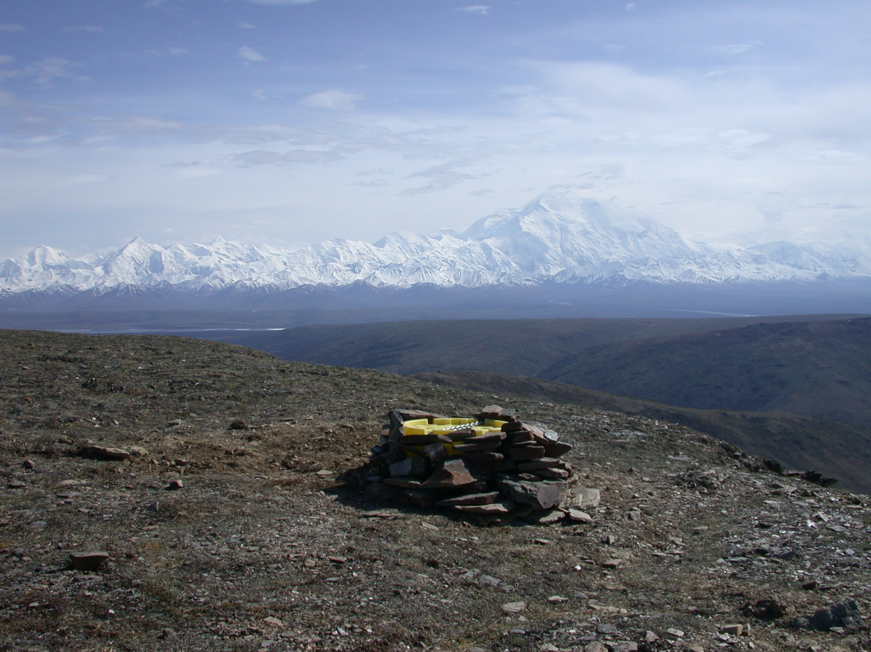

Seismic Station Network
Field installation
vault
hut
wind generator
Short period vs. broadband records
buried sensor

Slide 24






TNA – Tin City

Slide 25






UNV – Unalaska Valley

Slide 26

KHIT from the air
KHIT from the air

Slide 27

Design of seismic station power system for Alaska
Steve Estes

Slide 28
Design criteria
Capacity to run 24/7 x 365
solar recharge - wind in special cases
redundant system - survive damage, failures, improper installation
primary battery backup

Slide 29


BASIC Power consumption ~2.63 watts
Q330 digitizer ~ 0.8 watts
Broadband sensor ~ .75 watts
Freewave FGRplus ~ 1 watt
Power controller ~ 0.08 watts
DCPH Q300 & FGR+ 8/9/08
GRIN STS-2 7/8/09

Slide 30
BASIC Power production
Supply: BP350 solar panel 2.9 amps @ 12 volts 3 hours/day annual average insolation = 35,478 watt-hours/year, 72 cells @ 42mmx125mm= 0.378 m²
Storage: 10 x 100AH x 12V = 12,000 watt-hrs @ 2.63 watts continuous = 4,563 hours or 190 days
Demand: 2.63 watts continuous x 24 hours/day x 365 days/year = 23,039 watt-hours/year
Supply & Storage times two, with diode isolation = redundancy

Slide 31


Power consumption with options ~5.4 watts
Q330 digitizer - 0.8 watts
Broadband sensor - .75 watts
Strong Motion sensor - 1 watt
Ethernet switch ADAM-6520 - 0.75 watts
Two Freewave FGRplus @ 1 watts = 2 watts
Power controller ~ 0.08 watts
Episensor current at PS07 Oct 2007

Slide 32
Power production with options
Demand: 5 watts continuous x 24 hours/day x 365 days/year = 43,800 watt-hours/year
Supply: 2 x BP350 solar panel 2.9 amps @ 12 volts 3 hours/day annual average insolation = 70,956 watt-hours/year, almost double the demand.
Storage: 20 x 100AH x 12V = 24,000 watt-hrs @ 5 watts continuous = 4800 hours or 200 days
no redundancy but a good safety margin

Slide 33



Slide 34

Digging vault
LOGN - after approval

Slide 35

Drum, Sand, Cement, Water
heading to KLU

Slide 36

Mix cement
at Bering glacier base camp

Slide 37

Concrete and vault
slinging to site

Slide 38

Preparing vault
TABL - 18,008’ St. Elias in background

Slide 39

instrument installed
a trillium at LOGN

Slide 40

Q330s digitizer
in vault at KHIT (Khitrov hills)

Slide 41

lid on
ready to leave - MESA

Slide 42










NICH Nichawak

Slide 43







NICH Nichawak

Slide 44

Bering Glacier Network

Slide 45


Slide 46

Radiomobile
Radio paths, STEEP network http://www.cplus.org/rmw/english1.html
-146.174443,62.1053

Slide 47

Radio Path Profiles
uses DEM or STRM

Slide 48

VSAT
VSAT at Bering Glacier Camp

Slide 49

Just another day at the office
all done - ready to head home TABL - table mt.
\

Slide 50



Slide 51






Bear Damage

Slide 52

Yogi
Can you spot Yogi ?
Photo by John Sandru
September 15, 2008
A beach on Kodiak Island

Slide 53


Slide 54

Earthscope in Alaska

Slide 55

Alaskan Cell Towers
Cell Towers Data from FCC database April 2009

Slide 56

Public Schools and Earthquake Hazard in Alaska

Slide 57
Alaska earthquake and tsunami hazard is local (take-home points)
Alaska is the biggest earthquake and tsunami producer in the United States. Tsunamis generated by earthquakes off the Aleutian Islands and in the Gulf of Alaska could hit nearby communities within 30 minutes.
The Japanese tsunami of March 11, 2011 reminded the world of what an earthquake of magnitude 9 can do. In a similar Alaska event, the majority of fatalities and most of the damage will be caused by local near-field earthquake and tsunami effects.
Knowing what to do, rather than waiting to hear from authorities, can mean the difference between life and death for Alaska residents. Effective tsunami educational programs that include inundation and evacuation maps are critical.
Tsunami safety in Alaska is addressed through a partnership between several state and federal agencies. We cooperate in order to improve response to a potentially tsunamigenic earthquake in Alaska and work closely with coastal communities.

Slide 58
Alaska earthquake and tsunami hazard is local (take-home points/action items)
Problem - Modernization of the Alaska Seismic Network is critical
Still primary way of rapidly identifying damaging earthquakes and tsunamis
Most of the older instrumentation has been modernized
Large areas still have very sparse coverage
Solution - Opportunity for improving network with the NSF EarthScope
Installation of ~300 temporary seismic stations
Left in place for ~ 2 years
Ability to take over ownership at a reduced cost
Re-authorization of the Federal Tsunami Warning and Education Act

Slide 59
Summary of Earthquakes July 2009 – June 2010
2009 | Total # events | Events with M ≥ 4 | Largest Event | Location of Largest Event. |  | # Felt Events
July | 1,584 | 24 | M6.1 | Rat Islands | 5
August | 1,960 | 19 | M5.0 | Cook Inlet | 11
September | 2,183 | 20 | M5.4 | Andreanof Islands | 12
October | 2,547 | 31 | M6.5 | Fox Islands | 7
November | 1,710 | 19 | M5.3 | Fox Islands | 6
December | 2,045 | 22 | M5.8 | Andreanof Islands | 11
2010
January | 2,010 | 20 | M5.5 | Rat Islands | 14
February | 2,079 | 31 | M5.1 | Fox Islands | 9
March | 1,939 | 28 | M5.8 | Andreanof Islands | 8
April | 2,180 | 27 | M6.5 | Bering Sea | 8
May | 2,235 | 32 | M5.5 | South of Alaska | 17
June | 2,078 | 23 | M5.4 | Alaska Peninsula | 12
Totals | 24,550 | 296 |  |  | 120

