Slide 1
EarthScope’s Transportable Array
Key Technical Challenges in Large-Scale Temporary Networks
Bob Busby, TA Manager
Katrin Hafner, Chief of Operations
Frank Vernon, PI Array Network Facility
Bob Woodward, USArray Director
Seismic Instrumentation Technology Symposium
June 16-17, 2011
Albuquerque, NM

Slide 2
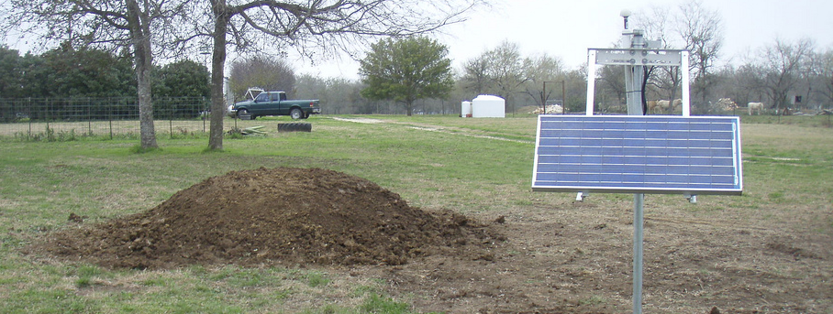
Overview
Introduction to Transportable Array Operations
Highlight a few technical challenges
A typical operating TA Station
535A Dale TX

Slide 3
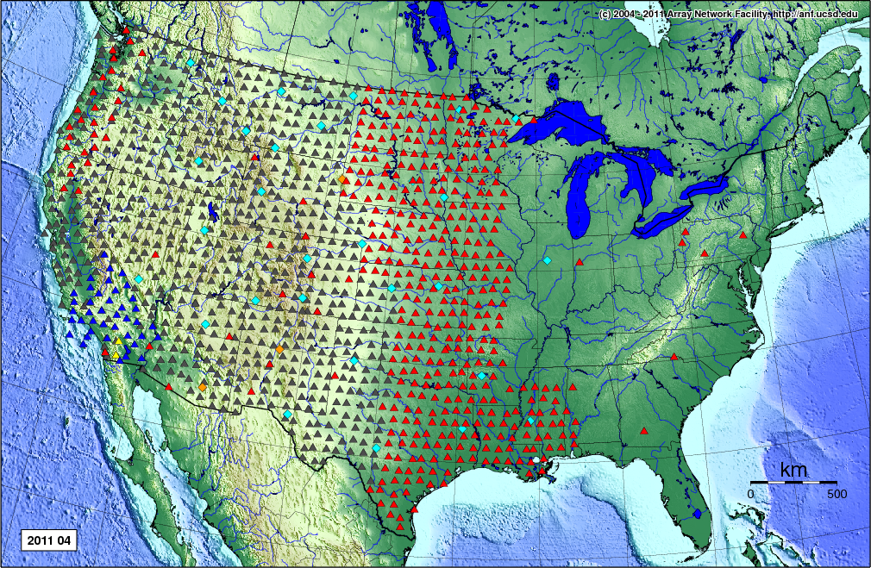
The Transportable Array
Large scale - 450 broadband stations
Transient stations – network configuration changes daily
Large investment – high expectations
1,680 sites
19 sta / month
4.5 Gb / day
$10M / year
2011 - 2013
Red = current array location
Grey = stations already removed

Slide 4
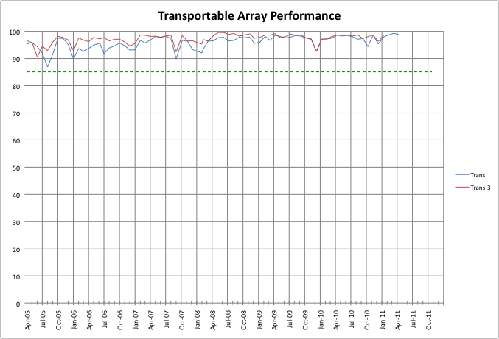
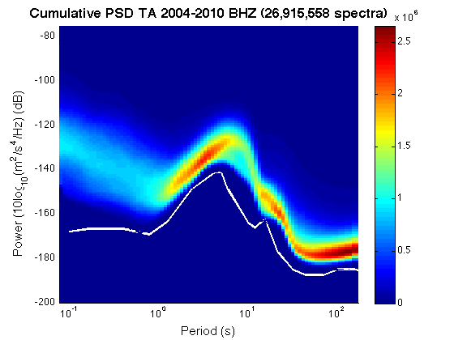
TA Performance
Network availability typically exceeds 98%
Station noise highly uniform and quite low for temporary installations

Slide 5
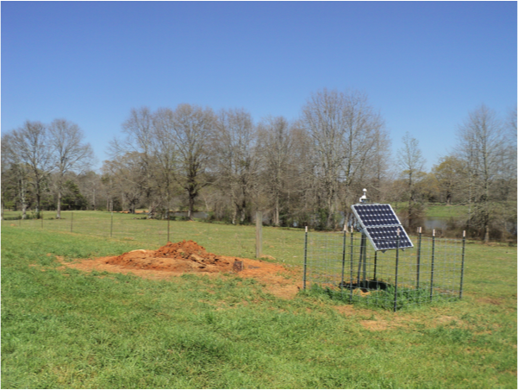
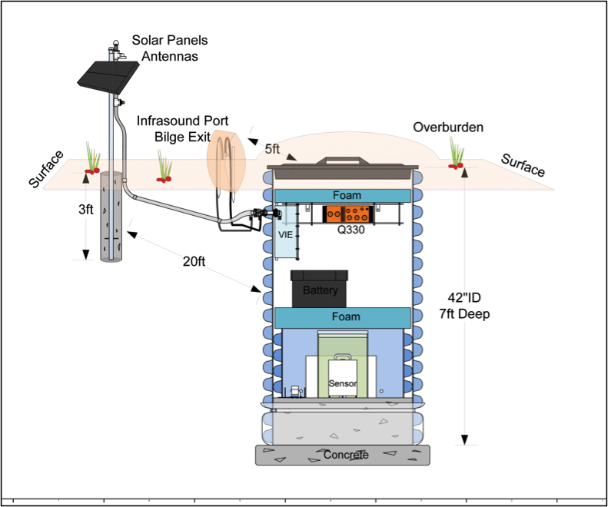
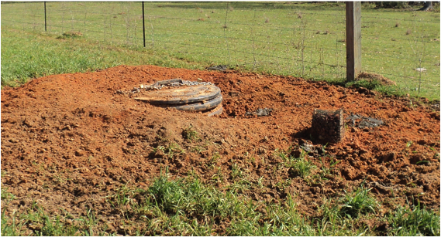
Recent Enhancements
Adding pressure transducers to create a 400 station atmospheric acoustic (infrasound) network
Span frequency band from DC to 20 Hz
TA Station 345A, MS

Slide 6
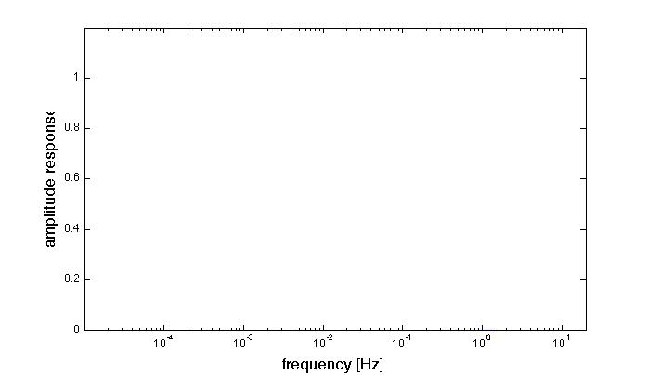
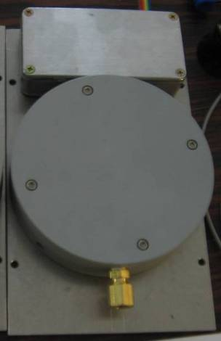
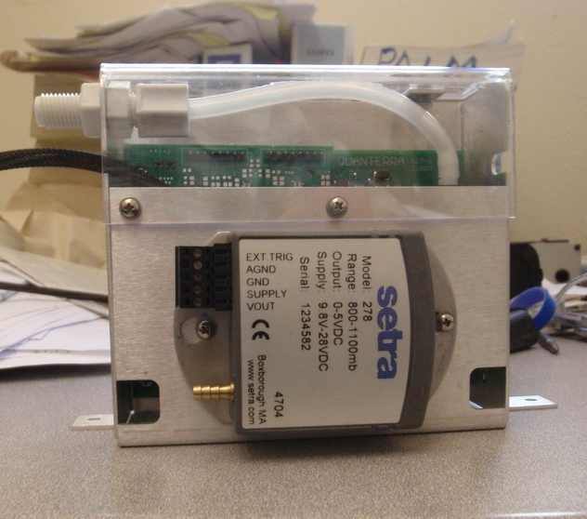
Pressure Sensor Response
Overlapping pass-bands provides continuous coverage from DC to 20 Hz
Setra Barometer
EP - LDO, EP - BDO
NCPA Infrasound Microphone
EP - LDF, EP - BDF
MEMS Barometer
EP - LDM
6

Slide 7
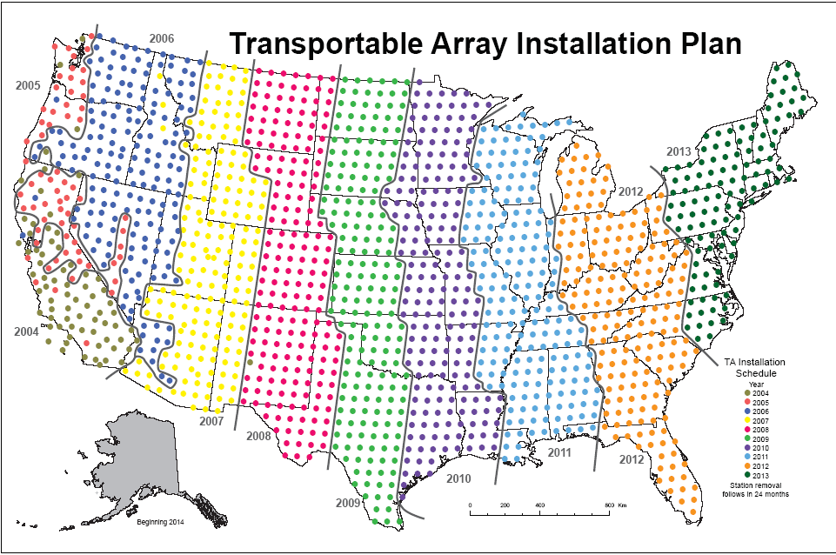
O&M Future
The next 3 years…
1683 grid points to occupy at 19 per month

Slide 8
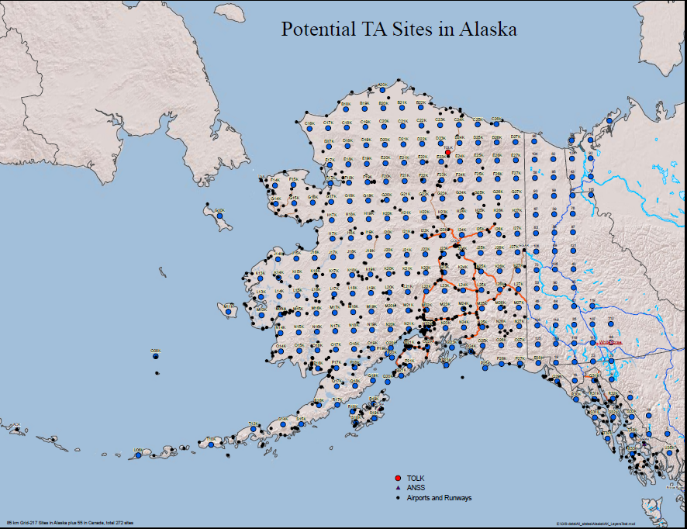
Alaska 2013-2018
272 sites
85 km
grid

Slide 9
Key Technical Challenges
TA applies concepts from manufacturing to high quality seismic station production.
Design process
Design verification
Acceptance testing of production elements
Defined procedures
Engineering Change Notices
Inventory tracking / Maintenance database
Quality Assessment of product
http://www.passcal.nmt.edu/taweb

Slide 10
Key Technical Challenges
Some Specific Topics - the challenge
  The Station Building Process, information management
  Cellular Communications, swift evolution
  Station Power, conditioning and control
  Sensor emplacement , better horizontals

Slide 11
Design Principles of Station
Solar Powered to avoid cultural noise sources, maximize siting opportunities, avoid line surges.
compact footprint to ease siting.
Fast construction, uniform and modular.
Good quality long period data.

Slide 12
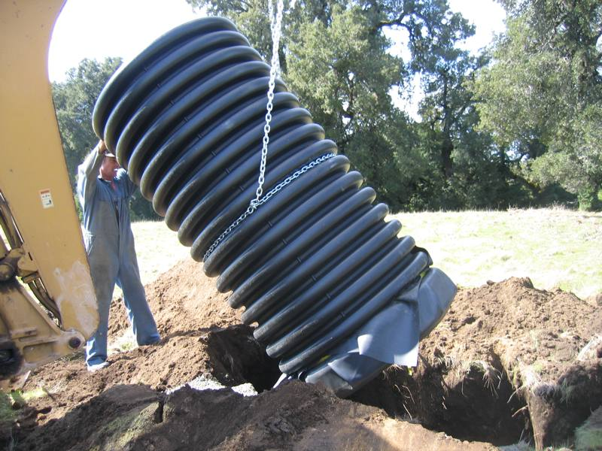
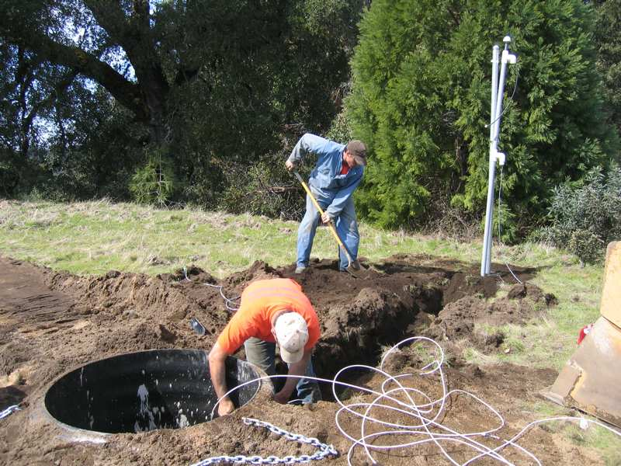
Station Design- tank vaults

Slide 13
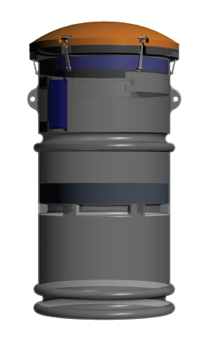
Station Design- tank vaults
RFP selected Freeman Engineered Products
for a custom rotomolded tank
$1200
105 kg

Slide 14
Station Building Process
Reconnaissance- which may involve office evaluation, field visits, landowner interaction but ends with the selection of a Candidate Site-that is a site for which we will seek a permit. A document called a recon report, which includes the outline of how the specific station will be provisioned including power and communication strategy.
Permitting- meaning the negotiation with landowner, paperwork necessary to obtain written permission to access the property and to install a station. Permits and the expertise to acquire them increase in complexity from a simple private landowner agreement, through cooperative ownerships, corporate ownership to state or federally managed lands.
Construction- digging a hole, pouring concrete, trenching cables and erecting a mast. This task can be accomplished by a backhoe operator and a laborer assistant. While construction details are important for good quality data, the task itself does not require scientific expertise.
Installation- installation of electronics, power system, communication system and sensor. Generally ends with data communication back to ANF. This step involves detailed understanding of seismic instrumentation, communications and power electronics and requires at least one highly trained person on site.
Removal-removal of the station and tank and preparing the equipment for shipping.

Slide 15
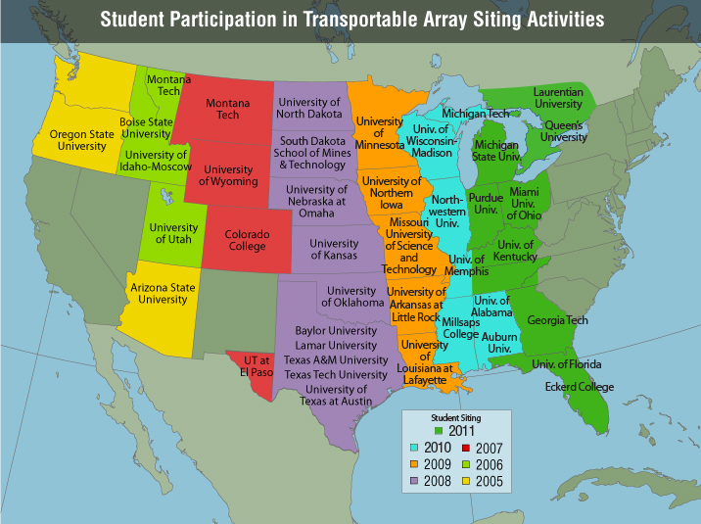
Well developed method
Recon Process
2005: >76 sites
  8 students
  Oregon State University
  Pilot Program
2006: 115 sites
  12 students
  4 Universities
2007: 156 sites
  20 students
  4 Universities
2008: 326 sites
  32 students
  10 Universities
  Enables backlog of permits
2009: 164 sites
  16 students
  5 Universities
2010: 131 sites
  12 students
  7 Universities

Slide 16
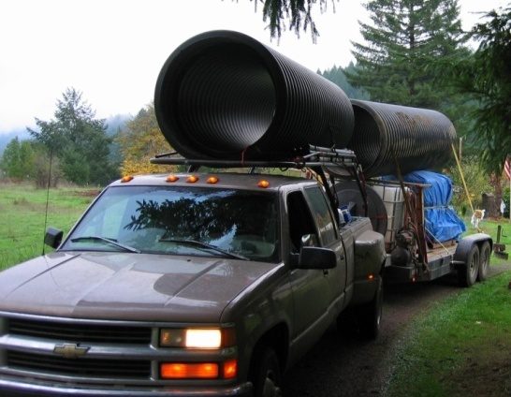
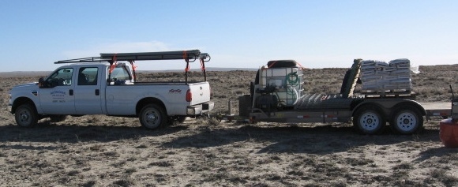
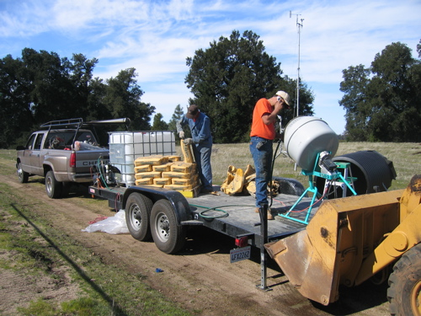
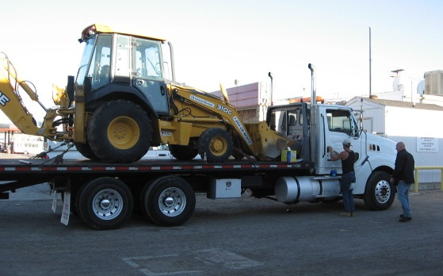
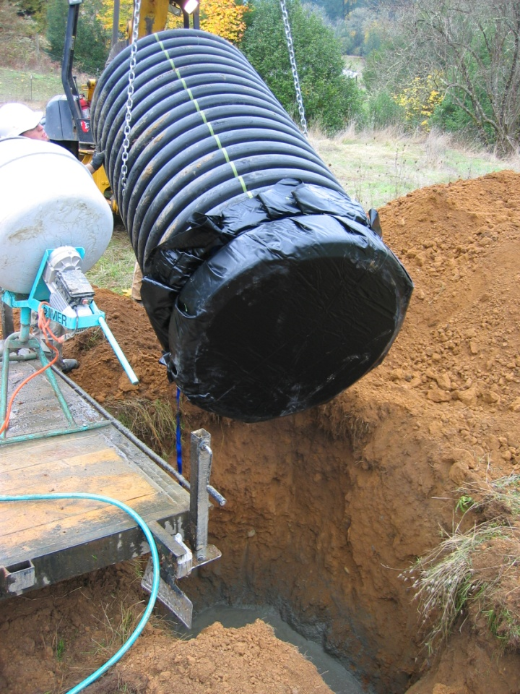
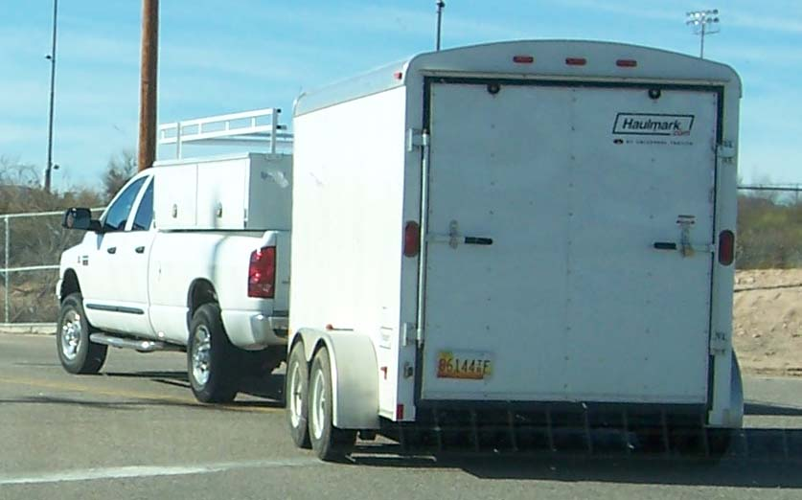
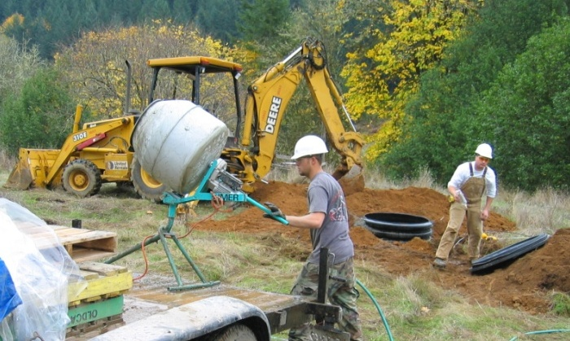
Construction
… No Student Involvement

Slide 17
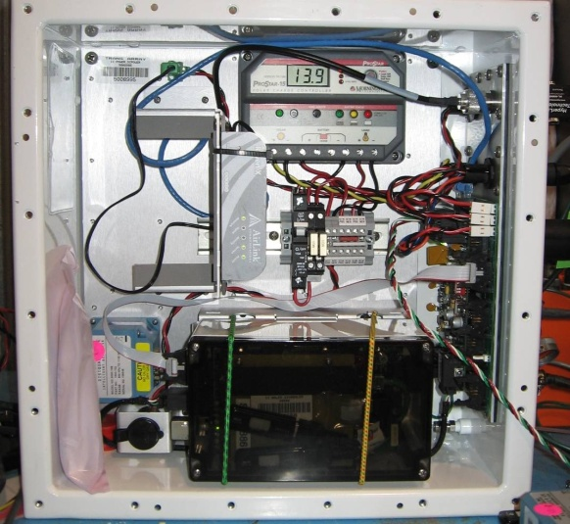
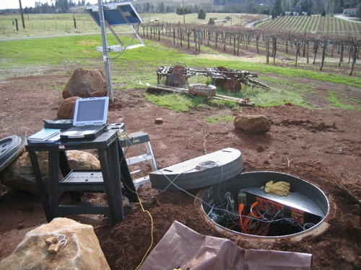
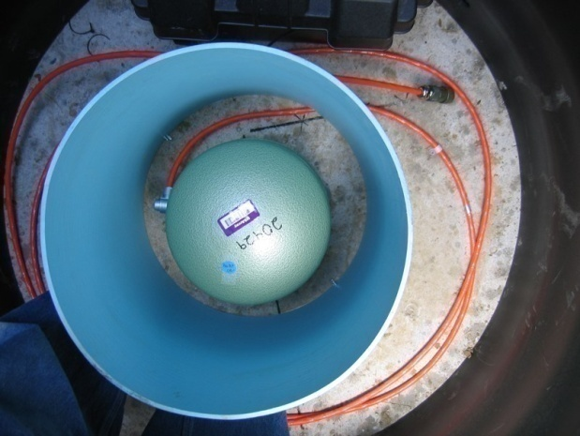
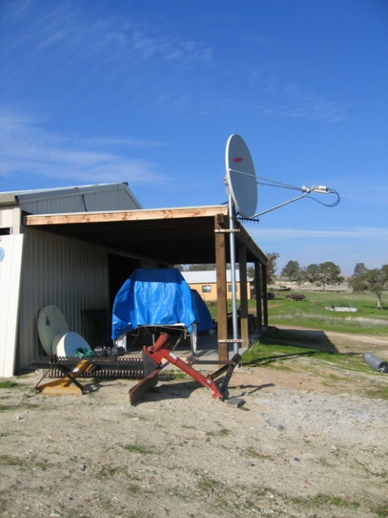
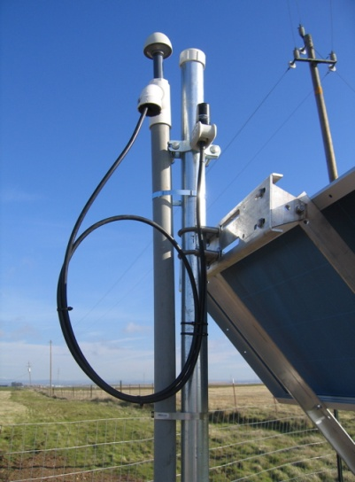
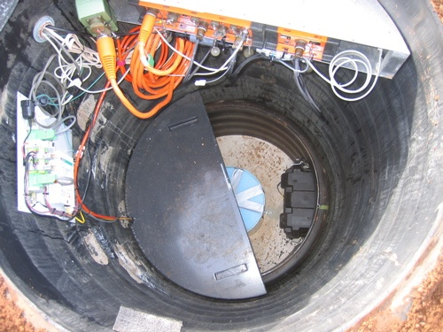
Installation
Sensor alignment, leveling and insulation
Takes 20 minutes
Vault Interface Enclosure, Cell modem, charge controller, Baler44, Barometer
3-5 weeks later,
1 pickup, 2 people
Lava Cap Winery. Site layout
Mast supports 80 W solar panel, GPS antenna, Cell omni directional antenna
View into vault. Sensor encased in sand, Q330 on shelf, foam insulation
VSAT located in barn with AC power
Notes:
17

Slide 18
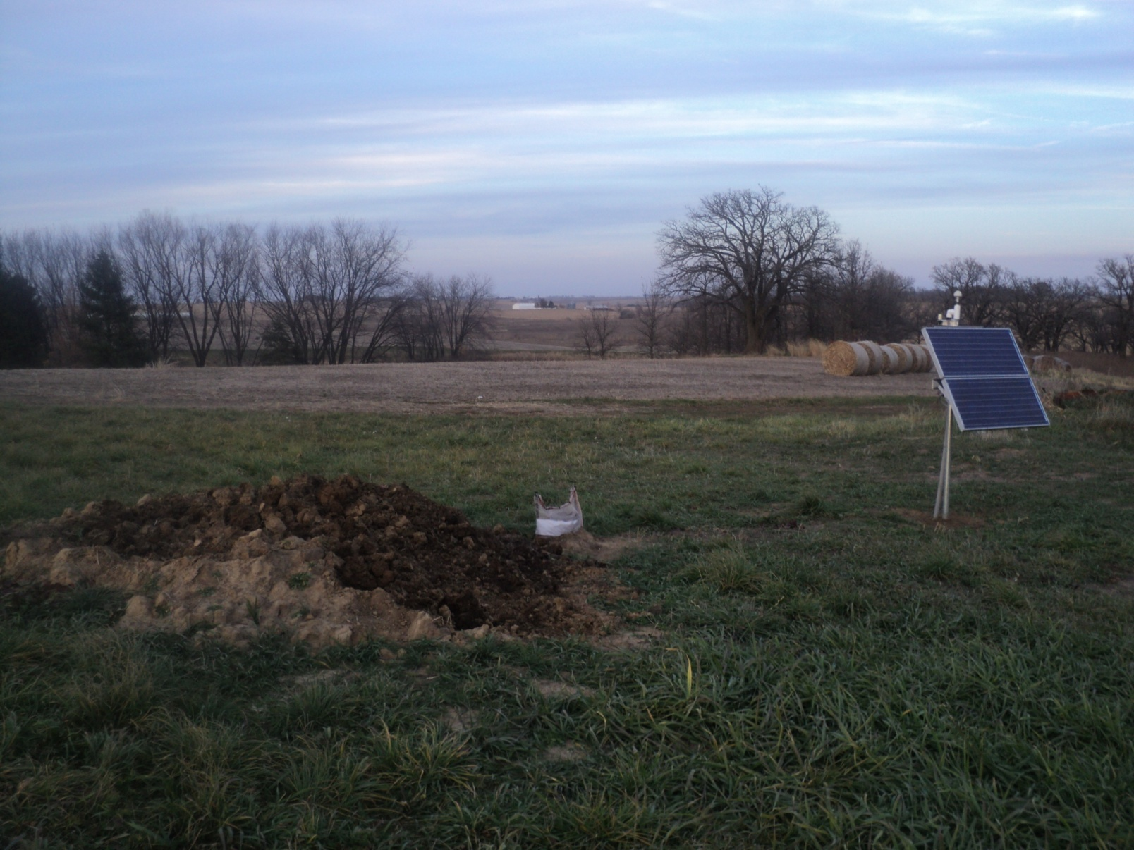
Completed Installation

Slide 19
Information Management
Recon: Students prepare, staff verifies a Reconnaissance Report.
Construction: formatted email report and photos placed on Flickr archive with tags.
Installation: formatted email report and photos placed on Flickr archive with tags.
Operation: database of station information-creates mseed dataless. Station service activities logged by formatted email reports, photos placed on Flickr archive with tags.
TA Flickr Archive has 72,000 photos

Slide 20
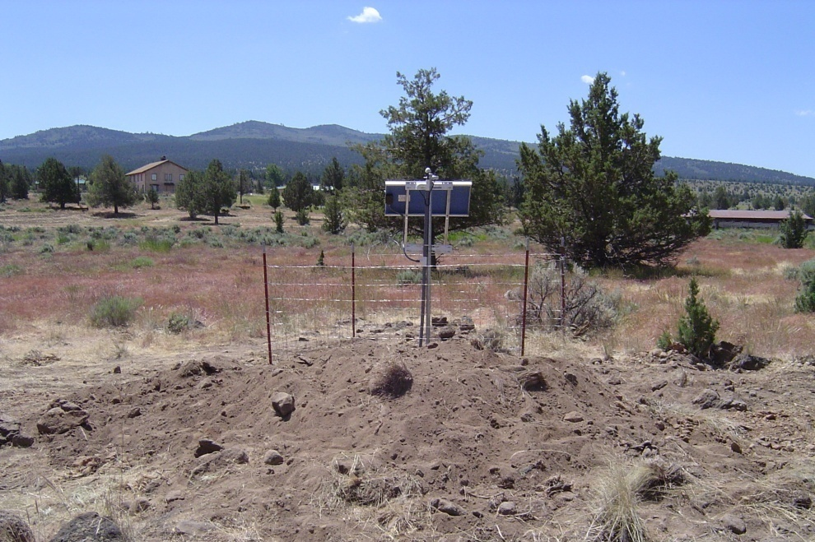
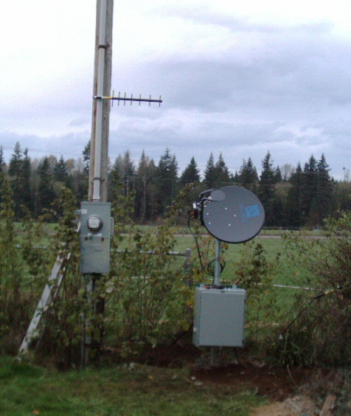
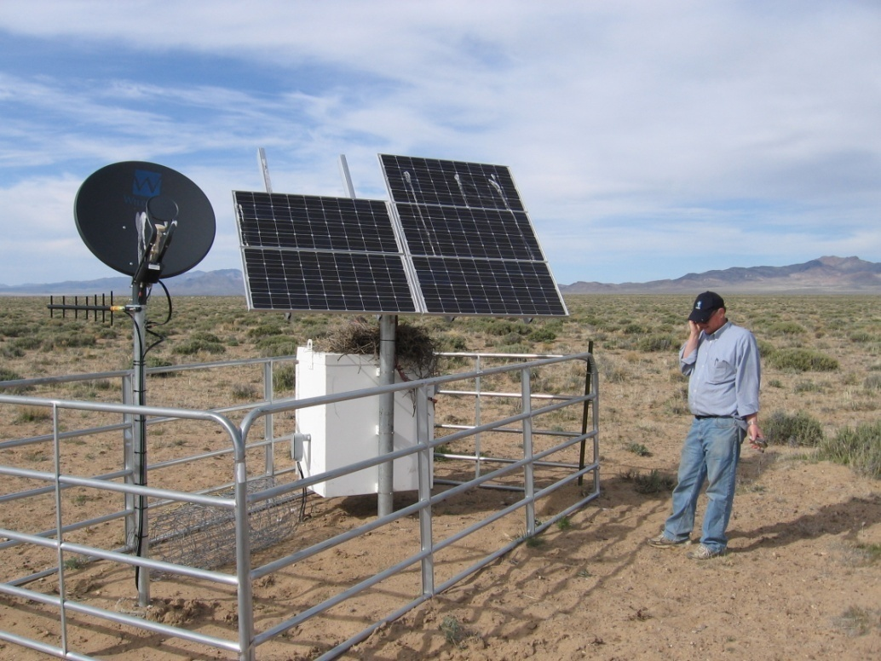
Data Communications
90% Cellular
8% AC VSAT
2% Solar VSAT
Cellular Modem
AC VSAT
Solar VSAT

Slide 21
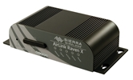
Cell Modem Operation
Sierra Wireless Raven X modems: 410 Verizon, 85 AT&T, 5 Sprint
Features
  Static IP address
  5 Gbyte/mo, continuous connection
    Real-time 0.9-1.4Gbyte
    SEED 400-800 Mbyte
  IP forwarding makes datalogger config simple
  Roaming issue at international borders
Management
  Monitor Seismic Data throughput & latency
  SNMP status, RRD
  Web based control
  Batch programming & firmware updates
Managing software updates of remote systems is tricky.
New Policies, features, and rapid obsolescence.

Slide 22
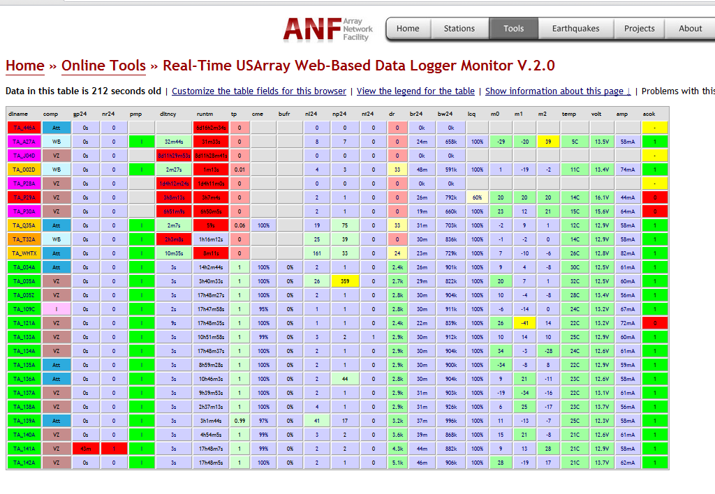
Web-based Monitoring
Identify changes and how they accumulate over time
  E.g., - in last 24 hours: number of reboots, number of IP changes, number of link cycles
E-mail Alerts: Some status changes result in an email alert to distribute more information immediately about the change: Pump active signal, Q330 reboot
http://anf.ucsd.edu/tools/webdlmon
Monitoring system renders data into actionable format
Information then feeds weekly management prioritization for all service activities

Slide 23
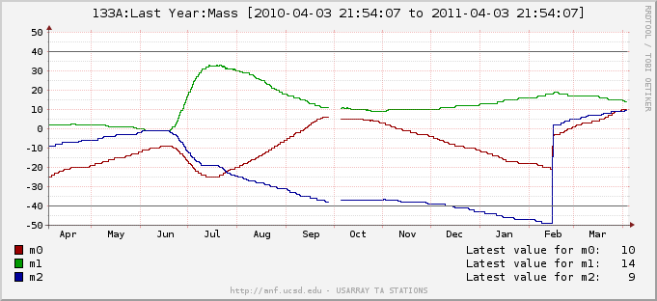
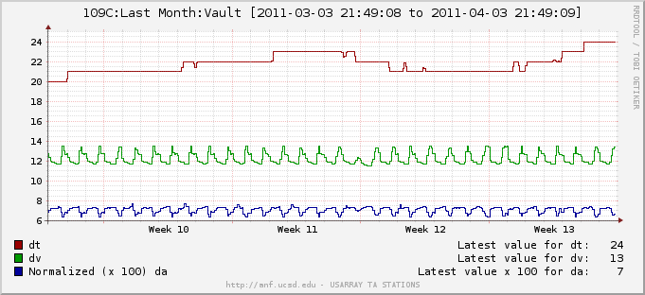
Real-time QC
Webdlmon
Cells can be selected to bring up an accumulated result view.
Round Robin Database is a recursive downsampling of mseed timeseries which enables us to efficiently form views of Last Hour, Day, Week, Month or Year.
Mass position of three elements for a year.
Vault temperature & station power supply for a month.

Slide 24
Station Power
Independent regulation / distribution
Power control of comms device
Switching of backup power

Slide 25

Device Integration
Vault Interface Enclosure (VIE)
16x16x8” Enclosure, hangs inside vault.
    IP68, 0.5” Lexan Clear lid, bulletproof!
Q330 interfaces converted to industrial standard connections;
    IDC flat ribbon, RJ45.
Custom power regulation circuit
    Faultfree switchover to alkaline backup battery
    Signalling via existing data channels for power SOH
    Sensor power regulation, filtered power for Q330 and Baler
    High efficiency regulation, load shedding/mode switch on backup power
    Independent fault isolation of powered devices.
Station Integration
    Integration of Baler44CT, Environmental sensor
    Reset power cycle for comms equipment
    Remotely controlled power interrupt for sensor
    Monitor and signalling of pump operation
Protected housing for electronics and auxiliary equipment-allowing better flexibility and increased reliability.
    Allows economical packaging choices for small ancillary devices
    Protects commercial modems, charge controllers and circuit boards.
    Simplifies troubleshooting, acts as a field replacable unit.
Uniform cabling for installation
    MS style connectors, molded termination
Commercial production in large runs; Enclosure, cables, PCB, testing, etc
    Custom cable fabrication, custom metal, factory assembly and testing.

Slide 26
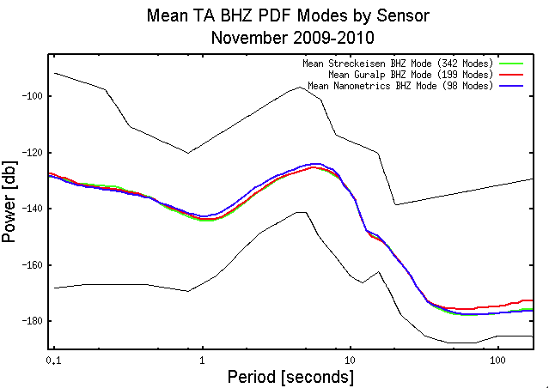
Sensor Performance

Slide 27
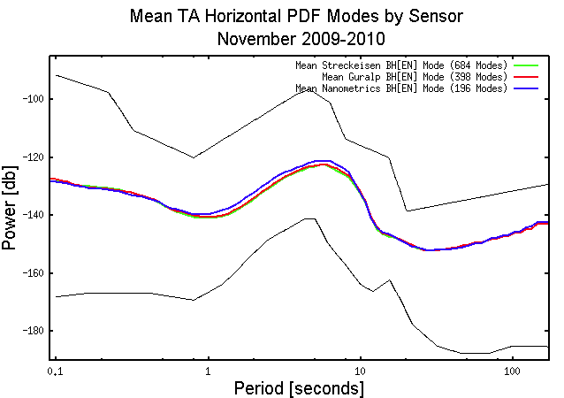
Sensor Performance

Slide 28
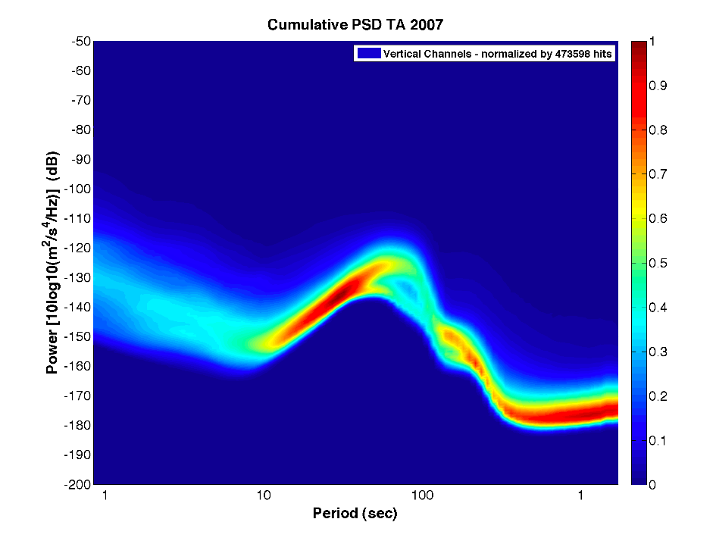
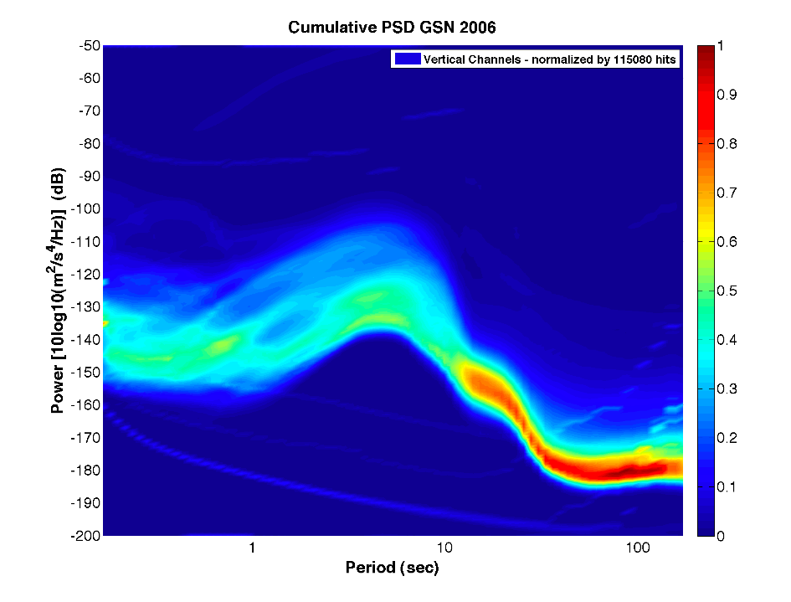
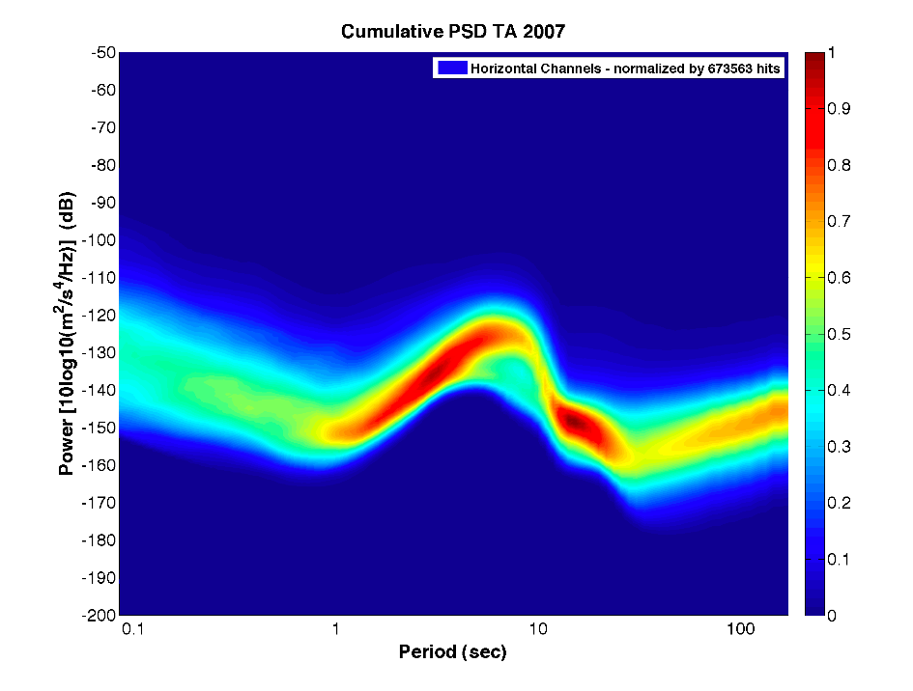
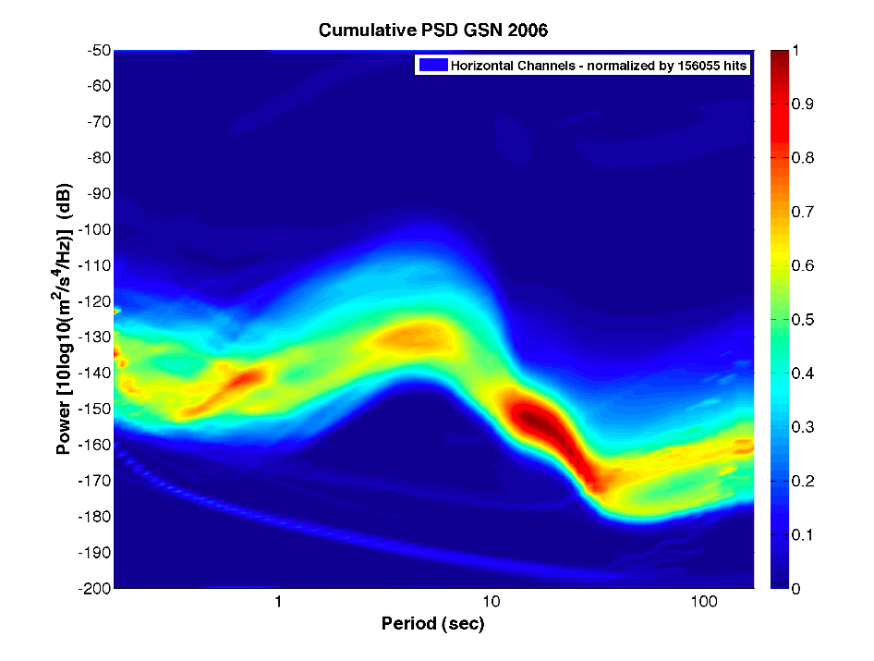
Power Density Functions
Noise PDF
TA Vertical
GSN Vertical
TA Horizontal
GSN Horizontal

Slide 29
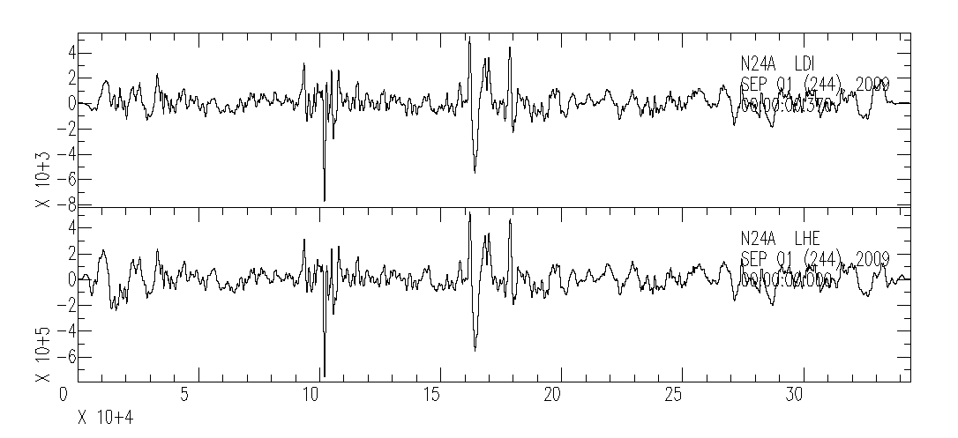
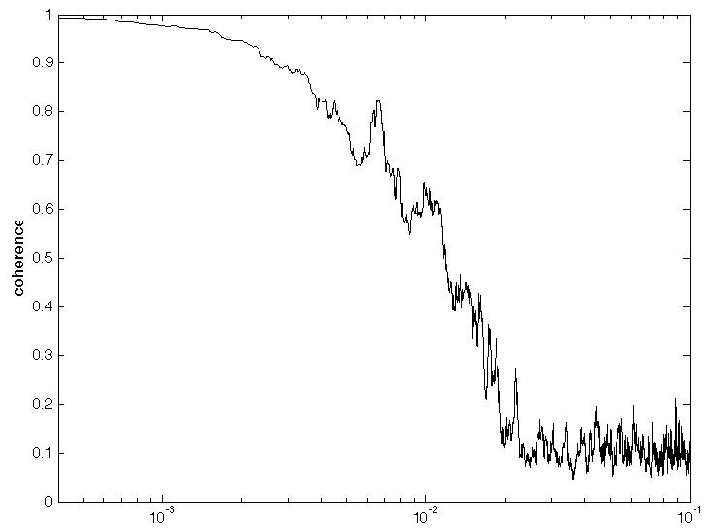
Pressure – Seismic Correlation
Pressure observations are strongly correlated to seismic data
Both vertical and horizontal seismic components
LDM - pressure
LHE- seismic
4 days
Applications
Use pressure signal to reduce seismic noise
Use forcing function (pressure) and response (tilt) to constrain crustal properties
Pressure – Seismic Coherence
1000 s
100 s
10 s

Slide 30
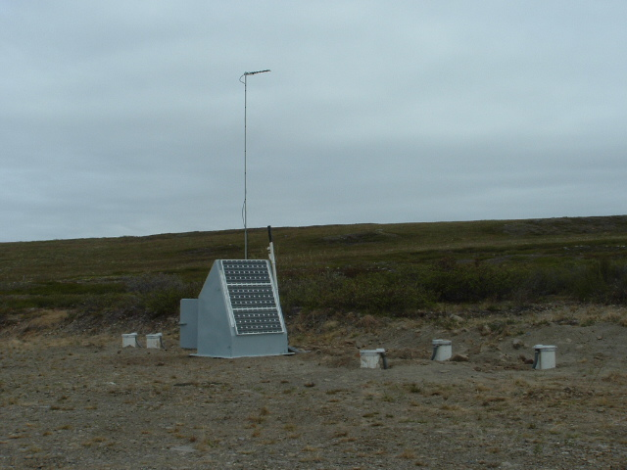
Buried Sensors
IMPROVE the performance of TA stations by using a shallow borehole deployment to reduce, we hope, the horizontal noise. The technique may also be more amenable to tundra or swamp setting in which the current vault is unwieldy (or impossible) and prone to leaking.
Hole Characteristics
Sensor Characteristics
3-5m depth
<8” diameter hole
Minimal casing
Cylindrical-ish
Impervious to water
Remote unlock or unpark
Mating surface for alignment tool
Internal levelling
Toolik Lake LTER, North Slope Alaska

Slide 31
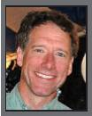
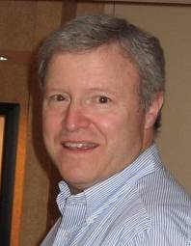

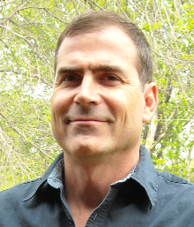
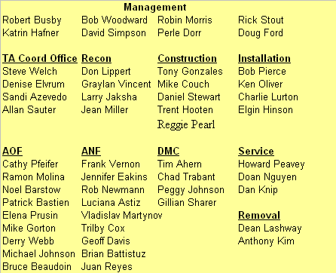




















TA Team

Slide 32

Summary
400 station network operating at >98% availability
  Uniform, autonomous, low-power stations
  Careful evolution of station and process
Sensor emplacement
– an emerging technology?
Info on the Web
EarthScope
  www.earthscope.org
USArray
  www.usarray.org
National Science Foundation
  www.nsf.gov
EarthScope is funded by the National Science Foundation.
EarthScope is being constructed, operated, and maintained as a collaborative effort with UNAVCO, and IRIS, with contributions from the US Geological Survey, NASA and several other national and international organizations.

Slide 34
34 Team Members
Organization Summary
Management: 2.0
Recon: 5
2.5 office
2.5 field team
Construction: 4
1 office
3 field crew
Installation: 4
4 field crew
Service: 4
4 field crew
Removal: 3
3 field crew
Support Facilities: 12
AOF NM Tech 6
ANF UCSD 6
Notes:
Split content slide example

Slide 35
Information Management
Equipment Inventory - a database
Equipment maintenance records - a database
Site reconnaissance – files, FLICKR 65k photos
Landowner database
Software system trouble ticketing

Slide 36
Design Principles Seismic Network

Slide 37

Guralp SNOFLU
Sudden Noise Onset, Fixed by Lock / Unlock
  Sudden increase in LP noise, remains noisy for days-weeks until a Lock / Unlock
  Managed by vigilance. Guralp has no remedy so far.
Two nearby stations
Vertical channel, 1 day
Z30A on top, normal
Z31A bottom, SNOFLU
Spectra:
Red Z30A normal
Green Z31A SNOFLU

Slide 38

Trillium Issue
Weeks long episodes of high horizontal noise levels
Occurs usually with high vault temperatures >27C
Correlates with Charge controller or Solar Insolation
X33A 60 days LHE, LHN and LHZ showing diurnal noise.

Slide 39
Trillium Issue
Weeks long episodes of high horizontal noise levels
Occurs usually with high vault temperatures >27C
Correlates with Charge controller or Solar Insolation
Stations 633A, 634A and 635A showing effect at 634A(a trillium).
Note that there seems to be some effect at 635A which has an STS2.
633A is a trillium that does not have the effect.

Slide 40

Amplitude Anomalies
Amplitude anomalies –overall 9 stations exhibit half amplitude on a channel
  Sudden decrease in single analog channel amplitude, reflected in all associated SEED channels-e.g. BHZ, LHZ, VHZ.
  Often fixed by remote calibration
  4 instances are due to a single datalogger.

Slide 41


Accumulated views
IRIS DMC QUACK process creates PDF color power grid.
Signal Quality performance, catches rare cases…
http://crunch.iris.washington.edu/stationinfo/TA/ABTX/PDFMode/PDFMode-BHZ_colorgrid.png

Slide 42
Webdlmon
Some changes accumulate over time to allow you to recognize it happened and how many times may be significant.
In Last 24 hours: number of reboots, number of IP changes, number of link cycles
http://anf.ucsd.edu/tools/webdlmon
EMAIL Alerts: Some status changes result in an email alert to distribute more information immediately about the change: Pump active signal, Q330 reboot.

Slide 43

440 Operating Stations
Geographical Status
Operating
Constructed
Permitted
Planned
Notes:
Split content slide example

Slide 44

Cell Modem Operation

Slide 45
Status Capture
SOURCES of Status Information
Q330 packets
  Last boot time
  Pump indicator
  Packet buffer queue
  330 firmware version
SNMP service
  Cell Radio signal strength
  Modem power
  Last reset
CAPTURE Method of Status Information
Structure of current values (pktmon -> JSON files)
A database record when certain values change; reboot time, Q330 firmware
Accumulate count of changes over a period; ip_address, link cycles

Slide 46


Coherence
Good coherence in overlapping portions of passbands

